Slide 1

We Engineer your Digital Success
LEARNING MANAGEMENT SYSTEM
6 May 2017
© 2017. All Rights Reserved / www.verbat.com

Slide 2

Contents
1
Teacher Module
2
Student Module

Slide 3
Teacher Module

Slide 4
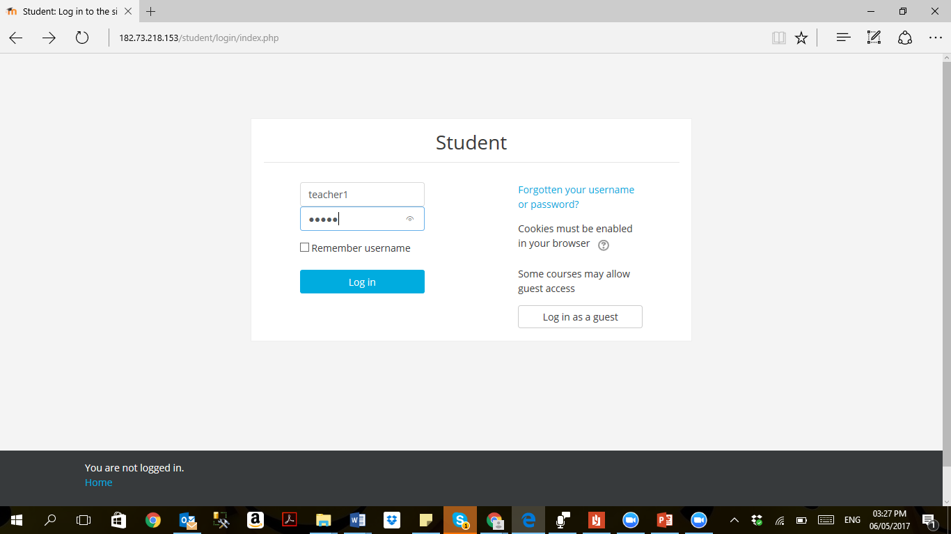
Teacher Login

Slide 5
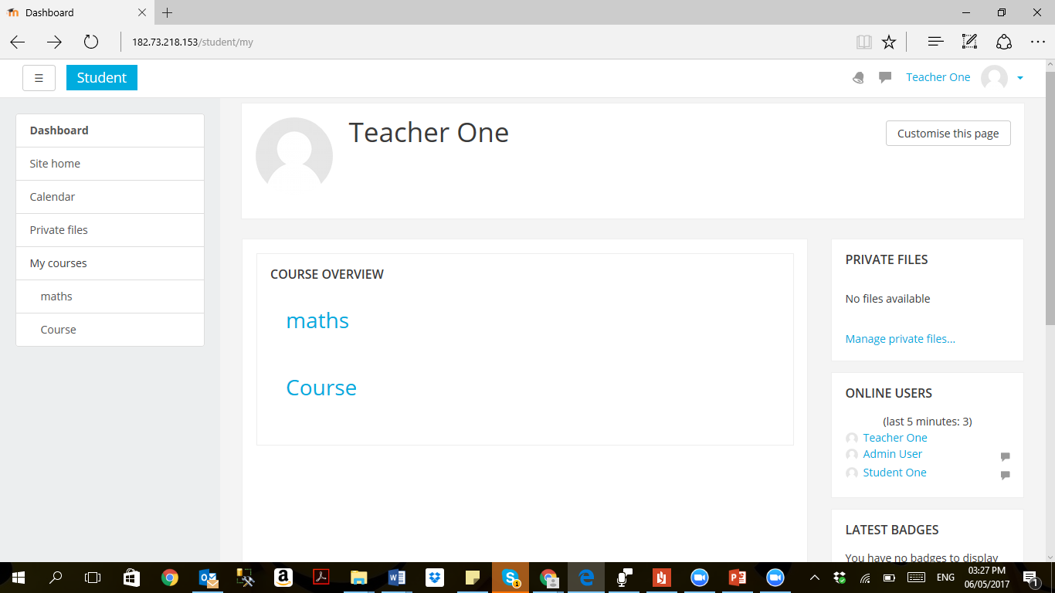
Teacher Course Overview

Slide 6
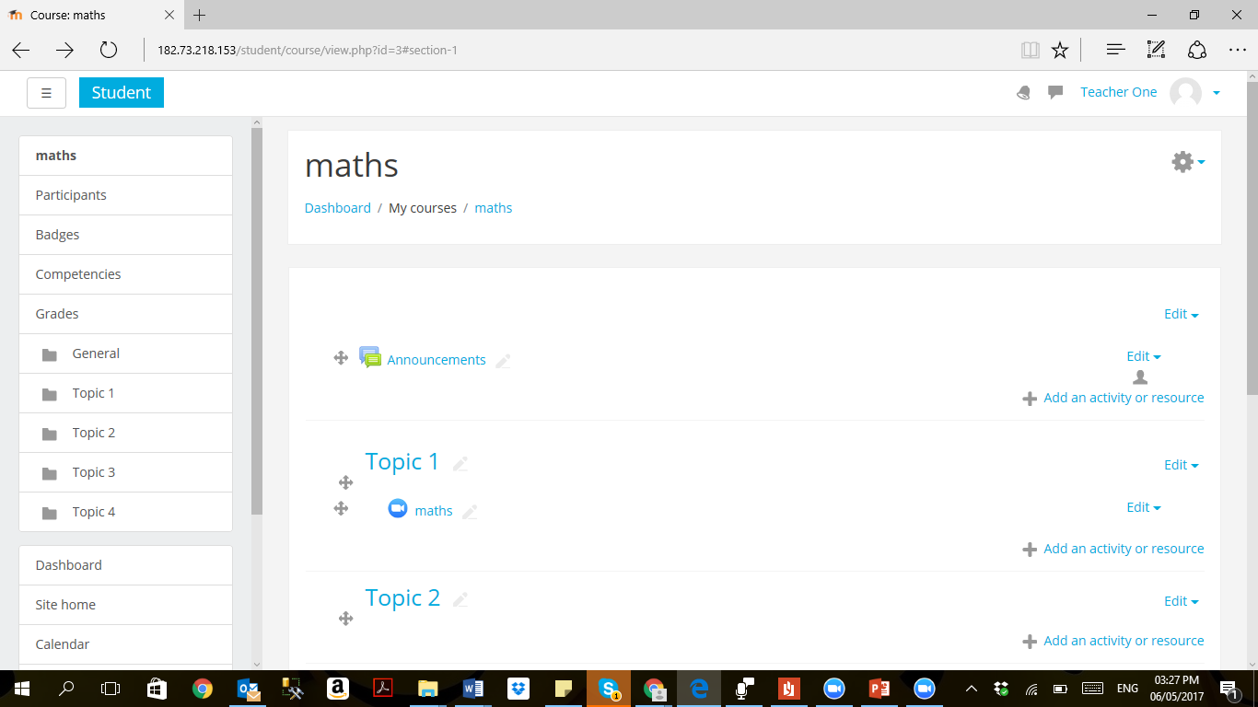
Teacher Course Topics

Slide 7
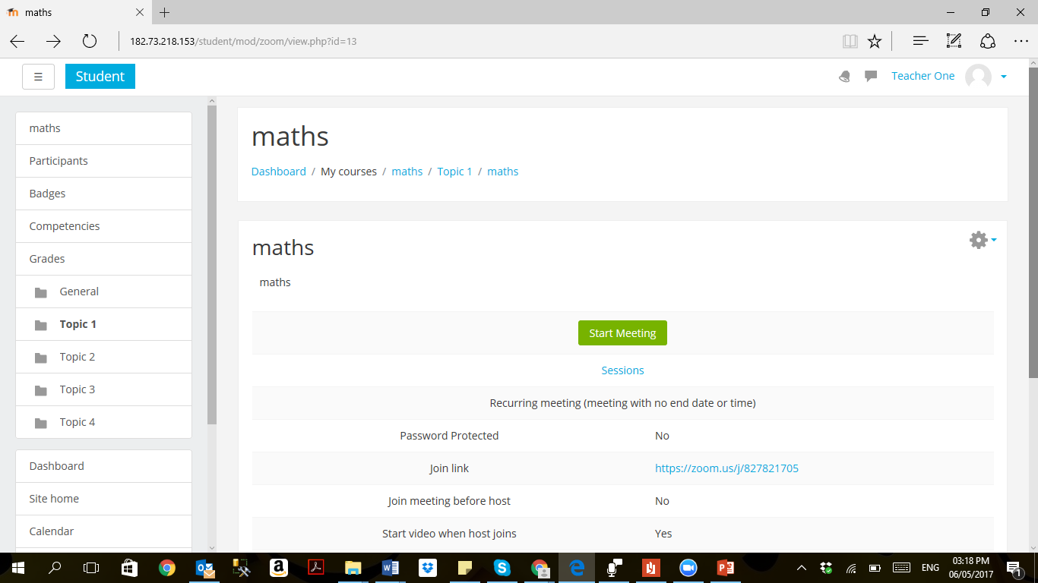
Teacher – Start Meeting

Slide 8
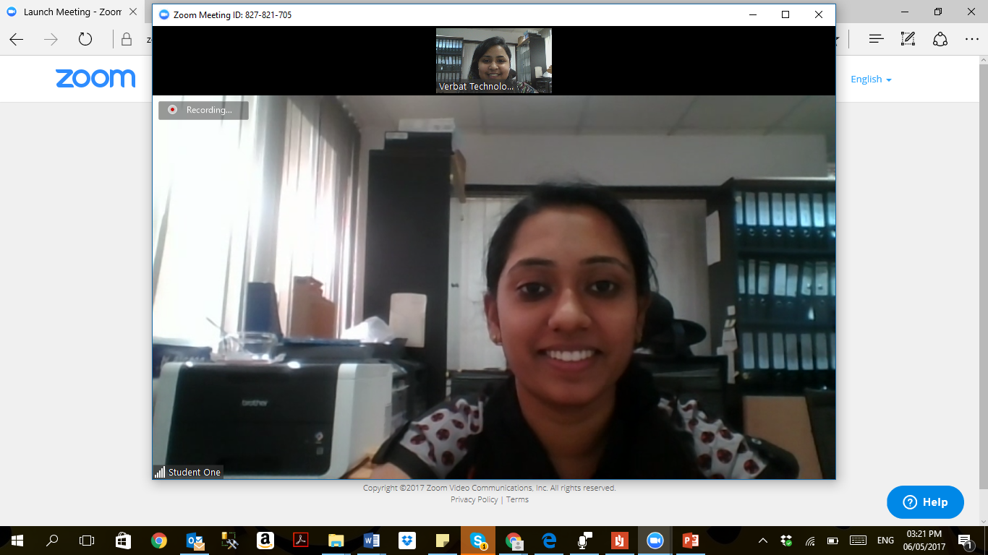
Training Session

Slide 9
Student Module

Slide 10
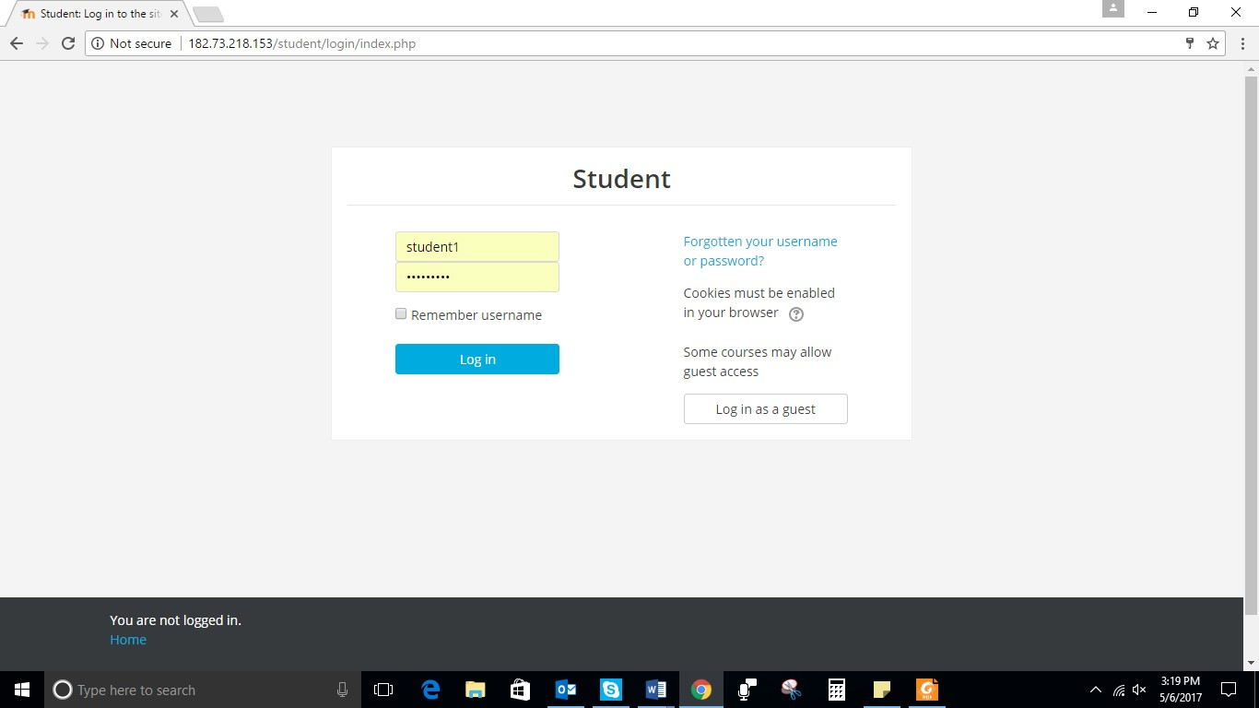
Student Login

Slide 11
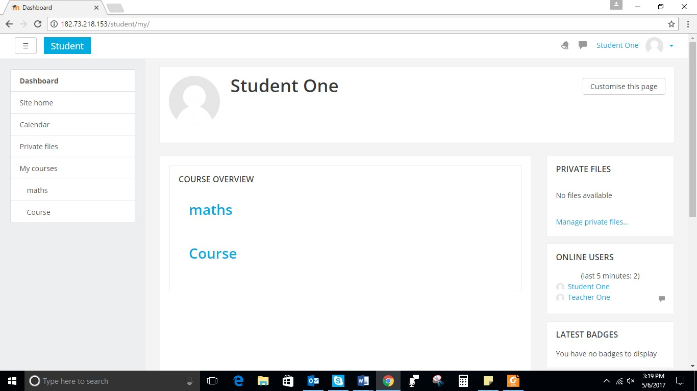
Student Course Overview

Slide 12
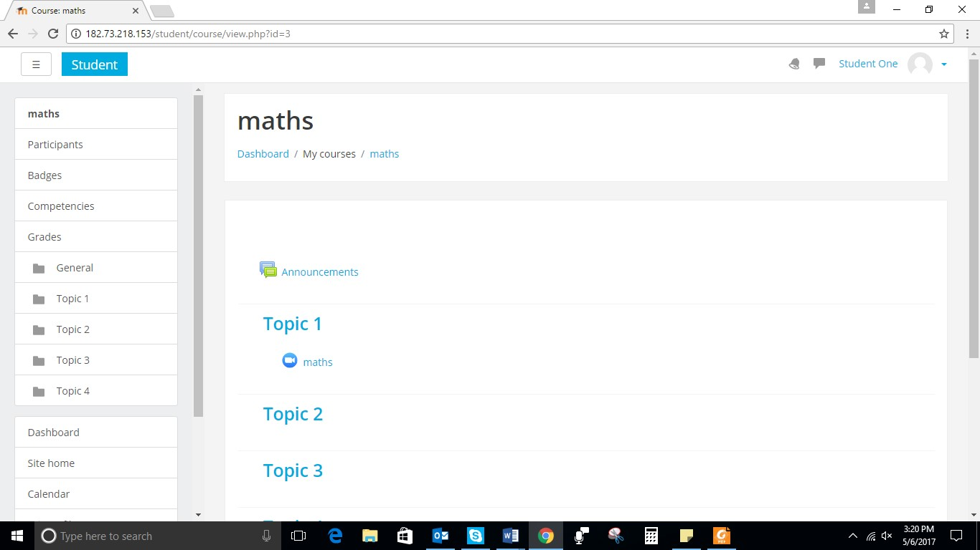
Student Course Topics

Slide 13
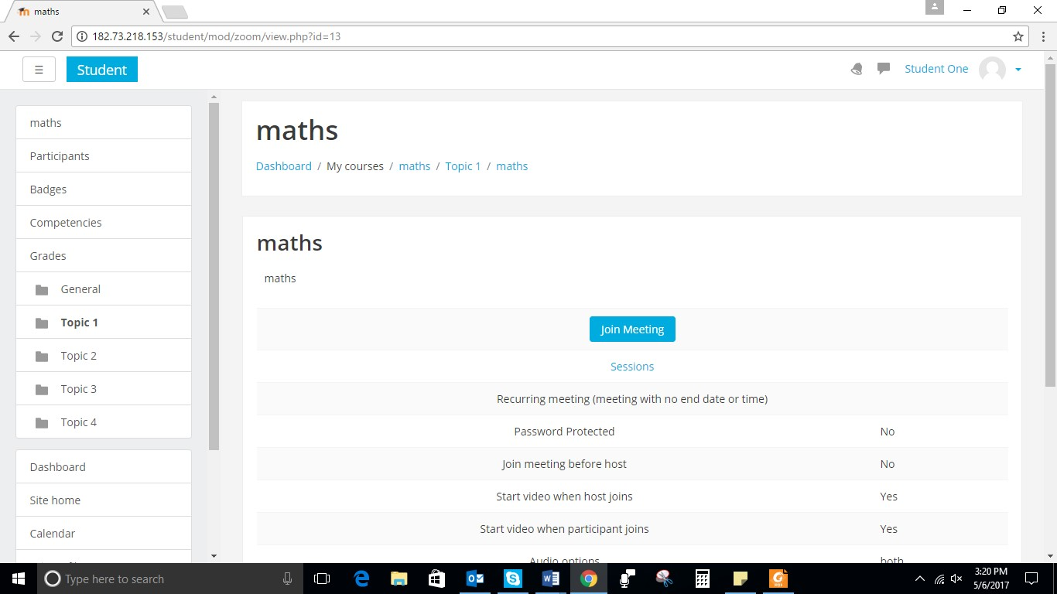
Student – Join Meeting

Slide 14
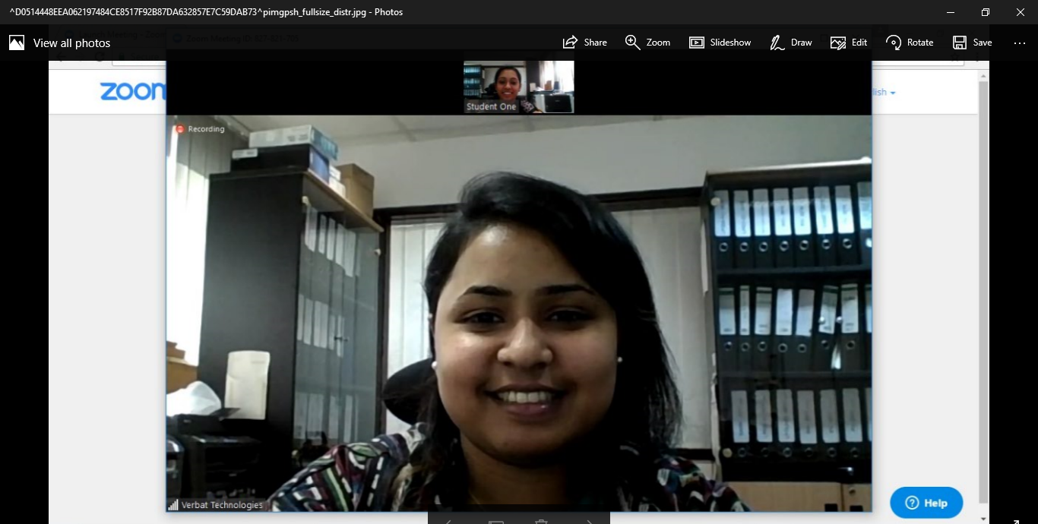
Training Session

Slide 15
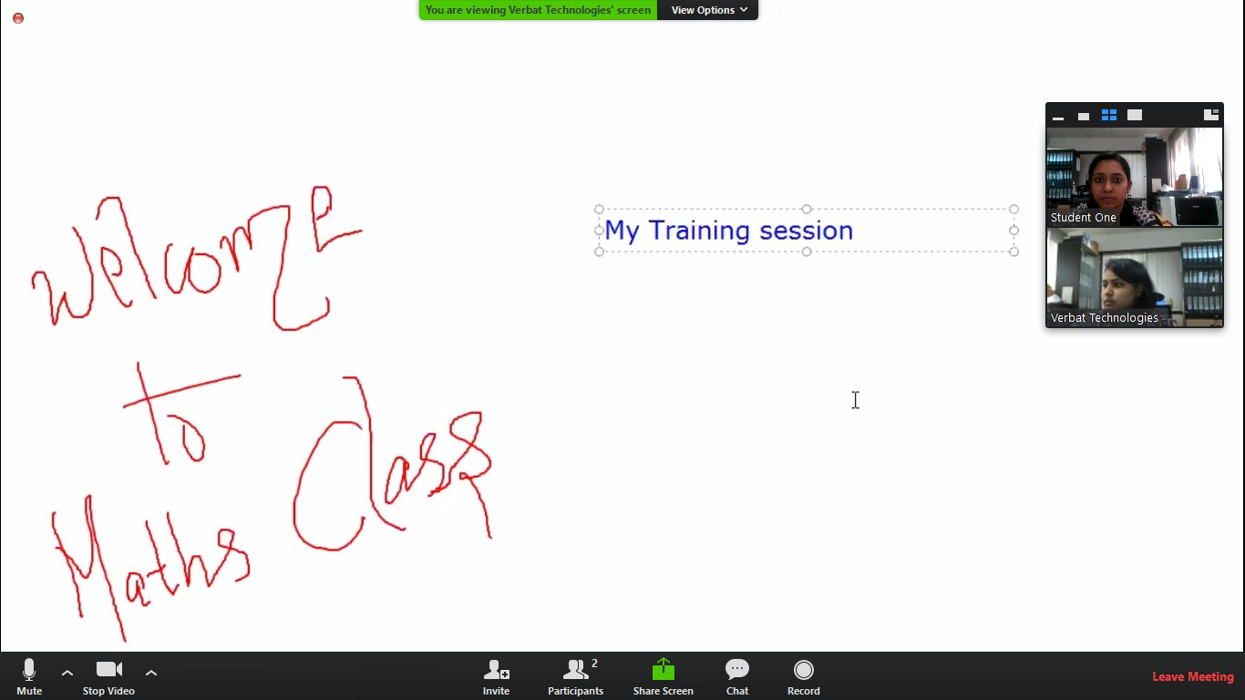
Training Whiteboard and Text Box
Text Box
Whiteboard

Slide 16
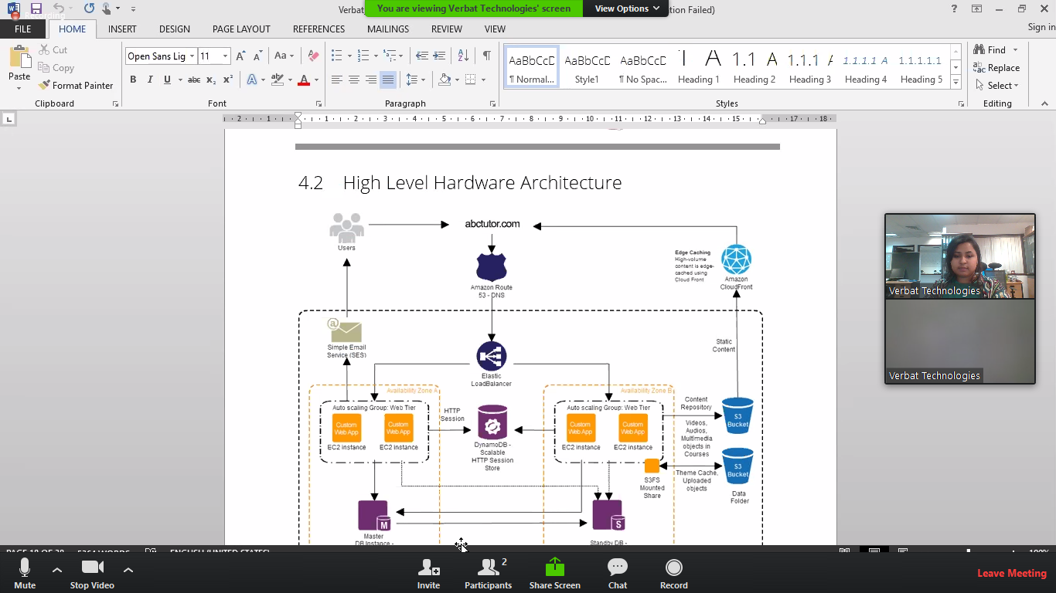
Training Screen Sharing

Slide 17
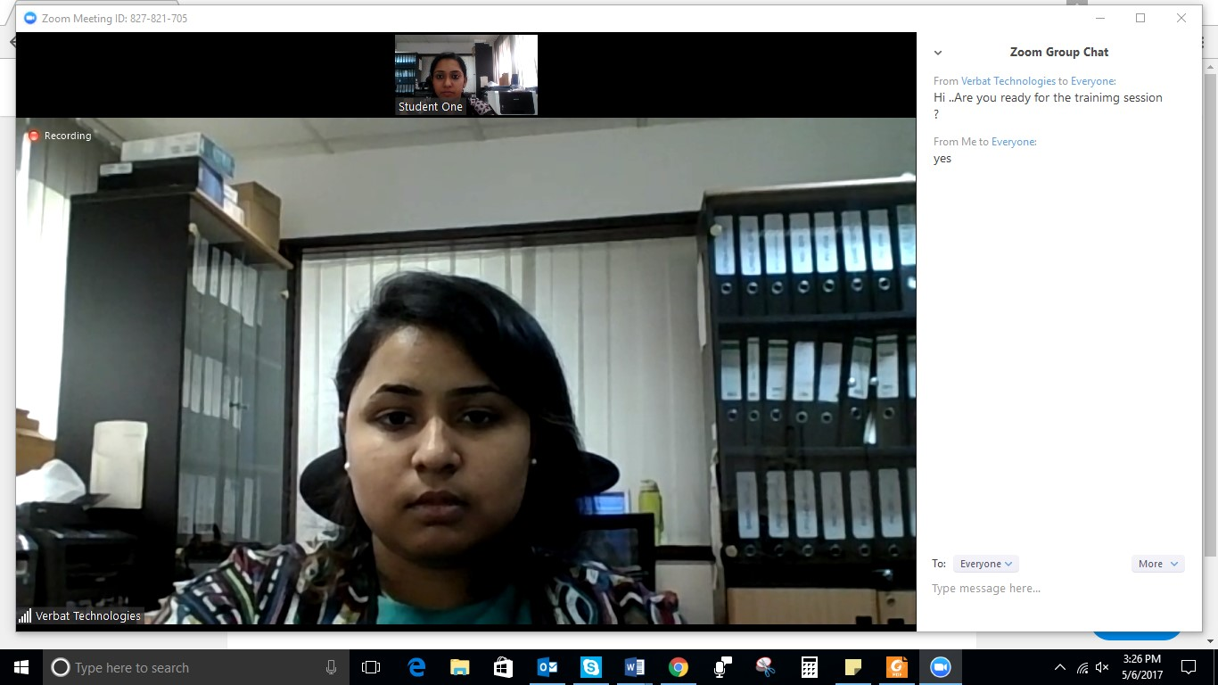
Training Chat Box
Chat Box

Slide 18



Contact Us
217, Sheikh Rashid Bldg
P.O Box 56272, Dubai United Arab Emirates
+971 4 2973236
uae@verbat.com
India
Level III, PTC Tower
Nanthancode, Trivandrum
Kerala
USA 2033 Gateway Place
Suite 500
San Jose , CA- 95110

Slide 19

Thank You
© 2017. All Rights Reserved Verbat Technologies www.verbat.com

