Slide 1
GenAIOps: End-to-End Architecture for Evaluation, Observability & Governance
Focus on Availability, Accessibility, Observability, Evaluation & Governance

Slide 2
Agenda
Overview of GenAIOps
Focus Areas
Core Services
Architecture Overview
Service Deep Dive
Evaluation & Governance
Observability & Health Monitoring
System Health Checks & Alerts
Pending Services (Future Roadmap)
Future Updates: AIOps Integration
GenAIOps vs AIOps (Comparison)
Key Takeaways
Q&A

Slide 3
Overview
Goal: Deliver a complete GenAIOps platform for managing LLM workflows
Focus Areas: Availability, Accessibility, Observability, Evaluation & Governance
Outcome: Reliable, reproducible, and monitored AI workflows

Slide 4
Focus Areas
Availability – Health checks & alerts for downtime
Accessibility – Streamlit UI, Grafana dashboards, APIs, MLFLOW
Observability – LangSmith tracing, Prometheus metrics, Grafana alerts, MLFLOW
Evaluation & Governance – Evaluation Service + MLflow Registry, compliance

Slide 5
Core Services
MLflow – Tracks experiments, metrics, artifacts
Mlflow Registry Manager – A micro service that interact with mlflow service to register or get models/prompts.
Orchestrator – Workflow runner, logs into MLflow + LangSmith + Grafana
Evaluation Service – Structured prompt/model benchmarking
LangSmith – Workflow tracing & debugging
UI (Streamlit) – User interface for queries & CSV upload
Prometheus – Metrics collection (workflows + system health)
Grafana – Dashboards + Alerts

Slide 6
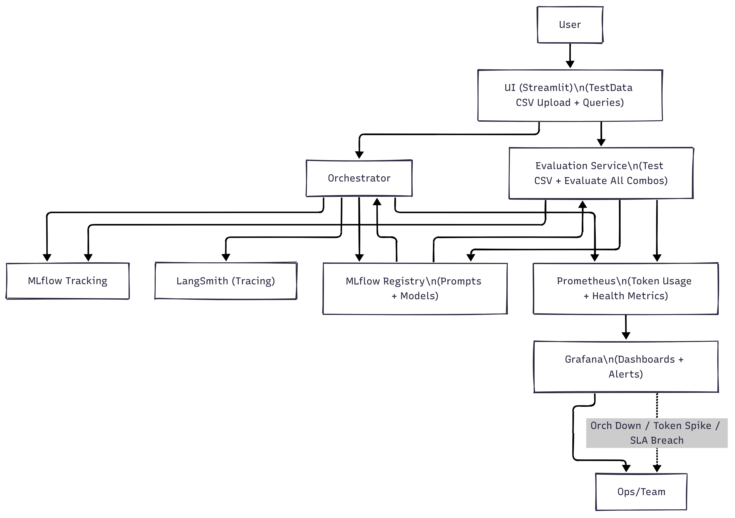
Architecture Overview

Slide 7
Service Deep Dive

Slide 8
MLFLOW
Tracks metrics, parameters, artifacts, and logs for every experiment.
Stores model versions with complete lineage.
Acts as the central hub for reproducibility — any experiment can be re-run with exact settings.
Integrated with Evaluation Service for benchmark results.

Slide 9
MLFLOW Registry Manager
Governs lifecycle of prompts and models:
Staging → Production → Archived.
Provides audit logs for compliance and rollback.
Ensures only best-performing combos (evaluated by benchmarks) get promoted.
Prevents “model drift” by enforcing controlled updates.

Slide 10
Orchestrator
Core “brain” of the pipeline.
Handles user requests and runs workflows/agents/tools.
Fetches prompts & models from MLflow Registry dynamically.
Logs results → MLflow & LangSmith for full traceability.
Supports parallel workflows with background jobs.
Provides hooks for token usage tracking, error handling, and retries.

Slide 11
Evaluation & Governance
Runs structured test cases against all registered prompts/models.
Supports CSV uploads from UI → benchmark against expected outputs.
Evaluates across multiple dimensions:
Accuracy & relevance
Latency & throughput
Robustness & error handling
Token efficiency
Writes results back into MLflow and eval_results.
Automatically updates Registry with best prompt+model combination per agent.

Slide 12
LangSmith
Provides deep observability into LLM workflows.
Records step-by-step traces of agent execution.
Debugging support → helps identify bottlenecks, long latencies, or failed nodes.
Acts as a workflow black-box recorder for auditability.

Slide 13
Prometheus + Grafana
Prometheus scrapes service metrics:
Latency, error rate, throughput, tokens used, CPU, RAM.
Grafana visualizes dashboards:
p95 latency
Workflow runs/errors
Agent-specific usage and health
Alerts configured for:
Orchestrator down
Error rate > 10%
CPU > 80% / RAM > 75%

Slide 14
UI
Simple user-friendly frontend.
Allows users to:
Trigger workflows
Upload test data (for evaluation service)
Visualize evaluation results and reports
Designed for non-technical stakeholders to interact with the pipeline.

Slide 15
Observability & Monitoring
Availability – Health checks for orchestrator, evaluation, UI
Accessibility – Grafana dashboards + UI
Observability – LangSmith tracing + Prometheus metrics
Grafana alerts – orch down, token spike, SLA breach

Slide 16
System Health Checks & Alerts
Metrics: CPU, RAM, Disk I/O
Alerts: Error rate >10%, Latency >2s (p95), CPU>80%, RAM>75%
Outcome: Preventive monitoring & proactive actions

Slide 17
Pending Services (Future Roadmap)
DVC – Dataset versioning & lineage tracking
LLM Model Training Service – Scalable fine-tuning, logs to MLflow Registry

Slide 18
Future Updates: AIOps Integration
Why AIOps – Extends GenAIOps into IT operations
Planned Enhancements: anomaly detection, RCA, predictive maintenance, auto-remediation
Outcome: From observability → proactivity, monitoring → automation, towards self-healing systems

Slide 19
GenAIOps vs AIOps
Feature | GenAIOps (Today) | AIOps (Future)
Focus | LLM workflows | Full IT + AI operations
Monitoring | Metrics + Logs | Anomaly detection + Root Cause Analysis (RCA)
Alerts | Threshold-based | Predictive + Adaptive
Governance | Model/Prompt Registry | End-to-end Ops
Action | Manual intervention | Automated remediation

Slide 20
Key Takeaways
Focus Areas: Availability, Accessibility, Observability, Evaluation & Governance
Evaluation + Registry ensures reliable prompt/model selection
LangSmith + Prometheus + Grafana → deep observability & monitoring
System Health Checks + Alerts prevent infra issues
Pending services (DVC + Training) → roadmap to maturity
Future AIOps vision → automated, self-healing operations

Slide 21
Q&A
Thank You – Questions?

