Slide 1
CSYE 7220 Final Project
Prashant Kabra
Amogh Chakkarwar

Slide 2

Project Structure
├── deploy_application.sh
├── deploy_infrastructure.sh
├── kubernetes_aws
├── kubernetes_azure
├── react_frontend
├── README.md
├── spring-boot_backend
├── terraform_aws
└── terraform_azure

Slide 3
Making API URL available to React App
Setting value in a file on S3
Passing as React environment variable
Passing as browser window variable

Slide 4
Passing as React env variable
Needs to be passed at build time
Can not be changed later by passing a new value on docker run

Slide 5
Passing as browser window variable
No Need set at build time
Can be changed later by passing a new value on docker run

Slide 6
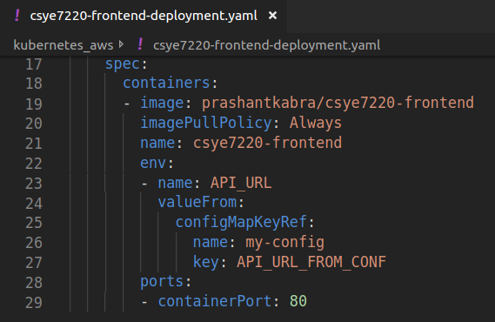
Setting env in kubernetes yaml
kubectl create configmap my-config –from-literal=API_URL_FROM_CONF=<backend_ip_address>
Setting value of API_URL_FROM_CONF in configmap called my-config
Setting docker env variable API_URL

Slide 7
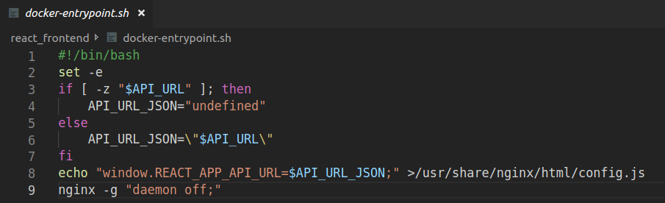
Setting API URL in React docker
Docker Entrypoint

Slide 8
Other files

Slide 9
Thank You!

