Slide 1

Grid Computing

Slide 2



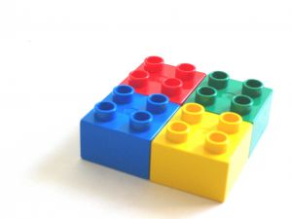

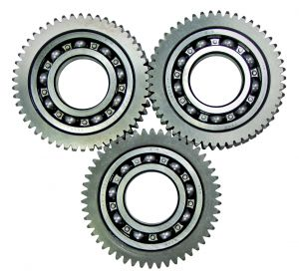

What is the Grid
What is a Grid made of And how it works
Grids in Existance
Applications

Slide 3
What is the Grid

Slide 4
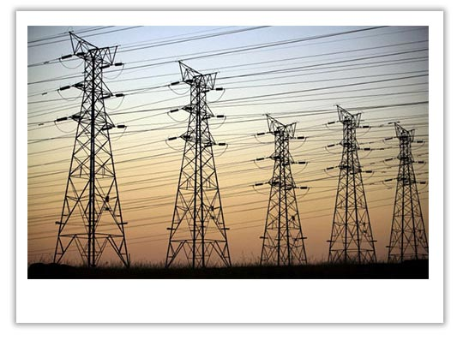

Slide 5
an electrical grid is an interconnected network that provides consistent, dependable, & transparent access to electricity irrespective of its source.
http://u.nu/8gvm

Slide 6
Grid computing is the application of several computers to a single problem at the same time.
http://u.nu/52xm

Slide 7
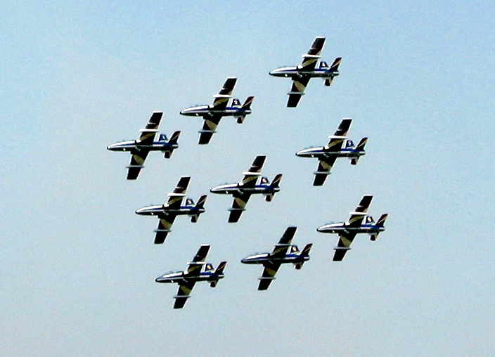
1.coordinates resources that are not subject to centralized control
http://u.nu/9jxm

Slide 8
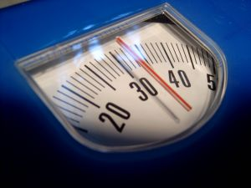
2.uses standard, open, general-purpose protocols and interfaces
http://u.nu/9jxm

Slide 9

3. delivers non-trivial qualities of service
http://u.nu/9jxm

Slide 10
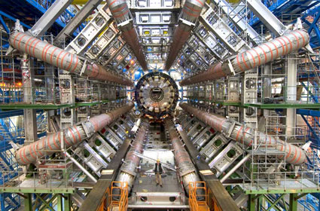
Large Hadron Collider
http://u.nu/4yxm

Slide 11
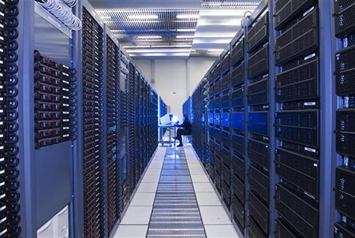
LHC Computing Grid
37 TB / Day acquired, processed and shared between Scientists via 10 Gbit/s Dedicated Links
http://u.nu/2zxm

Slide 12
what makes a grid?

Slide 13

Autonomy
http://u.nu/6wym

Slide 14

Heterogeneity
http://u.nu/6wym

Slide 15

Scalability
http://u.nu/6wym

Slide 16
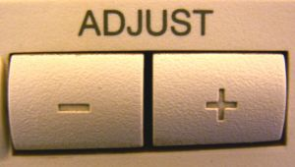
Adaptability
http://u.nu/6wym

Slide 17
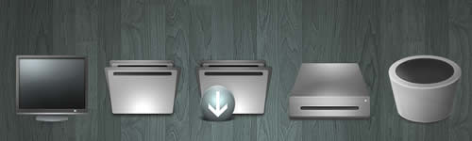
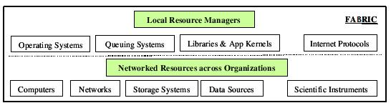
Grid Fabric
http://u.nu/6wym

Slide 18

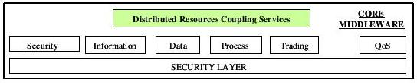
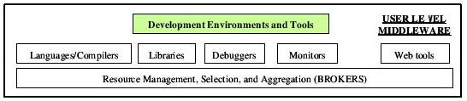
Grid Middleware
http://u.nu/6wym

Slide 19


Application & Portals
http://u.nu/6wym

Slide 20
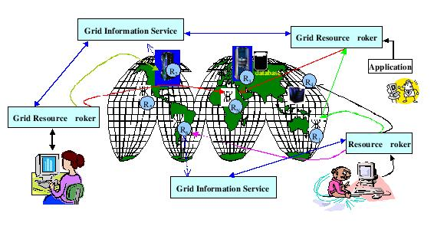
http://u.nu/6wym
http://u.nu/5yym

Slide 21
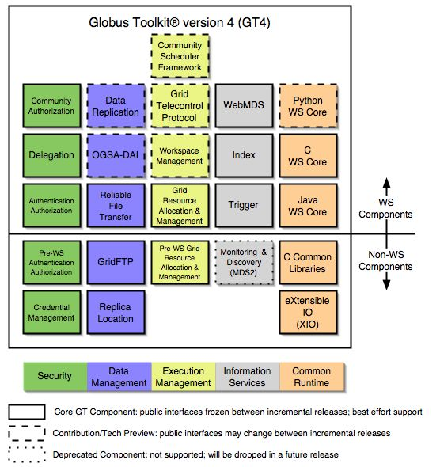
Globus Toolkit
The toolkit includes software for security, information infrastructure, resource management, data management, communication, fault detection, and portability
http://u.nu/42zm

Slide 22
existing Grids

Slide 23
EGEE
Enabling Grids for E-Science
100,000 CPU’s – 70 Istitutions – 27 Nations
http://u.nu/33zm

Slide 24
BEinGRID
Business Experiments in Grid
Provide the infrastructure to support Grid technologies in actual business scenarios
http://u.nu/44zm

Slide 25
Grid Applications

Slide 26

Computational Services – (distributed supercomputing)
Data Storage and Handling
Remote Applications
Information Services
http://u.nu/6wym

Slide 27
Concerns
Security - Power – Social Concerns
http://u.nu/44zm

Slide 28

More Info }
How Grids Work
http://tr.im/HowGridsWork
{Interactive Presentation on Working of Grids}
Grids Explained
http://tr.im/GridComputing
{Videos Depicting Working and Uses of Grids}

Slide 29

References
[1] – A Gentle Introduction to Grid Computing and Technologies - http://u.nu/76zm
[2] – Grids and Grid technolgies for wide area distributed computing - http://u.nu/6wym
[3] – Grid Computing - http://wikipedia.org
[4] – Gridipedia - http:///www.gridipedia.eu

