Slide 1


Smart HR
Making Hiring Decisions Easy
An Artificial Intelligence Based System
Presented By:
Prashant Kawle
Humaira Nasreen
Priyanka Vhadgir
Under the guidance of:
Kushal Sharma

Slide 2
“Without Data You Are Just Another Person
With An Opinion”
-Edward Deming

Slide 3
Problem Statement
To Analyze the Employees Performance.
To Predict The performance of the New Employee On the basis of Old employee.
Recommend To the HR which Candidate Should get Hire.

Slide 4
Objective:
Predict the Employee Performance which employee performance is high or low.
Our main objective is to Minimizes the HR efforts to Hire new employees.
To make decision easier.
Increase the productivity.

Slide 5
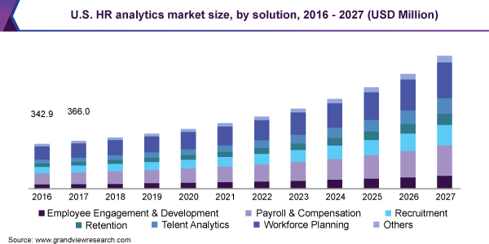
Market Survey
The global HR analytics market size was valued at USD 2.25 billion in 2019 and is expected to grow at a compound annual growth rate (CAGR) of 14.2% from 2020 to 2027.

Slide 6
Proposed Solution
In First Step we analyze the Previous data and Find the result which employee performance is Good. See their Schooling, College Details, Certifications, Grade.
Based on this details the system predict the performance of new employee.

Slide 7
To Analyze the Employees Performance.
Previous Data
Attributes
Visualize the data
To Predict The Performance of Candidate
Previous Employee Detail
Display the Prediction
Machine Learning
Model
Enter New Employee Details

Slide 8
Implementation
Data
Qualitative
Combine and Clean
Apply Machine Learning Algorithm
Quantitative
User Interface/ Output
Deploy On cloud

Slide 9
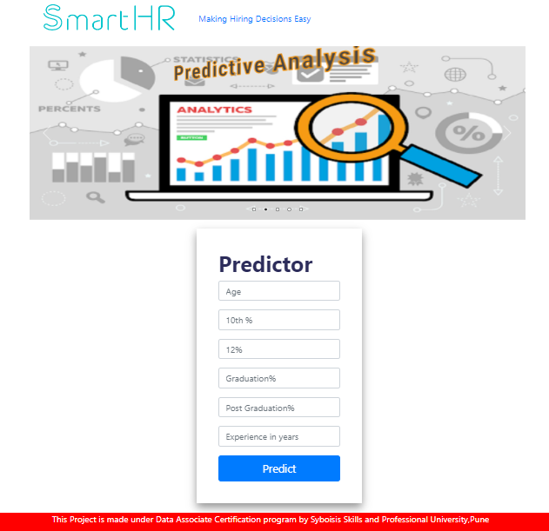
User Interface

Slide 10
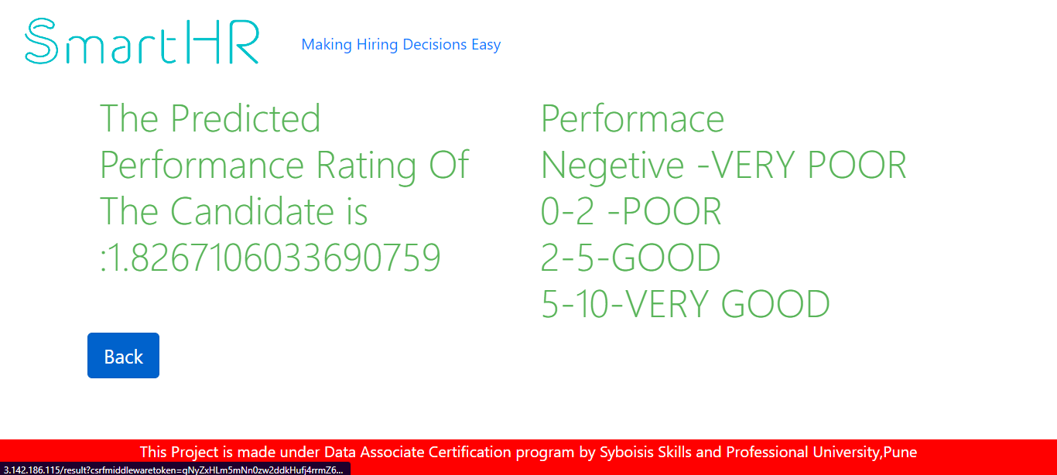
Result

Slide 11
Benefits
Minimize the Efforts of HR manager.
Less time required.
Easy to Handle.

Slide 12
Future Scope
Using qualitative analysis performance of the model can be improved.
Also using other machine learning algorithm we can increase the efficiency of model.
It can also implemented in an organization to real time training and predication of model.

Slide 13
Acknowledgements
I would like to express gratitude to all those people whose support and cooperation has been an invaluable asset during this project. I would also like to thank our guide Kushal Sharma Sir for guiding us throughout s of this project.

Slide 14
Conclusion
Predicted the performance of the employee.
Successfully trained and integrated model on Django framework.
Deployed the project in cloud so we can access throughout world.

Slide 15
Thank You

