Slide 1
IBM University Engagement Project Submission
“Exploring the Power of Agentic AI with IBM Granite and LangFlow”

Slide 2

Project Tile – Smart Study Generator Agent
Domain of Project –Education
Student Name | Recent Passport Photo | Email ID | Mobile number [WhatsApp]
Dr Prashant Keswani |  | prashantkeswani@gmail.com | 9909011169

Slide 3
Problem Statement - Smart Study Generator Agent
The Challenge
Students today face an overwhelming flood of information—lecture notes, textbooks, research papers, YouTube tutorials, and online resources. This content is scattered, unorganized, and often not personalized to their learning pace or style. As a result, students struggle with finding the right study material, summarizing key concepts, and staying exam-ready. Traditional study tools only provide static notes or flashcards, failing to adapt dynamically to student needs. The challenge is to move beyond static resources toward an intelligent, adaptive study companion.
The Objective
Build an agentic AI-powered Smart Study Generator that personalizes and streamlines learning for students.
The solution should:
Fuse Learning Resources: Aggregate content from class notes, textbooks, research articles, and online tutorials into structured, easy-to-digest study material.
Enable Multimodal Input: Allow students to upload notes, voice queries, or images (e.g., textbook pages), and generate concise summaries, flashcards, or concept maps.
Create a Predictive & Agentic Layer: Recommend personalized study plans, highlight important topics based on syllabus or past exams, and provide predictive alerts (e.g., “Focus on Topic X—frequently asked in exams”).
Visualize Study Progress: Offer a real-time dashboard showing learning milestones, weak areas, practice quizzes, and performance forecasts. .

Slide 4
Technology Used
Langflow platform -For designing and orchestrating multi-agent workflows visually.
IBM Grainte model - for eg – ibm-granite-4-h-small – For natural language understanding, reasoning, and personalization
IBM Cloud – It provides the infrastructure to build, deploy, and scale the Intelligent Shopping Agent efficiently.
IBM Watsonx.ai - For model deployment, embeddings, and AI governance.

Slide 5
Proposed Solution
Develop an Agentic AI-powered Smart Study Generator using IBM Granite Models, RAG, and a two-agent architecture. The first agent collects, processes, and summarizes learning materials from multiple sources (notes, textbooks, images, voice, and online resources) into structured study content. The second agent analyzes student progress to create personalized study plans, generate adaptive quizzes, predict exam readiness, and recommend important topics. A real-time dashboard visualizes learning progress, weak areas, and performance forecasts, providing students with an intelligent, personalized, and adaptive learning experience.

Slide 6
Langflow component Used -
1) Chat Input – Interface where users enter their queries, preferences, or meal details (text/voice/image).
2) IBM watsonx AI Agent - Processes user input using Granite models to generate personalized shopping insights and recommendations.
3) Name of IBM Granite model - ibm-granite-4-h-small → Fast, efficient for real-time shopping recommendations.
4) Chat output -Displays AI-generated responses such as which material has to use

Slide 7
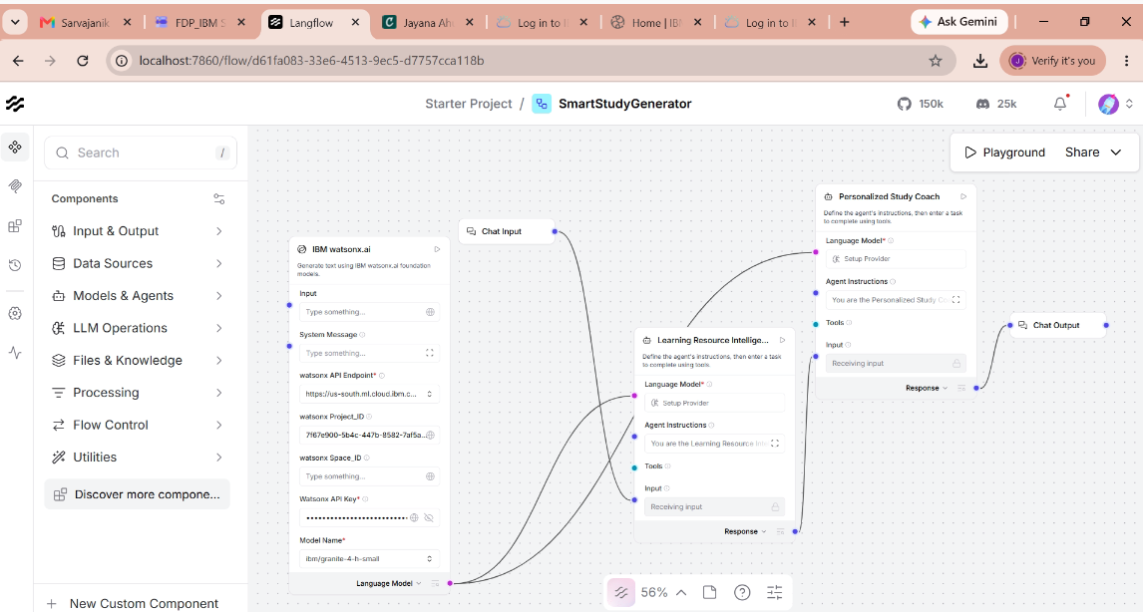
Langflow workflow -

Slide 8
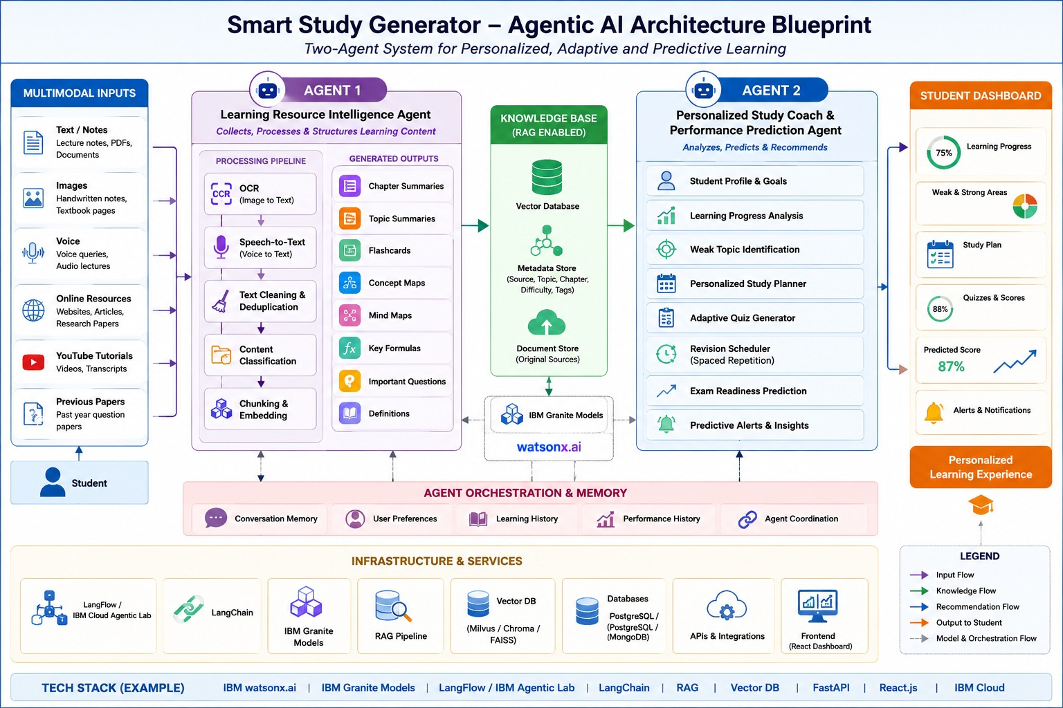
Architecture blueprint

Slide 9

Role of Agentic AI in the solution
Agentic AI enables autonomous collaboration between specialized AI agents to deliver a personalized learning experience. One agent organizes and transforms diverse study resources into structured content, while the other analyzes student performance to generate adaptive study plans, predictive recommendations, and real-time learning insights. This collaborative approach creates an intelligent, proactive, and continuously improving study companion.

Slide 10
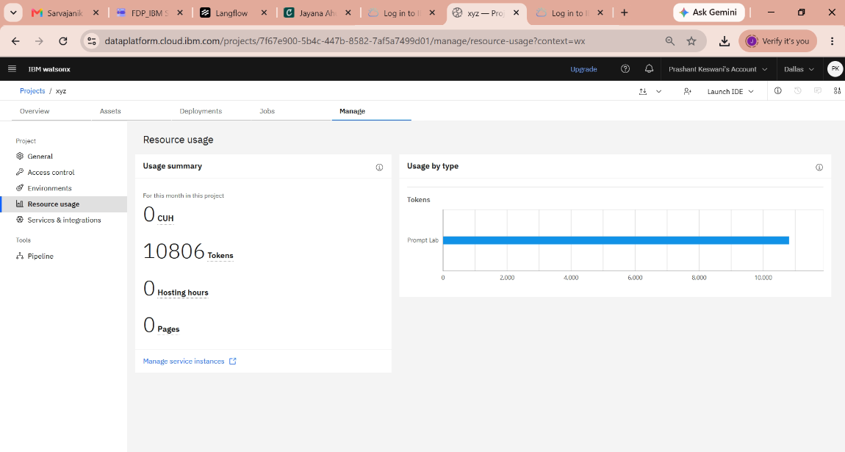
Token Usage
10806 token are used
Before Prompt
After the Prompt
Tokens : 3233
Forgot to take screenshot before giving prompt
·
·
·

Slide 11
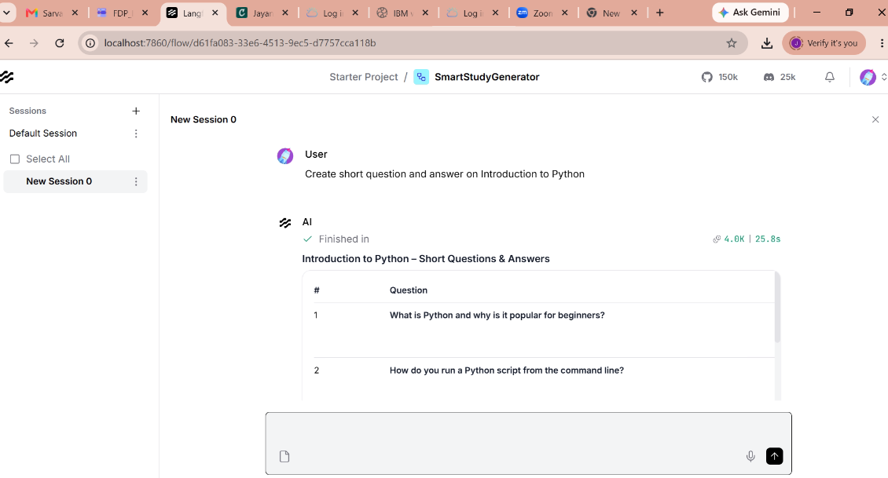
Output
·
·
·

Slide 12
Novelty and Uniqueness
The Smart Study Generator combines multimodal learning, RAG-based knowledge retrieval, and a two-agent Agentic AI architecture to deliver personalized study materials, adaptive learning plans, predictive exam insights, and real-time progress tracking. Unlike traditional study tools, it continuously learns from student interactions and dynamically adapts to individual learning needs.

Slide 13
Git Hub Link
· GitHub Public repository link:
https://github.com/prashantkeswani-commits/FDP_IBM_Project_SmartStudyGeneratorAgent
·
·
·

Slide 14
Certificate – Generative AI in Action
·
·
·

Slide 15
Certificate – Getting Started with Cybersecurity
·
·
·

Slide 16
Certificate – Level Up Cybersecurity with Generative AI
·
·
·

Slide 17
Certificate – Exploring Quantum Computing
·
·
·

Slide 18
Certificate – Lab: Troubleshoot your code using IBM Bob
·
·
·

Slide 19
Future Scope
Future Scope
Integrate AR/VR-based immersive learning for interactive education.
Support multiple languages to make learning accessible to a wider audience.
Incorporate real-time collaboration for group study and peer learning.
Enable integration with Learning Management Systems (LMS) and educational platforms.
Enhance predictive analytics using advanced AI to provide personalized career and skill recommendations.
Extend support to lifelong learning and professional certification programs.
·
·
·

Slide 20


