Slide 1
Dialysis HealthCare Analytics
GROUP- 2
Here is where the presentation begins

Slide 2
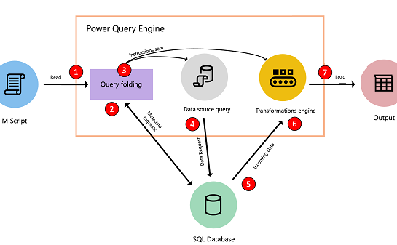
Why Is SQL Important for Data Analysis?
SQL is the language used to interact with relational databases. Since most systems today capture the data using one or more databases (like MySQL, Oracle, Redshift, SQL Server, etc.)
Another great thing about SQL is that it’s usually quite fast. It can work with large volumes of data.
The database engine is tuned so that you don’t wait forever to get the results. In fact, a well-written SQL query can fetch results from a few million rows within a minute.

Slide 3
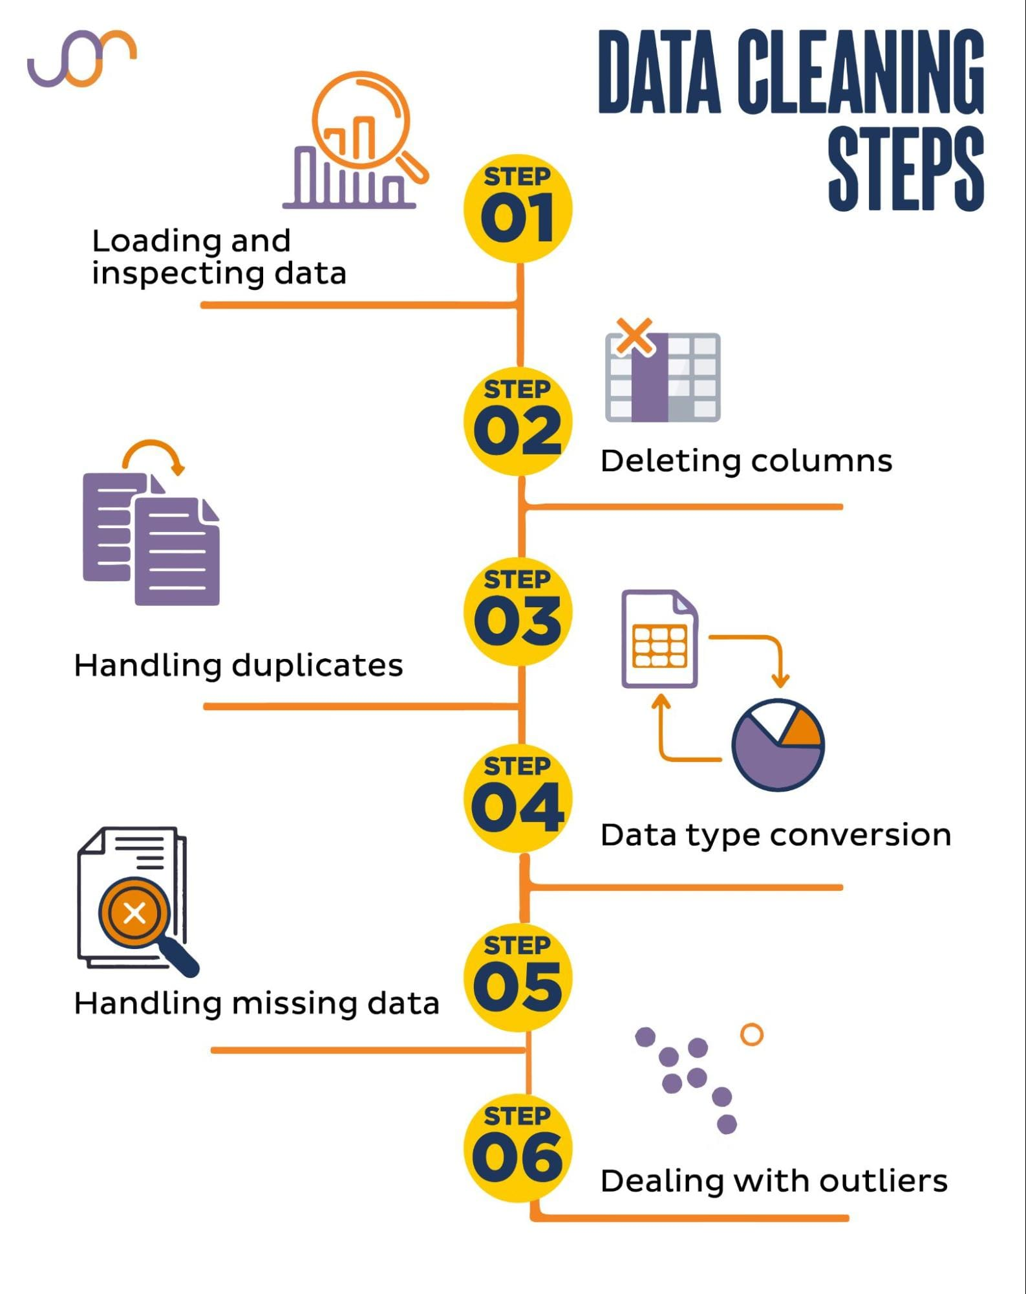

Slide 4
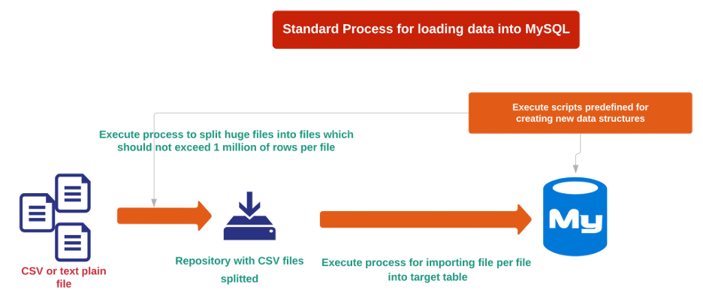

How to import CSV into MySQL:
Steps:
Open MYSQL Workbench, click on the Database/ create a Database.
After creating, then go to SCHEMAS, click on Database -> Tables.
Right click on Tables, select Table Data Import Wizard.
Pop-up box will open and select your csv file then click on next.
Your data is ready to go.

Slide 5

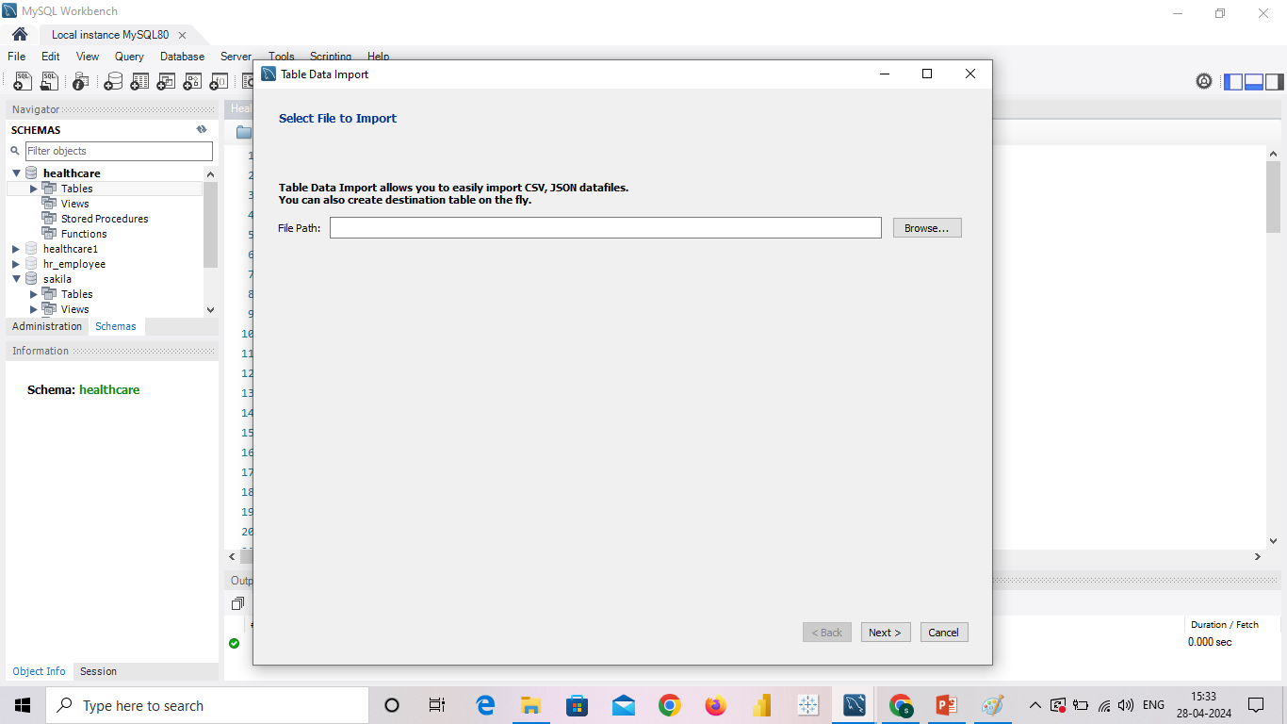
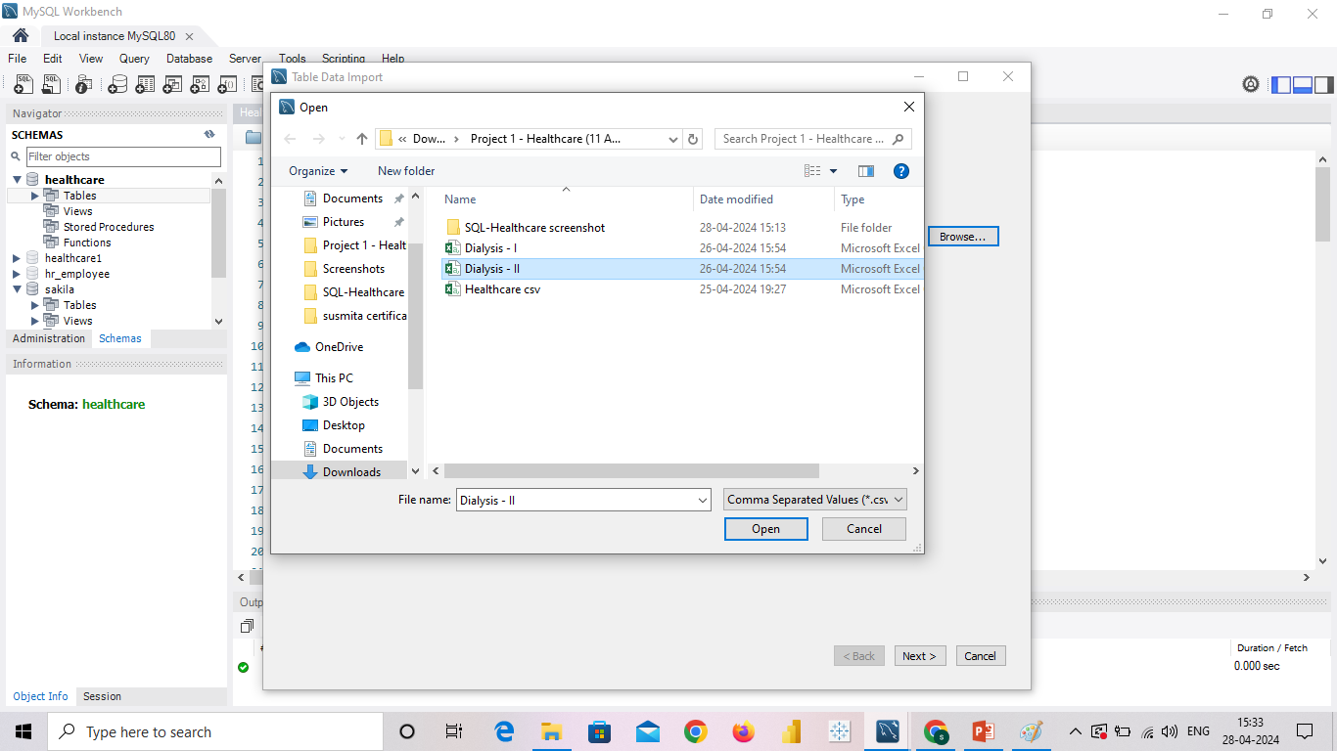
Screenshot of importing data in Mysql

Slide 6
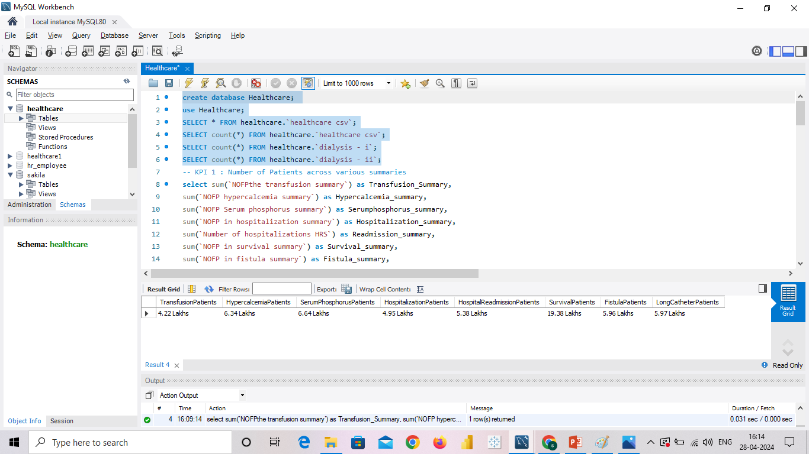
FINAL LOOK AFTER IMPORTING .CSV

Slide 7
Table of contents KPI’S
01
04
02
05
03
06
Number of Patients across various summaries
Dialysis Stations Stats
Profit Vs Non-Profit Stats
# of Category Text - As Expected
Chain Organizations w.r.t. Total Performance Score as No Score
Average Payment Reduction Rate

Slide 8
01
Number of Patients across various summaries

Slide 9
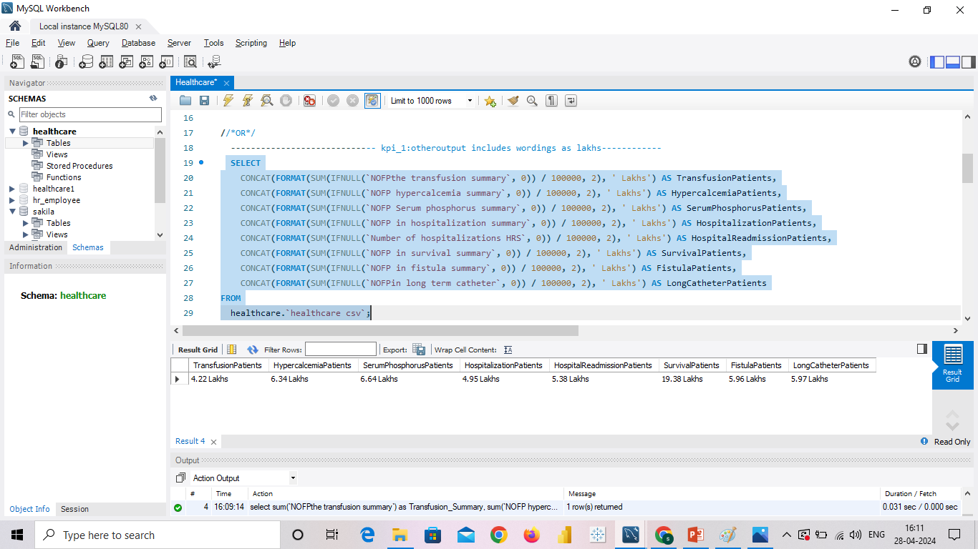
Insight of kpi-1
Analyzing the number of patients across various summaries is a crucial KPI in dialysis healthcare analytics.
It involves tracking the patient population trends, such as the total number of patients, patient demographics, and specific patient summaries (e.g., by age, gender, or medical conditions).
This KPI provides insights into the demand for dialysis services, helps in capacity planning, and assists healthcare providers in delivering personalized care based on patient characteristics.

Slide 10
02
Profit Vs Non-Profit Stats

Slide 11
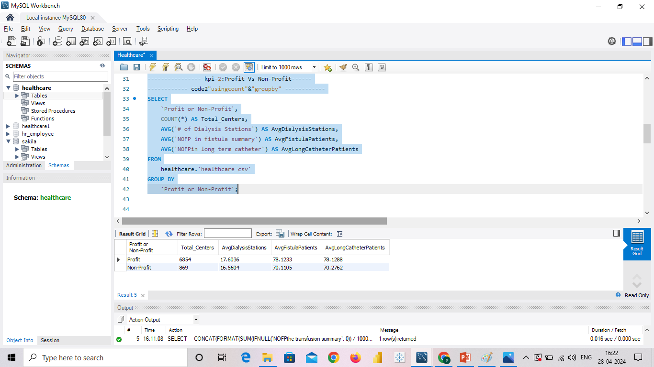
Insight of kpi-2
Comparing the financial performance of profit- driven and non-profit organizations is an important aspect of dialysis healthcare analytics.
This analysis involves examining key financial metrics, such as revenue, expenses, profit margins, and return on investment, to understand the economic landscape of the dialysis care sector.
It helps identify the differences in financial outcomes between profit and non-profit organizations and enables stakeholders to make informed decisions regarding resource allocation, cost management, and sustainability of care.

Slide 12
03
Chain Organizations w.r.t. Total Performance Score as No Score

Slide 13
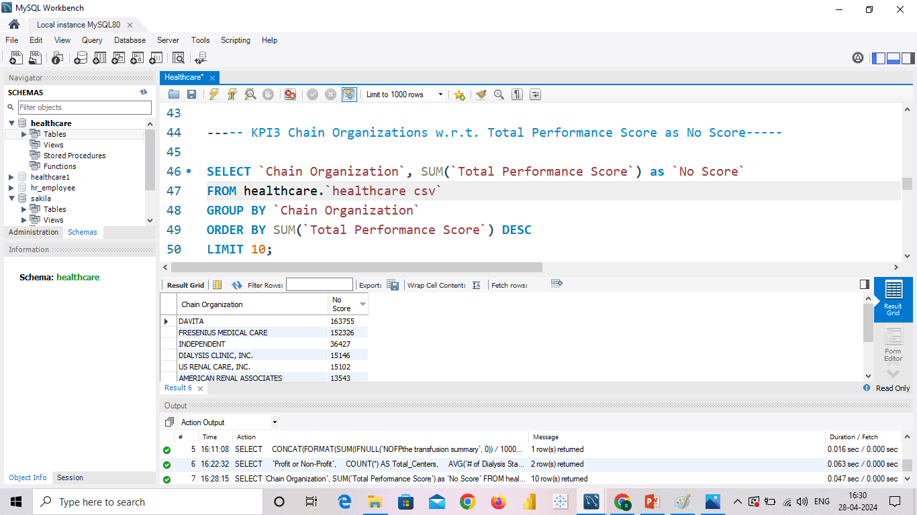
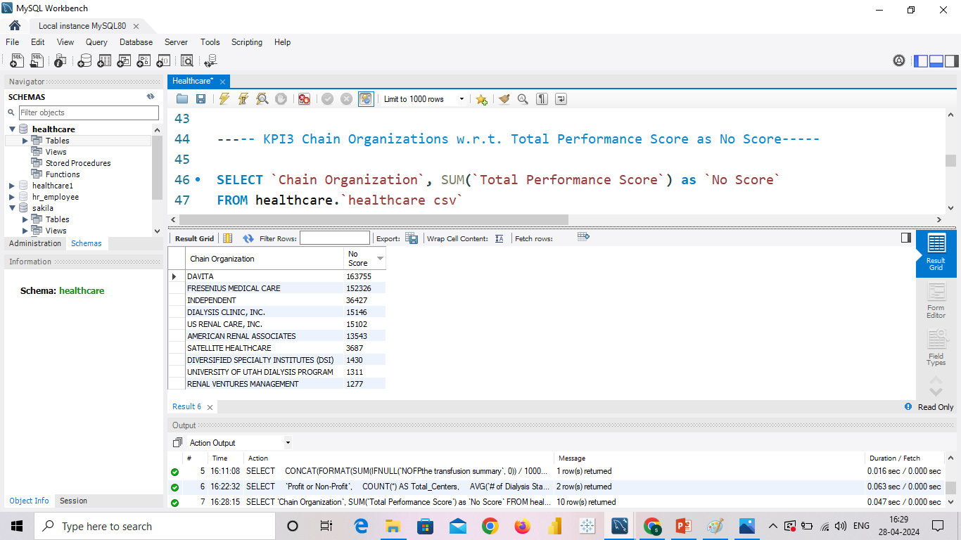
Insight of kpi-3
Assessing chain organizations based on their total performance score, particularly those with no score, is a significant KPI in dialysis healthcare analytics.
The total performance score evaluates various quality measures, patient outcomes, and adherence to best practices.
By analyzing chain organizations in terms of their total performance score, healthcare providers can identify areas of improvement, benchmark against industry standards, and promote quality care delivery across different chains.

Slide 14
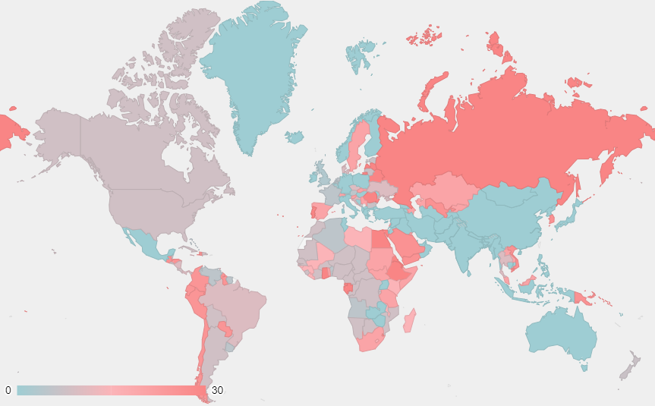
04
Dialysis Stations State

Slide 15
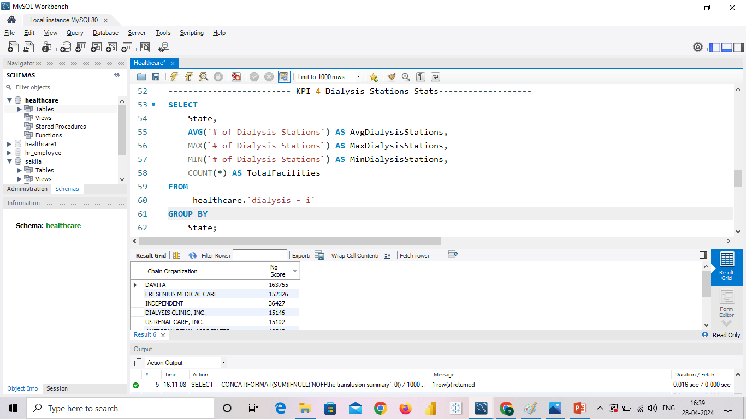
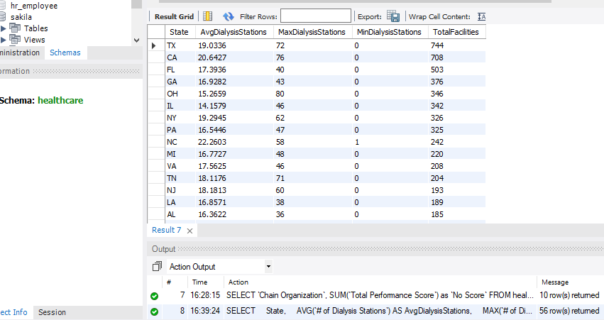
Insight of kpi-4
Monitoring dialysis stations' statistics is an essential KPI for dialysis healthcare analytics.
This involves tracking the number of dialysis stations, their utilization rates, availability, and efficiency of operations.
By analyzing these statistics, healthcare providers can optimize resource allocation, identify areas of underutilization or overcrowding, ensure equitable access to dialysis services, and improve overall operational efficiency in delivering care.

Slide 16
05
# of Category Text - As Expected

Slide 17
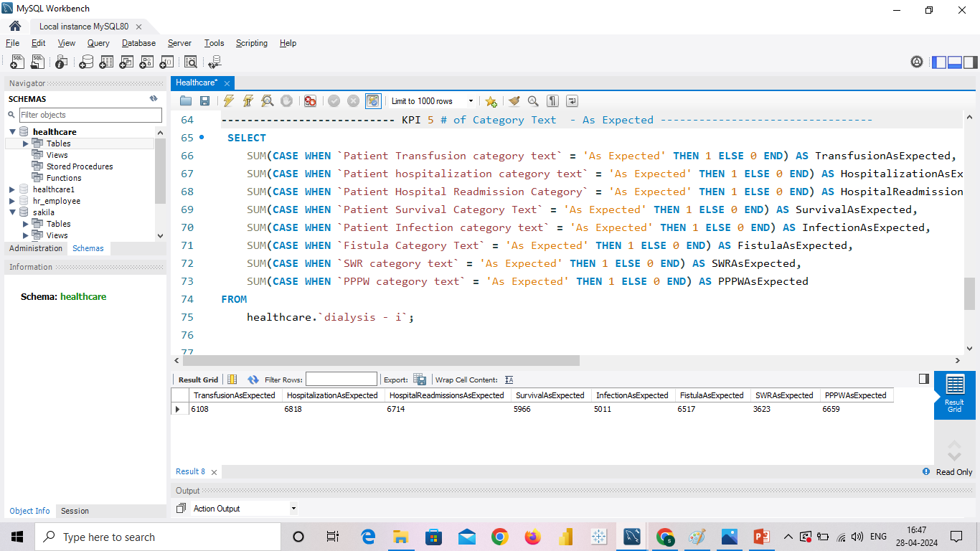
Insight of kpi-5
Analyzing the # of category text, such as patient classifications or other relevant criteria, is an important KPI in dialysis healthcare analytics.
It involves categorizing patients based on specific criteria and examining their outcomes.
By comparing these outcomes with expectations, healthcare providers can assess the effectiveness of different treatment plans, identify patterns, and tailor care strategies to specific patient categories, ultimately improving the quality of care provided

Slide 18
06
Average Payment Reduction Rate

Slide 19
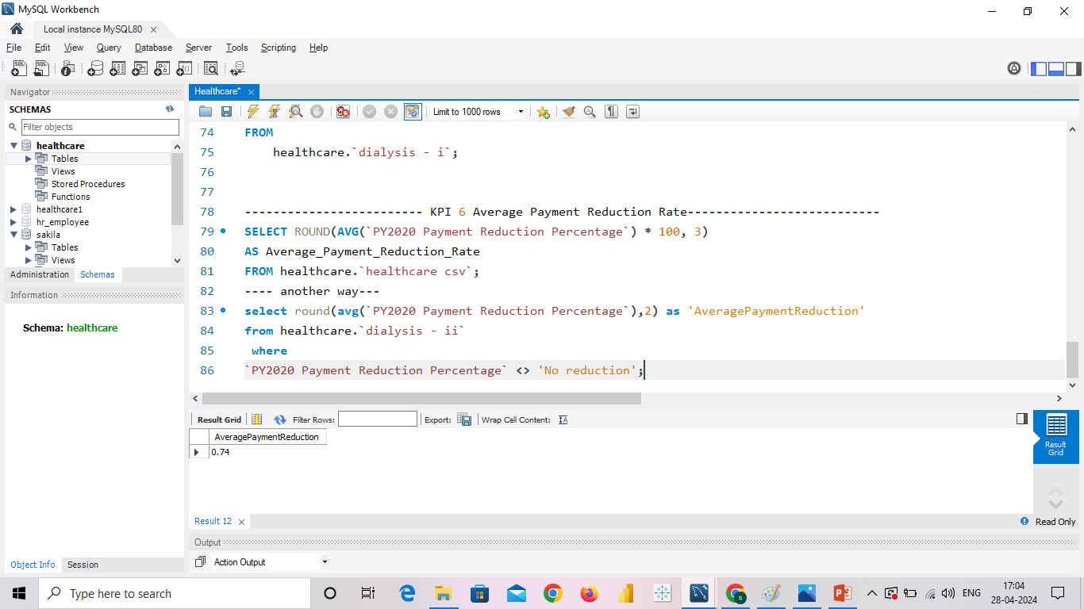
Insight of kpi-6
Monitoring the average payment reduction rate is a critical KPI in dialysis healthcare analytics.
It measures the rate at which payments for dialysis services are reduced, such as through reimbursement adjustments or contractual agreements.
By analyzing this KPI, healthcare providers can assess their financial performance, identify factors contributing to payment reductions, and develop strategies to mitigate the impact on revenue while maintaining high-quality care standards

Slide 20
CONCLUSION
Survival summary has the highest patient count, indicating positive outcomes, while npcr summary has the lowest count.
The count of profitable facilities decreased from 2018 to 2020, signaling a concerning trend.
DAVITA and Fresenius Medical Care have a majority of profitable facilities. Approximately 88.75% of facilities generate profit, while non-profit facilities need analysis.
The highest performance score was recorded in 1969, while the lowest was in 1971. Intermountain Healthcare and Memorial Hermann have high performance scores, while others need improvement.
The number of dialysis stations increased until 2018 and then started declining, which is concerning.
The survival category has a good patient count, while hospitalization has the highest count. Implementing cost containment strategies like operational efficiency improvements and optimized supply chain management can reduce costs.
Transitioning to value-based care models and leveraging technology and innovation can optimize healthcare delivery and potentially reduce payments. Quality improvement initiatives, such as reducing readmissions and preventing medical errors, can lead to cost savings and better payment rates.

Slide 21
THANK YOU
Have a Great Week Ahead!

