Slide 1
Ridge and Lasso Regression
by Niharika Dhapola, Sarita Kumari, Prashant Kumar, and Nicholas Soluri

Slide 2
Introduction
Ridge and Lasso Regression are shrinkage methods
Motivation →Useful when there are too many predictors
Example → more predictors than observations
Ridge can shrink coefficients to minimize their effect
Shrinks but does NOT set equal to 0
Lasso can shrink coefficients all the way to 0
Bias-Variance Trade-off

Slide 3


Ridge and Lasso Equations
Ridge:
Uses tuning parameter →shrinkage penalty
As λ grows, shrinkage penalty increases
Coefficients approach 0, but without reaching 0
Uses L2 norm
Penalty is λ times the sum of squares of the coefficients
Lasso:
Uses tuning parameter → shrinkage penalty
Some coefficients will be reduced to 0 exactly
Uses L1 norm
Penalty is λ times the sum of the magnitudes of the coefficients

Slide 4
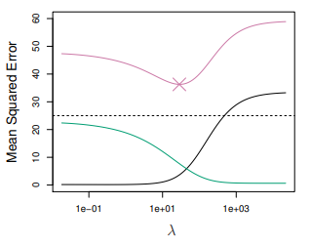
Ridge: Why Does it Improve Over Least Squares?
Bias-variance trade-off
As λ increases, flexibility decreases along with variance, but bias increases
Ridge MSE (pink), squared bias (black), variance(green)
From example data set containing 45 predictors and 50 observations

Slide 5
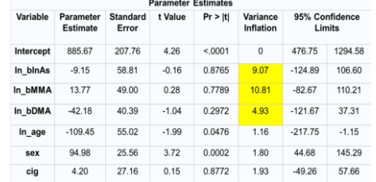
Ridge Example 1: Background
Paper from Columbia University
Goal/Response: Predict glutathione (bGSH) levels measured in a patient’s blood
Predictors: cigarette smoker status, sex, age, arsenic blood levels (InAs), monoethylarsenic blood levels (MMA), and dimethylarsenic blood levels (DMA)

Slide 6
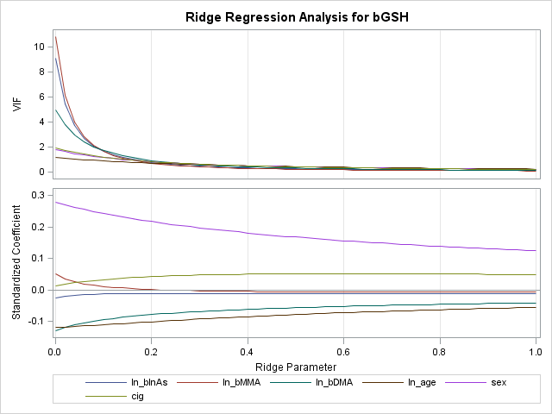
Ridge:
Ex. 1 →

Slide 7
Ridge Regression: Example 1 Findings
VIF = variance inflation factor
Quantifies the severity of multicollinearity in an ordinary least squares regression
Decreases for all coefficients, approaching 0 as the ridge parameter increases
Indicates that multicollinearity has been reduced/eliminated
Coefficients approach zero as the ridge parameter increases
None of the coefficients actually reach zero
Result/Goal: Choose ridge parameter 0.24
VIF has been sufficiently reduced without shrinking parameters too much (could increase MSE)

Slide 8
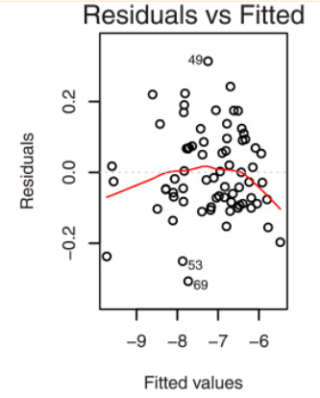
Ridge Example 2: background
Article Published in National Library of Medicine.
Goal: Improving prediction accuracy in Genome regression modelling in Vitamin B2 (Riboflavin) production data.
If data has outliers and multicollinearity, We use a robust ridge regression estimator "Rank- Ridge regression"(replacing data with its Rank).
We choose generalized cross validation (GCV) to estimate Ridge Parameter k and Shrinkage parameter d simultaneously. GCV estimate it by creating a balance between precision and bias.
Outliers in Vitamin B2 Production Data

Slide 9
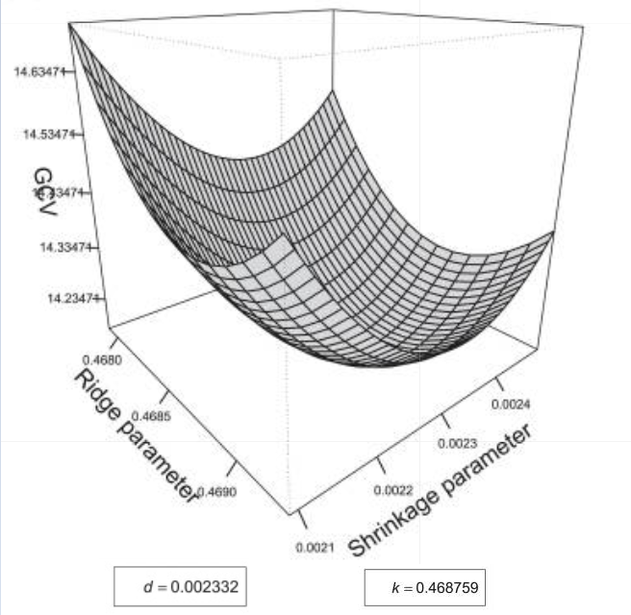
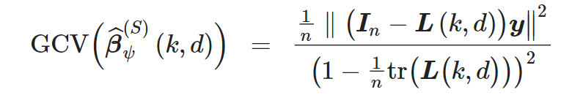
Minimized GCV to get k(ridge parameter) and d(shrinkage parameter)
GCV forming a Parabolic shape
Decreasing and then increasing giving a global minimum in between which are optimal for k and d.
GCV is function of (ridge parameter) and k(shrinkage parameter)
Notes:
We use R library to minimize this GCV function.
L is here

Slide 10
Ridge Regression: Example 2 Notes
GCV → Generalized Cross-Validation Statistic
To measure prediction accuracy LOOCV(Leave One Out Cross-Validation) is used.
GCV provides an approximation of LOOCV.
By defining GCV ,optimal value for both ridge and shrinkage parameters are obtained.
As ridge parameter increases, GCV forms a parabolic shape
Decreases to a global minimum, then increases
Main takeaway
Results show that there exists a single value of the ridge parameter which minimizes GCV.

Slide 11
Lasso
One significant problem of ridge regression is that the penalty term will never force any of the coefficients to be exactly zero.
Thus, the final model will include all p predictors, which creates a challenge in model interpretation
The lasso works in a similar way to ridge regression, except it uses a different penalty term that shrinks some of the coefficients exactly to zero.
The lasso performs variable/feature selection.

Slide 12
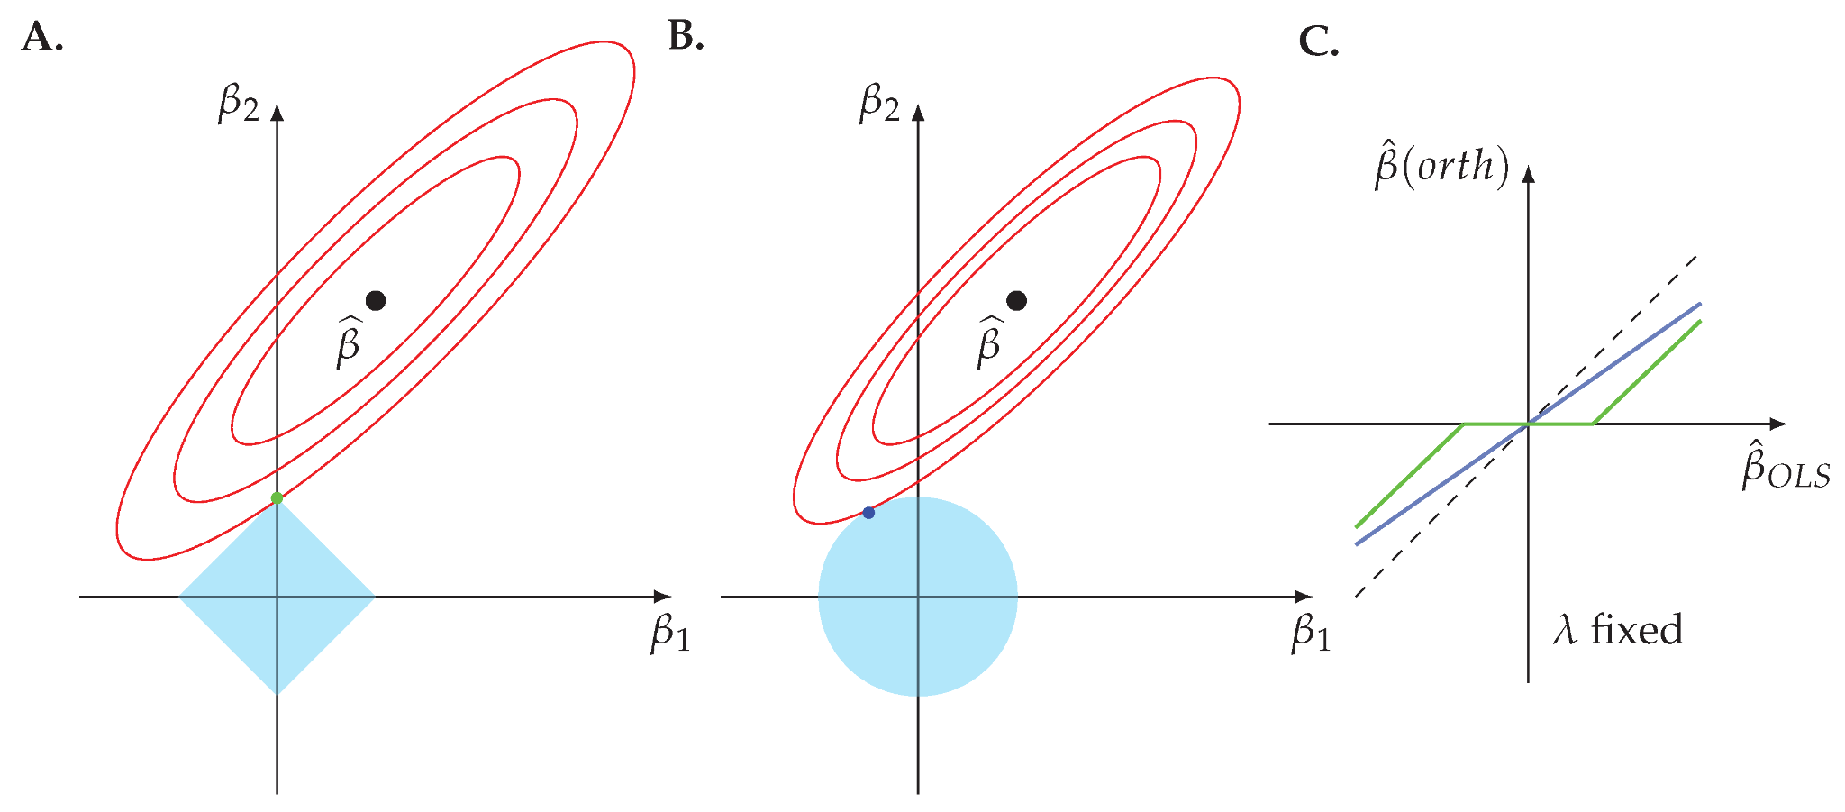
Variable selection property of the Lasso
increasing values of λ lead to the shrinkage of the regression coefficients and even become zero
The optimum result is the intersection of the ellipsis and the boundary of the penalty shapes.In order to shrink a coefficient to zero an intersection needs to occur alongside the two coordinate axis. this is only possible for the LASSO but not for ridge regression.
Lasso
β12 + β2 ≤ s
(Ridge)
Ridge
|β1|+|β2|≤s
(Lasso)
Contours of the error and constraint functions. The solid blue areas are the constraint regions, while the red ellipses are the contours of the RSS.

Slide 13

Example 1 for Lasso Regression
Objective: to measure quality of the wine with 1599 observations.
Predictors: fixed.acidity ,volatile.acidity , citric.acid , residual.sugar , free.sulfur.dioxide, chlorides , total.sulfur.dioxide , density , pH , sulphates , alcohol , Quality
Table 1 - shows coefficients estimates for the red wine data -

Slide 14
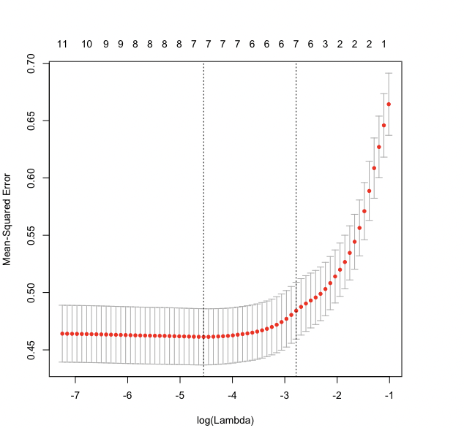
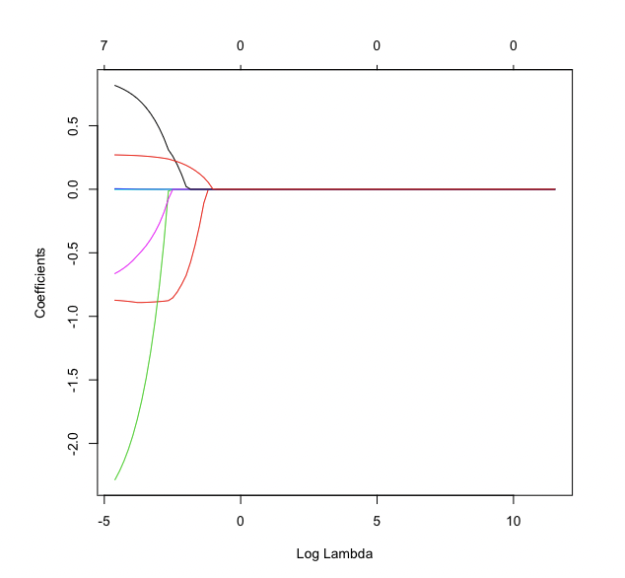
Lasso Ex-1
The plot shows the number of non-zero coefficients ̂ bi in the regression model for a given log λ.
The plots depict the mean squared prediction error MSE against log λ.

Slide 15

Lasso Regression: Findings
The LASSO tend to “shrink” to zero coefficient estimates ̂ bi in the sense that they reduce the norm of the estimate vector as λ increases.
The LASSO performs variable selection i. e. some of the coefficient estimates ̂ bi become exactly equal to zero, which makes the regression model easier to interpret.
The RSS value calculated on the train set is large and the RSS value calculated on the test set is small for Lasso regression when λ is selected appropriately.
Calculating the RSS on the test data set provides a good way to assess the regression model in contrast to using a single data set
Table 2
shows RSS for train & test sets

Slide 16
Example: Ridge and Lasso on the Same Data Set
From the Wave Data Lab Open Source Project
Data Set: Loans Given in Vermont in 2012
Response: Loan amount given
Predictors: applicant income, sex, race, and loan purpose

Slide 17
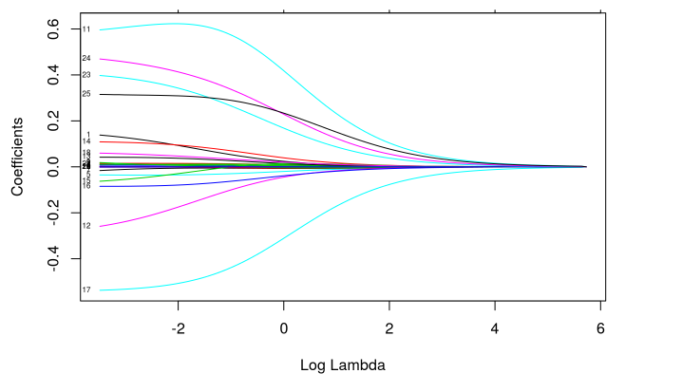
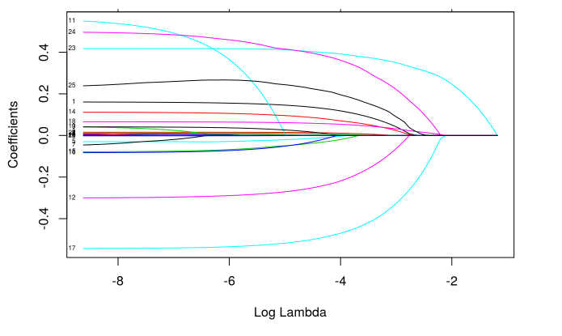
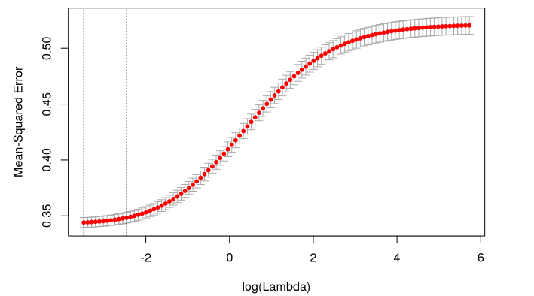
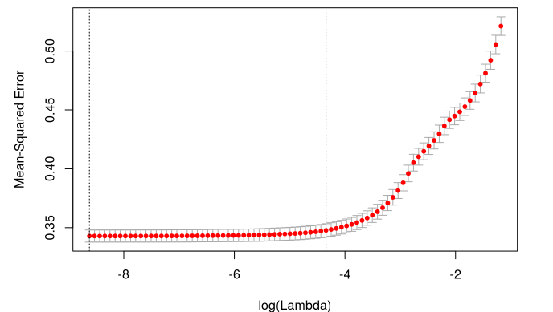
Ridge:
Lasso:
Coeff. Vs Lambda
MSE vs Lambda

Slide 18


General Findings
Both are useful in medical and finance fields
Help to make problems with many small predictors easier to interpret

Slide 19

Medical Studies
Often countless possible predictors could contribute to contraction of a disease
Genetics, life experiences, diet…
Amount of possible predictors can be nearly infinite
Ridge and Lasso help to focus on the most significant predictors

Slide 20

Bank Loans and Credit Cards
Similarly to medical studies, very large amount of predictors when approving a loan
Work history, credit history, savings, age, dependents…
Ridge and Lasso help to shrink these problems also

Slide 21
THANK YOU!

Slide 22
References
Sources:
Ridge: Columbia University
https://www.publichealth.columbia.edu/research/population-health-methods/ridge-regression
Ridge: NIH
https://www.ncbi.nlm.nih.gov/pmc/articles/PMC8031387/
Lasso: MDPI
https://www.mdpi.com/2504-4990/1/1/21/htm
Comparing Ridge vs Lasso:
https://www.sciencedirect.com/science/article/pii/S1877705817341474

