Slide 1

DS 250: Data Analysis and Visualization
Covid 19 Analysis
Sai Rishitha (11840540)
Meghna Singh(11840710)
Prashant Kumar(11840820)
Shanu Gautam(11841040)

Slide 2
Motivation
The idea of the project is to find the rate of spread of the disease in the upcoming days with the help of regression analysis models and forecast of COVID-19 in India with the next days for better management for doctors and various government organisations.

Slide 3
Objective
Covid 19 case Trend in India
Creating an ARIMA model to predict the rate of spread of the disease

Slide 4
Data Collection and Cleaning
We collected the links to raw files for COVID-19 dataset provided by JHU CSSE and downloaded them into respective dataframes for further analysis.
Then , we cleaned the dataset, i.e. converted the numerical values to numbers , dropped insignificant columns such as [‘Lat’, ‘Long’, ‘Country/Region’ , ‘Province/State’] .

Slide 5
Data Collection and Cleaning
Since the dataset for active cases was not available, we prepared the dataset of active cases by:
active = confirmed -(recovered + death)
Then, we extracted the data for India (as we mainly focus on India) to study the Covid 19 case Trend in India.

Slide 6
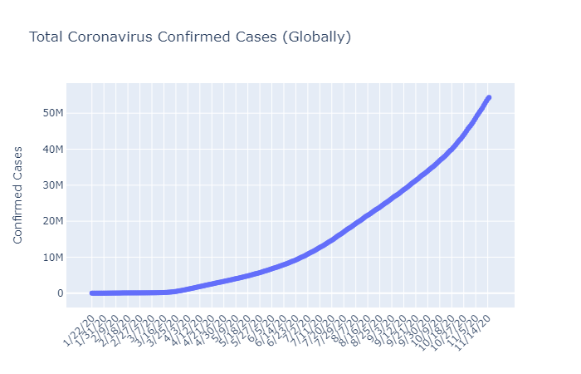
Confirmed cases globally
16 Nov,55.014M

Slide 7
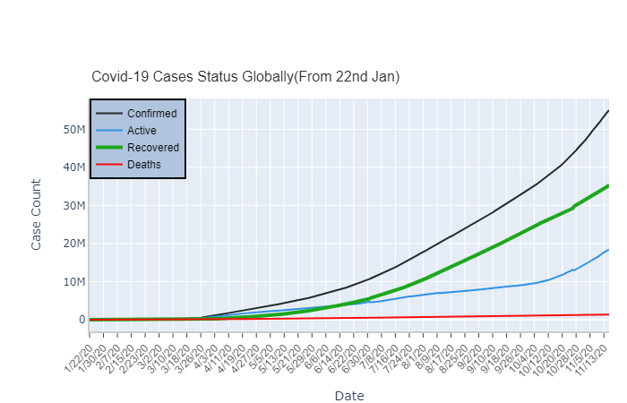
Case Trends Globally

Slide 8
Ranking of Countries
Highest Confirmed cases:
US, India, Brazil
Highest Deaths cases:
US, Brazil, India
Highest Recovered cases:
India, Brazil, US
Highest Active cases:
US, France, UK

Slide 9
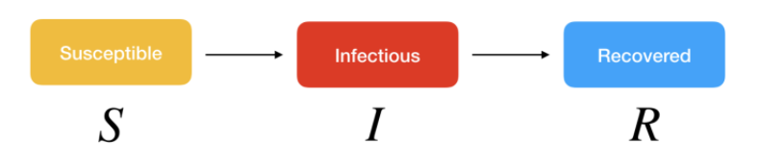
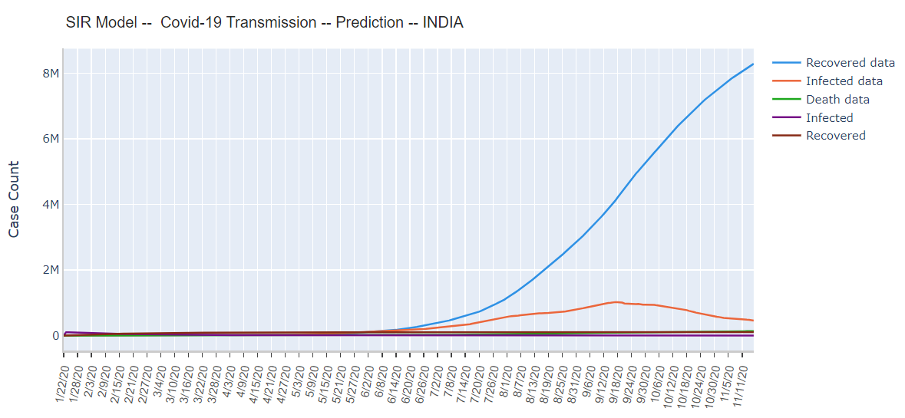

Models
SIR Model

Slide 10
ARIMA Model
Rolling forecast ARIMA model
->Recreated the ARIMA model for each new observation and the received observation is again fed into the model to do the next forecast.
How we trained and tested?

Slide 11
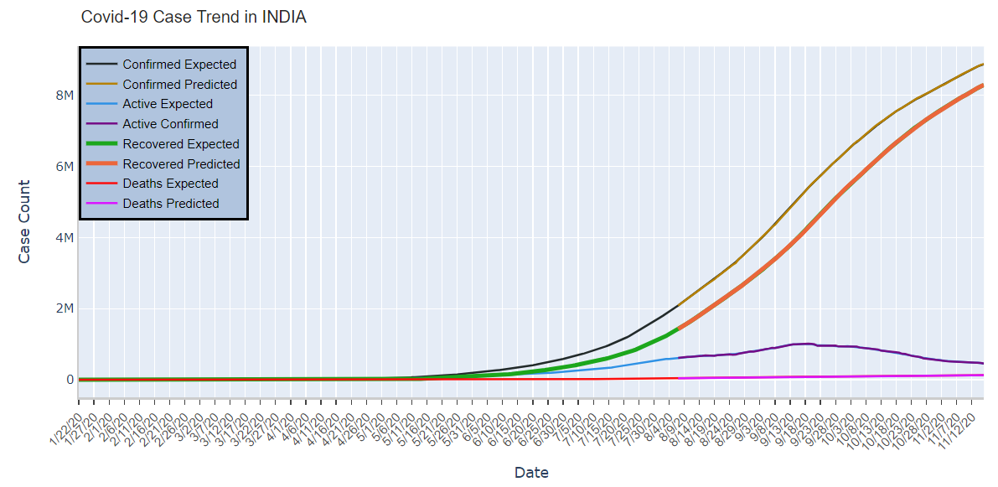
Training and Testing

Slide 12
Testing: Error
We got the following value of root mean square error for our four datasets:
Dataset | RMSE
Confirmed Cases | 6283.996
Recovered Cases | 5313.729
Active Cases | 7374.860
Deaths | 104.470

Slide 13
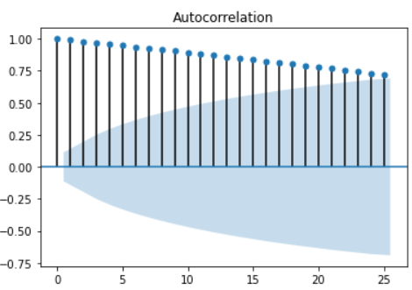
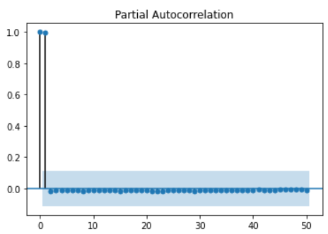
ARIMA Model

Slide 14
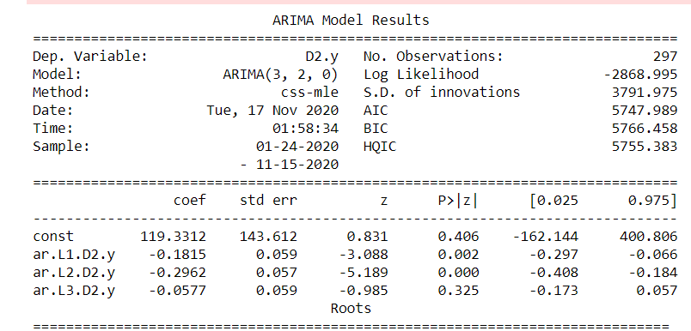
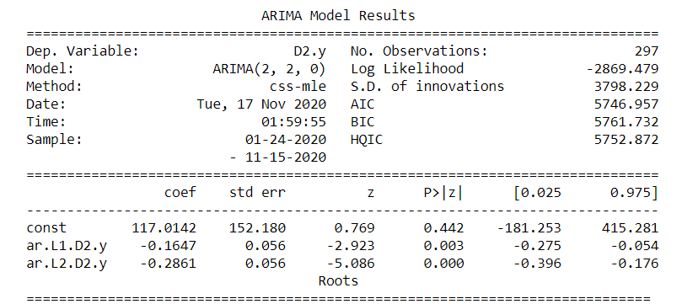
ARIMA Model

Slide 15
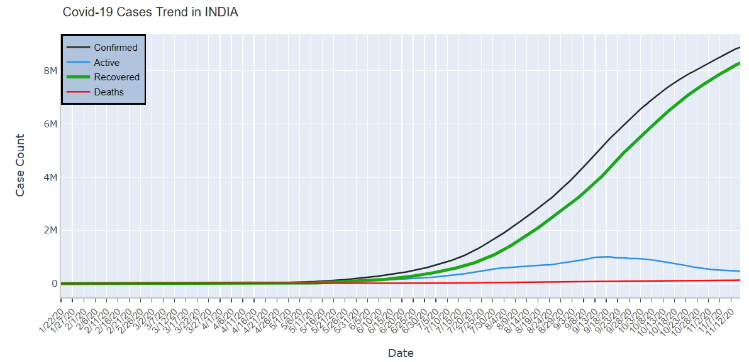
Data visualisations
16 Nov,8.87M
16Nov, 8.289M
16Nov,
465.478K
16Nov,
130.503K

Slide 16
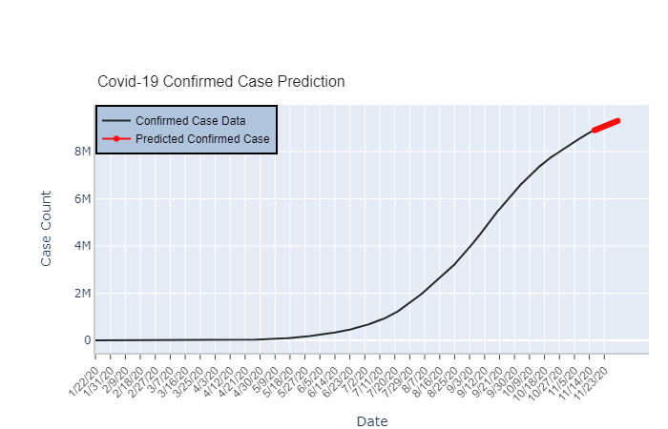
Predicted confirmed cases for next 15 days.
1 Dec,9.30M

Slide 17
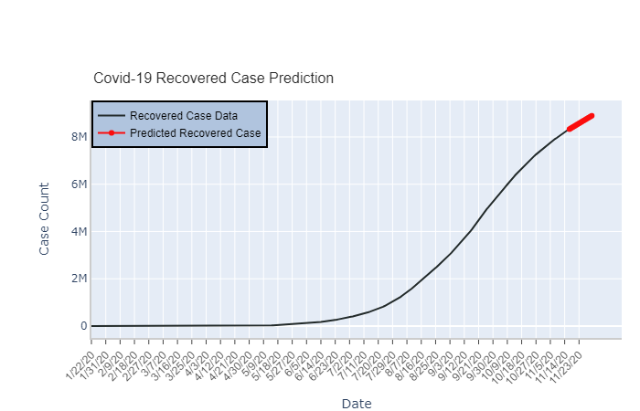
Predicted Recovered cases for next 15 days.
1 Dec ,8.896M

Slide 18
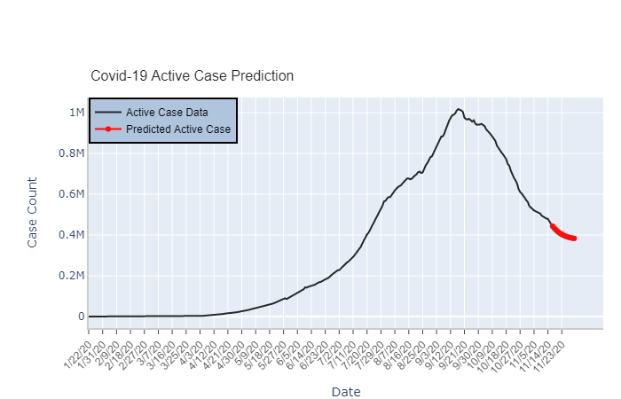
Predicted Active cases for next 15 days.
17 Sep,
1.0177M,
1 Dec
383.2499K,

Slide 19
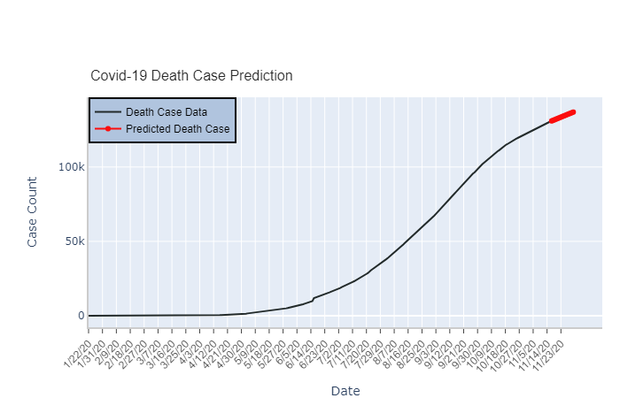
Predicted death cases for next 15 days.
1 Dec,
136.8904K

Slide 20
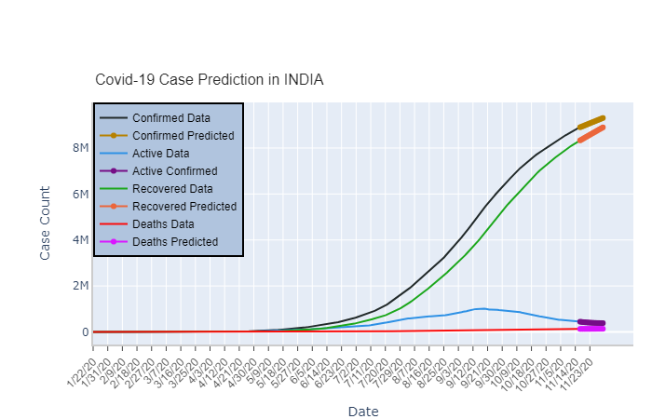

Slide 21
As people are going through a very challenging global health crisis, data analysis and visualisation helps us to understand what is happening and how to deal with the situation and how to take smart decisions to handle the situation. By doing this project we learnt how to use data science to predict future circumstances based on the current scenarios and datas.

Slide 22
THANK YOU!
THANK YOU!

