Slide 1

Domain: Food & Beverages
Project : Wine Quality data
--Prashant Mahamuni

Slide 2
Wine Quality Analysis
Data preparation: dividing quality score into 3 different categories, etc.
Univariate Analysis
Bivariate Analysis and Create visualisations to depict how residual sugar, density and alcohol affect the quality of the wine.
Other variable observations.
Faulty Wines: Characteristics that can influence wine quality negatively.

Slide 3
Data Preparation
Input Variables
1 - fixed acidity
2 - volatile acidity
3 - citric acid
4 - residual sugar
5 - chlorides
6 - free sulfur dioxide
7 - total sulfur dioxide
8 - density
9 - pH
10 - sulphates
11 - alcohol
12 - quality (score between 0 and 10)
Output Variables
1 – Quality Classification
(Poor Average Excellent)

Slide 4
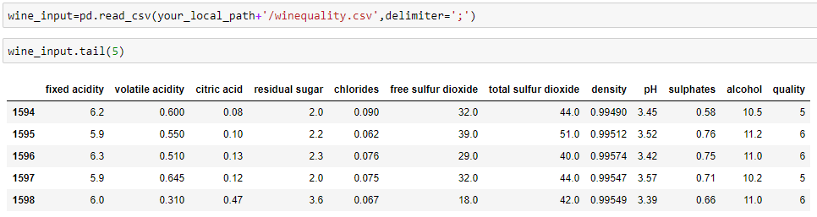
Data Preparation
Reading delimited file and storing in dataFrame

Slide 5

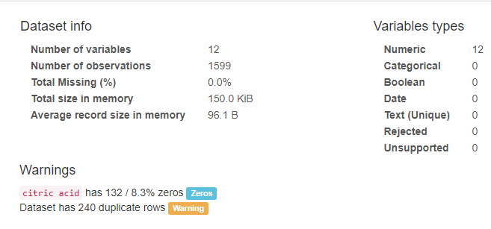
Data Preparation
Profiling input
Data Profiling report generated using pandas data profiling lib

Slide 6
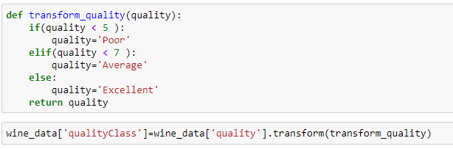
Data Preparation
Data Cleansing – Removing Outliers
Removing duplicates
Generating Quality Classification

Slide 7
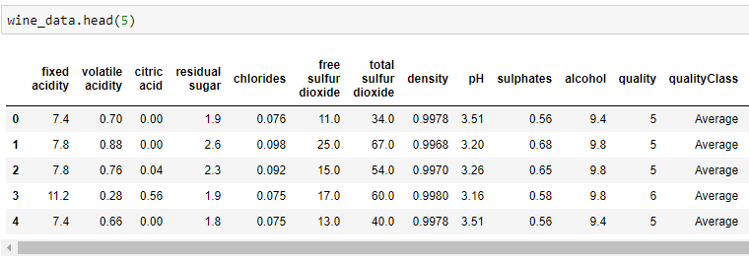
Data Preparation

Slide 8
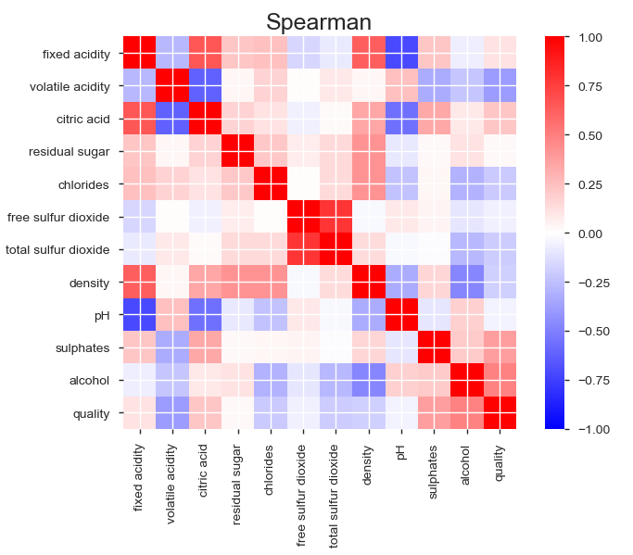
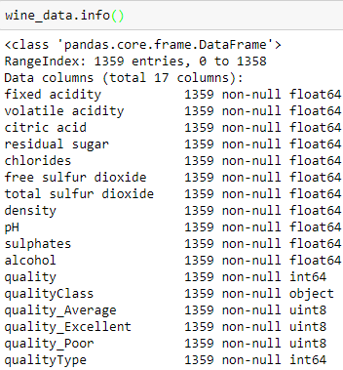
Data Description

Slide 9
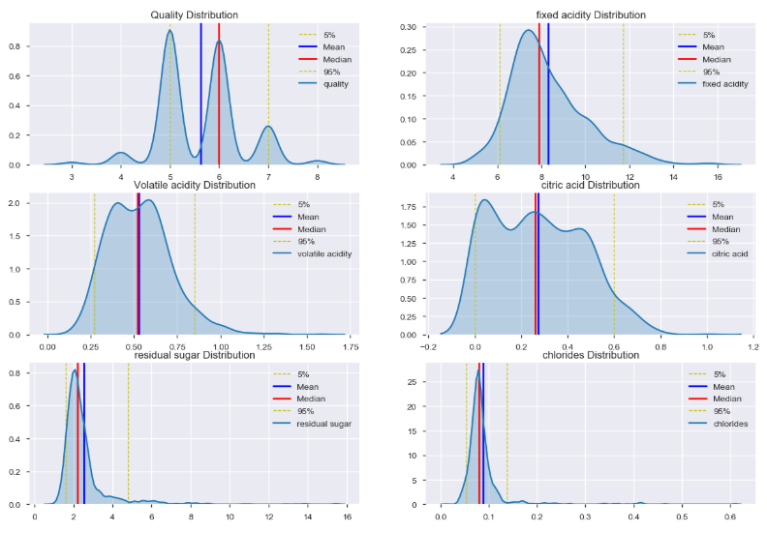
Univariate Analysis

Slide 10
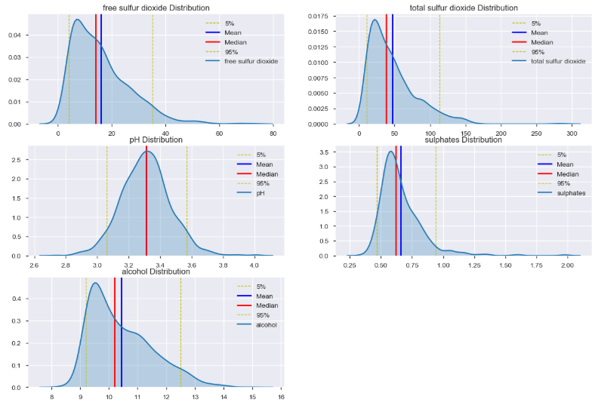
Univariate Analysis

Slide 11
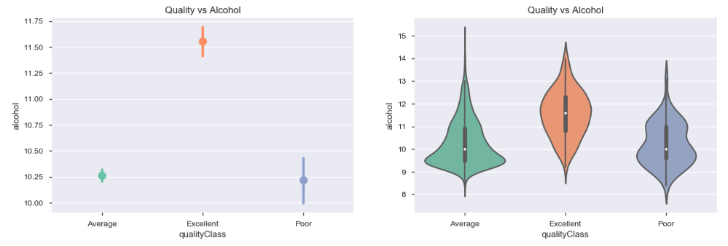
Bivariate Analysis
How alcohol affect the quality of the wine.
Conclusion.
Wine quality and Alcohol has positive Correlation.

Slide 12
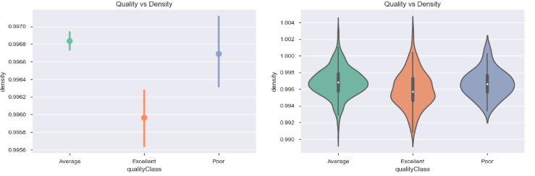
Bivariate Analysis
How density affect the quality of the wine.
Conclusion.
Wine quality and Density has negative Correlation.

Slide 13
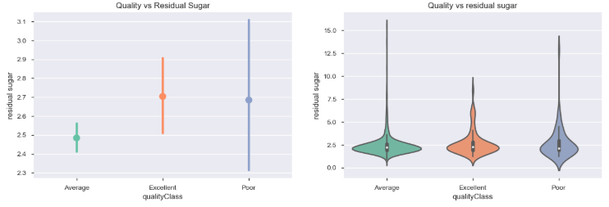
Bivariate Analysis
How residual Sugar affect the quality of the wine.
Conclusion.
Median values for all quality wines are almost same. While poor and average quality wines are having more outliers towards max value of residual sugar. We can conclude that for excellent quality of wine.. residual sugar should be in range of 1 to 4.

Slide 14
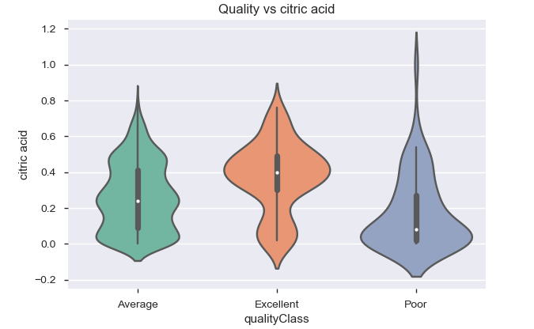
Bivariate Analysis
How Citric acid affects the quality of the wine.
Conclusion.
Wine Quality and Citric acid level is in positive correlation.

Slide 15
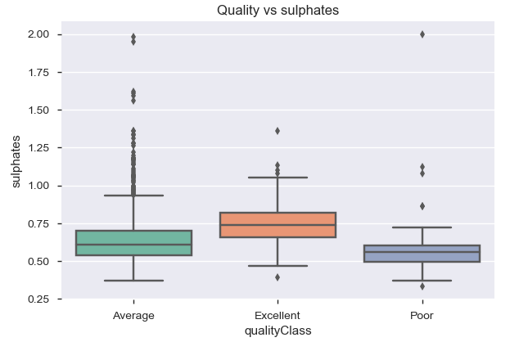
Bivariate Analysis
How Sulphtes affect the quality of the wine.
Conclusion.
Wine Quality and sulphates is in positive correlation.

Slide 16
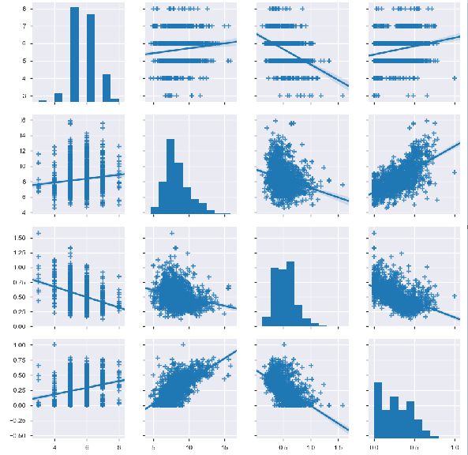
Bivariate Analysis
Quality Fixed Acidity Volatile Acidity Citric Acid
Quality Fixed Acidity Volatile Acidity Citric Acid

Slide 17
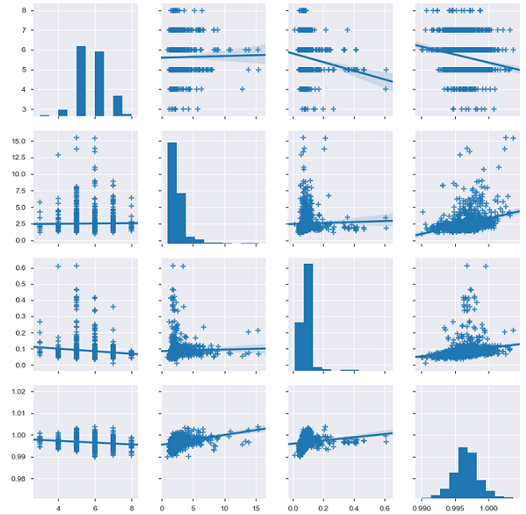
Bivariate Analysis
Quality residual sugar chlorides density
Quality residual sugar chlorides density

Slide 18
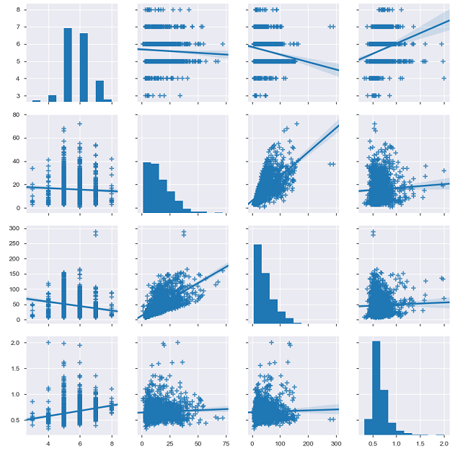
Bivariate Analysis
Quality free sulfur dioxide total sulfur dioxide sulphates
Quality free sulfur dioxide total sulfur dioxide sulphates

Slide 19
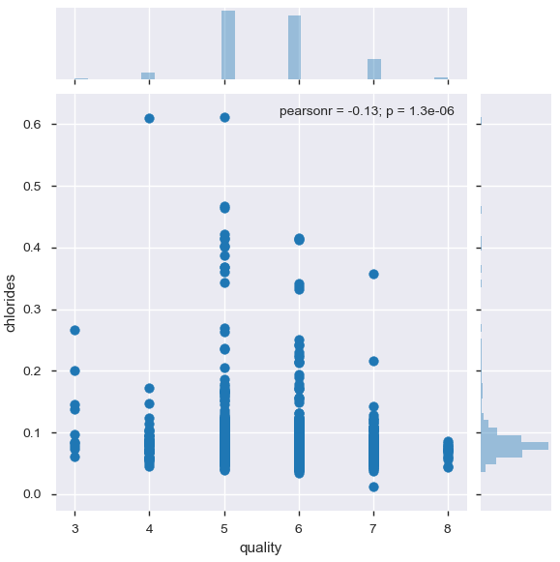
Faulty Wine Analysis
How chloride content affect the quality of the wine.
Conclusion.
Chlorides content affects wine quality Negatively.

Slide 20
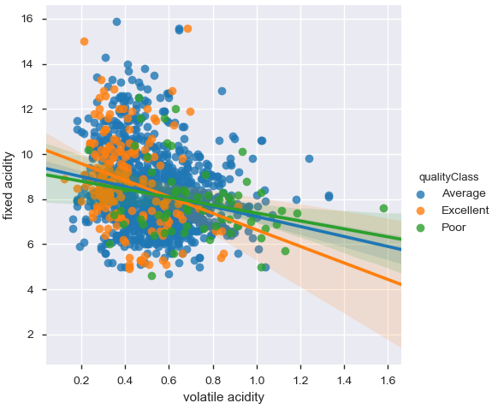
Faulty Wine Analysis
Is there any relationship between fixed acidity and volatile acidity
And how acidity attributes affects the quality of the wine.
Conclusion.
Volatile acidity affects wine quality Negatively in opposite of fixed acidity.
While increase in Fixed Acidity lowers volatile acidity(Negative correlation).

Slide 21
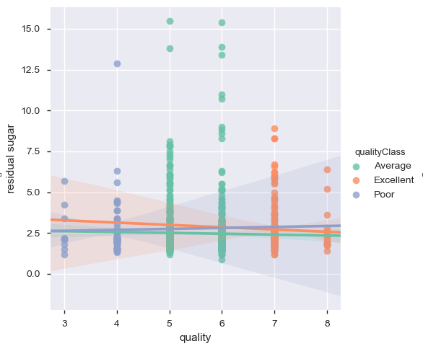
Faulty Wine Analysis
How residual sugar affects the quality of the wine.
Conclusion.
There is not much correlation between residual sugar and wine quality but..
Residual sugar is slightly affecting Excellent wine quality negatively.

Slide 22
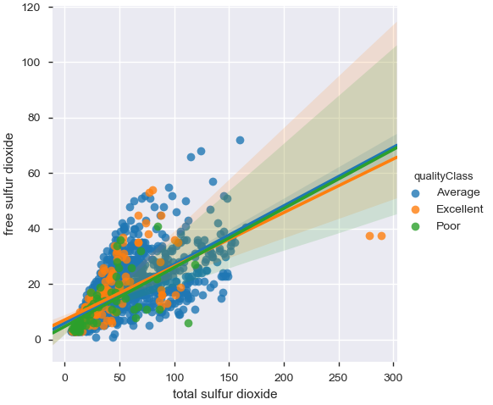
Faulty Wine Analysis
Is there any relationship between Free Sulphur dioxide and Total sulphur dioxide
And how these attributes affects the quality of the wine.
Conclusion.
Free sulphur dioxide and Total sulphur dioxide affects wine quality negatively.
While Free Sulphur Dioxide and Total Sulphur dioxide are in positive correlation

Slide 23
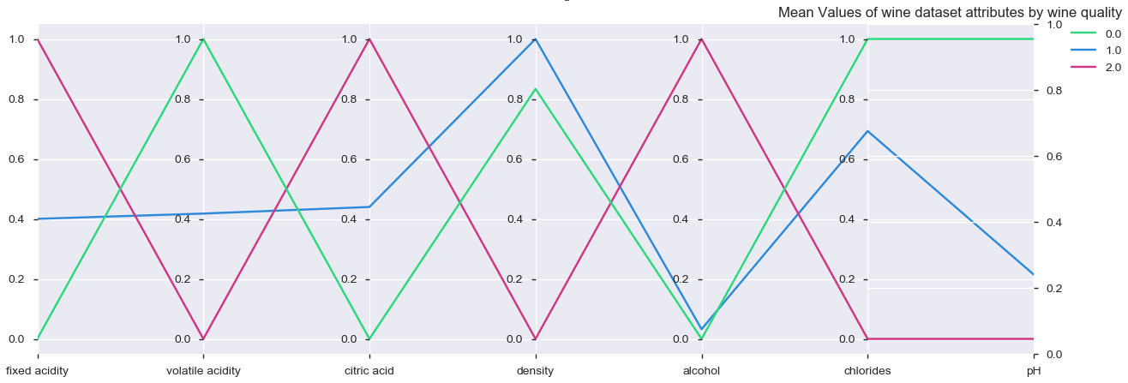
Miscellaneous Wine Quality Analysis
Conclusion.
Free Total sulphur dioxide and Total sulphur dioxide affects wine quality negatively.

Slide 24

Cheers!!!

