Slide 1
Global E-Commerce Market Analysis 2025
Strategic Insights and Future Outlook
Market Research Team
Notes:
This presentation outlines the global e-commerce landscape for 2025. We will explore regional performance, emerging technologies, and strategic recommendations.

Slide 2
Agenda
1
Executive Overview
2
Regional Revenue Breakdown
3
Top Growth Categories
4
Emerging Technologies
5
Payment Innovation
6
Logistics and Challenges
7
Strategic Recommendations
Notes:
We will cover seven key areas including regional data and technology trends. The session concludes with actionable strategic recommendations.

Slide 3
Executive Summary
▸ Asia Pacific leads with 49.2% market share
▸ Top two regions control 68% of total
▸ Middle East & Africa shows highest growth
Key Metric: $6.3T
Notes:
The global market reached $6.3 trillion in 2025. Asia Pacific dominates the landscape while emerging regions show rapid expansion.

Slide 4
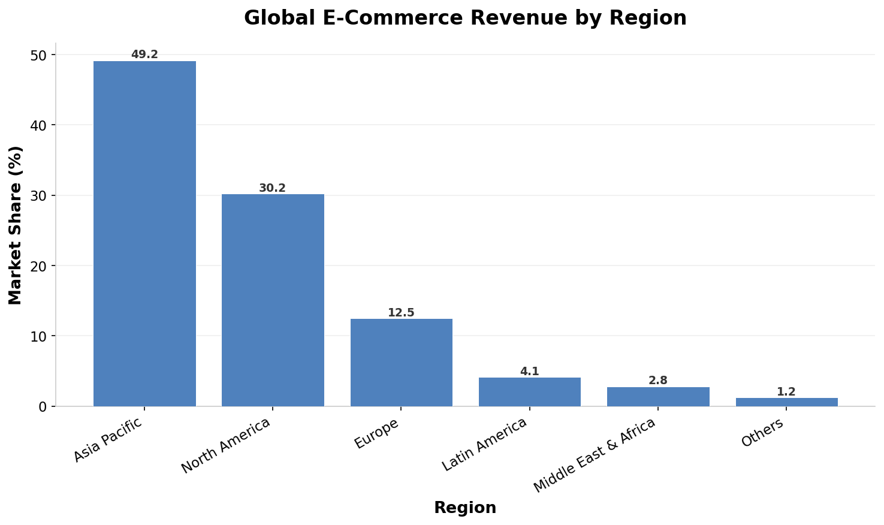
Regional Revenue Breakdown
Notes:
Asia Pacific holds nearly half the global market share. North America follows with a significant 30.2% portion.

Slide 5
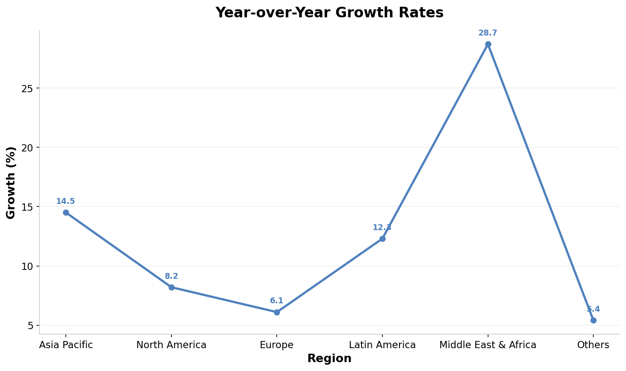
YoY Growth Trends
Notes:
Middle East and Africa leads growth at 28.7% annually. Asia Pacific maintains steady double-digit expansion.

Slide 6
Top Growth Categories
• Electronics and Smart Devices
• Sustainable Fashion and Apparel
• Health and Wellness Products
• Home Improvement and Decor
• Pet Care and Supplies
Notes:
These five categories drive the majority of new sales volume. Sustainability and health remain primary consumer priorities.

Slide 7
AI-Powered Personalization
• Real-time product recommendations
• Dynamic pricing optimization
• Predictive inventory management
• Chatbot customer support
Notes:
AI drives hyper-personalization across the customer journey. This technology significantly boosts conversion rates and retention.

Slide 8
Social Commerce Trends
• In-app checkout integration
• Influencer-driven product discovery
• Live streaming shopping events
• User-generated content marketing
Notes:
Social platforms are becoming primary sales channels. Live streaming and influencers drive immediate purchase decisions.

Slide 9
Augmented Reality Shopping
• Virtual try-on for fashion
• 3D furniture placement tools
• Interactive product demonstrations
• Enhanced mobile shopping apps
Notes:
AR reduces return rates by improving product visualization. Customers can virtually test products before buying.

Slide 10
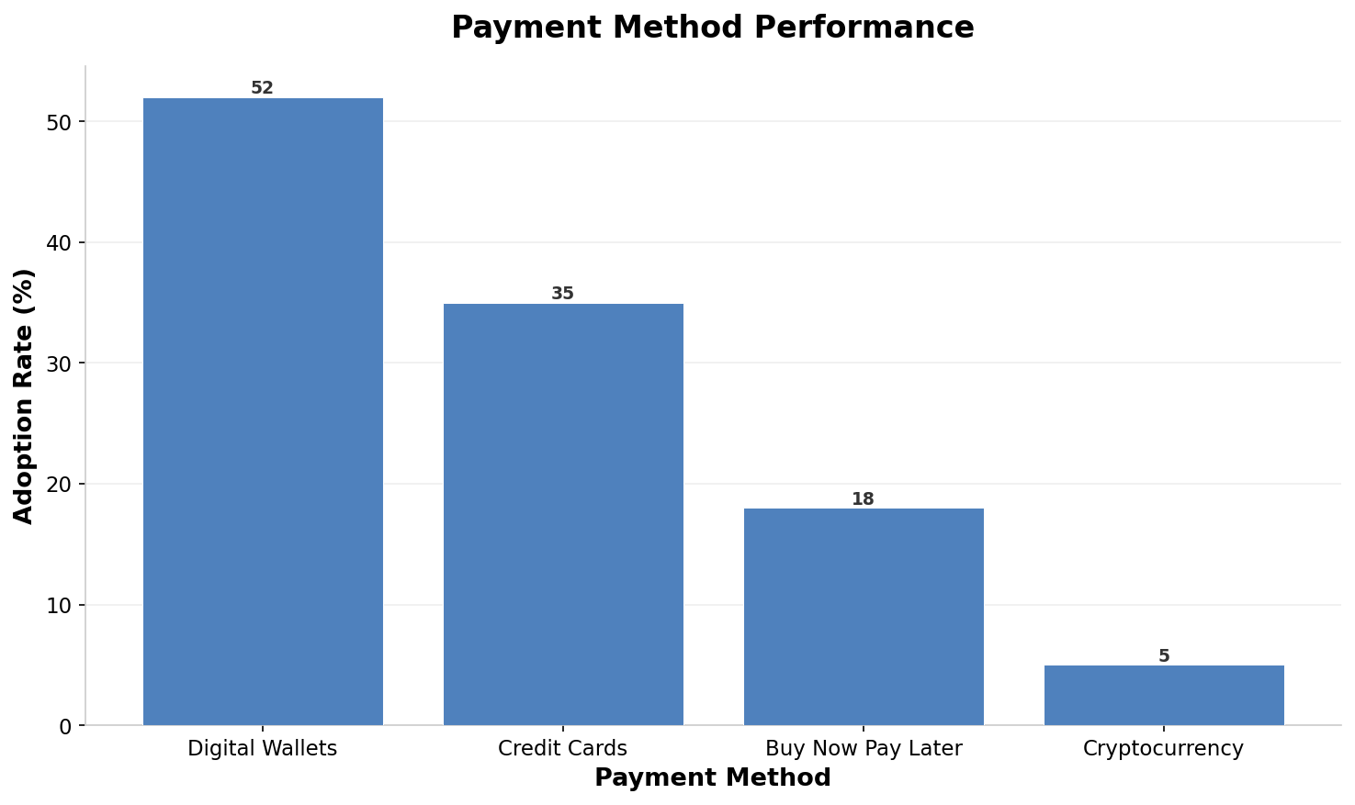
Payment Innovation Metrics
Notes:
Digital wallets lead adoption at 52% globally. Cryptocurrency shows high average order value despite low adoption.

Slide 11
Logistics and Challenges
• Same-day delivery expansion
• Last-mile optimization strategies
• Supply chain disruption risks
• Cybersecurity and data privacy
Notes:
Logistics focus shifts to speed and reliability. Security risks remain a critical challenge for growth.

Slide 12
Key Takeaways
🌏
Asia Pacific leads with 49.2% share
💳
Digital Wallets lead adoption at 52%
📊
Top two regions control 68% total
🚀
Middle East & Africa growth at 28.7%
💰
Crypto leads Avg Order Value at $285
Notes:
Focus on Asia Pacific and emerging markets for growth. Prioritize digital payments and secure logistics infrastructure.

