Slide 1
Q3 2025 Performance Report
Strategic Review & Outlook
Executive Team
Notes:
This presentation outlines our Q3 2025 performance across revenue, product, and market position. We will review key metrics and strategic priorities for the upcoming quarter.

Slide 2
Agenda
1
Revenue Overview
2
Key Metrics
3
Product Development
4
Market Position
5
Financial Outlook
6
Strategic Priorities
Notes:
We will cover revenue, key metrics, and product updates before analyzing market position. The session concludes with financial outlook and Q4 strategic priorities.

Slide 3
Executive Summary
▸ CompetitorA leads market share at 32%
▸ Net Revenue Retention outperforms churn by 98.3x
▸ EZ-Deck leads growth rate at 23%
Key Metric: $4.2M
Notes:
Q3 revenue reached $4.2M with strong retention metrics. While CompetitorA holds the largest share, our growth rate and NPS remain superior.

Slide 4
Revenue Overview
• Record quarterly revenue growth achieved
• Enterprise segment expansion continues
• New customer acquisition costs lowered
Notes:
Revenue growth was driven by enterprise expansion and optimized acquisition costs. These factors contributed to our record-breaking Q3 performance.

Slide 5
Key Metrics
• Net Revenue Retention at 118%
• Monthly churn rate remains low
• Customer lifetime value increased
• Active user engagement up
Notes:
Our Net Revenue Retention of 118% significantly outperforms the monthly churn rate. Engagement and lifetime value metrics also show positive trends.

Slide 6
Product Development
• Platform 3.0 launch completed successfully
• AI features beta testing initiated
• User feedback integration ongoing
• Scalability improvements deployed
Notes:
Platform 3.0 launched successfully with immediate scalability improvements. We have also initiated beta testing for new AI features.

Slide 7
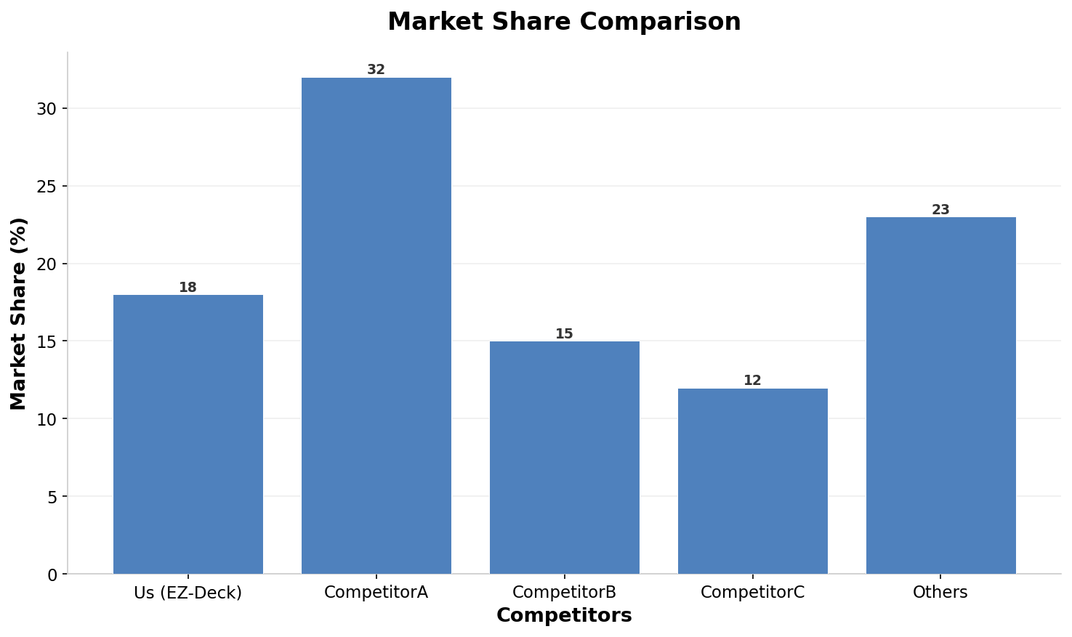
Market Position
Notes:
CompetitorA leads the market with 32% share, while we hold 18%. This chart visualizes the competitive landscape across all major players.

Slide 8
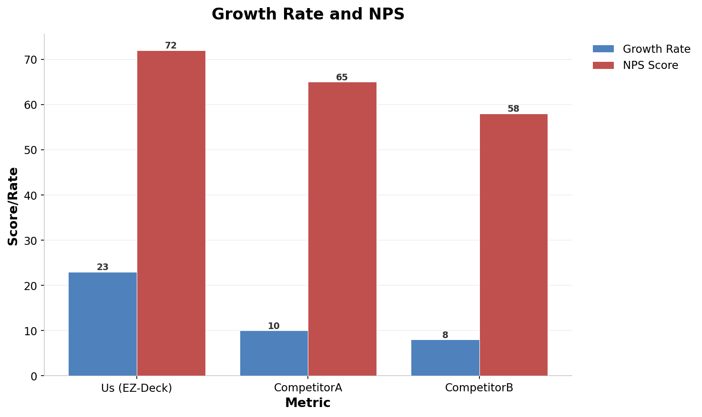
Growth & NPS Scores
Notes:
We lead in both growth rate at 23% and NPS score at 72. CompetitorA trails us significantly in customer satisfaction metrics.

Slide 9
Financial Outlook
• Projected revenue increase of 15%
• Operating expenses optimized for scale
• Cash flow remains positive
Notes:
Financial projections for Q4 indicate a 15% revenue increase. We are optimizing expenses to support this growth while maintaining positive cash flow.

Slide 10
Team Growth
• Engineering headcount expanded by 20%
• Sales team onboarding completed
• Retention programs showing results
• Diversity initiatives progressing
Notes:
We expanded engineering headcount by 20% and completed sales onboarding. Retention programs are yielding positive results across departments.

Slide 11
Strategic Priorities & Risks
• Accelerate AI feature rollout
• Expand enterprise sales channels
• Mitigate talent retention risks
• Enhance platform security protocols
Notes:
Q4 priorities include accelerating AI rollout and expanding enterprise channels. We are also addressing talent retention and security risks proactively.

Slide 12
Key Takeaways
📈
CompetitorA leads market share at 32%
🚀
Net Revenue Retention leads at 118%
🏆
EZ-Deck leads growth rate at 23%
⭐
EZ-Deck leads NPS score at 72
⚡
Retention outperforms churn by 98.3x
Notes:
Key takeaways highlight our superior growth and retention metrics despite CompetitorA's market share lead. We are well-positioned for Q4 success.

