Slide 1
Global E-Commerce Market Analysis 2025
Strategic Insights and Future Trends
Notes:
This presentation outlines the current state and future trajectory of the global e-commerce market. We will explore regional performance, emerging technologies, and strategic recommendations.

Slide 2
Agenda
1
Executive Overview
2
Regional Revenue Breakdown
3
Top Growth Categories
4
Emerging Technologies
5
Payment Innovation
6
Logistics and Challenges
7
Strategic Recommendations
Notes:
We will cover seven key areas, starting with an executive summary and moving through regional data and technology trends. The session concludes with actionable strategic recommendations.

Slide 3
Executive Summary
▸ Asia Pacific dominates with 49.2% market share
▸ Top two regions control 68% of total revenue
▸ Middle East & Africa shows highest growth potential
Key Metric: $6.3T
Notes:
The global e-commerce market reached $6.3 trillion in 2025, driven by Asia Pacific's dominance. High growth in emerging markets and digital adoption are key themes.

Slide 4
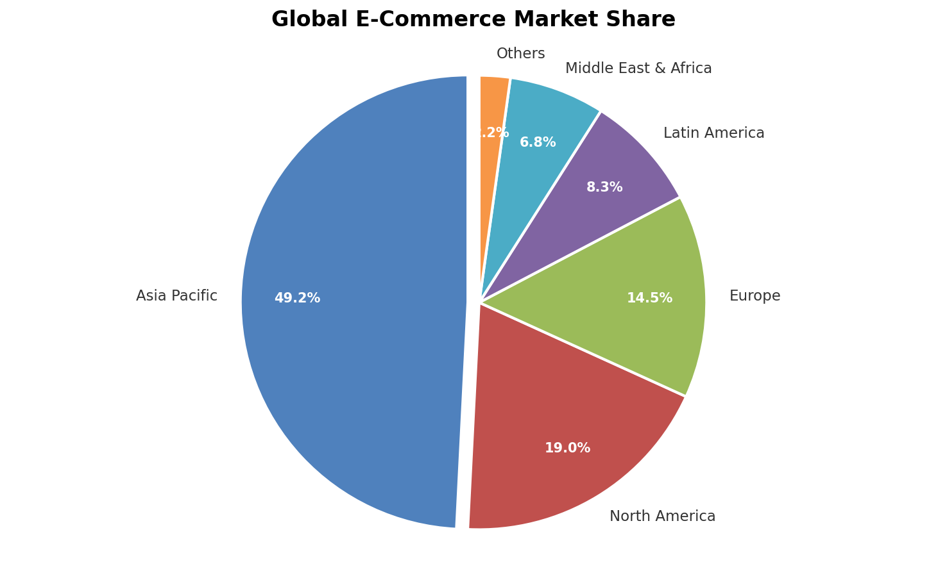
Global Market Share by Region
Notes:
Asia Pacific holds nearly half the global market share, significantly outpacing North America and Europe. This concentration highlights the region's massive consumer base.

Slide 5
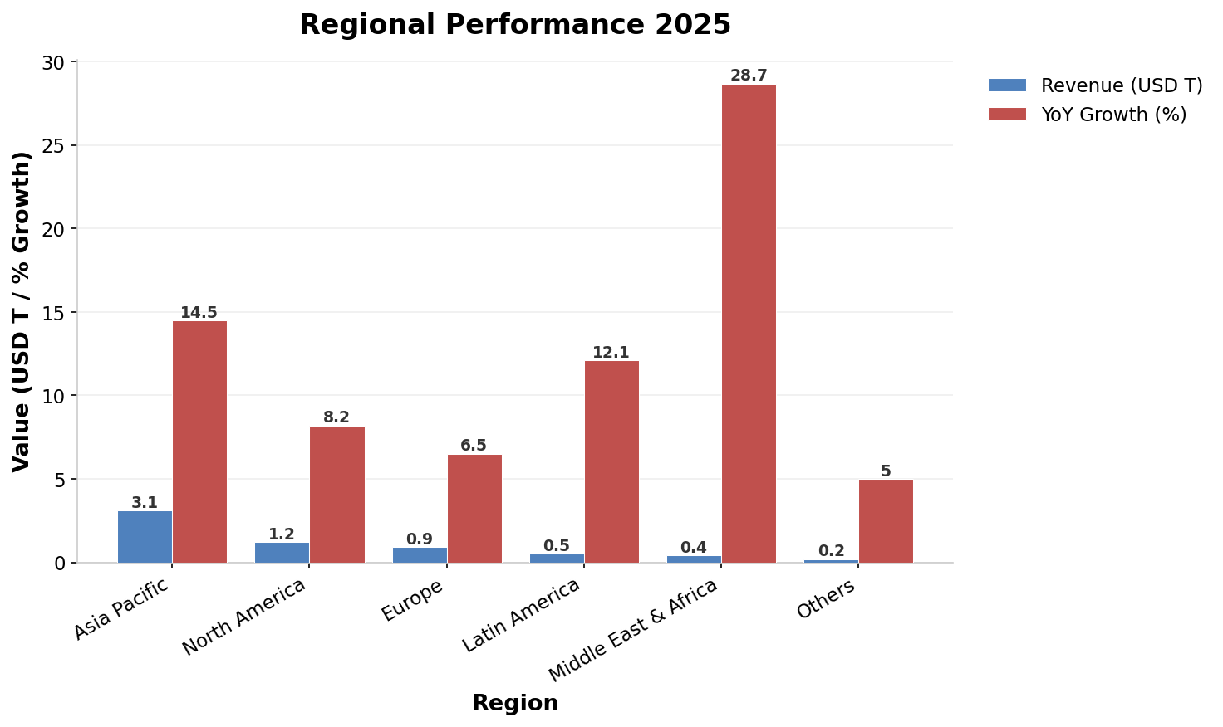
Regional Revenue and Growth
Notes:
While Asia Pacific leads in revenue, the Middle East and Africa show the highest year-over-year growth at 28.7%. North America remains a stable, high-revenue contributor.

Slide 6
Top Growth Categories
• Electronics and Consumer Tech
• Fashion and Apparel
• Health and Wellness Products
• Home and Garden Supplies
• Sustainable and Eco-Friendly Goods
Notes:
These five categories are driving significant volume growth across all major regions. Sustainability is emerging as a key differentiator for consumers.

Slide 7
Emerging Technologies
AI-Powered Personalization
Social Commerce
• Hyper-personalized product recommendations
• Dynamic pricing strategies
• Predictive inventory management
• Enhanced customer support chatbots
• In-app purchasing features
• Influencer-driven sales channels
• Live streaming shopping events
• Community-based buying groups
Notes:
AI is transforming personalization, while social platforms are becoming direct sales channels. Both technologies are essential for modern engagement strategies.

Slide 8
Augmented Reality Shopping
• Virtual try-on for fashion and beauty
• 3D furniture visualization in homes
• Interactive product demonstrations
• Reduced return rates through visualization
Notes:
AR technology allows customers to visualize products before buying, significantly reducing return rates. This is particularly impactful in fashion and home decor.

Slide 9
Payment Innovation Metrics
Method | Adoption Rate | Transaction Volume | Avg. Order Value
Digital Wallets | 52% | $2.8T | $67
Credit/Debit Cards | 35% | $2.1T | $85
Buy Now Pay Later | 18% | $1.1T | $120
Cryptocurrency | 5% | $0.3T | $285
Notes:
Digital wallets lead in adoption and volume, while cryptocurrency commands the highest average order value. Diverse payment options are crucial for global reach.

Slide 10
Logistics and Fulfillment
1
2
3
4
Real-time Inventory Tracking
AI-driven stock management
Automated Warehousing
Robotics and sorting systems
Last-Mile Optimization
Drone and autonomous delivery
Sustainable Packaging
Eco-friendly materials and reuse
Notes:
Modern logistics rely on automation and real-time data to speed up delivery. Sustainability is now integrated into the final packaging stage.

Slide 11
Challenges vs Opportunities
Key Challenges
VS
Strategic Opportunities
High fraud exposure
Cybersecurity Risks
Advanced AI detection
Complex global laws
Regulatory Compliance
Standardized frameworks
Rising fuel prices
Logistics Costs
Automated efficiency
Intense competition
Market Saturation
Niche market expansion
Notes:
While challenges like cybersecurity and regulation persist, technology offers robust solutions. Companies can turn these hurdles into competitive advantages.

Slide 12
Key Takeaways
🌏
Asia Pacific leads with 49.2% market share
💳
Digital Wallets dominate at 52% adoption
📊
Top two regions control 68% of total
🚀
Middle East & Africa leads growth at 28.7%
💎
Crypto leads Avg Order Value at $285
Notes:
Focus on Asia Pacific and emerging markets for growth. Prioritize digital wallet integration and leverage high-value crypto transactions.

