Slide 1
Team Offsite 2024
Driving Innovation and Collaboration
Leadership Team
Notes:
Welcome everyone to our annual team offsite. This session is designed to align our strategic goals and foster deeper collaboration across all departments.

Slide 2
Agenda
1
Purpose & Objectives
2
Product Roadmap Review
3
Engineering Excellence
4
Customer Insights
5
Logistics & Next Steps
Notes:
We will cover five key areas today, starting with our core purpose and ending with actionable logistics. Please keep your questions for the end of each section.

Slide 3
Executive Summary
▸ Align on Q3-Q4 strategic priorities
▸ Review engineering performance metrics
▸ Deep dive into customer feedback loops
Key Metric: 100% Team Participation
Notes:
This summary outlines our primary goals: strategic alignment, technical review, and customer focus. We aim for full participation to ensure every voice is heard.

Slide 4
Strategic Planning
Product & Engineering Focus
Notes:
We are now moving into the core strategic planning section. This part of the day focuses on our product future and engineering standards.

Slide 5
Product Roadmap
Feature Launch Alpha
Release core functionality to beta users
Full Product Launch
Global release and marketing campaign
Q3
Q3
Q4
Market Research
Gather feedback from early adopters
Notes:
Our roadmap targets a Q3 beta launch followed by a full global release in Q4. These milestones are critical for meeting our annual revenue targets.

Slide 6
Engineering Excellence
98.5%
15%
2.5s
Uptime
Bug Reduction
Load Time
Exceeds industry standard
Year-over-year improvement
Optimized for mobile users
Notes:
Our engineering team has achieved a 98.5% uptime and reduced bugs by 15%. These metrics demonstrate our commitment to high-quality, reliable software.

Slide 7
Customer Focus
Insights & Feedback Analysis
Notes:
Next, we shift our focus to the customer. Understanding their needs is essential for our product roadmap and engineering priorities.

Slide 8
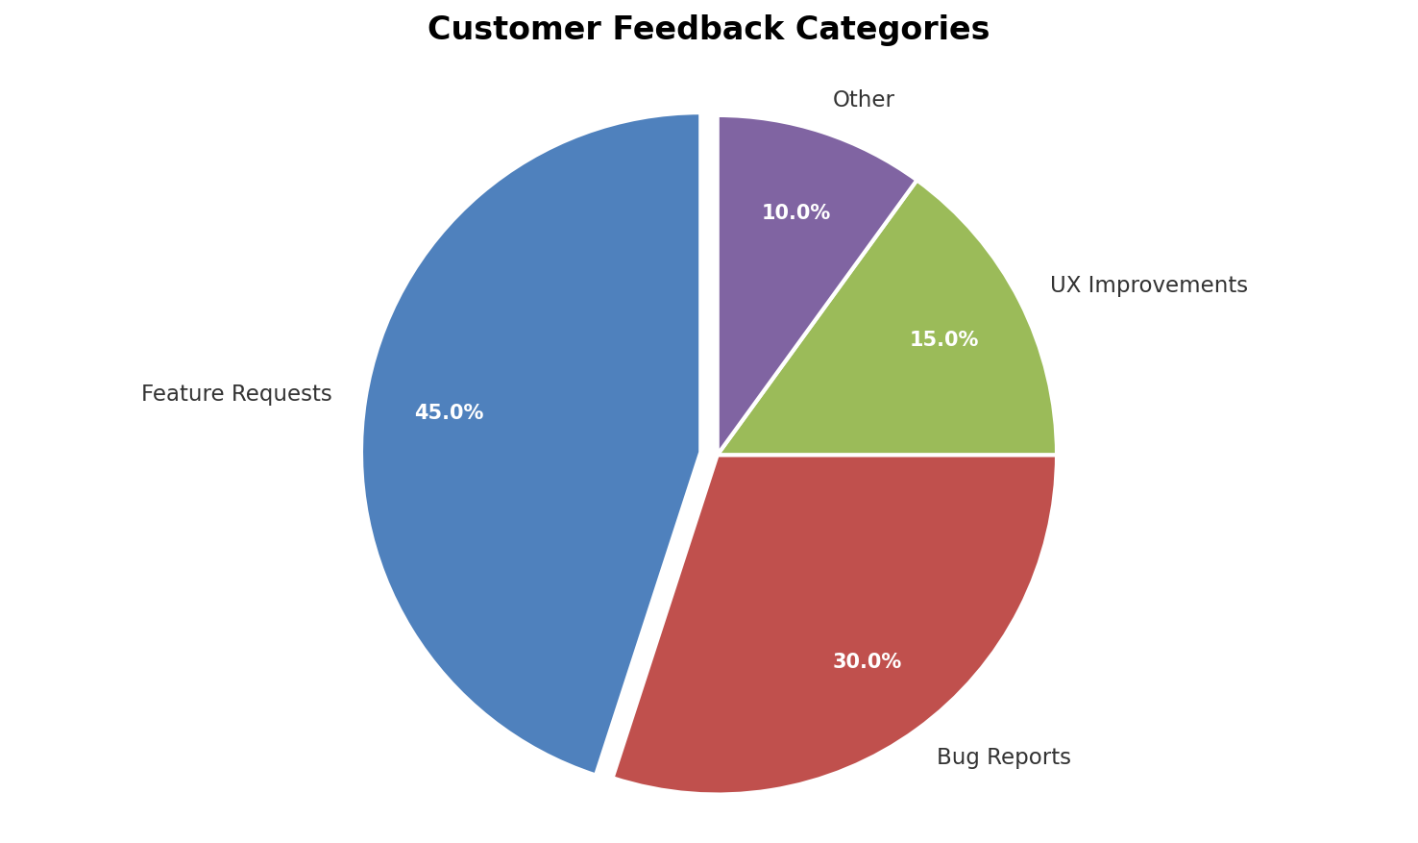
Customer Feedback Distribution
Notes:
Feature requests make up the largest portion of our feedback at 45%. This indicates strong demand for new capabilities in our current product suite.

Slide 9
Logistics Overview
Venue Information
Accommodation
• Main Hall: 200 Capacity
• Breakout Rooms: 4 Available
• AV Equipment Included
• Hotel: Downtown Plaza
• Check-in: 3:00 PM
• Check-out: 11:00 AM
Notes:
The main hall accommodates 200 people with four breakout rooms available for smaller sessions. Accommodation is arranged at the Downtown Plaza hotel.

Slide 10
Expected Outcomes
1
2
3
4
Define Strategy
Finalize Q3-Q4 goals
Assign Owners
Allocate tasks to teams
Set Deadlines
Establish clear timelines
Review Progress
Schedule follow-up meetings
Notes:
By the end of this offsite, we will have defined strategies, assigned owners, and set clear deadlines. A follow-up review is scheduled to track progress.

Slide 11
Offsite Schedule Summary
Time | Activity | Location
09:00 | Opening Remarks | Main Hall
10:30 | Product Workshop | Room A
12:00 | Lunch Break | Cafeteria
14:00 | Engineering Review | Room B
Notes:
This table outlines the detailed schedule for the day, including breaks and specific room assignments. Please refer to this for timing and location details.

Slide 12
Key Takeaways
🎯
Aligned on Q3-Q4 strategic goals
🚀
Engineering metrics show strong performance
👥
Customer feedback drives future features
📅
Clear action items assigned to teams
Notes:
To conclude, we have aligned on our goals, reviewed strong engineering metrics, and prioritized customer feedback. Everyone now has clear action items to execute.

