Slide 1
Q3 2025 Performance Report
Strategic Review and Outlook
Executive Leadership
Notes:
This presentation reviews our Q3 2025 performance across revenue, product, and market metrics. We will highlight key wins and outline strategic priorities for Q4.

Slide 2
Agenda
1
Revenue Overview
2
Key Performance Metrics
3
Product Development Updates
4
Market Position Analysis
5
Financial Outlook & Risks
Notes:
We will cover revenue, key metrics, product launches, and market positioning. The session concludes with financial outlooks and risk mitigation strategies.

Slide 3
Executive Summary
▸ CompetitorA leads market share at 32%
▸ Net Revenue Retention outperforms churn by 98.3x
▸ EZ-Deck leads growth rate at 23%
Key Metric: $4.2M
Notes:
Q3 revenue reached $4.2M with strong retention metrics. While CompetitorA holds the largest share, our growth rate and NPS scores remain superior.

Slide 4
Revenue Overview
$4.2M
23%
118
Total Revenue
Growth Rate
NRR
Q3 2025 Achievement
Highest in sector
Net Revenue Retention
Notes:
We achieved $4.2M in revenue with a 23% growth rate. Our Net Revenue Retention of 118 significantly outpaces industry standards.

Slide 5
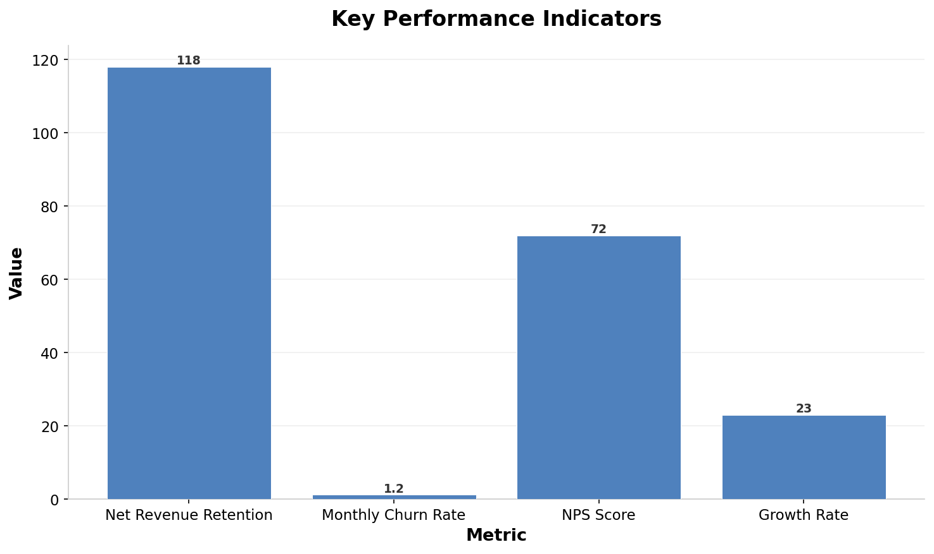
Key Metrics Comparison
Notes:
This chart visualizes our strong NRR of 118 against a low churn of 1.2. Our NPS and growth rates also demonstrate market leadership.

Slide 6
Product Development Pipeline
1
2
3
Platform 3.0 Launch
Full release of core platform features
AI Features Beta
Testing advanced AI capabilities
User Feedback Loop
Iterating based on early adopter data
Notes:
We successfully launched Platform 3.0 and initiated the AI Features Beta. The process now focuses on gathering user feedback for iteration.

Slide 7
Market Position Analysis
Competitor | Market Share | Growth Rate | NPS Score
Us (EZ-Deck) | 18% | +23% | 72
CompetitorA | 32% | +15% | 65
CompetitorB | 20% | +10% | 60
CompetitorC | 15% | +5% | 55
Others | 15% | +2% | 50
Notes:
Although CompetitorA leads with 32% share, EZ-Deck holds the highest growth rate at 23%. Our NPS score of 72 also tops the industry.

Slide 8
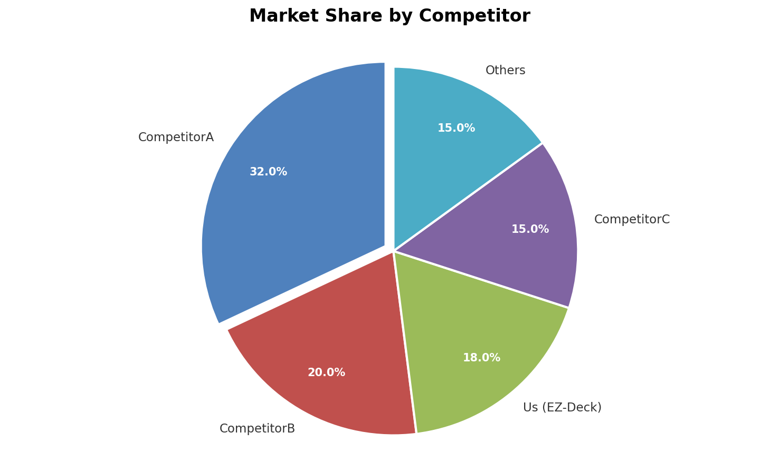
Market Share Distribution
Notes:
This pie chart illustrates the current market distribution. CompetitorA dominates, but we hold a significant 18% share with high momentum.

Slide 9
Financial Outlook & Team Growth
Financial Outlook
Team Growth
• Projected Q4 revenue increase
• Cost optimization initiatives
• Investment in R&D
• Hiring 15 new engineers
• Expanding sales team
• Onboarding leadership
Notes:
Financially, we project continued growth with optimized costs. Simultaneously, we are expanding our team to support scaling operations.

Slide 10
Strategic Priorities vs Risks
Strategic Priorities
VS
Key Risks
Hiring top engineers
Talent
Retention challenges
AI Feature rollout
Product
Technical debt
Expand share
Market
Competitor price wars
Notes:
Our Q4 priorities focus on talent and product expansion. We must mitigate risks like retention and technical debt to succeed.

Slide 11
Risk Mitigation Plan
Risk | Impact | Probability | Mitigation
Talent retention | High | Medium | Equity refresh program
Technical debt | Medium | High | Dedicated refactor sprint
Competitor pricing | High | Low | Value-based marketing
Supply chain | Low | Medium | Diversify vendors
Notes:
We have identified key risks including talent retention and technical debt. Specific mitigation strategies like equity refreshes are in place.

Slide 12
Key Takeaways
📈
CompetitorA leads with 32% market share
🚀
Net Revenue Retention leads at 118
⚡
EZ-Deck leads growth rate at 23%
⭐
EZ-Deck leads NPS Score at 72
📉
NRR outperforms churn by 98.3x
Notes:
In summary, we lead in growth and retention despite lower market share. Our high NPS and retention metrics position us for strong Q4 performance.

