Slide 1
Q4 2025 Financial Performance Report
Notes:
Welcome to the Q4 2025 Financial Performance Report. This presentation will cover our key financial results, strategic initiatives, and future outlook.

Slide 2
Agenda
1
Executive Summary
2
Revenue Breakdown by Segment
3
Regional Performance
4
Customer Acquisition
5
Platform Performance
6
Expense Analysis
7
Profitability Trends
8
AI Platform Launch
9
International Expansion
10
Product Innovation
11
2026 Guidance
12
Risk Factors
13
Conclusion
14
Key Takeaways
Notes:
This agenda outlines the key sections of our Q4 2025 financial performance report, including our strategic highlights and future outlook.

Slide 3
Executive Summary
$2.8 billion
KEY METRIC
Cloud Services leads with 39% share (58)
Top 2 (Cloud Services + Total) control 63% of total
Cloud Services leads Total by 71% (24 difference)
Middle East & Africa outperforms North America by 3.2x (89 vs 28)
Notes:
TechVista delivered exceptional results in Q4 2025, with revenue growing 34% YoY to $2.8 billion. Key highlights include strong enterprise adoption, international expansion, and improved profitability.

Slide 4
Revenue Breakdown by Segment
Segment | Q4 2025 | Q4 2024 | Growth
Cloud Services | $1,200M | $759M | +58%
Enterprise Software | $890M | $720M | +24%
Professional Services | $450M | $380M | +18%
Hardware | $260M | $230M | +13%
Total | $2,800M | $2,089M | +34%
Notes:
This table shows the revenue breakdown by segment for Q4 2025, highlighting the growth of each segment compared to the previous year.

Slide 5
Regional Performance
Region | Revenue | YoY Growth | Market Share
North America | $1,540M | +28% | 18.4%
Europe | $672M | +41% | 12.7%
Asia Pacific | $420M | +52% | 8.3%
Latin America | $112M | +67% | 6.1%
Middle East & Africa | $56M | +89% | 4.2%
Notes:
This table outlines the regional performance for Q4 2025, showing revenue, YoY growth, and market share across different regions.

Slide 6
Customer Acquisition
▸ New enterprise logos: 2,340 (Q4 2025)
▸ Customer acquisition cost: $12,400 (down 18%)
▸ Average contract value: $285,000 (up 22%)
▸ Net revenue retention: 124%
Notes:
Customer acquisition metrics show strong performance, with a 18% reduction in cost and a 22% increase in average contract value.

Slide 7
Platform Performance
▸ System uptime: 99.97%
▸ Average response time: 42ms
▸ Data processed: 15.8 petabytes/day
▸ API calls: 4.2 billion/day
Notes:
Platform performance metrics highlight our robust infrastructure, with high uptime, fast response times, and massive data processing capabilities.

Slide 8
Expense Analysis
Category | Amount | % of Revenue
Cost of Revenue | $980M | 35%
R&D | $560M | 20%
Sales & Marketing | $392M | 14%
General & Admin | $168M | 6%
Operating Expenses | $2,100M | 75%
Notes:
This table provides an overview of expense categories and their percentage of total revenue, showing the allocation of our operating expenses.

Slide 9
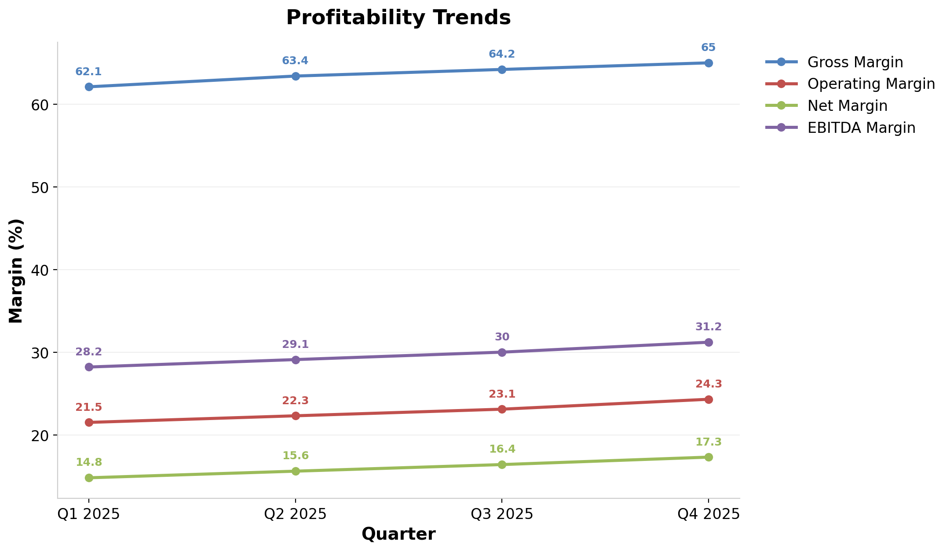
Profitability Trends
Notes:
This line chart shows the profitability trends across quarters, highlighting the improvement in gross, operating, net, and EBITDA margins.

Slide 10
AI Platform Launch
▸ Beta customers: 450 enterprises
▸ Revenue contribution: $45M (pilot phase)
▸ Customer satisfaction: 4.6/5.0
▸ Use cases deployed: 1,200+
Notes:
The AI platform launch has achieved significant milestones, with strong customer satisfaction and a growing number of use cases deployed.

Slide 11
International Expansion
▸ New offices opened: Tokyo, Singapore, Dubai, São Paulo
▸ International headcount: 2,800 employees (up 45%)
▸ Localized products: 12 languages supported
▸ Partner ecosystem: 340 certified partners
Notes:
International expansion has accelerated, with new offices opened and a significant increase in headcount and localized product offerings.

Slide 12
Product Innovation
▸ Launched TechVista Analytics Pro
▸ Released mobile SDK 3.0
▸ Introduced zero-trust security framework
▸ Deployed edge computing capabilities
Notes:
Product innovation has driven new features and capabilities, including the launch of Analytics Pro and the deployment of edge computing.

Slide 13
2026 Guidance
Metric | FY 2025 | FY 2026 Guidance | Growth
Revenue | $9.8B | $12.5B - $13.0B | 28-33%
Operating Income | $2.2B | $3.0B - $3.2B | 36-45%
EPS | $8.45 | $11.00 - $11.50 | 30-36%
Free Cash Flow | $2.1B | $2.8B - $3.0B | 33-43%
Notes:
This table outlines our 2026 guidance, showing projected revenue, operating income, EPS, and free cash flow growth.

Slide 14
Risk Factors
▸ Increased competition in cloud market
▸ Regulatory changes in international markets
▸ Currency fluctuation impact (5-7% revenue exposure)
▸ Talent acquisition in AI/ML domain
▸ Supply chain dependencies
Notes:
Key risks to monitor include increased competition, regulatory changes, currency fluctuations, talent acquisition challenges, and supply chain dependencies.

Slide 15
Key Takeaways
Record quarterly revenue of $2.8B
^
Cloud services driving 43% of total revenue
^
International expansion accelerating (40%+ growth)
+
Continued investment in AI capabilities
+
Strong guidance for FY 2026
^
Notes:
Key takeaways include record revenue, strong cloud growth, accelerated international expansion, continued AI investment, and positive guidance for FY 2026.

