Slide 1
NovaMind AI Platform: Product Launch Strategy
Notes:
Introduce the NovaMind AI Platform and its strategic importance for enterprise AI adoption.

Slide 2
Agenda
1
Vision Statement
2
Market Opportunity
3
System Components
4
Implementation Phases
5
Competitive Analysis
6
Pricing Model
7
Customer Outcomes
8
Platform Performance
9
Target Segments
10
Launch Activities
11
Infrastructure Requirements
12
Risk Mitigation
13
Conclusion
14
Key Takeaways
Notes:
Outline the agenda for the product launch strategy presentation.

Slide 3
Executive Summary
$5,000
KEY METRIC
Document Processing leads with 24% share (41.2)
Enterprise leads Professional by 300% (7.5K difference)
Top 2 (Enterprise + Professional) control 96% of total
System uptime leads in Platform Performance at 100.0
Notes:
Highlight key insights and metrics from the product launch strategy.

Slide 4
Market Opportunity
Segment | 2025 Size | 2028 Projected | CAGR
Conversational AI | $18.4B | $42.1B | 31.8%
Process Automation | $15.2B | $38.7B | 36.4%
Analytics & BI | $22.8B | $51.3B | 30.9%
Document Processing | $8.6B | $24.2B | 41.2%
Total Addressable | $65.0B | $156.3B | 34.1%
Notes:
Present the market opportunity for enterprise AI across key segments.

Slide 5
Pricing Model
Tier
Monthly Price
• Starter
• Professional
• Enterprise
• Custom
• $499
• $2,499
• $9,999
• Contact us
Notes:
Outline the pricing tiers and their respective monthly costs.

Slide 6
Customer Outcomes
Metric
Improvement
• Support ticket resolution
• Document processing time
• Customer satisfaction
• Employee productivity
• 95% faster
• 93% faster
• +21%
• 34% gain
Notes:
Showcase the measurable improvements achieved with NovaMind.

Slide 7
System Components
▸ NovaMind Core Engine
▸ NovaMind Connect
▸ NovaMind Analytics
▸ NovaMind Security
Notes:
Introduce the core components of the NovaMind AI Platform.

Slide 8
Implementation Phases
1
2
3
4
Foundation
Environment setup and configuration
Integration
Connect existing systems
Expansion
Department-wide rollout
Optimization
Fine-tune models with company data
Notes:
Outline the four-phase implementation process for NovaMind.

Slide 9
Competitive Analysis
NovaMind
VS
OpenAI Enterprise
40% lower
Inference costs
N/A
On-premise option
Deployment
Cloud-only
Industry-specific models
Models
General models
24/7 dedicated
Support
Standard
Notes:
Compare NovaMind with OpenAI Enterprise across key dimensions.

Slide 10
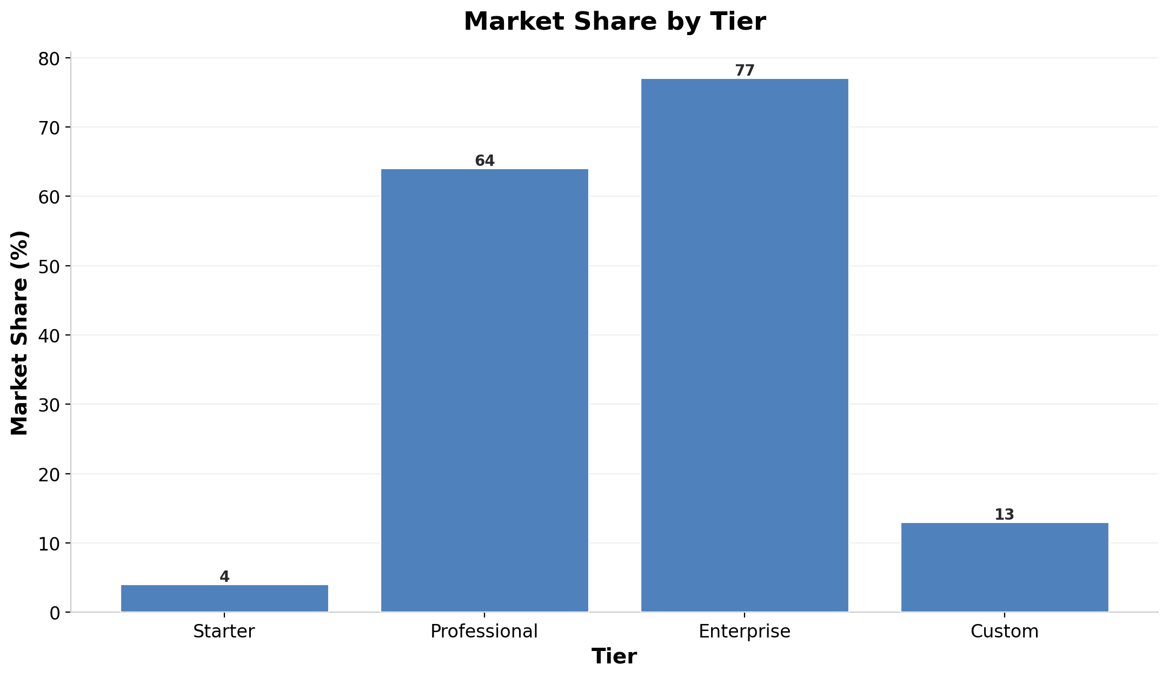
Market Share by Tier
Notes:
Visualize the market share distribution across pricing tiers.

Slide 11
Target Segments
▸ Financial Services
▸ Healthcare
▸ Legal
▸ Manufacturing
Notes:
Identify the key target segments for NovaMind.

Slide 12
Launch Activities
▸ Industry analyst briefings
▸ Press release and media outreach
▸ Customer webinar series
▸ Partner certification program
▸ Conference presence at AI Summit
Notes:
Outline the planned launch activities for NovaMind.

Slide 13
Infrastructure Requirements
Minimum | Recommended
8 vCPUs, 32GB RAM per node | 16 vCPUs, 64GB RAM per node
500GB SSD storage | 2TB NVMe storage
1 Gbps network connectivity | 10 Gbps network connectivity
Kubernetes 1.28+ | GPU acceleration (NVIDIA A100)
Notes:
Compare minimum and recommended infrastructure requirements for NovaMind.

Slide 14
SECTION 1
Risk Mitigation
Notes:
Introduce the risk mitigation section.

Slide 15
Risk Mitigation
Risk | Probability | Impact | Mitigation
Data breach | Low | Critical | Zero-trust architecture, encryption
Model hallucination | Medium | High | Human-in-loop validation
Integration failure | Medium | Medium | Comprehensive testing, rollback
Adoption resistance | Medium | Medium | Change management, training
Cost overrun | Low | Low | Usage alerts, budget limits
Notes:
Present the risk mitigation plan for NovaMind.

Slide 16
Key Takeaways
$156B market opportunity by 2028
^
4-phase implementation in 16 weeks
+
95% faster task completion
+
Enterprise-grade security built-in
+
Flexible pricing for all company sizes
+
Notes:
Summarize the key takeaways from the product launch strategy.

