Slide 1
Q3 2025 Performance Report
A 373-word document overview
Notes:
This presentation covers the key points from the document 'Q3 2025 Performance Report'.

Slide 2
Agenda
1
Revenue Overview
2
Key Metrics
3
Product Development
4
Platform 3.0 Launch
5
AI Features Beta
6
Market Position
7
Financial Outlook
8
Team Growth
Notes:
Here is what we will cover in this presentation.

Slide 3
Executive Summary
$4.2M
KEY METRIC
CompetitorA leads with 32% share (32)
Net Revenue Retention outperforms Monthly churn rate by 98.3x (118 vs 1.2)
Net Revenue Retention leads in Key Metrics at 118
Us (EZ-Deck) leads in Growth Rate at 23
Notes:
CompetitorA leads with 32% share (32). Net Revenue Retention outperforms Monthly churn rate by 98.3x (118 vs 1.2).

Slide 4
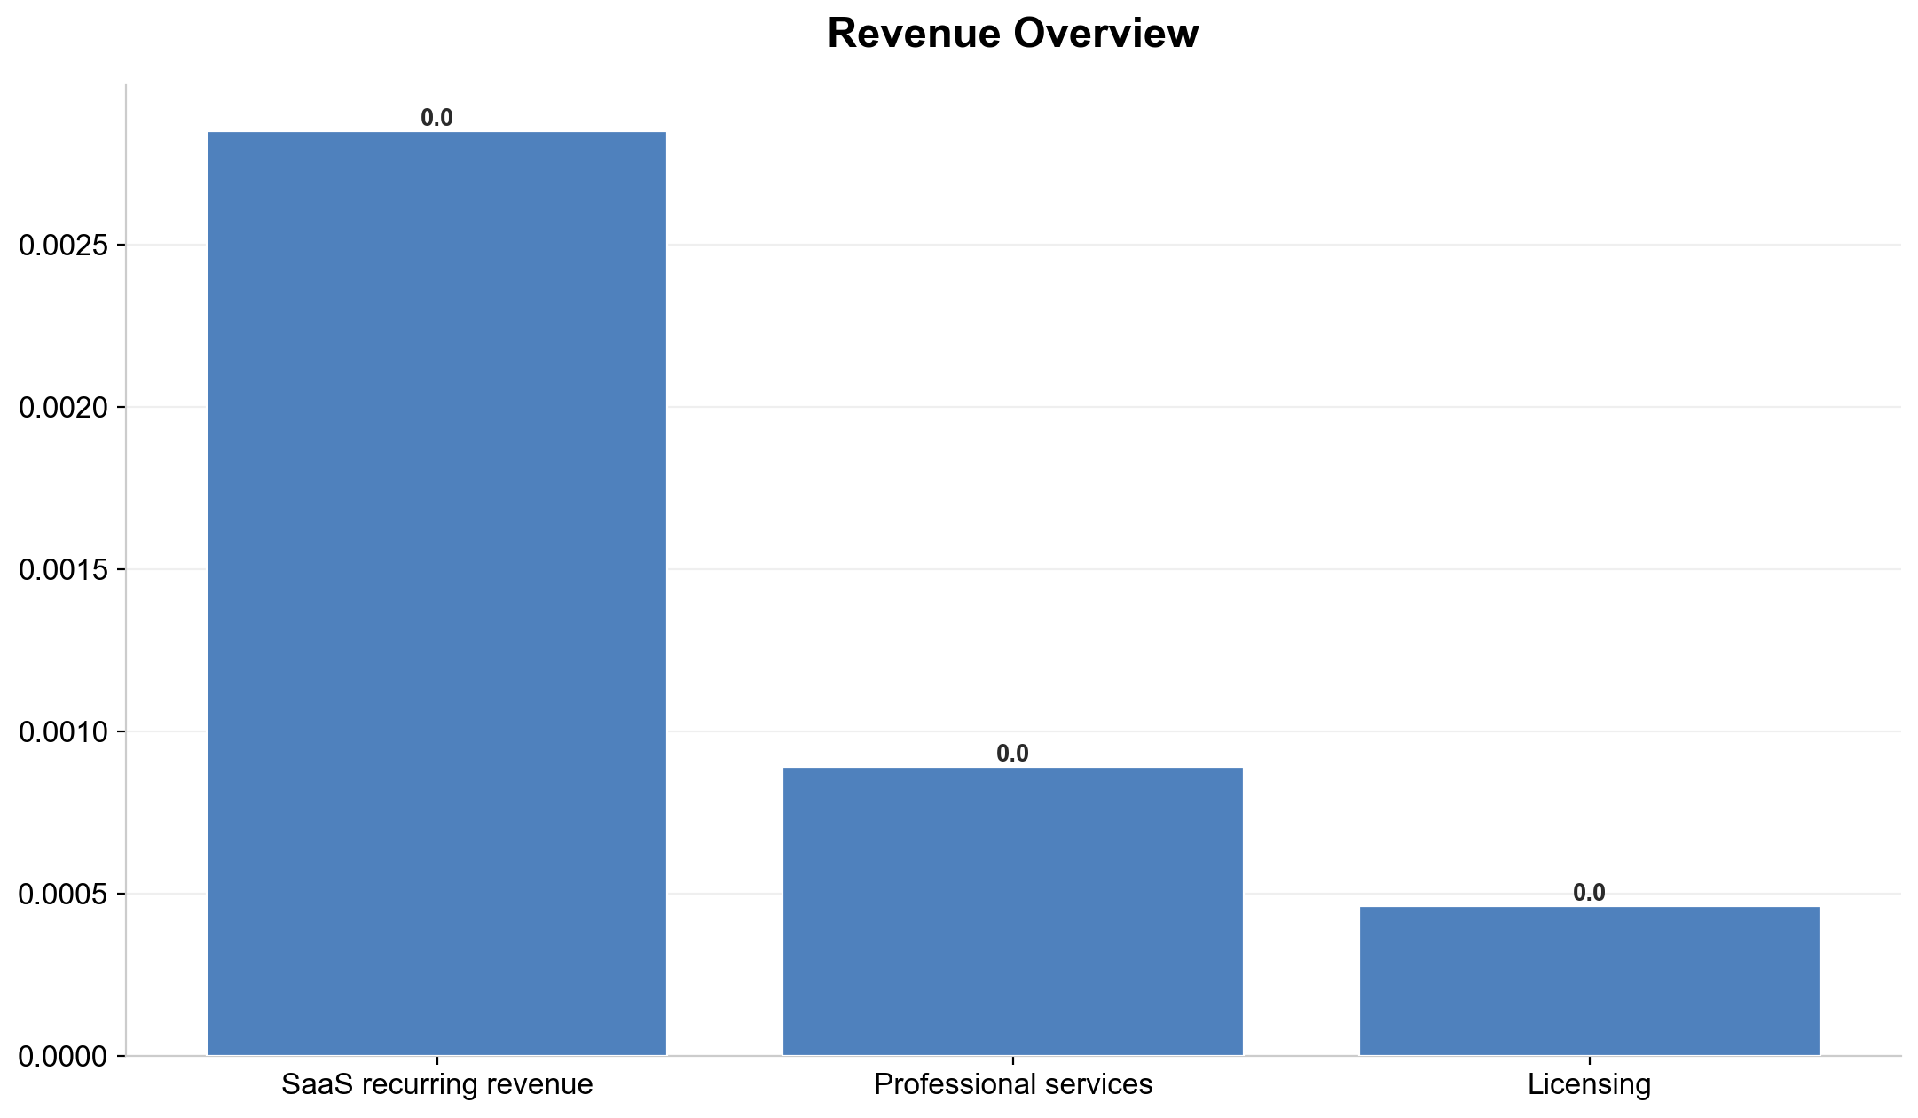
Revenue Overview
Notes:
Key points about Revenue Overview.

Slide 5
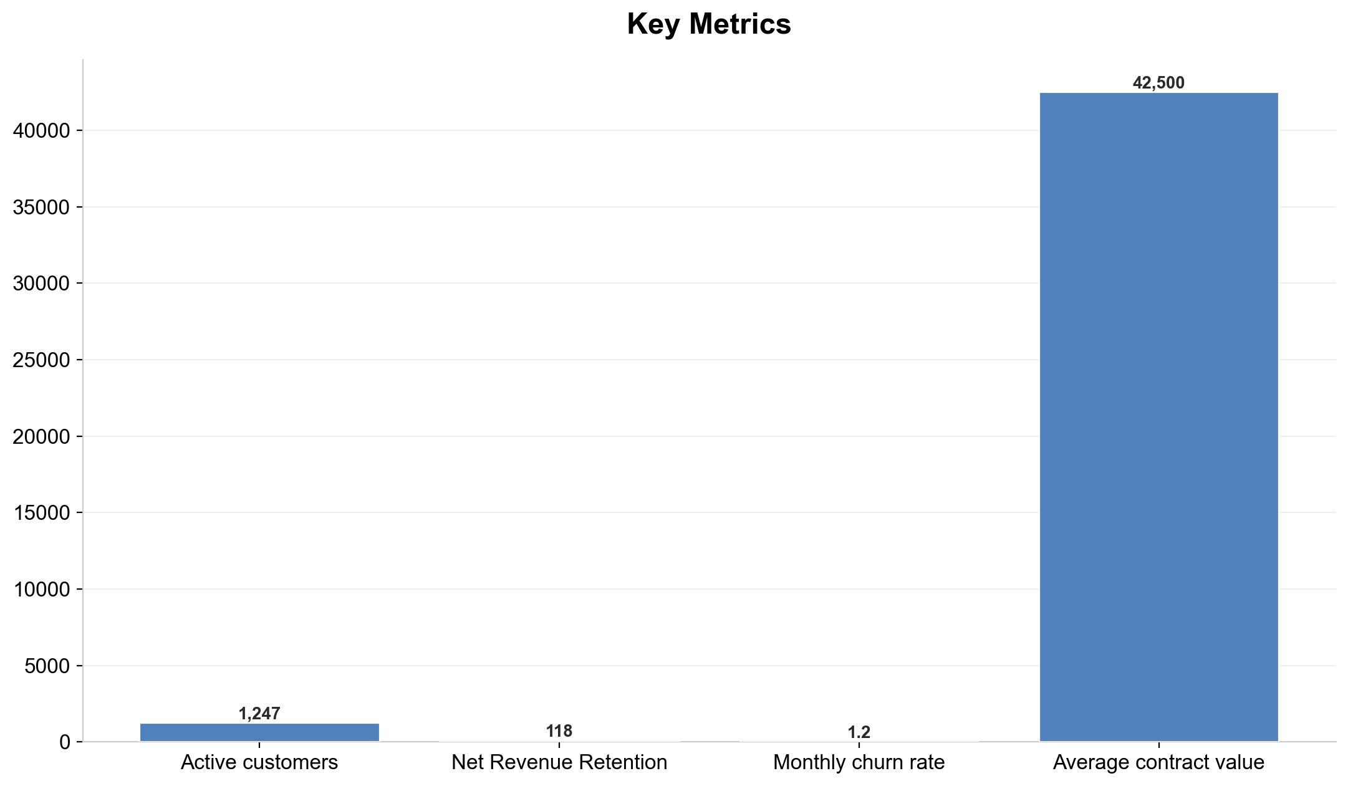
Key Metrics
Notes:
Net Revenue Retention leads in Key Metrics at 118. Net Revenue Retention outperforms Monthly churn rate by 98.3x (118 vs 1.2).

Slide 6
Product Development
▸ The engineering team shipped three major releases…
Notes:
Summary of Product Development.

Slide 7
Platform 3.0 Launch
45%
PERCENTAGE
Notes:
Key points about Platform 3.0 Launch.

Slide 8
AI Features Beta
▸ 87% user satisfaction score
▸ Average 3.2 hours saved per week per user
▸ 12 enterprise customers in pilot program
Notes:
Key points about AI Features Beta.

Slide 9
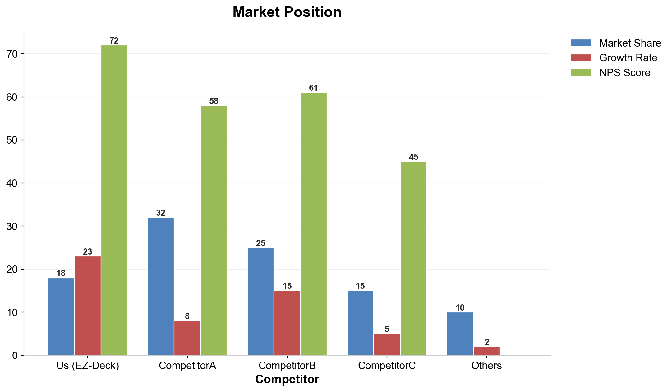
Market Position
Notes:
CompetitorA leads with 32% share (32). CompetitorA leads CompetitorB by 28% (7 difference). Us (EZ-Deck) leads in Growth Rate at 23.

Slide 10
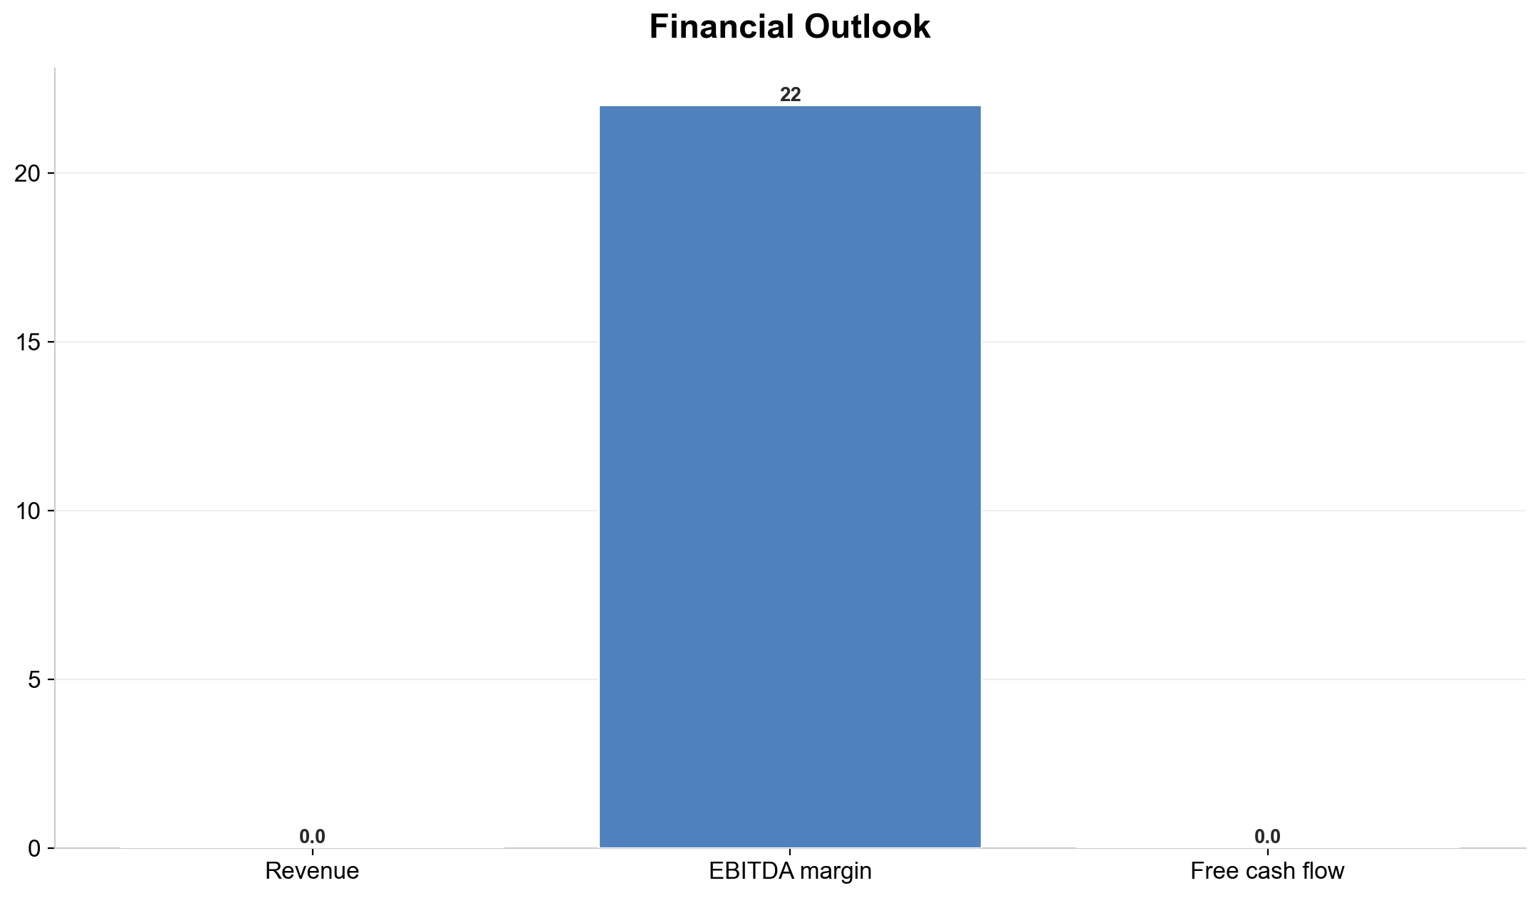
Financial Outlook
Notes:
Key points about Financial Outlook.

Slide 11
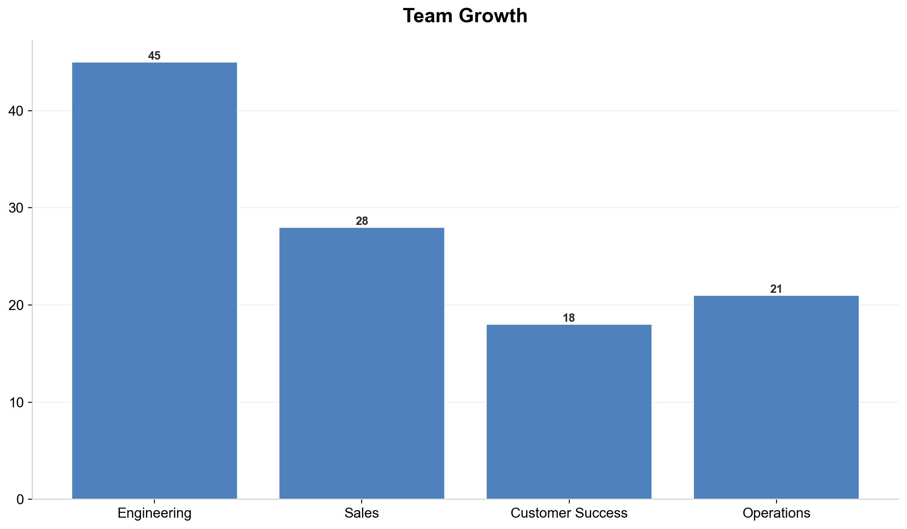
Team Growth
Notes:
Key points about Team Growth.

Slide 12
Strategic Priorities for Q4
1
2
3
4
Launch AI assistant
to general availability
Expand into European
market (UK and Germany first)
Achieve SOC 2
Type II certification
Close Series B
funding round at $25M target
Notes:
Key points about Strategic Priorities for Q4.

Slide 13
Risks and Mitigations
Risk | Impact | Probability | Mitigation
Talent retention | High | Medium | Equity refresh program
Exchange rate volatility | Medium | High | Currency hedging
AI regulatory changes | Medium | Low | Legal monitoring team
Supply chain delays | Low | Medium | Dual vendor strategy
Notes:
This table shows data related to Risks and Mitigations.

Slide 14
Key Takeaways
CompetitorA leads with 32% share (32)
🏆
Net Revenue Retention leads in Key Metrics at 118
🏆
Us (EZ-Deck) leads in Growth Rate at 23
🏆
Us (EZ-Deck) leads in NPS Score at 72
🏆
Net Revenue Retention outperforms Monthly churn rate by 98.3x (118 vs 1.2)
⚡
Notes:
These are the top takeaways from our presentation.

