Slide 1
Global E-Commerce Market Analysis 2025
A 486-word document overview
Notes:
This presentation covers the key points from the document 'Global E-Commerce Market Analysis 2025'.

Slide 2
Agenda
1
Executive Overview
2
Regional Revenue Breakdown
3
Top Growth Categories
4
AI-Powered Personalization
5
Social Commerce
6
Augmented Reality Shopping
7
Payment Innovation
8
Logistics and Fulfillment
Notes:
Here is what we will cover in this presentation.

Slide 3
Executive Summary
$6.3 t
KEY METRIC
Asia Pacific leads with 49% share (49.2)
Top 2 (Asia Pacific + North America) control 68% of total
Asia Pacific leads North America by 159% (30.2 difference)
Middle East & Africa outperforms North America by 3.5x (28.7 vs 8.2)
Notes:
Asia Pacific leads with 49% share (49.2). Top 2 (Asia Pacific + North America) control 68% of total.

Slide 4
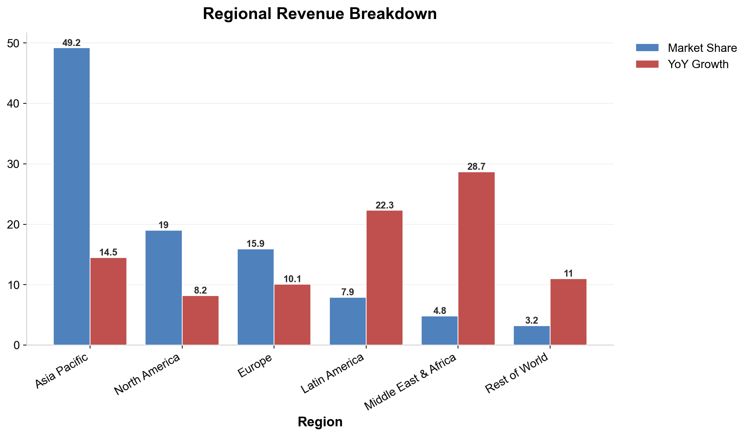
Regional Revenue Breakdown
Notes:
Asia Pacific leads with 49% share (49.2). Top 2 (Asia Pacific + North America) control 68% of total. Asia Pacific leads North America by 159% (30.2 difference).

Slide 5
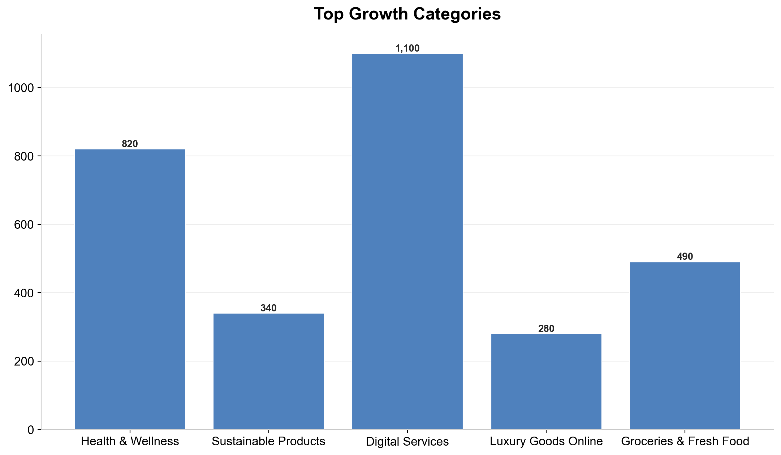
Top Growth Categories
Notes:
Key points about Top Growth Categories.

Slide 6
AI-Powered Personalization
35%
PERCENTAGE
Notes:
Key points about AI-Powered Personalization.

Slide 7
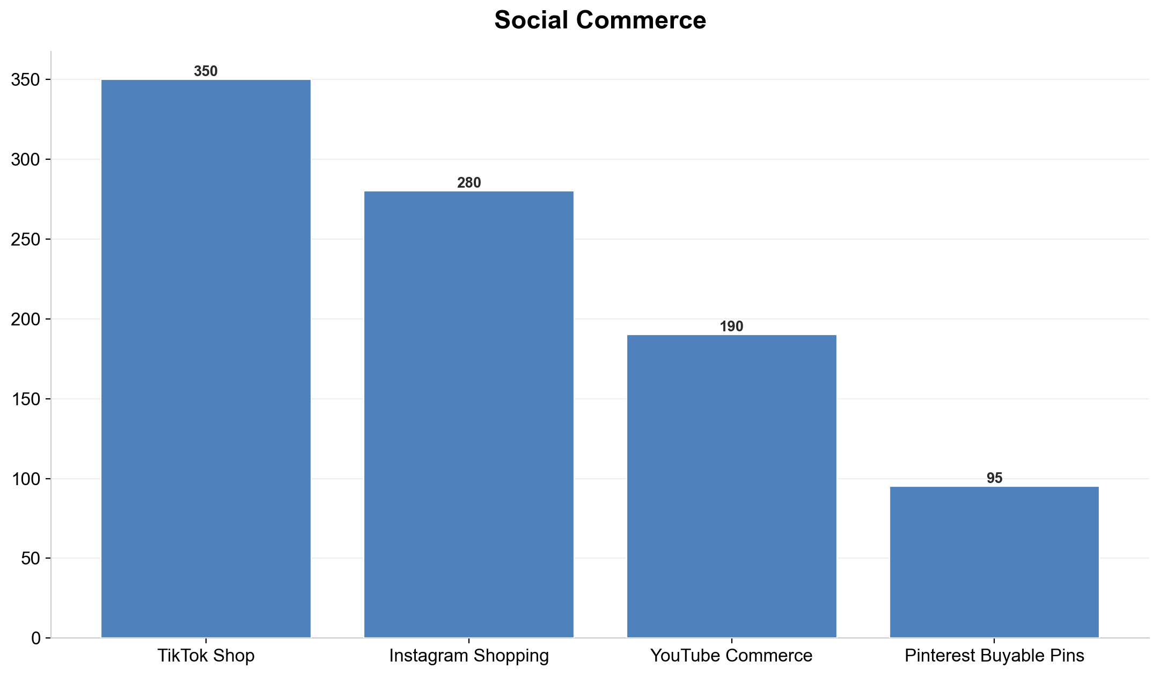
Social Commerce
Notes:
Key points about Social Commerce.

Slide 8
Augmented Reality Shopping
40%
28%
PERCENTAGE
PERCENTAGE
Notes:
Key points about Augmented Reality Shopping.

Slide 9
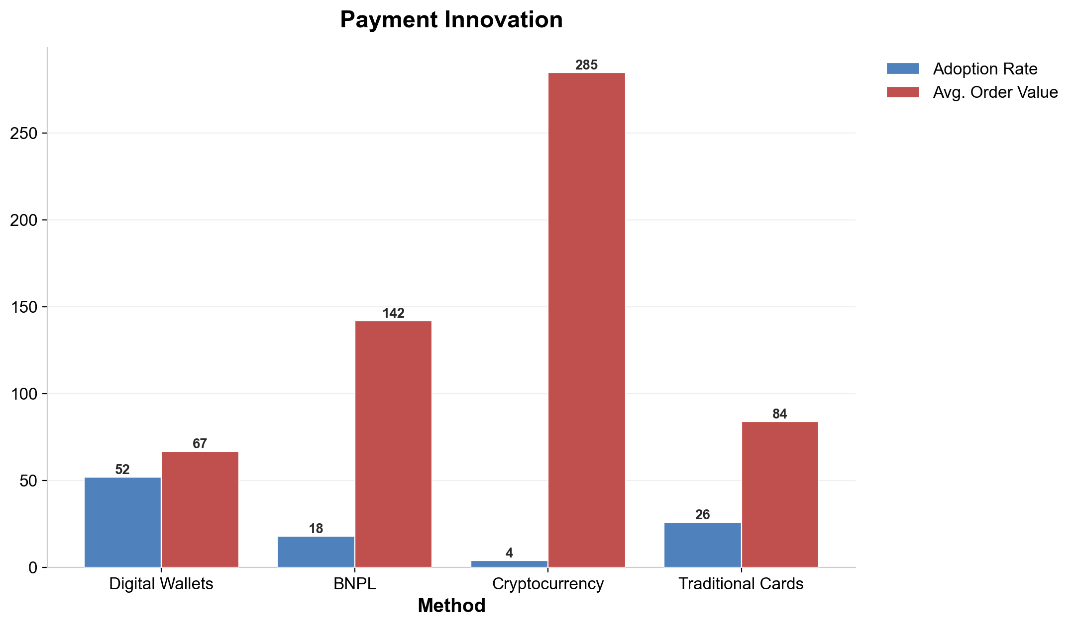
Payment Innovation
Notes:
Digital Wallets leads in Adoption Rate at 52. Digital Wallets outperforms Cryptocurrency by 13.0x (52 vs 4). Cryptocurrency leads in Avg. Order Value at 285.

Slide 10
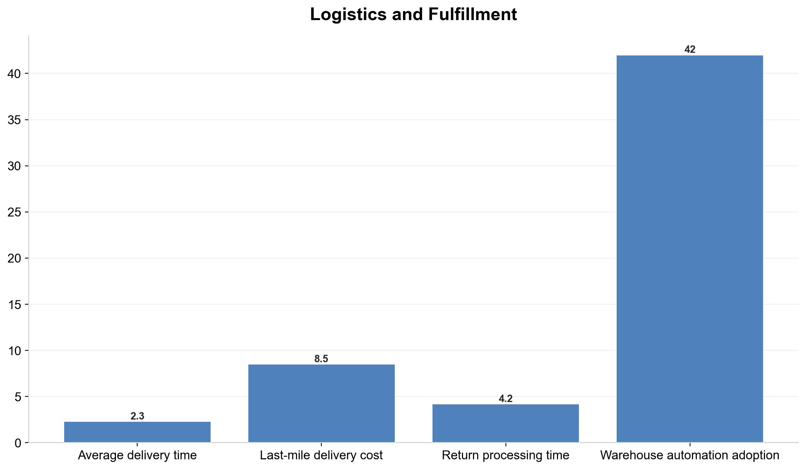
Logistics and Fulfillment
Notes:
Key points about Logistics and Fulfillment.

Slide 11
Challenges and Risks
▸ Rising tariffs and trade restrictions in 23 countries
▸ Data privacy regulations (GDPR, CCPA, PIPL) increasing compliance costs by 15%
▸ Cybersecurity threats costing the industry $48B annually
▸ Supply chain disruptions affecting 31% of cross-border shipments
Notes:
Key points about Challenges and Risks.

Slide 12
Strategic Recommendations
1
2
3
Invest in mobile-first
experiences and progressive web apps
Adopt AI-driven inventory
management to reduce stockouts by 30%
Expand into high-growth
markets (Latin America, Middle East, Southeast Asia)
4
5
Build omnichannel capabilities
bridging online and offline retail
Prioritize sustainability and
transparent supply chains
Notes:
Key points about Strategic Recommendations.

Slide 13
Key Takeaways
Asia Pacific leads with 49% share (49.2)
🏆
Digital Wallets leads in Adoption Rate at 52
🏆
Top 2 (Asia Pacific + North America) control 68% of total
📊
Middle East & Africa leads in YoY Growth at 28.7
🏆
Cryptocurrency leads in Avg. Order Value at 285
🏆
Notes:
These are the top takeaways from our presentation.

