Slide 1
E-Commerce Growth Analysis: India 2020–2025
India's e-commerce sector has witnessed unprecedented growth over the past five years, driven by smartphone penetration,...
Notes:
This presentation covers the key points from the document 'E-Commerce Growth Analysis: India 2020–2025'.

Slide 2
Agenda
1
Executive Summary
2
Market Size & Revenue
3
Category-wise Revenue Breakdown (2025)
4
Key Growth Drivers
5
Platform Market Share (2025)
6
Customer Acquisition Cost vs Lifetime Value
7
Logistics & Delivery Metrics
8
Challenges
Notes:
Here is what we will cover in this presentation.

Slide 3
Executive Summary
Market Size (USD Billion) grew 195% from 2020 to 2025 (38 → 112)
Market Size (USD Billion) grew 195% from 2020 to 2025 (38 → 112)
Electronics leads with 28% share (28)
Sharpest growth occurred 2020→2021 with 42% increase
Sharpest growth occurred 2020→2021 with 250% increase
Notes:
Market Size (USD Billion) grew 195% from 2020 to 2025 (38 → 112). Electronics leads with 28% share (28).

Slide 4
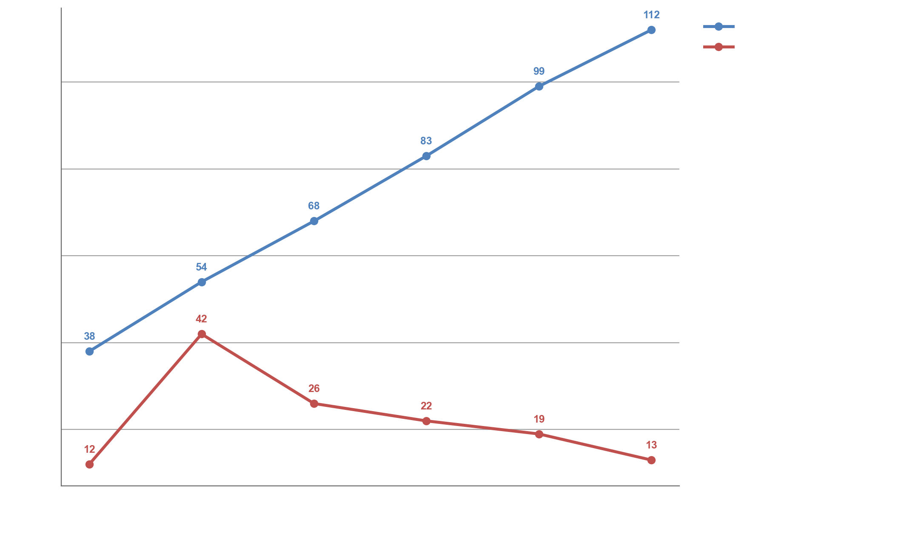
Market Size & Revenue
Notes:
Market Size (USD Billion) grew 195% from 2020 to 2025 (38 → 112). Sharpest growth occurred 2020→2021 with 42% increase. Market Size (USD Billion) growth is decelerating — rate slowed from 22% to 13%.

Slide 5
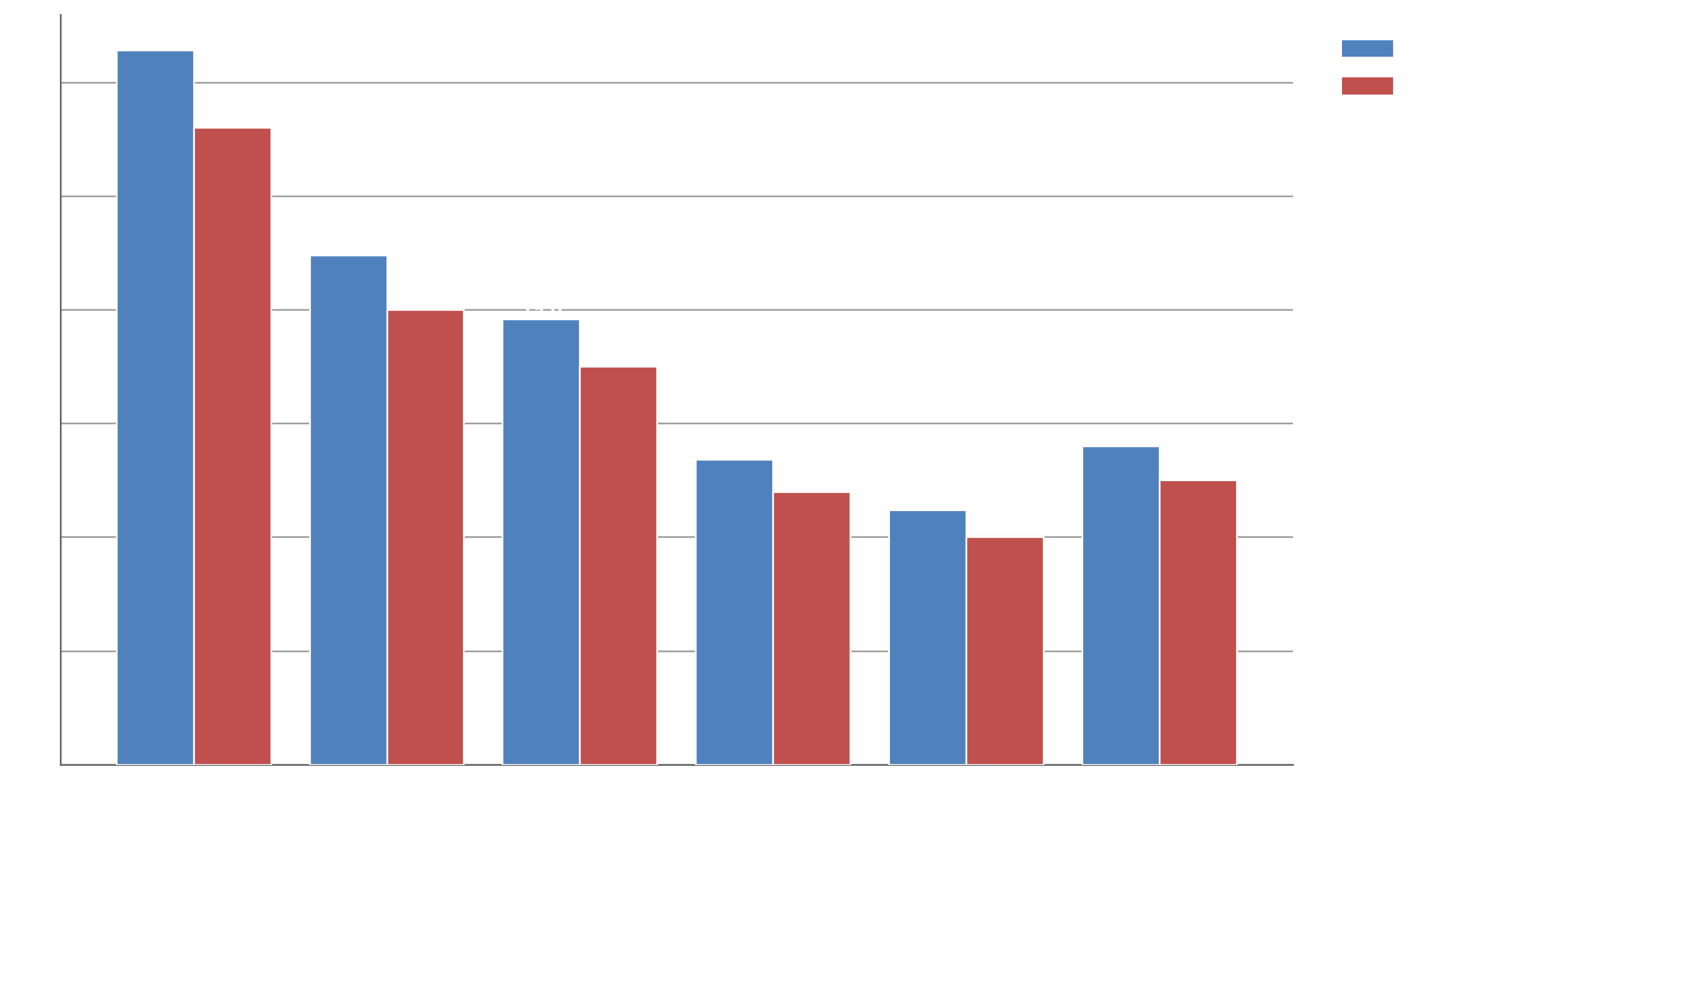
Category-wise Revenue Breakdown (2025)
Notes:
Electronics leads in Revenue (USD Billion) at 31.4. Electronics outperforms Home & Furniture by 2.8x (31.4 vs 11.2). Electronics leads with 28% share (28).

Slide 6
Key Growth Drivers
▸ Internet Users: Grew from 560M (2020) to 900M (2025)
▸ UPI Transactions: 8.4 billion monthly transactions in 2025 vs 1.3B…
▸ Smartphone Users: 650M active smartphone users in 2025
▸ Rural E-Commerce: Rural segment now contributes 35% of total orders, up from 18%…
Notes:
Key points about Key Growth Drivers.

Slide 7
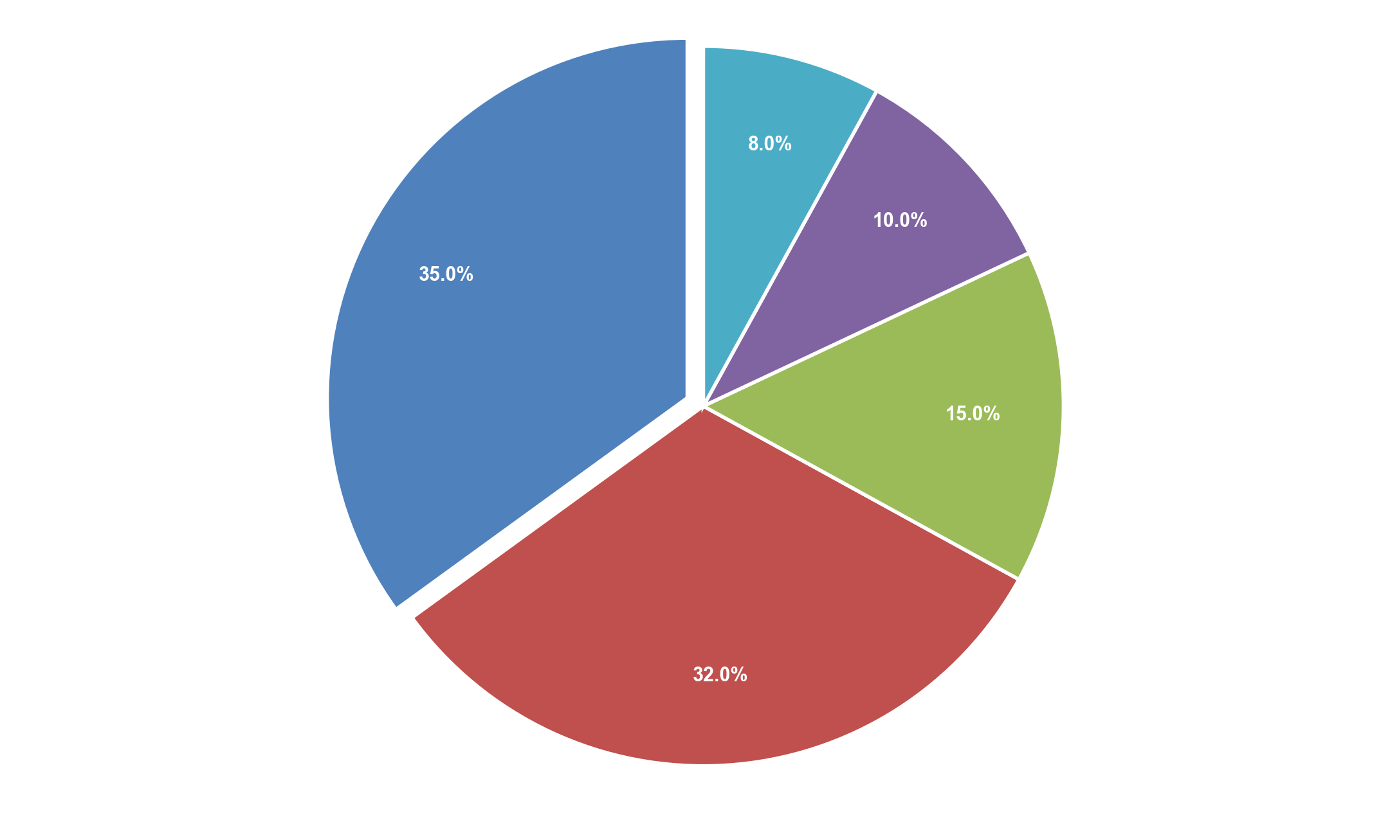
Platform Market Share (2025)
Notes:
Flipkart (incl. Myntra) leads with 35% share (35). Top 2 (Flipkart (incl. Myntra) + Amazon India) control 67% of total. Others represents only 8% — smallest segment.

Slide 8
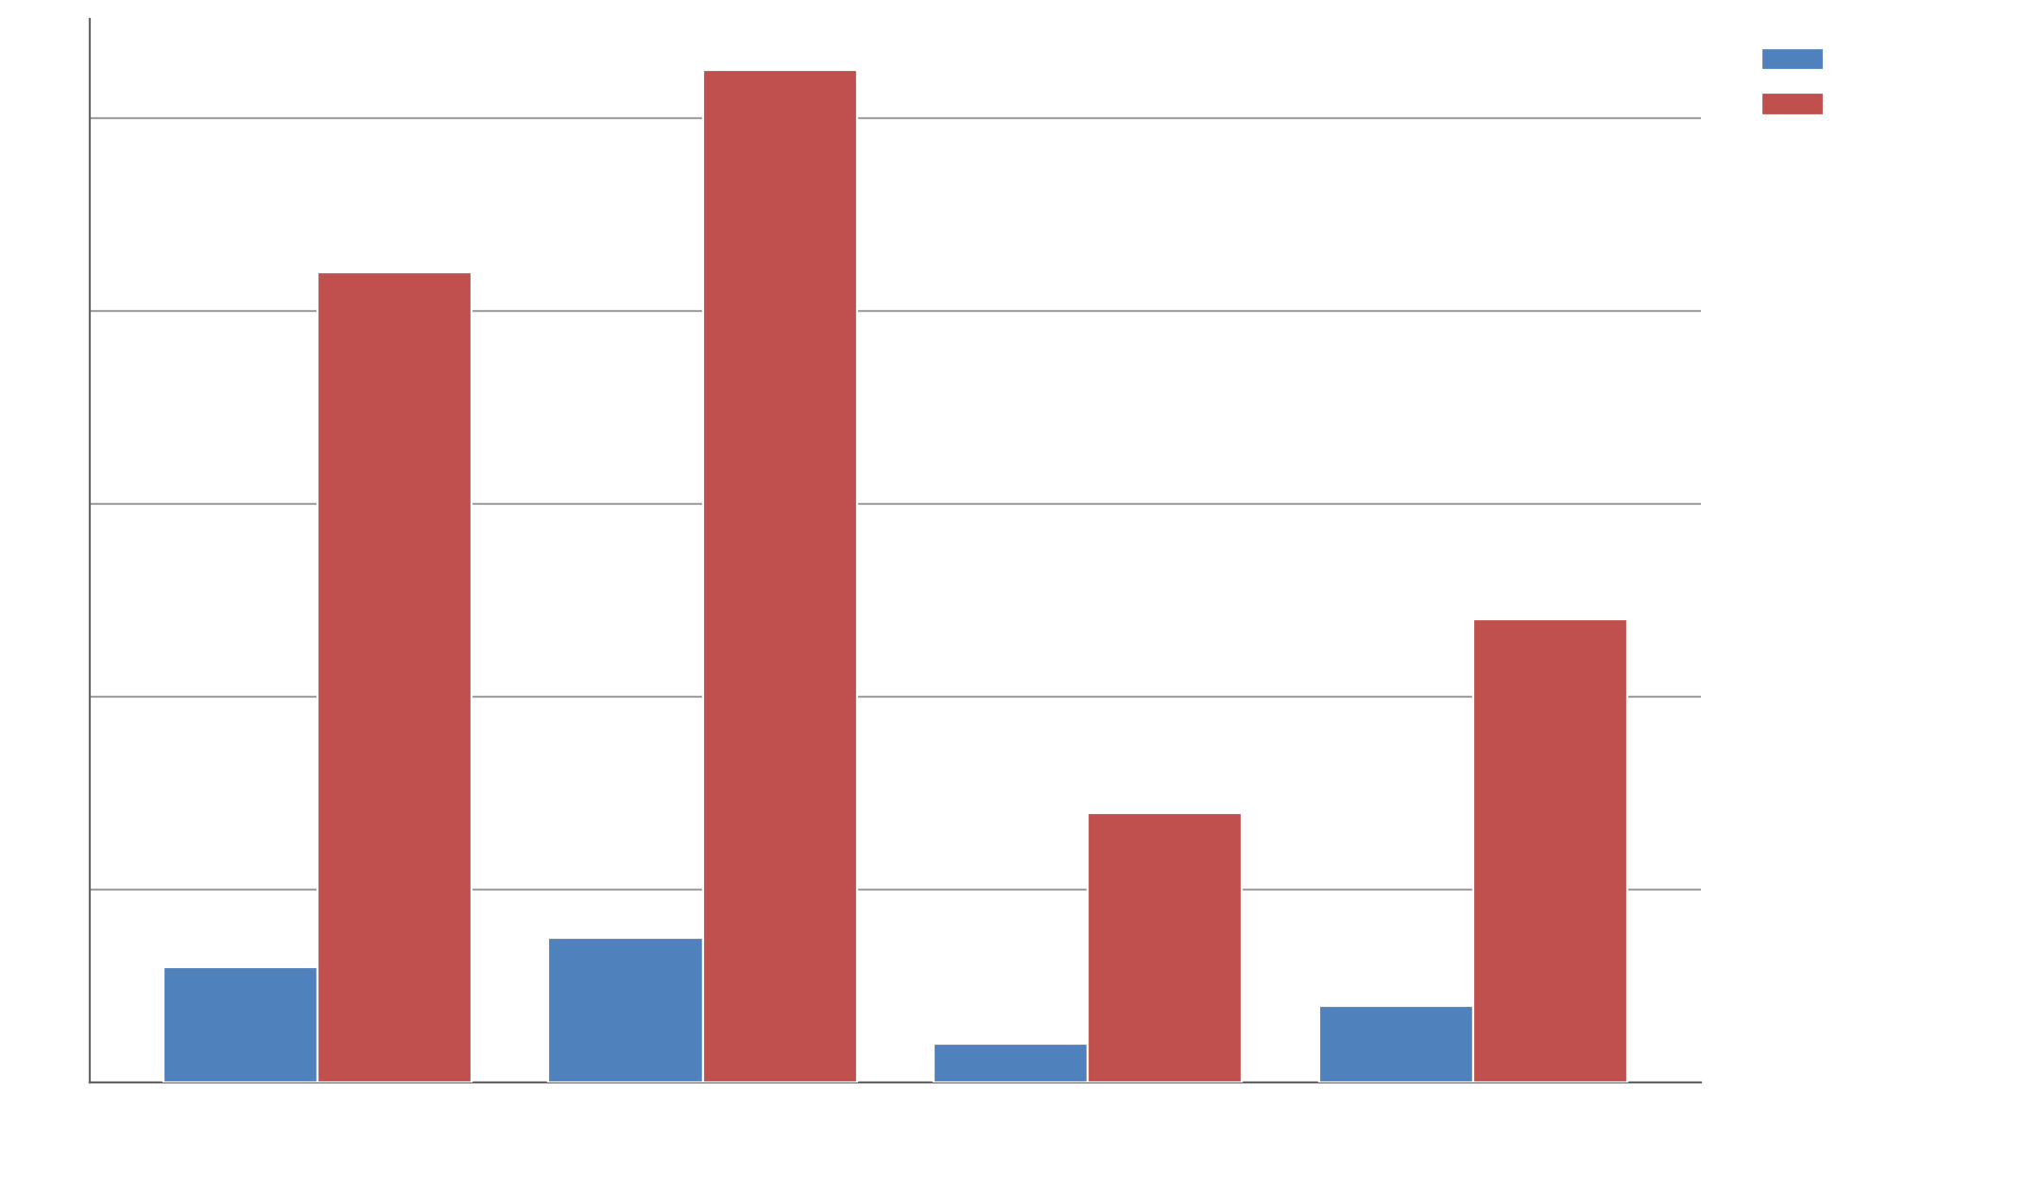
Customer Acquisition Cost vs Lifetime Value
Notes:
Amazon leads in CAC (USD) at 15. Amazon outperforms Meesho by 3.8x (15 vs 4). Amazon leads in LTV (USD) at 105.

Slide 9
Logistics & Delivery Metrics
▸ Average delivery time reduced from 5.2 days (2020) to 1.8…
▸ Same-day delivery available in 42 cities
▸ Return rate: 18% for fashion, 4% for electronics
▸ Last-mile delivery cost: reduced by 34% due to route optimization AI
Notes:
Key points about Logistics & Delivery Metrics.

Slide 10
Challenges
▸ Logistics in Tier 3+ cities: Infrastructure gaps remain
▸ High return rates in fashion: Impacts margins significantly
▸ Customer trust: 22% of first-time buyers cite trust as a barrier
▸ Regulatory uncertainty: FDI norms under review
Notes:
Key points about Challenges.

Slide 11
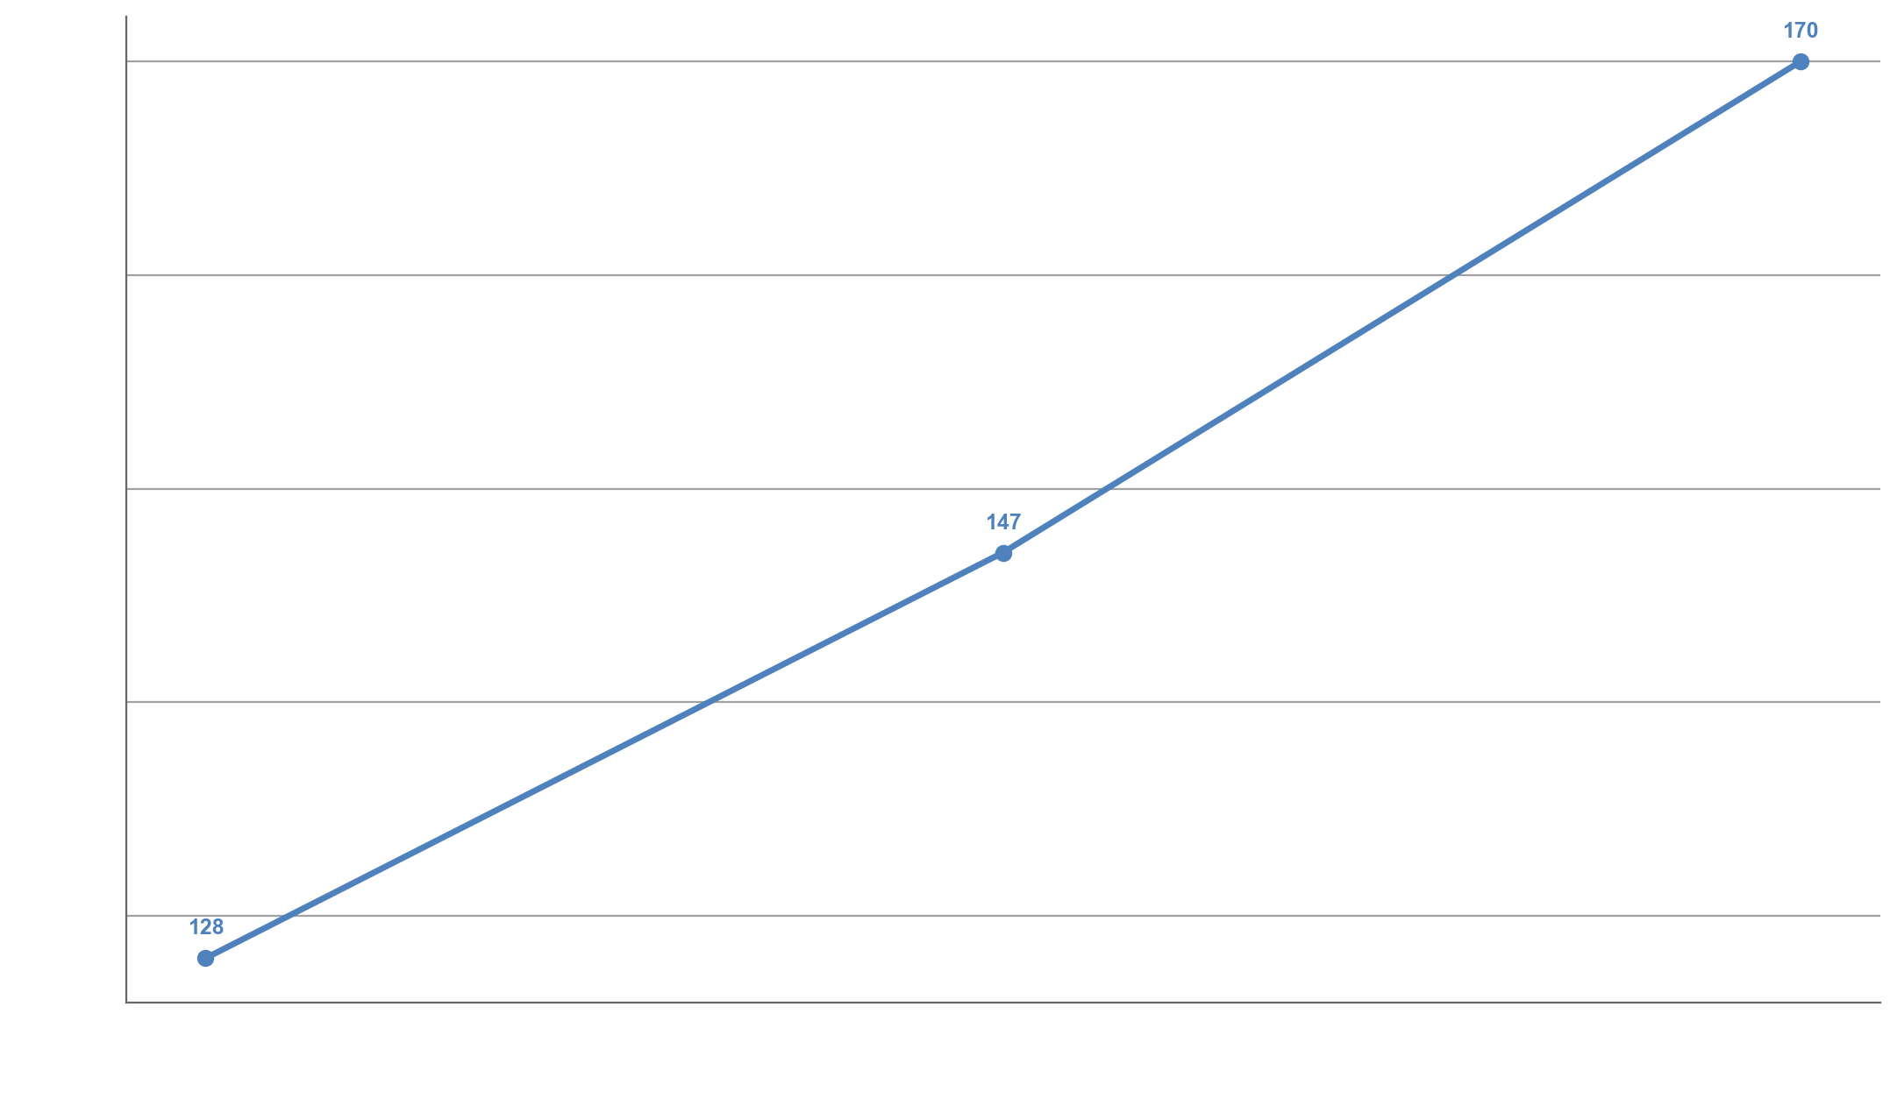
Forecast 2026–2028
Notes:
Projected Market Size (USD B) grew 33% from 2026 to 2028 (128 → 170).

Slide 12
Key Takeaways
Market Size (USD Billion) grew 195% from 2020 to 2025 (38 → 112)
^
Electronics leads with 28% share (28)
+
Flipkart (incl. Myntra) leads with 35% share (35)
+
Projected Market Size (USD B) grew 33% from 2026 to 2028 (128 → 170)
^
Sharpest growth occurred 2020→2021 with 42% increase
+
Notes:
These are the top takeaways from our presentation.

Slide 13
Thank You
Presentation generated from E-Commerce Growth Analysis: India 2020–2025
Notes:
Thank you for your attention. Questions?

