Slide 1
Global E-Commerce Market Analysis 2025
A 486-word document overview
Notes:
This presentation covers the key points from the document 'Global E-Commerce Market Analysis 2025'.

Slide 2
Agenda
1
Executive Overview
2
Regional Revenue Breakdown
3
Top Growth Categories
4
AI-Powered Personalization
5
Social Commerce
6
Augmented Reality Shopping
7
Payment Innovation
8
Logistics and Fulfillment
Notes:
Here is what we will cover in this presentation.

Slide 3
Executive Summary
▸ The global e-commerce market reached $6
▸ Region Revenue (USD) Market Share YoY Growth Asia Pacific $3
▸ Health & Wellness: $820B, growing at 18% annually Sustainable Products: $340B, growing at 25% annually Digital Services:...
▸ Machine learning algorithms now drive 35% of all product recommendations on major platforms
Key Metric: $6.3 t
Notes:
This slide summarizes the key insights from the document.

Slide 4
Executive Overview
• The global e-commerce market reached $6
• 3 trillion in 2025, up from $5
• 8 trillion in 2024
• Mobile commerce now accounts for 72
• 9% of all online transactions, driven by improved payment infrastructure and 5G
Notes:
Summary of Executive Overview.

Slide 5
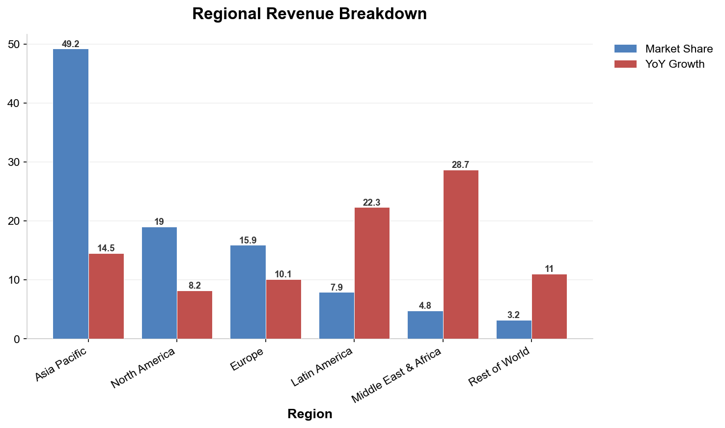
Regional Revenue Breakdown
Notes:
Bar chart showing Regional Revenue Breakdown data.

Slide 6
Top Growth Categories
$820B
$340B
$1.1T
Currency
Currency
Currency
Notes:
Key statistics from Top Growth Categories.

Slide 7
AI-Powered Personalization
• Machine learning algorithms now drive 35% of all product recommendations on majo
• Conversion rates for AI-personalized experiences are 2
• 5x higher than generic browsing
Notes:
Summary of AI-Powered Personalization.

Slide 8
Social Commerce
$350B
$280B
$190B
Currency
Currency
Currency
Notes:
Key statistics from Social Commerce.

Slide 9
Augmented Reality Shopping
40%
28%
Percentage
Percentage
Notes:
Key statistics from Augmented Reality Shopping.

Slide 10
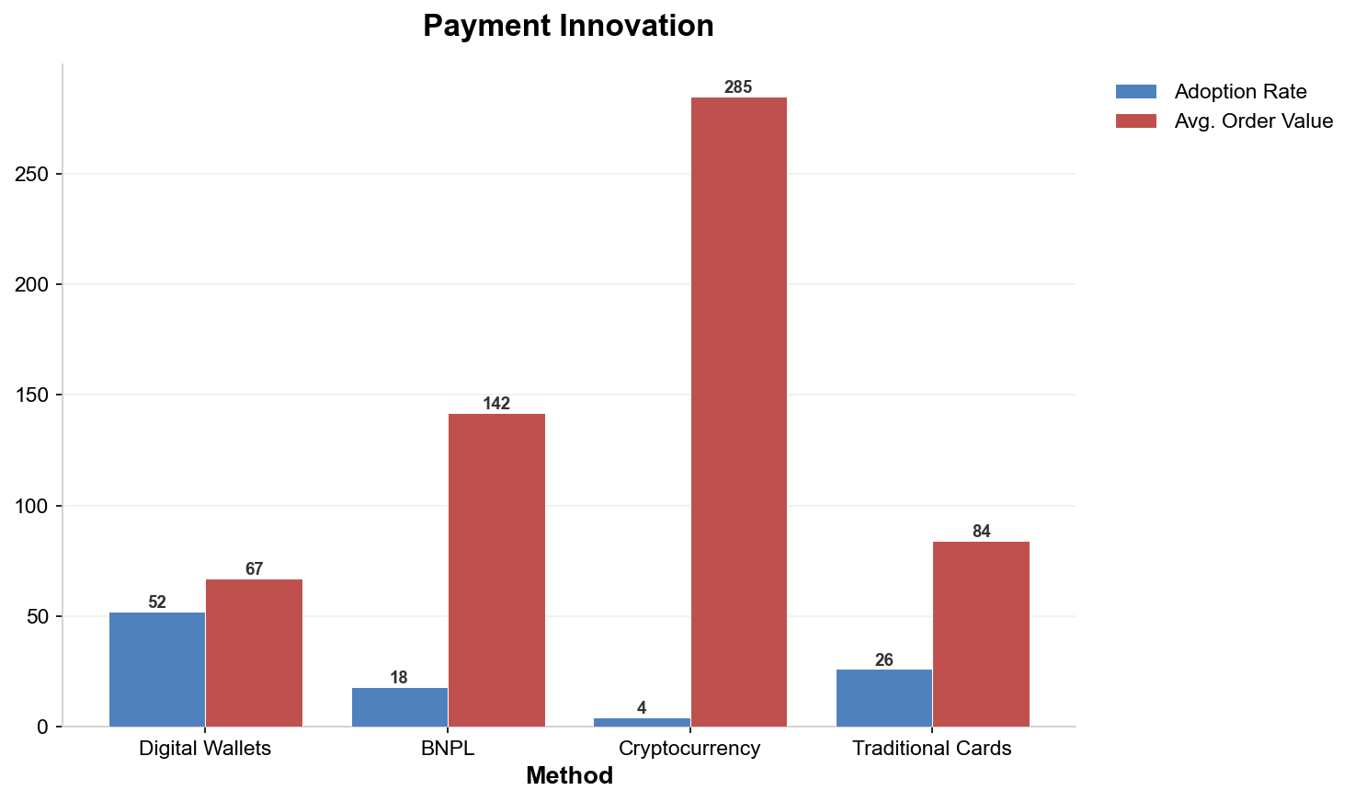
Payment Innovation
Notes:
Bar chart showing Payment Innovation data.

Slide 11
Logistics and Fulfillment
$8.50
12%
42%
Currency
Percentage
Percentage
Notes:
Key statistics from Logistics and Fulfillment.

Slide 12
Challenges and Risks
$48B
15%
31%
Currency
Percentage
Percentage
Notes:
Key statistics from Challenges and Risks.

Slide 13
Key Takeaways
✓
The global e-commerce market reached $6
✓
Region Revenue (USD) Market Share YoY Growth Asia Pacific $3
✓
Health & Wellness: $820B, growing at 18% annually Sustainable Products: $340B, g
✓
Machine learning algorithms now drive 35% of all product recommendations on majo
✓
Social media platforms generated $1
Notes:
These are the top takeaways from our presentation.

