Slide 1
Q3 2025 Performance Report
A 373-word document overview
Notes:
This presentation covers the key points from the document 'Q3 2025 Performance Report'.

Slide 2
Agenda
1
Revenue Overview
2
Key Metrics
3
Product Development
4
Platform 3.0 Launch
5
AI Features Beta
6
Market Position
7
Financial Outlook
8
Team Growth
Notes:
Here is what we will cover in this presentation.

Slide 3
Executive Summary
▸ Total revenue for Q3 2025 reached $4
▸ Our customer base expanded significantly this quarter: Active customers: 1,247 (up from 1,089 in Q2) Net Revenue Retenti...
▸ The engineering team shipped three major releases this quarter
▸ The new platform architecture reduces page load times by 45% and supportsreal-time collaboration for up to 50 concurrent...
Key Metric: $4.2M
Notes:
This slide summarizes the key insights from the document.

Slide 4
Revenue Overview
$4.2M
23%
68%
Currency
Percentage
Percentage
Notes:
Key statistics from Revenue Overview.

Slide 5
Key Metrics
$42,500
118%
1.2%
Currency
Percentage
Percentage
Notes:
Key statistics from Key Metrics.

Slide 6
Product Development
• The engineering team shipped three major releases this quarter
Notes:
Summary of Product Development.

Slide 7
Platform 3.0 Launch
• The new platform architecture reduces page load times by 45% and supportsreal-ti
Notes:
Summary of Platform 3.0 Launch.

Slide 8
AI Features Beta
87%
87
3.2
Percentage
Numeric Density
Numeric Density
Notes:
Key statistics from AI Features Beta.

Slide 9
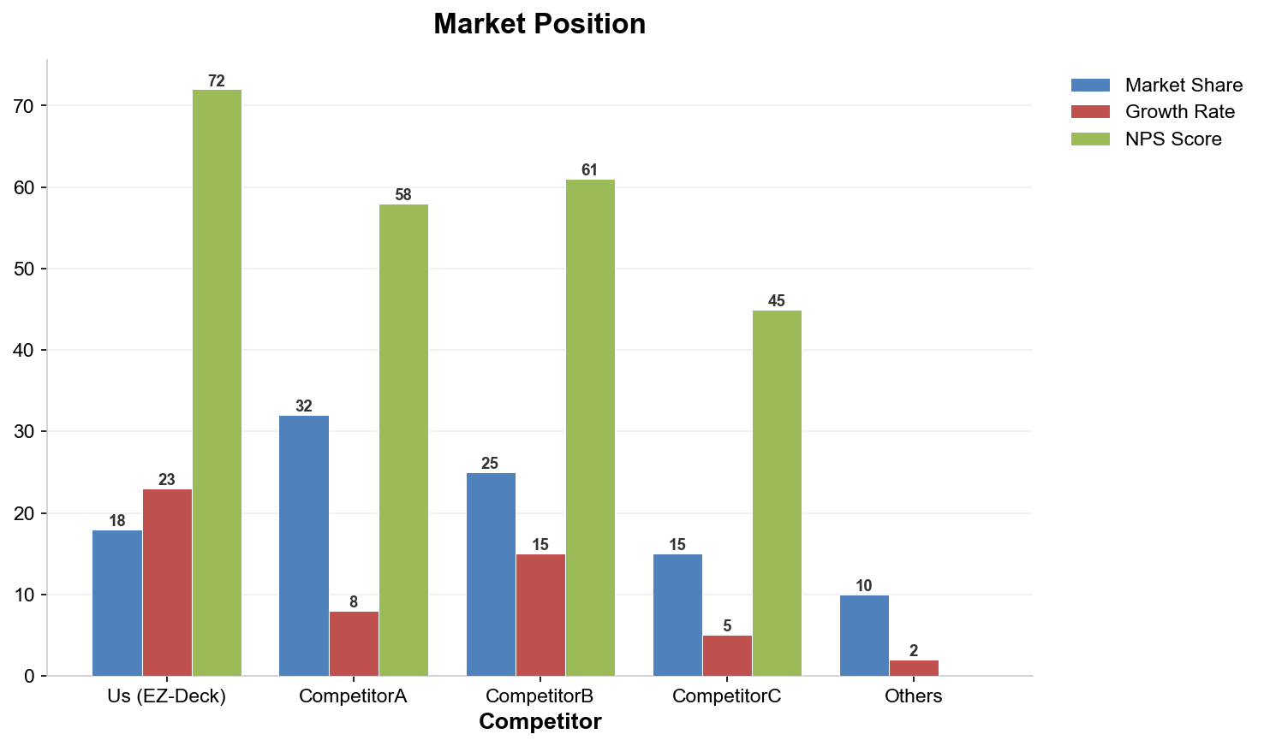
Market Position
Notes:
Bar chart showing Market Position data.

Slide 10
Financial Outlook
$16.5M
$17.2M
$15.8M
Currency
Currency
Currency
Notes:
Key statistics from Financial Outlook.

Slide 11
Team Growth
85
112
Numeric Density
Numeric Density
Notes:
Key statistics from Team Growth.

Slide 12
Strategic Priorities for Q4
• Launch AI assistant to general availability
• Expand into European market (UK and Germany first)
• Achieve SOC 2 Type II certification
• Close Series B funding round at $25M target
Notes:
Key points about Strategic Priorities for Q4.

Slide 13
Risks and Mitigations
Risk | Impact | Probability | Mitigation
Talent retention | High | Medium | Equity refresh program
Exchange rate volatility | Medium | High | Currency hedging
AI regulatory changes | Medium | Low | Legal monitoring team
Supply chain delays | Low | Medium | Dual vendor strategy
Notes:
This table shows data related to Risks and Mitigations.

Slide 14
Key Takeaways
✓
Total revenue for Q3 2025 reached $4
✓
Our customer base expanded significantly this quarter:
✓
The engineering team shipped three major releases this quarter
✓
The new platform architecture reduces page load times by 45% and supportsreal-ti
✓
We launched our AI assistant in beta with 200 early adopters:
Notes:
These are the top takeaways from our presentation.

