Slide 1

Sample 2
SQL and Databases Project Report
By Prashant Patil
AIML Online October 2023-A Batch 05-May-2024

Slide 2
Sample 2
Business Overview
Total Revenue
Total Orders
Total Customers
Average Rating
Good feedback
Average ship time
125M
1000
994
3.14
44%
98 Days
Quarter#1
Quarter#2
Quarter#3
Quarter#4
$39.63M
$32.91M
$29.43M
$23.49M
Orders: 310
Orders: 262
Orders: 229
Orders: 199
Orders: 199
Avg Feedback: 3.55
Avg Feedback: 3.36
Orders: 229
Avg Feedback: 2.40
Avg Feedback: 2.96
Avg Feedback: 2.40
Avg Ship Time: 57 Days
Avg Ship Time: 71 Days
Avg Feedback: 2.96
Avg Ship Time: 174 Days
Avg Ship Time: 118 Days
Avg Ship Time: 174 Days
Top Performing Maker : Chevrolet
Top Performing Maker : Chevrolet
Avg Ship Time: 118 Days
Top Performing Maker : Chevrolet
Top Performing Maker : Chevrolet
Top Performing Maker : Chevrolet
Top Performing State :
California
Top Performing State :
California
Top Performing Maker : Chevrolet
Top Performing State : California
Top Performing State :
California
Top Performing State :
California
Discount Offered : 0.54
Discount Offered : 0.60
Top Performing State : California
Discount Offered : 0.70
Discount Offered : 0.64
Very Good : 30%
Good : 29%
Okay: 19 %
Bad: 11%
Very Bad: 11%
Very Good : 29%
Good : 22%
Okay: 20 %
Bad: 14%
Very Bad: 15%
Very Good : 17%
Good : 21%
Okay: 22 %
Bad: 23%
Very Bad: 18%
Very Good : 10%
Good : 10%
Okay: 20 %
Bad: 29%
Very Bad: 31%

Slide 3
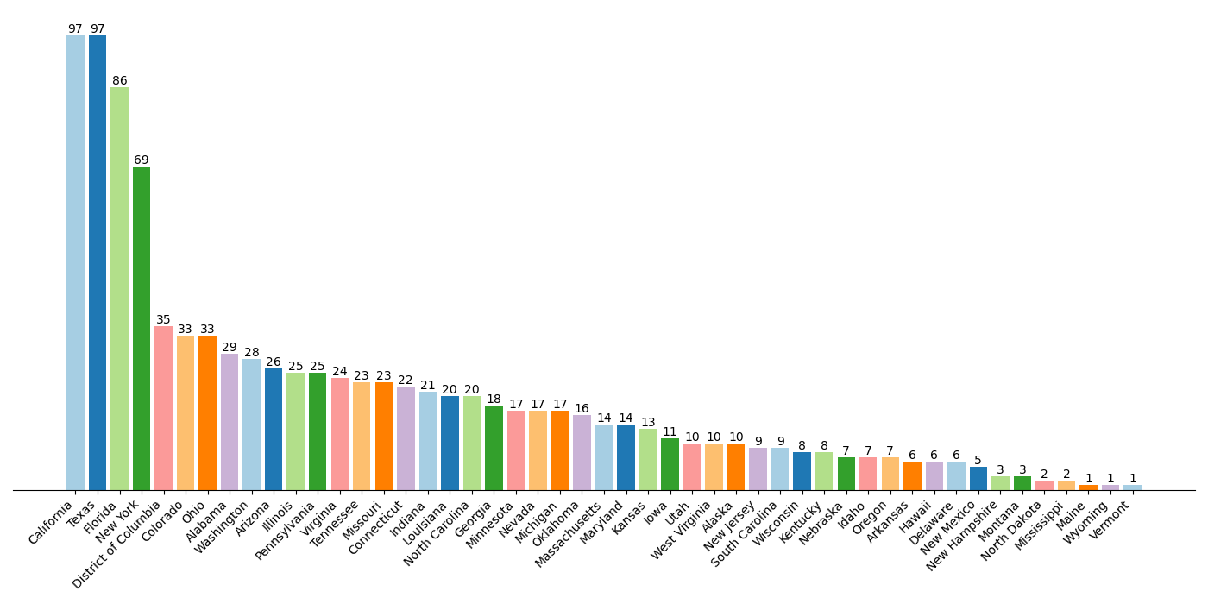
Sample 2
Q1
Distribution of Customers across States
Customer Count
States

Slide 4
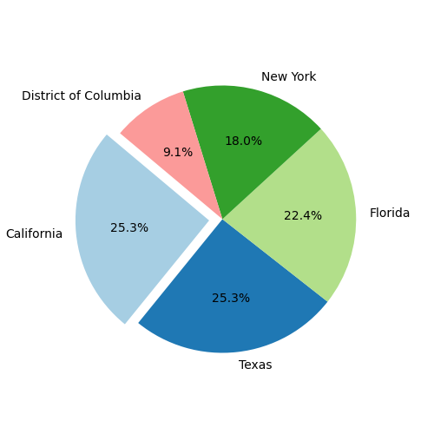
Sample 2
Q1
Distribution of Customers across States
Observations
Bar chart shows diversity of customers across various states. Though most of the share is lead by California, Texas, Florida and New York.
California and Texas emerge as the top states with the highest customer counts, suggesting a strong market presence or popularity of the product/service in these regions
States like Florida, New York, and Texas, which are known for their dense populations, also feature prominently in the top 10, indicating the potential for a large customer base
States like Alabama, Washington, and Arizona also make it to the top 10, indicating potential opportunities for market expansion or targeting specific regional markets
The inclusion of the District of Columbia in the top 10 suggests a concentration of customers in urban centers or metropolitan areas
Top 5 states with maximum customer base

Slide 5
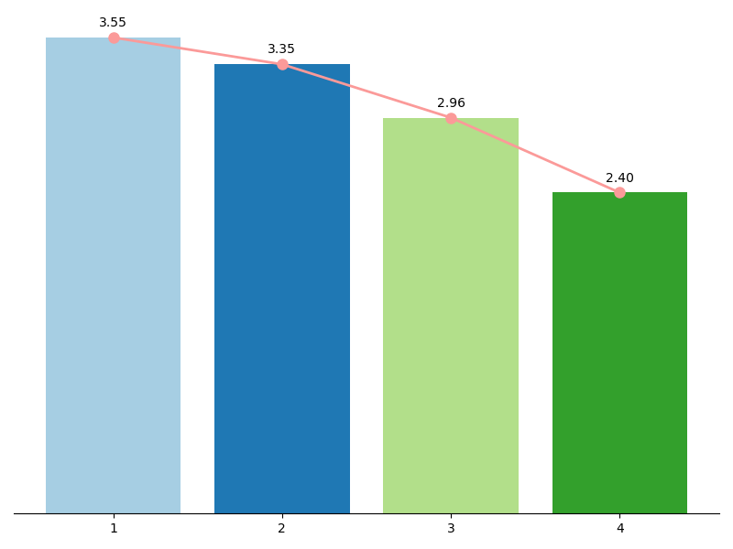
Sample 2
Q2
Average Customer Ratings by Quarter
Observations
Gradual Decline: There is a gradual decline in average ratings from the first quarter to the fourth quarter. This decline suggests a decreasing level of satisfaction or perceived quality of products or services over time
Significant Drop: The most significant drop in average ratings occurs between the third and fourth quarters, indicating a potential issue or dissatisfaction among customers during that period
Average rating varies from 3.55 to 2.4
The decreasing trend in average ratings underscores the need for action to address any underlying issues affecting customer satisfaction. This could involve improving product quality, enhancing customer service, or addressing any other factors contributing to the decline in ratings
Average Rating
Quarters

Slide 6
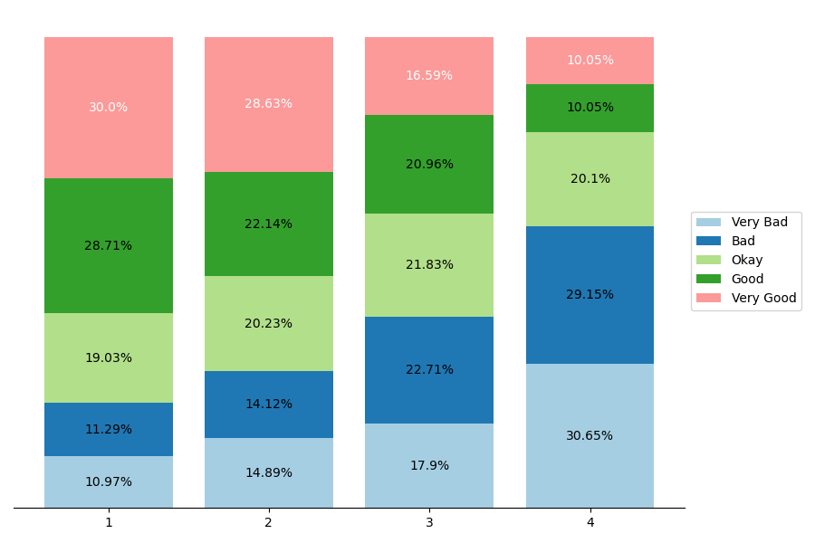
Sample 2
Q3
Trend of Customer Satisfaction
Observations
Clear indication of gradual drop in positive feedback and increase in negative feedback over each quarter
Good and Very Good rating has been dropped whereas Bad and very bad ratings has been increased consistently. Okay rating is consistent across quarters.
Eventually shows increase in customers dissatisfaction with each quarter
This decline suggests a potential decrease in customer engagement or participation in providing feedback over time
The trends in feedback distribution underscore the importance of taking proactive measures to address any issues highlighted by negative feedback and to reinforce positive aspects of the business to maintain customer satisfaction and loyalty.
Maybe conducting customer surveys/interviews could be beneficial
Average Rating for each category
Quarters
Note:
Above Bar chart shows quarter-wise percentage of each customer feedback category

Slide 7
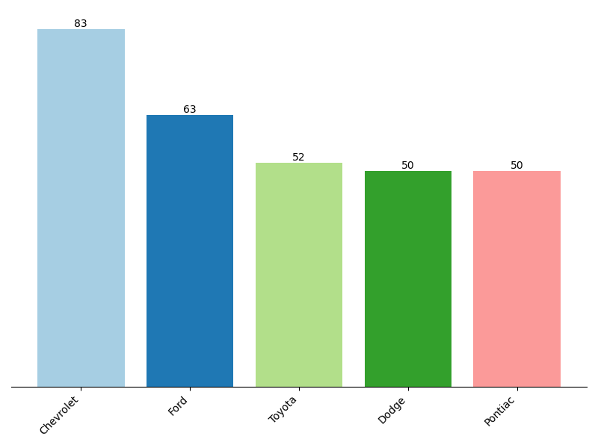
Sample 2
Q4
Top Vehicle makers preferred by customers
Observations
List indicates top 5 brands on the basis of customer counts
Chevrolet leads in terms of customer count, indicating a strong presence and potentially a higher market share. Ford follows Chevrolet closely in customer count.
Chevrolet, Ford seems to be most favored brands when compared to others
Toyoto, Dodge and Pontiac are also favoured by customer and have almost equal distribution among them
Customer Count
Vehicle makers

Slide 8
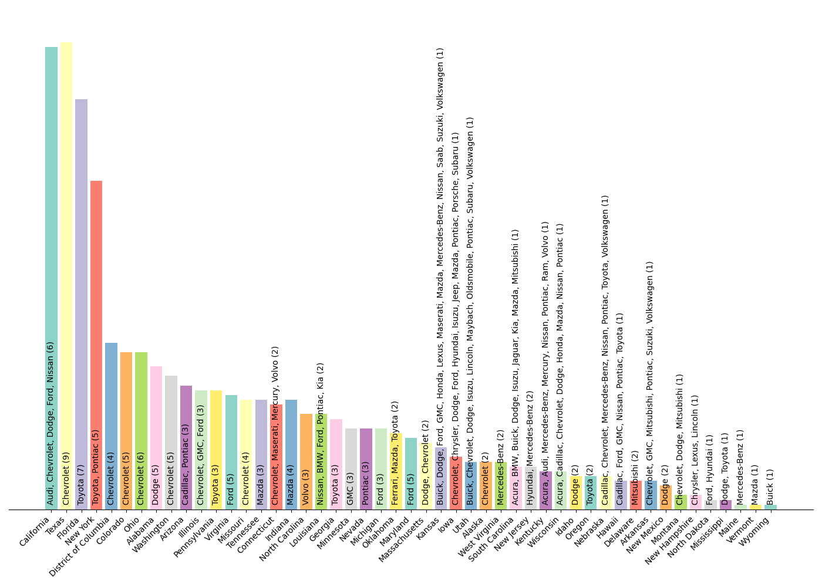
Sample 2
Q5
Most preferred vehicle make in each state
Observations
Chart display state wise top vehicle makers on the basis of customer count
Chevrolet lead the list by topping in most of the (17) states. Clear indication being market leader and most favoured brand by customers.
Dodge, Ford, Toyota also topped in certain states
While some states exhibit a single dominant vehicle maker, others showcase a diverse range of top brands.
State-wise preferred makers
Note: Adjacent Bar plot shows:
State wise overall customer count
State wise preferred vehicle makers (text inside bars) those having maximum customer counts
State wise customer count for top vehicle makers (text inside bars)
Y axis represents overall state wise customer count where as count inside bars are of top vehicle makers
States

Slide 9
Sample 2
Q5
Most preferred vehicle make in each state
State | Top Vehicle makers | Count
California | Audi, Chevrolet, Dodge, Ford, Nissan | 6
Texas | Chevrolet | 9
Florida | Toyota | 7
New York | Toyota, Pontiac | 5
District of Columbia | Chevrolet | 4
Colorado | Chevrolet | 5
Ohio | Chevrolet | 6
Alabama | Dodge | 5
Washington | Chevrolet | 5
Arizona | Cadillac, Pontiac | 3
Illinois | Chevrolet, GMC, Ford | 3
Pennsylvania | Toyota | 3
Virginia | Ford | 5
Missouri | Chevrolet | 4
Tennessee | Mazda | 3
Connecticut | Chevrolet, Maserati, Mercury, Volvo | 2
Indiana | Mazda | 4
North Carolina | Volvo | 3
Louisiana | Nissan, BMW, Ford, Pontiac, Kia | 2
Georgia | Toyota | 3
Minnesota | GMC | 3
Nevada | Pontiac | 3
Michigan | Ford | 3
Oklahoma | Ferrari, Mazda, Toyota | 2
Maryland | Ford | 5
Massachusetts | Dodge, Chevrolet | 2
State | Top vehicle makers | Count
Kansas | Buick, Dodge, Ford, GMC, Honda, Lexus, Maserati, Mazda, Mercedes-Benz, Nissan, Saab, Suzuki, Volkswagen | 1
Iowa | Chevrolet, Chrysler, Dodge, Ford, Hyundai, Isuzu, Jeep, Mazda, Pontiac, Porsche, Subaru | 1
Utah | Buick, Chevrolet, Dodge, Isuzu, Lincoln, Maybach, Oldsmobile, Pontiac, Subaru, Volkswagen | 1
Alaska | Chevrolet | 2
West Virginia | Mercedes-Benz | 2
South Carolina | Acura, BMW, Buick, Dodge, Isuzu, Jaguar, Kia, Mazda, Mitsubishi | 1
New Jersey | Hyundai, Mercedes-Benz | 2
Kentucky | Acura, Audi, Mercedes-Benz, Mercury, Nissan, Pontiac, Ram, Volvo | 1
Wisconsin | Acura, Cadillac, Chevrolet, Dodge, Honda, Mazda, Nissan, Pontiac | 1
Idaho | Dodge | 2
Oregon | Toyota | 2
Nebraska | Cadillac, Chevrolet, Mercedes-Benz, Nissan, Pontiac, Toyota, Volkswagen | 1
Hawaii | Cadillac, Ford, GMC, Nissan, Pontiac, Toyota | 1
Delaware | Mitsubishi | 2
Arkansas | Chevrolet, GMC, Mitsubishi, Pontiac, Suzuki, Volkswagen | 1
New Mexico | Dodge | 2
Montana | Chevrolet, Dodge, Mitsubishi | 1
New Hampshire | Chrysler, Lexus, Lincoln | 1
North Dakota | Ford, Hyundai | 1
Mississippi | Dodge, Toyota | 1
Maine | Mercedes-Benz | 1
Vermont | Mazda | 1
Wyoming | Buick | 1

Slide 10
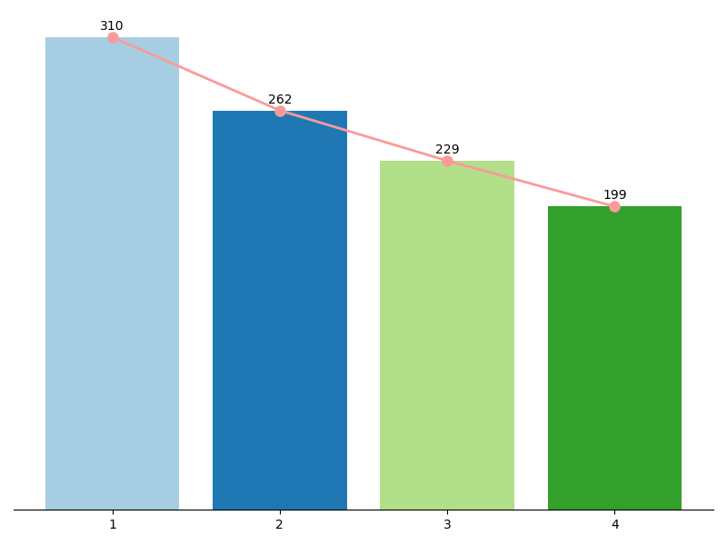
Sample 2
Q6
Trend: Number of orders by quarters
Observations
Chart shows quarter wise order counts
There is a noticeable decrease in the number of orders as the quarters progress, indicating a declining trend in orders.
This clearly shows issue either with product quality or other issues like customer experience
Decline in orders can be due to external factors such as economic conditions, market dynamics.
Relating this result with quarterly average rating, it seems like decline is due to customer dissatisfaction.
Order count
Quarters

Slide 11
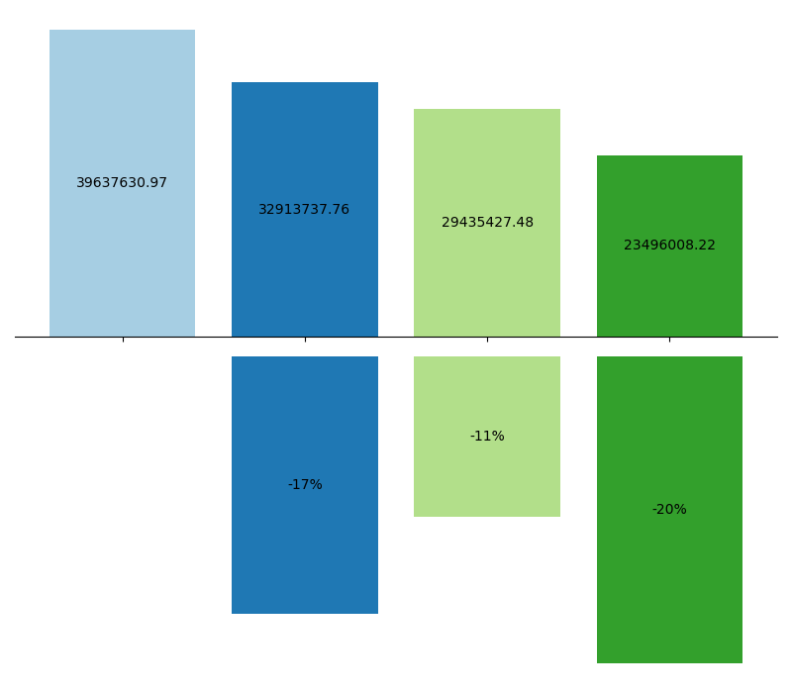
Sample 2
Q7
Quarter on Quarter % change in Revenue
Quarter-wise revenue
Observations
Chart shows quarter wise revenue at the top and percentage change of revenue at bottom
Clear decline in the revenue with every quarter noticed
This clearly shows issue either with product quality or other issues recession or bad financial crisis.
Relating this result with quarterly average rating, it seems like decline is due to customer dissatisfaction.
Last quarter has highest decline in the revenue highlighting major issues.
Revenue
Q1
Q2
Q3
Q4
Change in revenue (%)
Quarter-wise change in revenue
(Comparing previous quarter revenue)

Slide 12
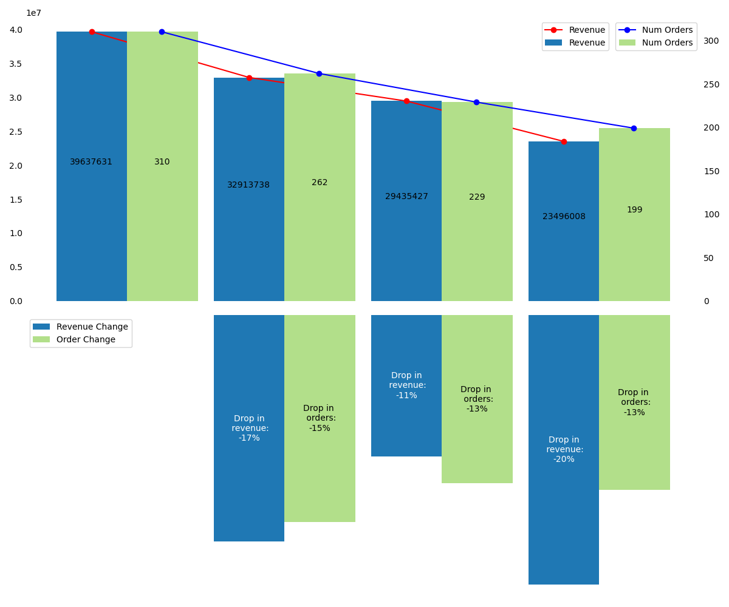
Sample 2
Q8
Trend of Revenue and Orders by Quarter
Quarter-wise revenue / Orders
Observations
Chart indicates clear decline in the revenue and order counts with every quarter.
Relating this result with quarterly average rating, it seems like decline is due to customer dissatisfaction.
Last quarter has highest decline 20% for revenue whereas order decline has stayed at 13%.
Gradual decrease in orders and revenue highlight possibility of product quality issues or bad customer experience. It could be impacted due to other factors like Market condition.
Revenue
Orders
Q1
Q2
Q3
Q4
Change in revenue (%)
Change in Orders (%)
Note: Adjacent Chart Overview
Top Section:
Blue Bars: Quarterly Revenue Trend (Y-axis: Left-hand side)
Green Bars: Quarterly Order Trend (Y-axis: Right-hand side)
Bottom Section:
Blue Bars: Quarterly Revenue Percentage Change
Green Bars: Quarterly Order Count Percentage Change
Quarter-wise change in revenue / Orders
(Comparing previous quarter revenue)

Slide 13
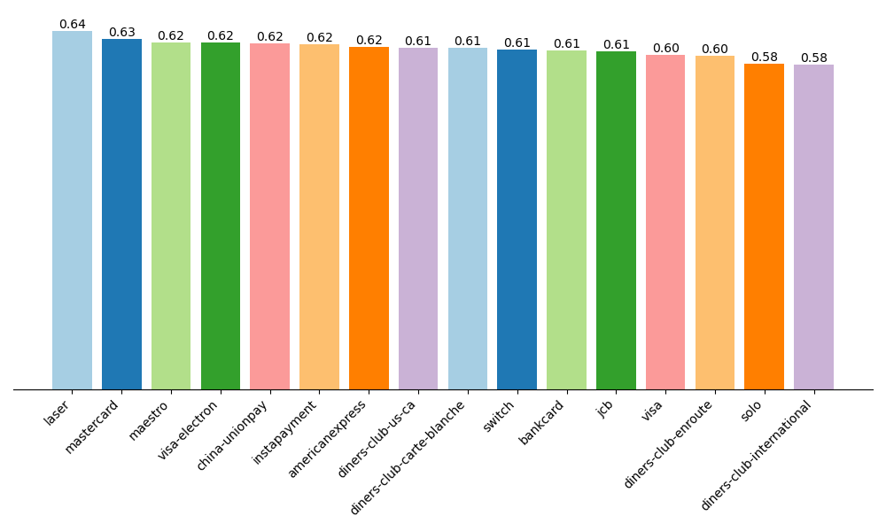
Sample 2
Q9
Average discount offered by Credit Card type
Observations
Discounts offered on various cards could be good marketing strategy
Laser type offering maximum average discount (0.64) followed by mastercard (0.63)
Average discount ranges between 0.58 to 0.64
Diners club international is offering lowest discount
Customers have plenty of alternatives available as many of the credit cards are offering good discounts
Average discount
Credit card type

Slide 14
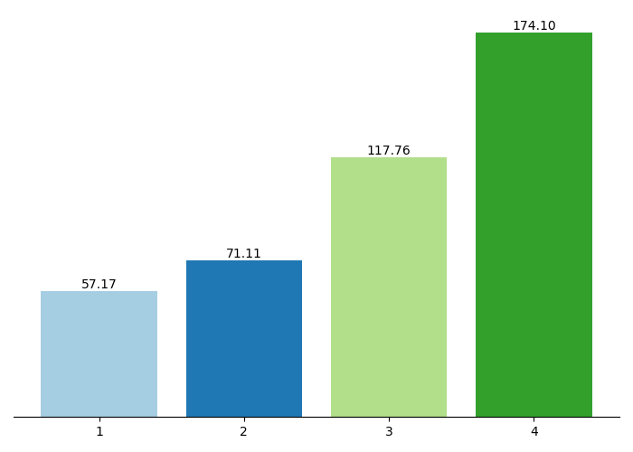
Sample 2
Q10
Time taken to ship orders by Quarter
Observations
Significant increase in shipping time with every quarter
Last quarter has seen maximum increase in order shipping time
Huge difference between average order ship time between quarter#1 and quarter#4 stating severe issues in managing the orders
This indicates possible production issues or shortage of spare parts. This can be also impacted due to market condition of supply chain issues
Time taken to ship order (In days)
Quarters

Slide 15
Sample 2
Consistent Performing Vehicle Maker
Vehicle Maker | Q1 Revenue | Q1 Order Count | Q2 Revenue | Q2 Order Count | Q2 Revenue Change% | Q3 Revenue | Q3 Order Count | Q3Revenue Change% | Q4 Revenue | Q4 Order Count | Q4 Revenue Change % | Total Revenue [Q1+Q2+Q3+Q4] | Total Orders [Q1+Q2+Q3+Q4] | Average Revenue Change
Chevrolet | 3290302.53 | 28 | 2768288.36 | 23 | -15.87 | 2336264.00 | 18 | -15.61 | 1963054.01 | 14 | -15.97 | 10357908.90 | 83 | -15.82
Ford | 2849474.12 | 20 | 2524824.95 | 21 | -11.39 | 1576875.05 | 13 | -37.55 | 1103735.60 | 9 | -30.00 | 8054909.72 | 63 | -26.31
Toyota | 1773390.02 | 16 | 1446958.71 | 11 | -18.41 | 1345744.53 | 13 | -6.99 | 1791688.25 | 12 | 33.14 | 6357781.51 | 52 | 2.58
Pontiac | 2435034.42 | 20 | 1273362.58 | 11 | -47.71 | 1365054.83 | 11 | 7.20 | 953682.73 | 8 | -30.14 | 6027134.56 | 50 | -23.55
Dodge | 1729345.01 | 15 | 1436896.59 | 11 | -16.91 | 1285538.62 | 10 | -10.53 | 1475766.67 | 14 | 14.80 | 5927546.89 | 50 | -4.22
Mercedes-Benz | 1018803.11 | 10 | 1181672.11 | 9 | 15.99 | 2128728.53 | 15 | 80.15 | 1177666.10 | 11 | -44.68 | 5506869.85 | 45 | 17.15
Mitsubishi | 954247.58 | 8 | 1932551.30 | 15 | 102.52 | 1181043.89 | 9 | -38.89 | 1117387.05 | 9 | -5.39 | 5185229.82 | 41 | 19.41
Mazda | 1732165.91 | 15 | 1923708.97 | 16 | 11.06 | 833850.70 | 6 | -56.65 | 630792.21 | 6 | -24.35 | 5120517.79 | 43 | -23.32
Buick | 1942083.50 | 17 | 513347.10 | 4 | -73.57 | 1521977.96 | 12 | 196.48 | 940495.81 | 7 | -38.21 | 4917904.37 | 40 | 28.24
GMC | 1525626.66 | 9 | 1506327.59 | 13 | -1.26 | 992854.21 | 7 | -34.09 | 856097.78 | 8 | -13.77 | 4880906.24 | 37 | -16.38
Volkswagen | 1243347.56 | 10 | 1442835.31 | 10 | 16.04 | 1199201.26 | 9 | -16.89 | 747866.71 | 6 | -37.64 | 4633250.84 | 35 | -12.83
Nissan | 1430112.70 | 11 | 1027928.77 | 8 | -28.12 | 695601.91 | 5 | -32.33 | 668563.31 | 7 | -3.89 | 3822206.69 | 31 | -21.45
Volvo | 1098290.10 | 8 | 478885.91 | 4 | -56.40 | 1343911.19 | 11 | 180.63 | 435456.44 | 3 | -67.60 | 3356543.64 | 26 | 18.88
BMW | 1126207.06 | 10 | 747910.17 | 5 | -33.59 | 727442.18 | 6 | -2.74 | 754105.15 | 7 | 3.67 | 3355664.56 | 28 | -10.89
Audi | 1293896.55 | 9 | 1067295.69 | 8 | -17.51 | 488146.36 | 4 | -54.26 | 379187.35 | 4 | -22.32 | 3228525.95 | 25 | -31.37
Suzuki | 921901.87 | 6 | 680129.22 | 5 | -26.23 | 1152416.90 | 8 | 69.44 | 391778.04 | 3 | -66.00 | 3146226.03 | 22 | -7.60
Note:
Above data shows change in revenue/orders over quarters for vehicle makers whose minimum total revenue exceeds 30M
Observations
In this analysis, we explore the quarterly revenue, order volumes, and their percentage changes for various vehicle makers. We focus on makers whose total revenue exceeds $30 million. While overall revenue has experienced a consistent decline, there are makers demonstrating resilience in maintaining their revenue streams. Our focus is directed towards these consistent performers
Toyota, Dodge, Chevrolet, Mitsubishi, Buick (highlighted) are some of the brands maintaining or even increasing revenues especially in last quarters
These brands present an opportunity for focused attention, with the potential to maximize sales and ultimately improve overall profitability. Management can focus on these brands and can intend to maximize their sales.

Slide 16
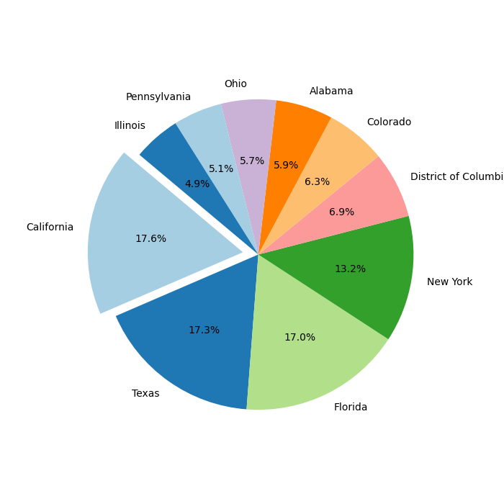
Sample 2
Top revenue generator states
Observations
Top Revenue States: California, Texas, and Florida are the top three states in terms of total revenue generated, with California leading the list.
Contribution of Top States: The top three states (California, Texas, and Florida) contribute significantly to the total revenue, accounting for a substantial portion of the overall revenue.
Distribution of Revenue: There is a notable disparity in revenue among states, with some states like California generating substantially higher revenue compared to others like Maine and Wyoming.
Regional Economic Disparities: The data suggests that there may be regional economic disparities, with states like California, New York, and Texas having higher economic activity compared to states with lower revenue figures.
Market Potential: States with higher revenue figures may present greater market potential or higher consumer demand for the products or services offered.This information is relevant with state-wise customer count analysis

Slide 17
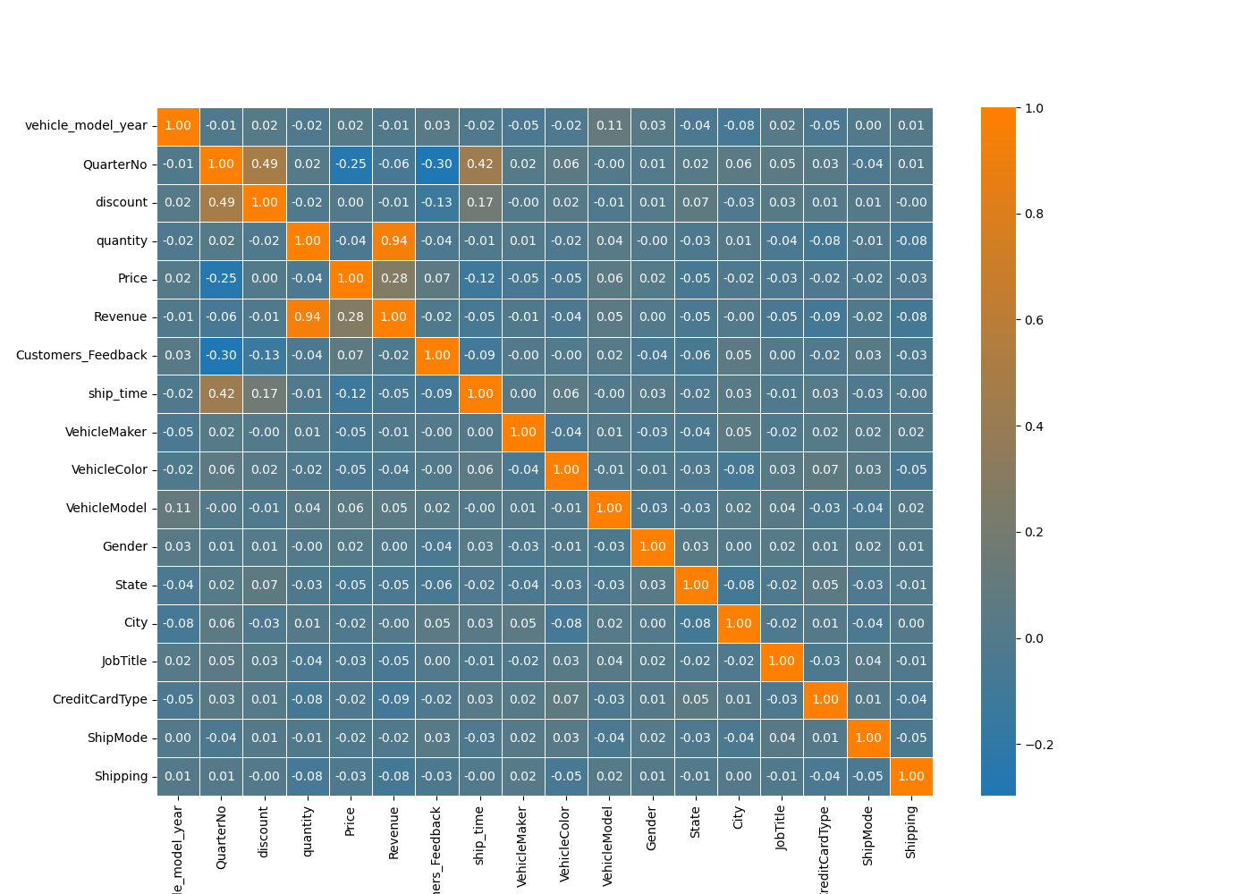
Sample 2
Correlation analysis
Observations
Positive correlation of quarters with customers feedback and ship_time is highlighted again
Change in discount (increase) and price (drop) with quarters can be seen
Relation between quantity and revenue is obvious
No much corelation found in the data that could be considered as impacting factors on decline in revenue, feedback.
Note:
Legend:
1/Dark Orange indicate maximum correlati0on (Impact)
-1/Dark blue indicate maximum negative correlation

Slide 18
Sample 2
Conclusion
Insights
Both order counts and revenue have shown a consistent downward trend.
Customer dissatisfaction has been on the rise continuously.
The delay in vehicle shipping time has been steadily increasing.
Despite price drops and increased discounts, sales have continued to decline.
However, amidst the overall sales decline, some brands are managing to maintain relatively better performance.
It's important to consider external factors such as economic conditions, market dynamics, or promotional campaigns, as they may significantly impact business performance in each quarter.
Recommendations
Initiate customer surveys and interviews to pinpoint pain points and areas for enhancement in the customer experience.
Prioritize efforts to enhance delivery times by diagnosing and resolving the underlying causes of delays.
Allocate resources towards brands such as Toyota, Chevrolet and Dodge, which exhibit consistent quarterly revenue generation. Minimizing involvement with consistently underperforming brands can offer benefits.
Focus on high performing brands and increase sale
Focus on optimizing business strategies in low-performing states to potentially boost performance.
Evaluate opportunities for enhancing customer experience across various touchpoints.
Analyze the impact of market dynamics to forecast demand fluctuations and tailor strategies accordingly.
Some research and brainstorming on understanding customer feedback, product quality and shipping delay time would be crucial for sustainability

Slide 19
Sample 2
Thank You!

