Slide 1
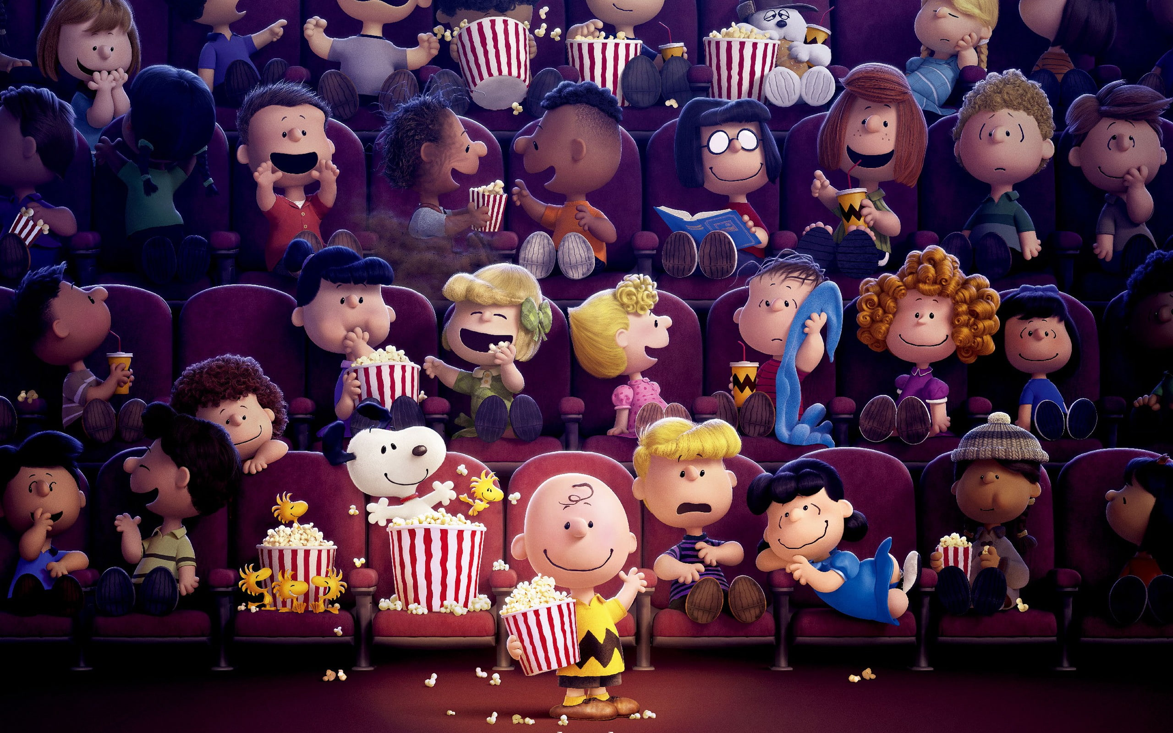
CINΣ_PLUS MOVIE MUZIX APP

Slide 2
Under Guidance:-
MRs. Sangeetha BooPathy
MRs. Mythreye Raghunathan
We have created this project under exceptional guidance of our Mentors Mythreye Mam & Sangeetha Mam. Their inputs were very valuable in this project. We wish to thank them for their mentoring throughout the journey.

Slide 3


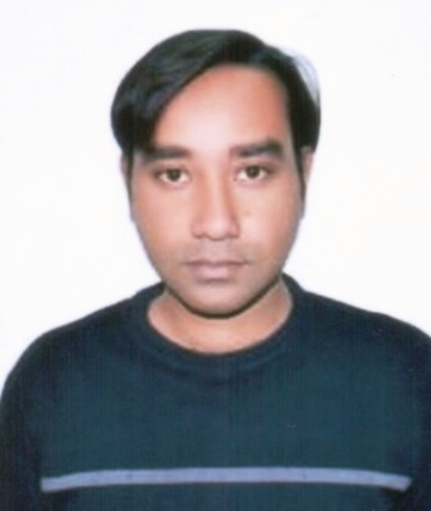
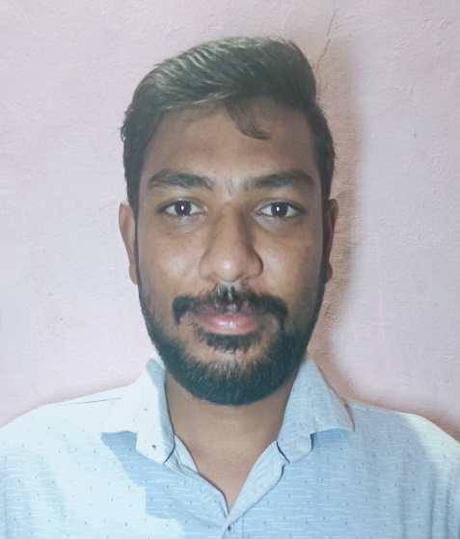
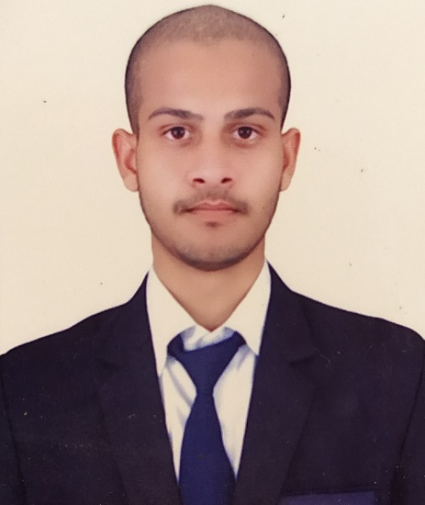
TEAM MEMBERS
ASHWANI KUMAR
RAGHAVENDRA SINGH
PRASHANT PANTH

Slide 4
INTRODUCTION
CINΣ_PLUS Muzix App is an Indian video streaming service based on OTT Platform.
It offers films and television series available in multiple languages.
We achieved team integrity while working in this project together.
We leant new tools & acknowledged proper usage of softwares.
With this full fledged app we came across many challenges and picked up how to combine one app to other.
After this project we will get assessment in real world projects, tasks.
It also has Seamless n Quick User Interface.

Slide 5

OBJECTIVES
We provide ease to access binge watching platform.
You can watch movies at your comfort.
Can watch movies based on languages.
Can preview trailers of the respective movies as per preference.
Stream movies and TV shows on your all sorts of devices.

Slide 6
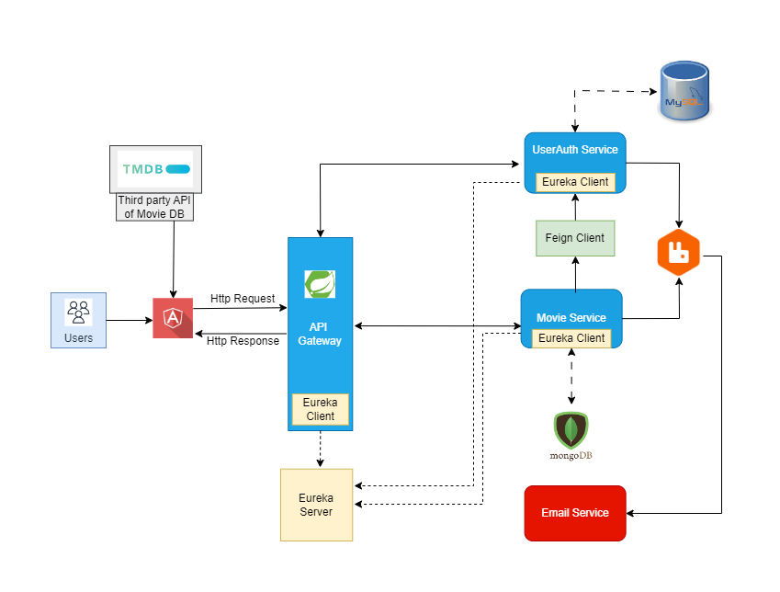
ARCHITECTURAL DIAGRAM

Slide 7
MODULES
Register and Login.
Login will be done by token.
Get a single or list of movies.
Create a playlist of favourite movies.
Add/remove/update favourite list.
Browse movies including trailers.
Get recommendations based on Language.

Slide 8




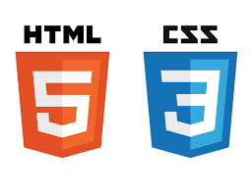

FRONTEND TOOLS
ANGULAR
JAVASCRIPT
ANGULAR MATERIAL
BOOTSTRAP
HTML & CSS
TYPESCRIPT

Slide 9










BACKEND TOOLS
DATABASES
Java/JDK 1.8
RabbitMQ
MySQL
MongoDB
TMDB
Spring Boot
API Gateway
JWT
Eureka
Feign Client

Slide 10
FEATURES
Favorite List
User can create a favorite list..
Browse
Browse movies and enjoy any movie trailer with IMDB ratings.
Search
Search movies on language, genre, kids and name basis.
Add/Delete
Users can add and delete any movie from favorite list.
Recommend movies filtered by language as per your favorite list.
Retrieve Password
User can retrieve his old password through OTP.
Dedicated Segment
Binge watch kids and trending shows and movies.
Recommend

Slide 11
LET’s PROCEED TO THE PROJECT

Slide 12


Slide 13
CONCLUSION
More or, less there are countless n redundant ways of implementing modules/functions to make CinePlus Muzix Movie Application look more corollary, so we made it simple yet attractive.
Thus, easy to access for the user or viewer and luring them into it where they can not only browse but also have a preview of the content and all data is provided by TMDB.
Last but not the least we also want to Thank our mentors who helped n guided us through our journey and having belief on us.

Slide 14
Thank You !
THE END

