Slide 1
Anomaly Detection on KDDCup 1999 Data
11th April 2016

Slide 2
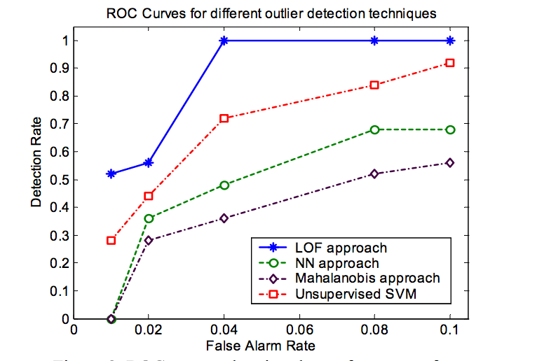
Overview of LOF

Slide 3
Overview of LOF
How to compute LOF?
  For each data example O compute k-distance (the distance to the k-th nearest neighbor) and k-distance neighborhood (all points in k-distance sphere)
  Compute reachability distance for each data example O with respect to data example p as : reach-dist(O,p) = max(k-distance(p),d(O,p)), where d(O,p) is distance from data example O to data example p.
  Compute local reachability density of data example O as inverse of the average reachabaility distance based on the MinPts (minimum number of data examples)nearest neighbors of data example O.
  Compute LOF of data example O as average of the ratios of the local reachability density of data example O and local reachability density of O’s MinPts nearest neighbors.

Slide 4
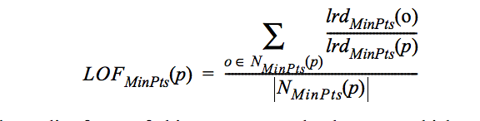
Weighted LOF
We tried to experiment with the weighting mechanism by considering cluster centers as representative of all points in the cluster and having a weight formula.
The existing formula for calculating LOF
Added a weight factor in the numerator of above formula such that sum of weights for all min points is 1.

Slide 5
Weighted LOF
w1 = number of points in cluster 1 / total number of points in min points clusters
wi = number of points in cluster i / total number of points in min points clusters
By changing our implementation and introducing weighted mechanism we ran experiments with different K (Number of clusters ) , Min points (number of points ) and different threshold value (TOP K%)

Slide 6
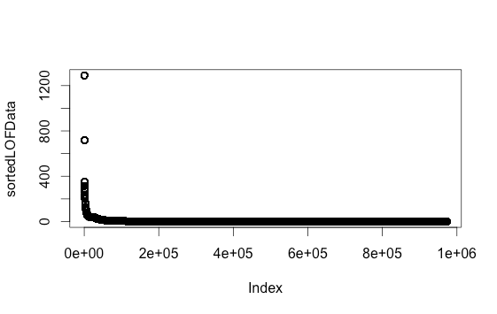
Weighted LOF
Threshold selection : plotted outlier factor against number of points and took a cut at different level like 2,5,10,15 to measure results.

Slide 7
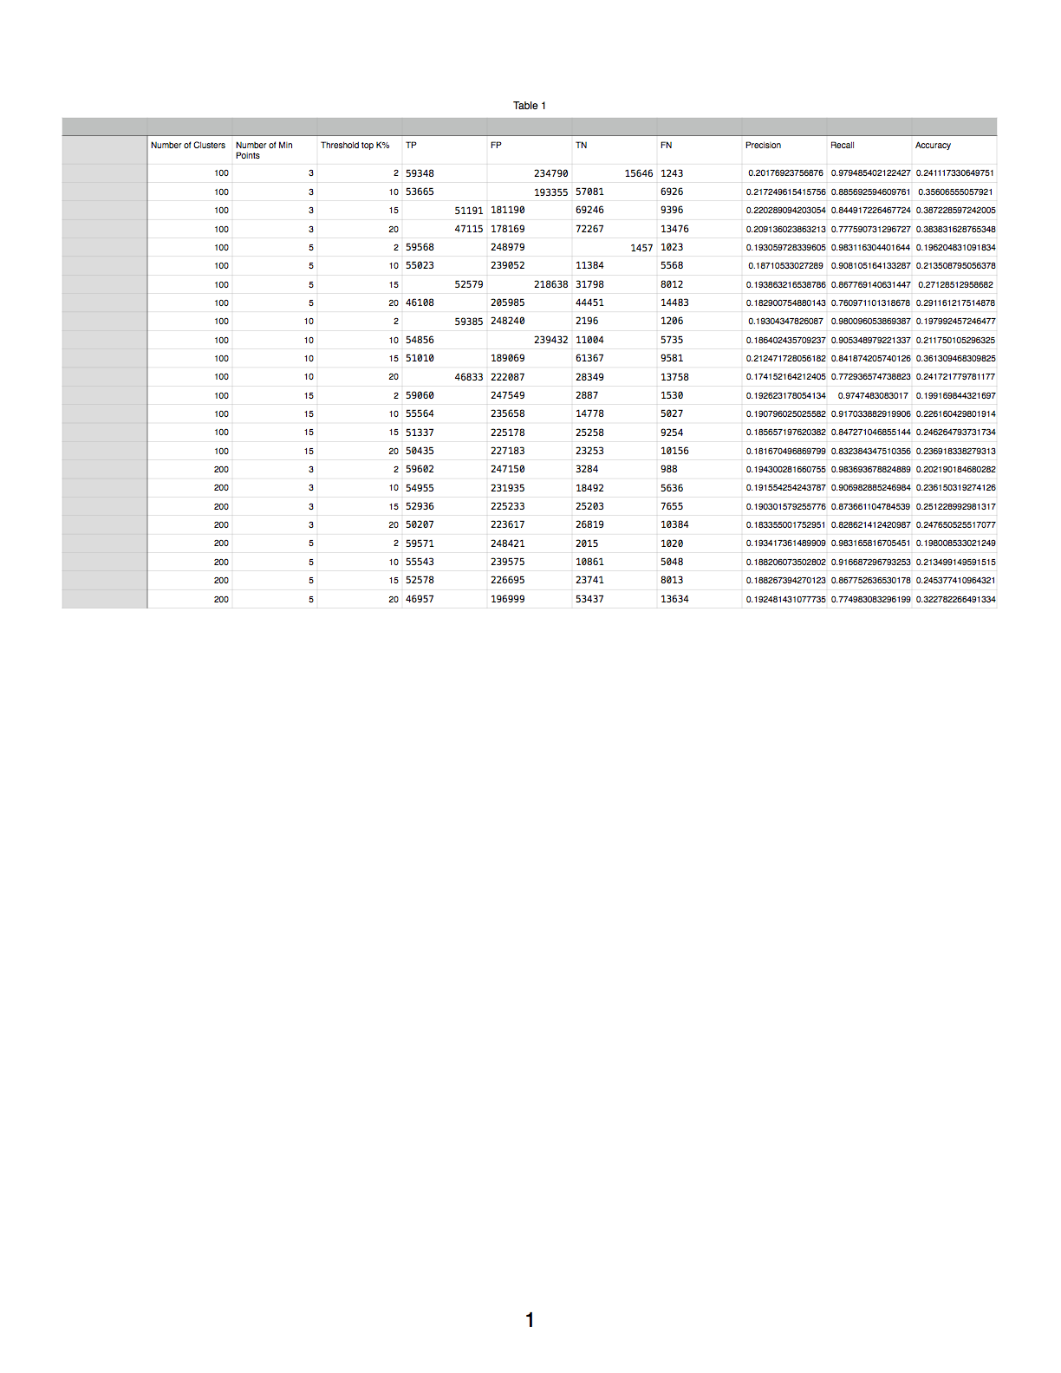
Results

Slide 8
More Experiments on LOF (New)
We removed weighting mechanism and ran our experiments taking clusters as points participating in LOF calculation.
We also tried LOF implementation as given in the paper no parallel and considering only data points participating in LOF calculation. In this section we tried multiple experiments but the code is going to memory issue which we were not able to fix it . ( Need some more time to fix this)
We also compared LOF and our KMeans results by comparing like in top 500,1000 etc.. how many are getting detected as Anomaly.

Slide 9
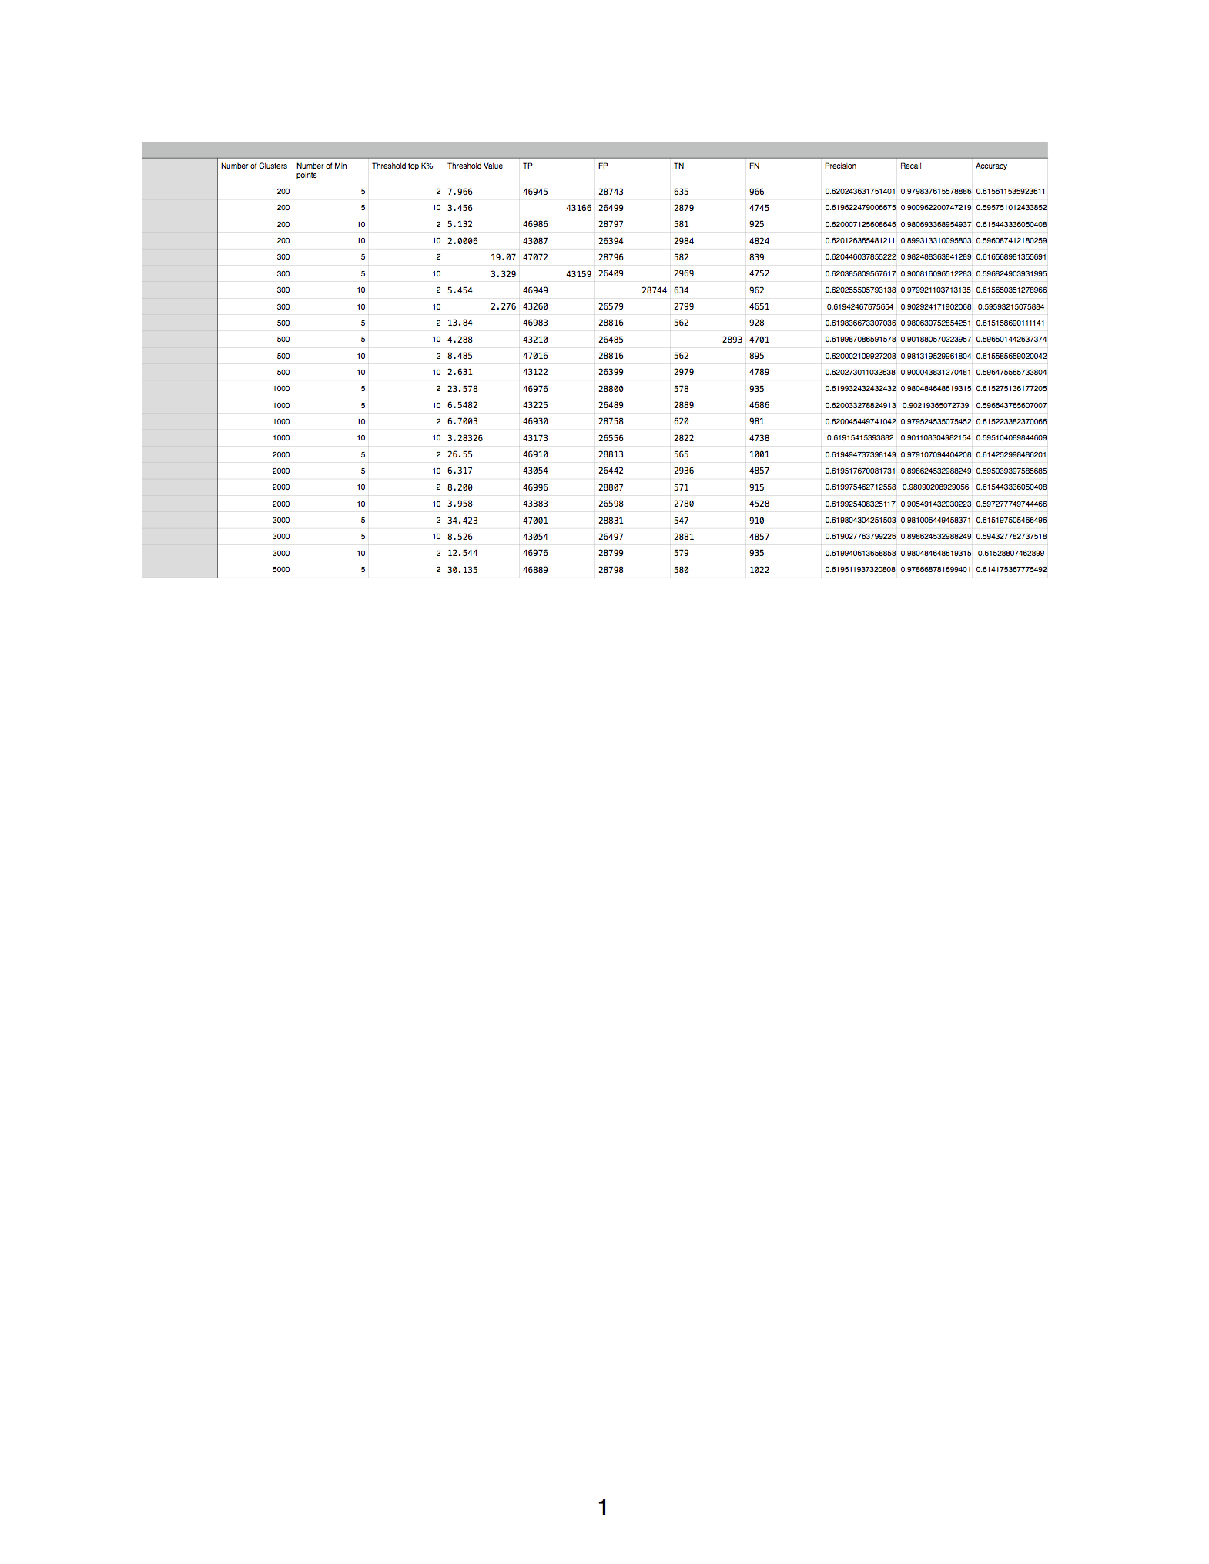
Results LOF based on Cluster Centers

Slide 10
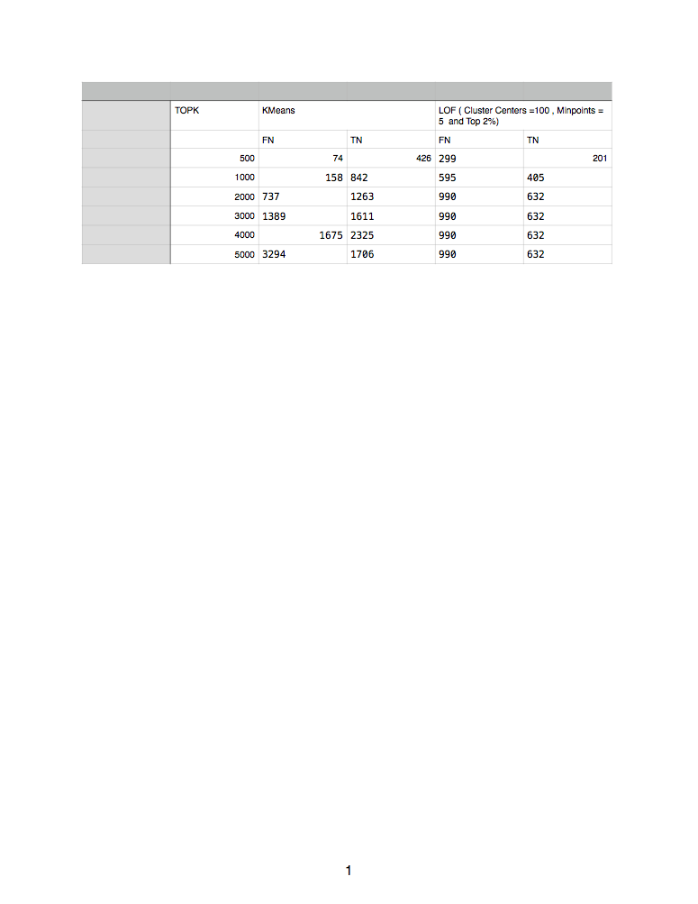
Comparison of Kmeans and LOF based on TOPK

Slide 11
Immediate Next Steps
Quickly Fixing the memory issue or looking into some other well Known Data mining tool which provide LOF calculation matching our requirements.
From the results we can see that even after increasing number of clusters its not helping much in our accuracy. Also I want to bring this point that once for k (number of clusters) is 1000 . The time taken by spark to complete this experiment is around 2 hours.
Also we can run one or two experiments on weighted LOF in parallel to see hows its behaving on more number of clusters.

