Slide 1
Anomaly Detection on KDDCup 1999 Data
25th April 2016

Slide 2
LOF Experiments
We Fixed the memory issue in LOF Code and ran different experiments with various setups.
We also used open source tool and ran LOF to compare our results with the tool so that we can make sure that our implementation is right.
We realized that LOF involves distance computation (KNN) and its time consuming process.
With discussion we tried if we can change KNN implementation introducing heap data structure to store only top k min distance and their instances it might bring the basic computation step from nlogn to nlogk where k = 3,5,etc.
Heap implementation wins over the dictionary implementation in term of running time but this gain is infinitesimal as compared to time taken by distance calculation.

Slide 3
LOF Experiments (Contd…)
Rapid miner (An open source tool) used for LOF calculation also takes exponential amount of time and keeps running for days without producing any output.
Size of training data : 800000
Size of Testing data : 300000
Why its time consuming ? As every time one instance distance is calculated with the rest of 800000 training data.

Slide 4
LOF Experiments Details
System Number | Type of Experiment
1(Slave 9) | LOF is running with 30% of training data and threshold selection is based on top 2% values of LOF from training data
2(Slave 10) | LOF is running with 30% of training data and threshold is 1
3(Slave 11) | LOF is running with all of training data and threshold is based on top 2% values of LOF from training data.
4 (Slave 12) | LOF is running with Heap Implementation with 30% of training data and threshold as 1
5(Slave 13) | LOF is running with Heap Implementation with all training data and threshold as 1
6(Slave 14) | LOF is running with Heap implementation including instances with same distance as same instances with all training data and top 2% as threshold
7 (Slave 15) | LOF is running with Heap implementation including instances with same distance as same instances with 30% training data and 2% as threshold
8( Slave 16) | LOF is running with Heap Implementation with 30% of training data and threshold as top 2%
9( Slave 17) | LOF is running with Heap Implementation with all training data and threshold stop 2%
 | Note : All System has same memory and cpu . RAM is 32gb Intel(R) Xeon(R) CPU E5-2420 v2 @ 2.20GHz

Slide 5
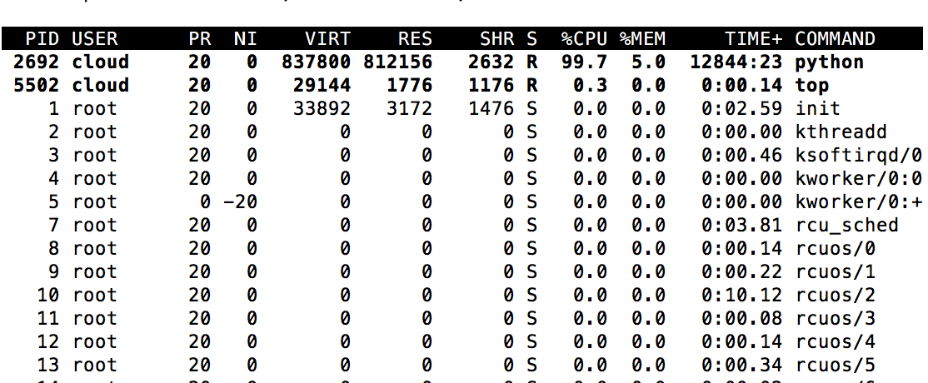
LOF Experiments Details (Slave 9)

Slide 6
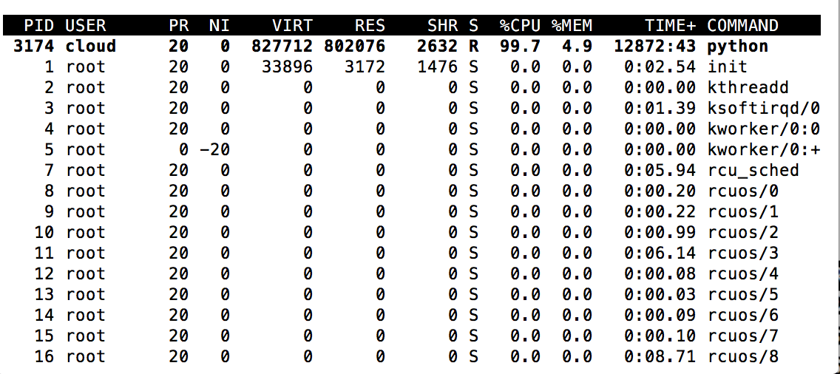
LOF Experiments Details (Slave 10)

Slide 7
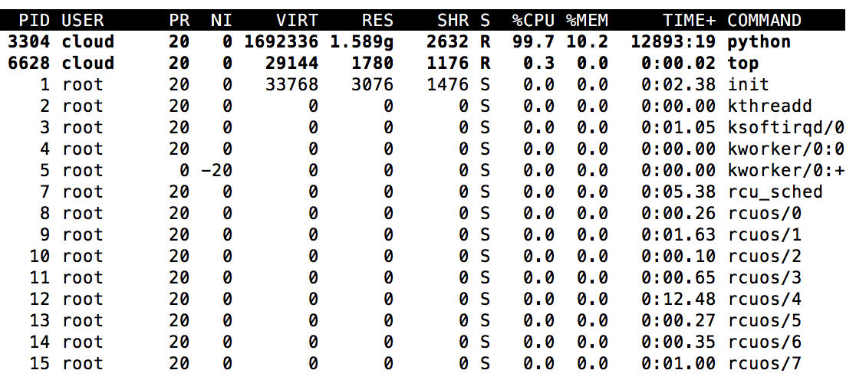
LOF Experiments Details (Slave 11)

Slide 8
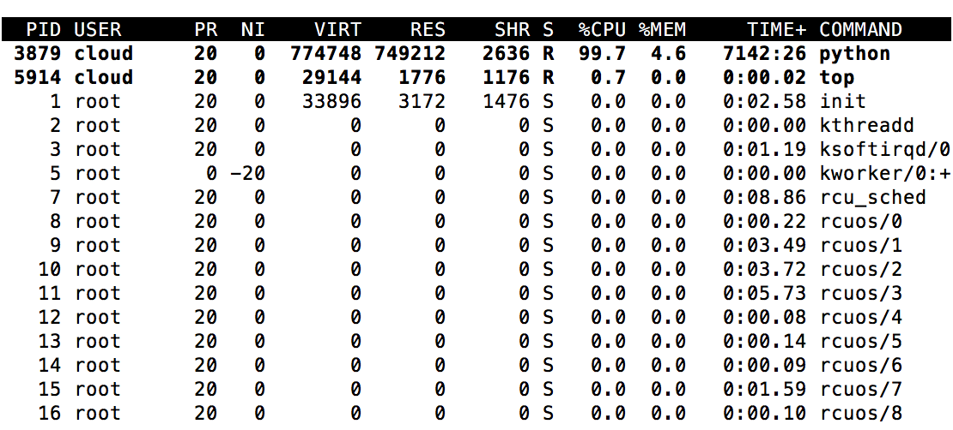
LOF Experiments Details (Slave 12)

Slide 9
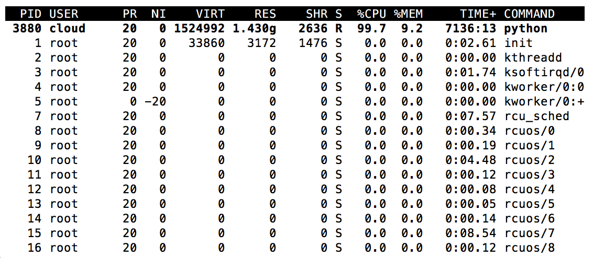
LOF Experiments Details (Slave 13)

Slide 10
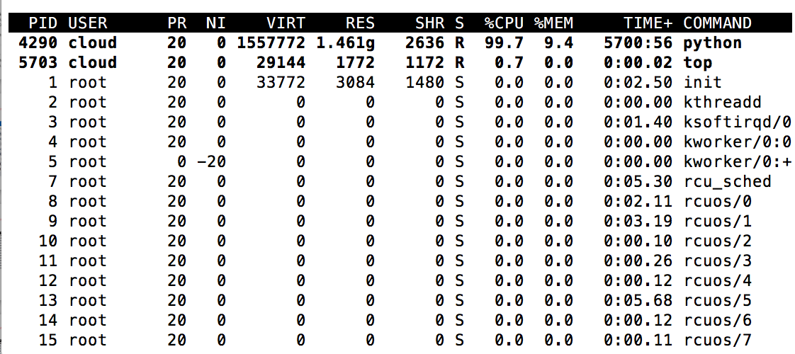
LOF Experiments Details (Slave 14)

Slide 11
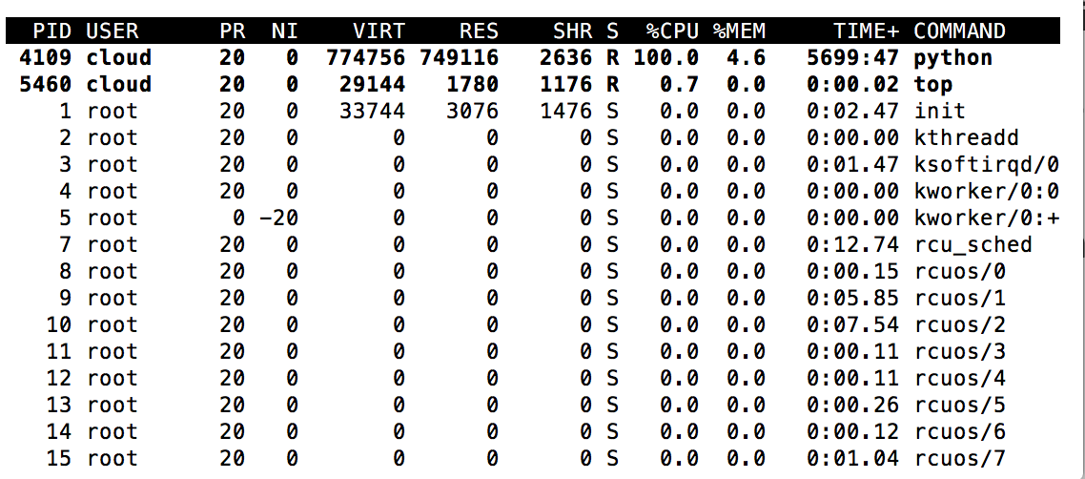
LOF Experiments Details (Slave 15)

Slide 12
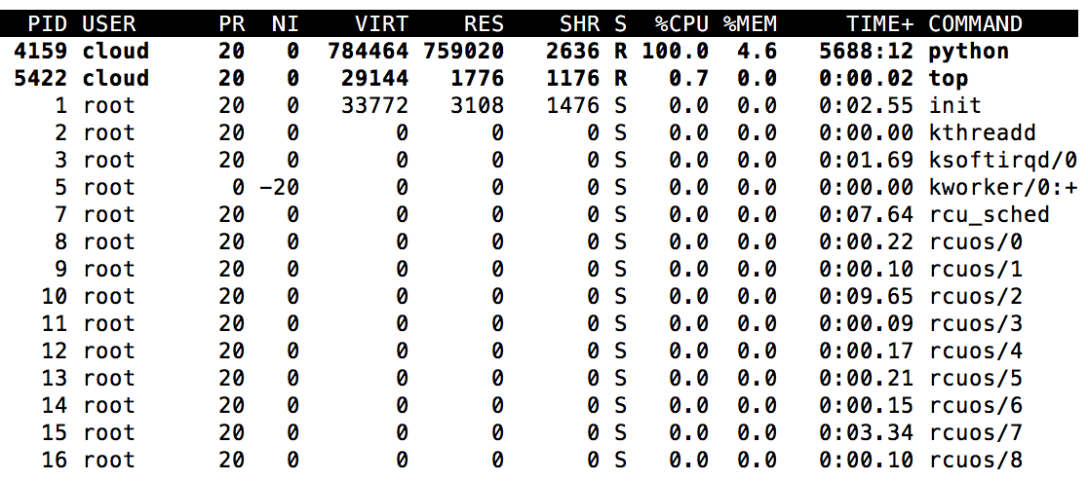
LOF Experiments Details (Slave 16)

Slide 13
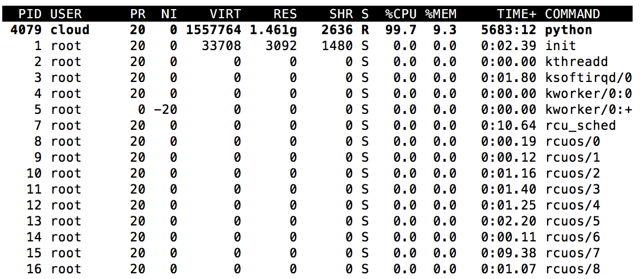
LOF Experiments Details (Slave 17)

Slide 14
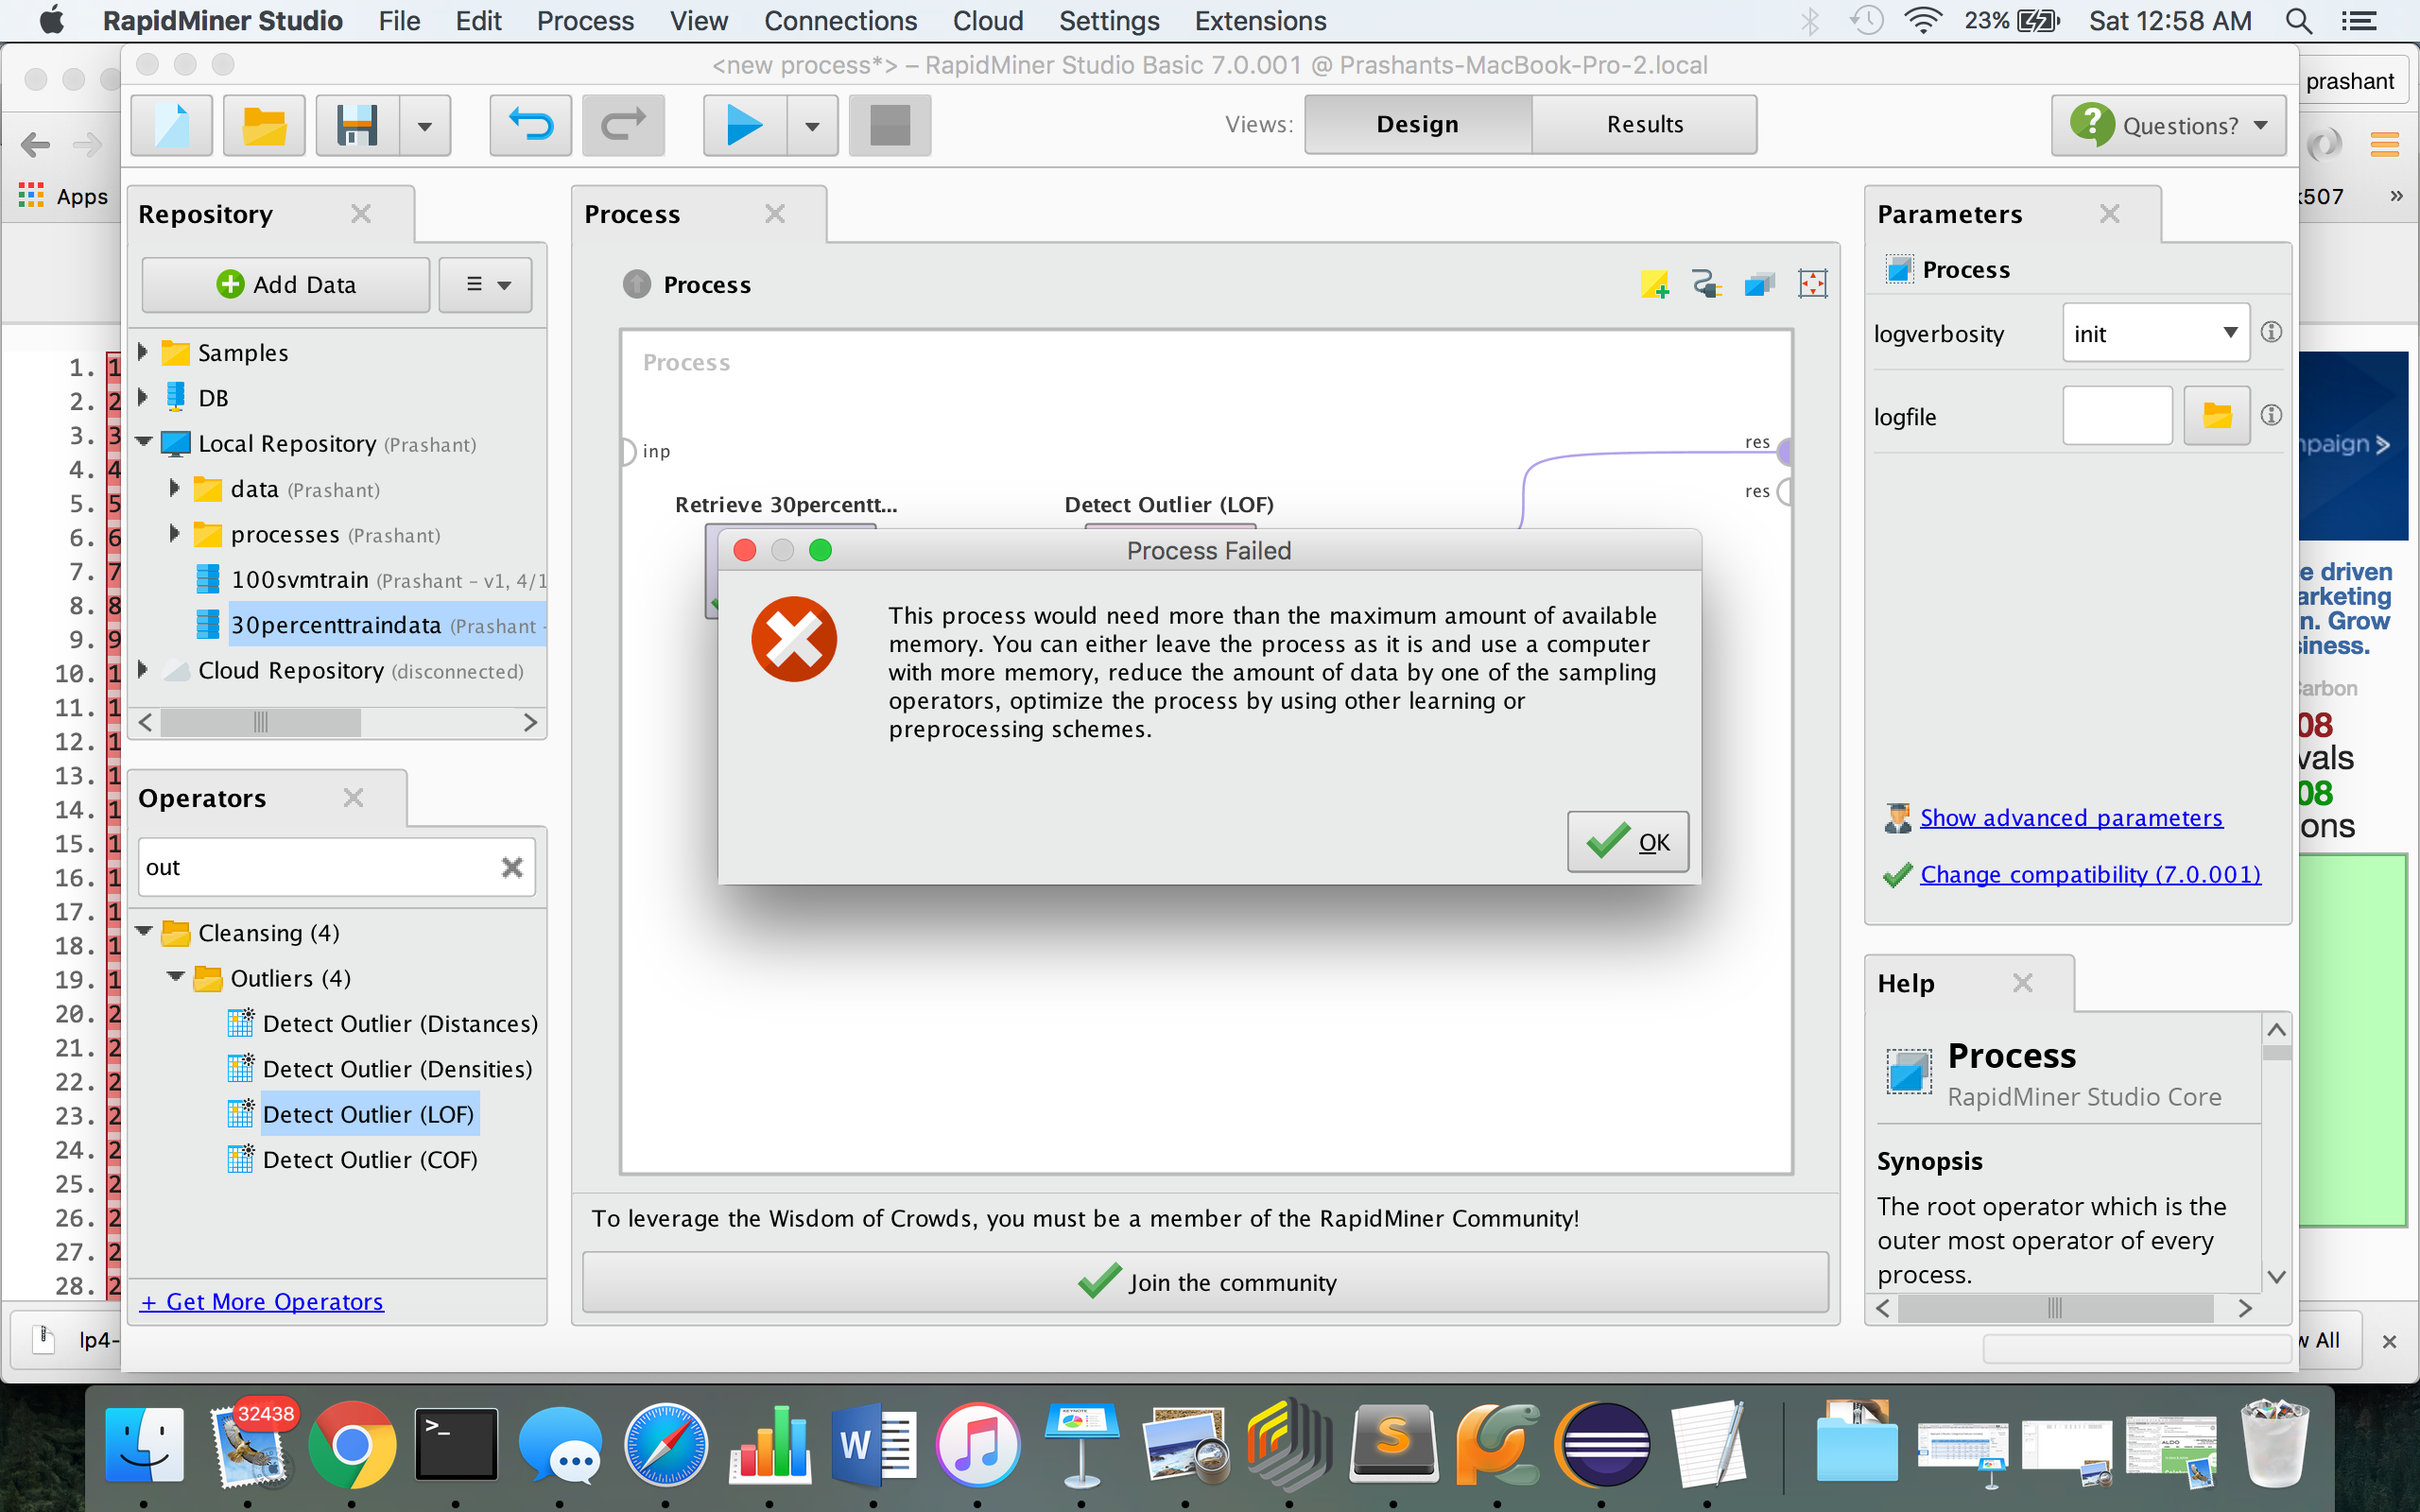
LOF Experiments (Using Rapid Miner Open Source Tool)
This experiment was run on Mac System with 8gb of RAM and i5 processor.
With 30 % of training data . It ran for 10 days and then end up with memory issue .

Slide 15
Code Repo
https://github.com/prashantprakash/KDDDataResearch/blob/master/Code/PythonCode_LOF/RunTimeAnal.py (Running time analysis of Dictionary data structure and Heap Data structure)
https://github.com/prashantprakash/KDDDataResearch/blob/master/Code/PythonCode_LOF/lof_heap.py ( LOF implementation using Heap)
https://github.com/prashantprakash/KDDDataResearch/blob/master/Code/PythonCode_LOF/lof.py (LOF implementation)

Slide 16
LOF (How can we improve running time further? )
We can implement Caching technique to save our time of distance computation , but its not that straight forward .
When we were reading about LOF and why its so time consuming we found incremental LOF update. But we are not sure how useful its going to be.

