Slide 1
Anomaly Detection on KDDCup 1999 Data
Date : 10th March 2016

Slide 2
Master Thesis Replication Results
Master Thesis
TP | FP | TN | FN | Precision | Recall | Accuracy
28954 | 7765 | 40111 | 395 | 0.7885 | 0.9865 | 89.43%
Master Thesis Replicated
TP | FP | TN | FN | Precision | Recall | Accuracy
234788 | 15648 | 49953 | 10640 | 0.9375 | 0.9566 | 91.5%
Removal of duplicate data from Test Data Set
TP | FP | TN | FN | Precision | Recall | Accuracy
25563 | 6494 | 41411 | 1267 | 0.7974 | 0.9527 | 92.6%

Slide 3
Master Thesis Replication Results
Master Thesis Experiment with 28 features and 8 pca
One experiment is still running and the other experiment failed for some reason from logs not able to trace the reason.
TP | FP | TN | FN | Precision | Recall | Accuracy
234538 | 15898 | 50941 | 9650 | 0.9365 | 0.9604 | 91.7%

Slide 4
Outlier Detection Schemes
KNN (Kth nearest neighbor) Approach
NN (Nearest neighbor) Approach
Mahalanobis-distance Approach
Density based Local outliers

Slide 5
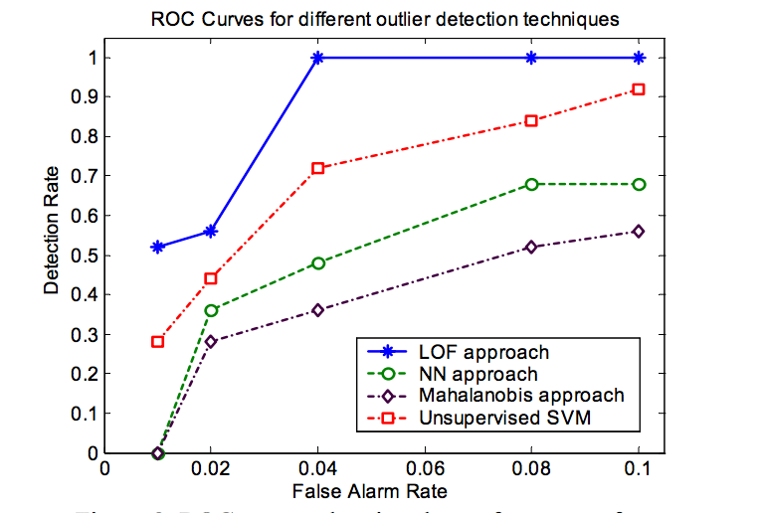
Results Comparison

Slide 6
Density based local Outliers
The main idea of this approach is to assign to each data point a degree of being outlier. The degree is called LOF( Local Outlier Factor).
How to compute LOF?
  For each data example O compute k-distance (the distance to the k-th nearest neighbor) and k-distance neighborhood (all points in k-distance sphere)
  Compute reachability distance for each data example O with respect to data example p as : reach-dist(O,p) = max(k-distance(p),d(O,p)), where d(O,p) is distance from data example O to data example p.
  Compute local reachability density of data example O as inverse of the average reachability distance based on the MinPts (minimum number of data examples)nearest neighbors of data example O.
  Compute LOF of data example O as average of the ratios of the local reachability density of data example O and local reachability density of O’s MinPts nearest neighbors.

Slide 7
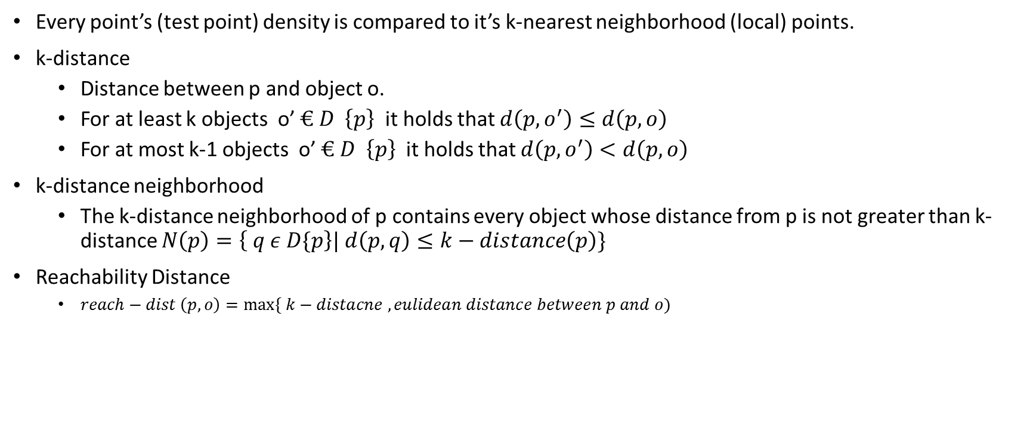
Density Based Local Outlier Factor Approach

Slide 8
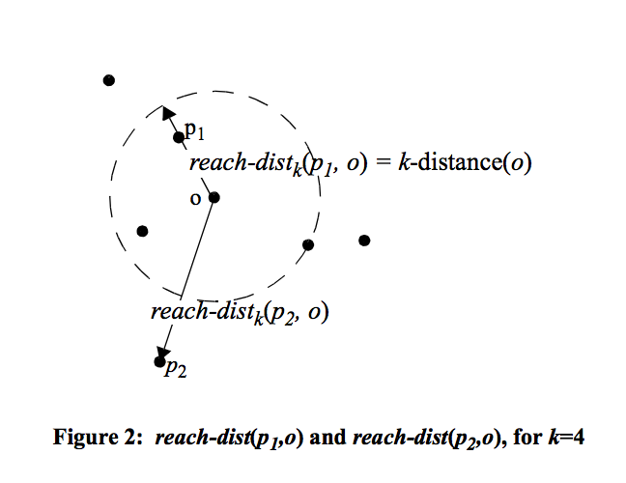
Density Based Local Outlier Factor Approach

Slide 9
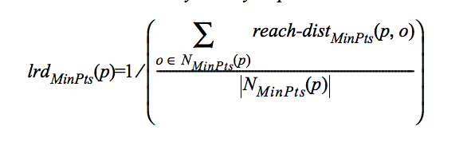
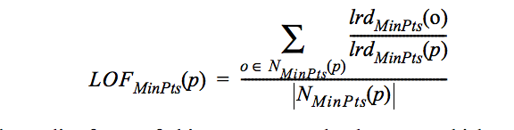
Density Based Local Outlier Factor Approach
Local reachability density of point p is defined as :
Local Outlier factor of p is defined as:
Here N(minpts) is the same as value of k for k-nearest neighbors

Slide 10
Our Implementation of Density based LOF
If we go with the approach then scalability is going to be an issue here as we have to compute distance or every point to other points in train data and then closest k .
We have decided to go with the cluster centers as representative of all the points in that cluster to assign outlier factor value for a data point. So instead of distance calculation among all the points we reduce our set and k-distance calculation will be done only with cluster centers.
The rest of the calculations are same as explained in the paper.

Slide 11
Our Implementation of Density based LOF
Train Data
KMeans Clustering
Cluster Centers
This LOF model is going to use all the cluster centers as its base points for identifying LOF
Any Data Point
LOF Model
Data Point with an outlier factor value

Slide 12
Why we are Introducing Clustering in LOF ?
One of the main reason is scalability . We can go with KNN approach as well but in general KNN is not scalable.
One of the futuristic vision for this implementation is right now in our implementation we are not considering weight while calculating the outlier factor but in our next implementation we are going to devise some technique to assign weight to clusters so that based on density of clusters it can contribute significant part in the outlier factor of a point.
With Clustering approach we can update our model easily in less time.

Slide 13
Results of Density based LOF
Threshold is chosen as 1 , this can be improved by making a good way to choose to threshold. For Clustering we have right now K =100, pca=20 .
K (Min Pts) | TP | FP | TN | FN | Precision | Recall | Accuracy
5 | 126413 | 36723 | 23868 | 124023 | 0.7748 | 0.5047 | 48.31%
10 | 118641 | 30599 | 29992 | 131795 | 0.7949 | 0.4737 | 47.78%
15 | 109867 | 25567 | 35024 | 140569 | 0.8112 | 0.4387 | 46.58%
20 | 60271 | 21013 | 39578 | 190165 | 0.7414 | 0.2406 | 32.10%

Slide 14
Code Repository
https://github.com/prashantprakash/KDDDataResearch/blob/master/Code/LOF_SDM/src/main/scala/LOF.scala

Slide 15
Next Steps
The same experiment needs to be repeated by choosing a nice threshold.
Add weight factor as discussed before.
Also we can increase the number of clusters in this case to include more points which can contribute to LOF .
Also we have to remove duplicates from test data to get the accurate results.

