Slide 1
Anomaly Detection on KDDCup 1999 Data
Date : 10th March 2016

Slide 2
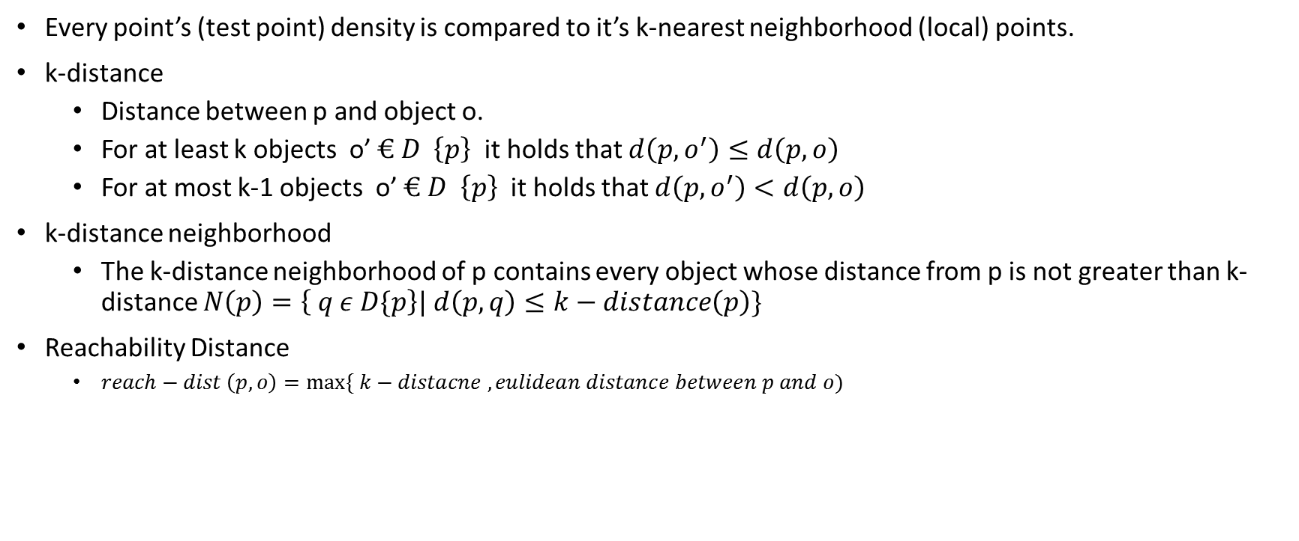
Density Based Local Outlier Factor Approach
Every point’s (test point) density is compared to it’s k-nearest neighborhood (local) points.
k-distance
Distance between p and object o.
For at least k objects o’ $€ D \left\{p\right\}$ it holds that $d\left(p,o^{′}\right)≤d\left(p,o\right)$
For at most k-1 objects o’ $€ D \left\{p\right\}$ it holds that $d\left(p,o^{′}\right)<d\left(p,o\right)$
k-distance neighborhood
The k-distance neighborhood of p contains every object whose distance from p is not greater than k-distance $N\left(p\right)=\left\{ q ε D\{p\right\}| d\left(p,q\right)≤k−distance\left(p\right)\}$
Reachability Distance
$reach−dist \left(p,o\right)=\max{\{ k−distacne , eulidean distance between p and o)}$

Slide 3
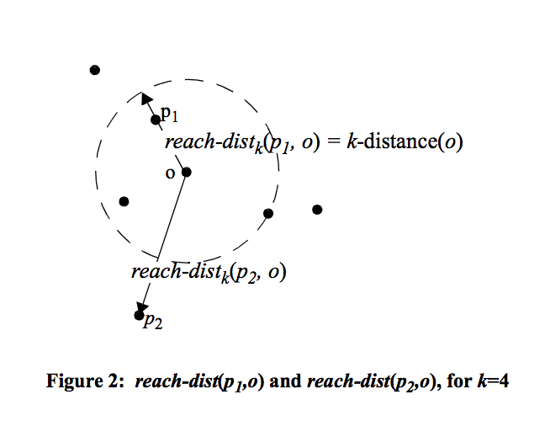
Density Based Local Outlier Factor Approach

Slide 4
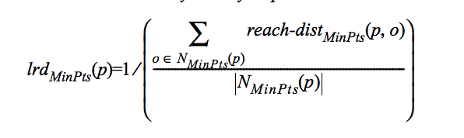
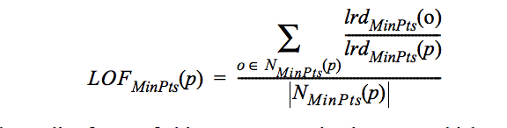
Density Based Local Outlier Factor Approach
Local reachability density of point p is defined as :
Local Outlier factor of p is defined as:
Here N(minpts) is the same as value of k for k-nearest neighbors

Slide 5
Our Implementation of Density based LOF
If we go with the approach then scalability is going to be an issue here as we have to compute distance or every point to other points in train data and then closest k .
We have decided to go with the cluster centers as representative of all the points in that cluster to assign outlier factor value for a data point. So instead of distance calculation among all the points we reduce our set and k-distance calculation will be done only with cluster centers.
The rest of the calculations are same as explained in the paper.

Slide 6
Our Implementation of Density based LOF
KMeans Clustering
This LOF model is going to use all the cluster centers as its base points for identifying LOF
Train Data
Cluster Centers
LOF Model
Any Data Point
Data Point with an outlier factor value

Slide 7
Why we are Introducing Clustering in LOF ?
One of the main reason is scalability . We can go with KNN approach as well but in general KNN is not scalable.
One of the futuristic vision for this implementation is right now in our implementation we are not considering weight while calculating the outlier factor but in our next implementation we are going to devise some technique to assign weight to clusters so that based on density of clusters it can contribute significant part in the outlier factor of a point.
With Clustering approach we can update our model easily in less time.

