Slide 1
Anomaly Detection in KDDCup 1999 Data

Slide 2
How is it done in Thesis
We went through the paper completely and tried to get the full understanding of how and where one-class SVM is used.
The Whole process is done in three steps.
Step1 is cluster Analysis , cluster formation and capturing distances of all data points from cluster centers.
Step2 is Modeling Normal instances , from validation set only normal instances are chosen which are normal predicted from model as well as normal in actual.
Step3 is predict final output , what is anomaly and what is not.

Slide 3
Initial Setting
The data is divided into three parts : Train Data , Validation Data and Test Data.
The number of clusters for K-means clustering is chosen from 3 to 5 and PCA value for dimensionality reduction is 8.
One-Class SVM is used for outliers detection as well as for final classification of Anomalies.

Slide 4

Block Diagram Of the Experiment
Train Data distances
Trained with only normal instances from validation Set
Train Data
Cluster Analysis
Modeling Normal Instances
Final One-Class SVM Model
Confusion Matrix
Validation data
Validation data distances
Test data

Slide 5
Step 1: Cluster Analysis
Clusters are built using the initial settings for clusters. The training data is used for building clusters.
The euclidean distances are stored for all the training data points from nearest cluster centers. (Does this data set contains normal as well as attack class label data or only normal label data)
The euclidean distances are stored for all the validation data points from nearest cluster centers.(This data set contains normal as well as attack class label data)

Slide 6
Step 2: Modeling Normal Instances
One-Class SVM model is built using the distances obtained from train data in cluster analysis step.
The validation data set is passed through the model.
We consider only those data points from validation set which are predicted normal from one-class SVM model and labeled normal in actual also.
Save the data points obtained in above step from validation data set.

Slide 7
Step 3 : Predict Output
Build One-class SVM model again using the data point obtained after doing filtering from validation data set.
Pass test data set to the SVM model built to predict what is anomaly and what is not.

Slide 8
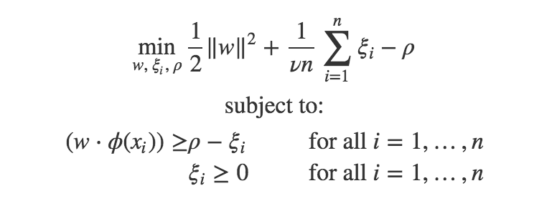
What are we trying to do?
We don’t have One-class SVM in Spark.
We are trying to run One - Class SVM in R using as many data points possible.
We will gather all the parameters required for solving all the equations.

Slide 9
What are we trying to do?
The parameters obtained in the previous step can be used back to identify the function back in spark.
After function identification we run the test data to this function and identify the data points as normal and Anomaly.

