Slide 1
Anomaly Detection on KDDCup 1999 Data
27 th May 2016

Slide 2
Techniques
We tried Hierarchical clustering experiments , with different second level clustering rules.
80- 20 and 90 - 10
Re-clustering Big Clusters

Slide 3


Input Data
Cluster1
C2
C3
C4
……
C80
c30
c31
c32
ci0
ci1
ci2
Here C3 is either a cluster not satisfying 80 - 20, i.e. its not pure enough
or
It is a cluster with large number of data points in it.
The k-values considered for second level clusters 2,3,4,5,6,10,20,30

Slide 4
Subset of Clusters: NormalCount, AttackCount
12:238,1
13:1,0
14:8,0
15:36,0
16:1,0
17:4631,0
18:129,0
19:291,0
20:378150,1114006 (Has to be Re - Clustered)
21:1,59
22:34,1
23:13621,1
24:78,0
25:2,0
26:5,15
27:3370,298
28:1,0
29:359,2173
30:12,0
31:2,0
32:19,1
33:1,0
34:1,0
35:83806,2807959 (Has to be Re - Clustered)
36:2,0
37:1,0
38:1,0
39:2,0
40:6,0

Slide 5
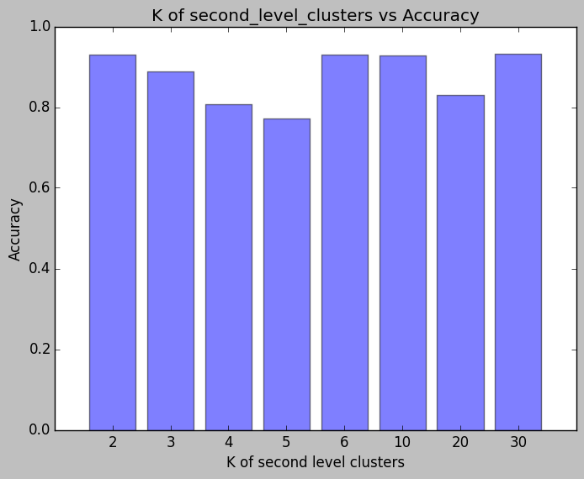
'2', '3', '4', '5', '6', '10','20','30'
0.9296685, 0.8888135, 0.80711967, 0.77198124, 0.930633, 0.9287522,0.82988614,0.93157357

Slide 6
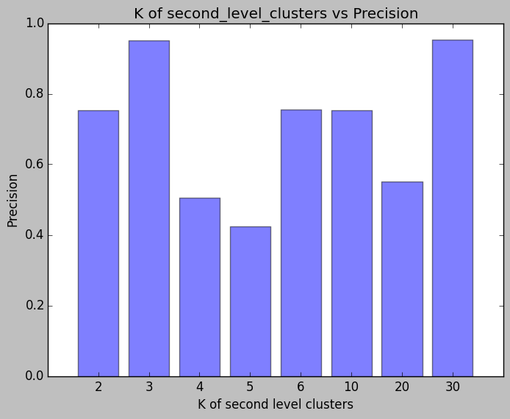

Slide 7
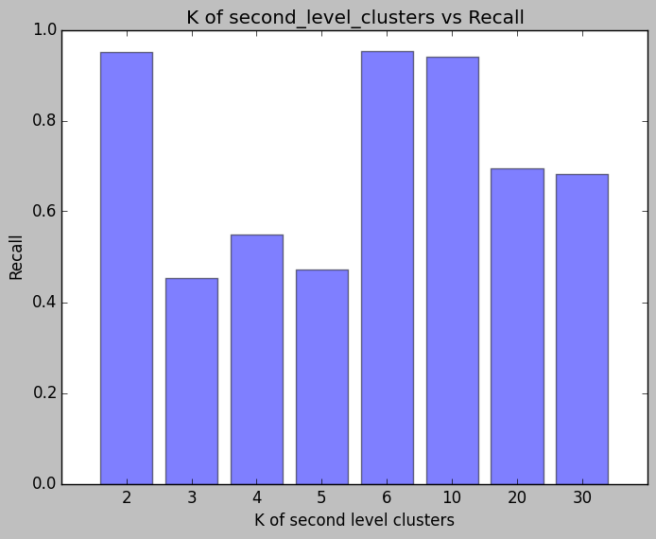

Slide 8
Second level clusters = 2
TP is : 57685
FP is : 18969
TN is : 231467
FN is : 2906
precision is : 0.75253737
recall is : 0.95203906
Accuracy is :0.9296685
Second level clusters = 3
TP is : 27395
FP is : 1386
TN is : 249050
FN is : 33196
precision is : 0.9518432
recall is : 0.45212984
Accuracy is :0.8888135
Second level clusters = 4
TP is : 33234
FP is : 32634
TN is : 217802
FN is : 27357
precision is : 0.50455457
recall is : 0.5484973
Accuracy is :0.80711967
Second level clusters = 5
TP is : 28556
FP is : 38885
TN is : 211551
FN is : 32035
precision is : 0.42342195
recall is : 0.47129112
Accuracy is :0.77198124
Second level clusters = 6
TP is : 57776
FP is : 18760
TN is : 231676
FN is : 2815
precision is : 0.75488657
recall is : 0.953541
Accuracy is :0.930633
Second level clusters = 10
TP is : 57043
FP is : 18612
TN is : 231824
FN is : 3548
precision is : 0.7539885
recall is : 0.94144344
Accuracy is :0.9287522
Second level clusters = 20
TP is : 42086
FP is : 34405
TN is : 216031
FN is : 18505
precision is : 0.5502085
recall is : 0.6945916
Accuracy is :0.82988614
Second level clusters = 30
TP is : 41298
FP is : 2000
TN is : 248413
FN is : 19280
precision is : 0.9538085
recall is : 0.68173265
Accuracy is :0.93157357

Slide 9
Next steps
Try to combine K- Means approaches into one model.
Make the K- Means Streaming so that it can adapt to the data on the fly.

