Slide 1
ArchitectPoint
Find, compare and hire the right architect, now with an AI assistant
Project presentation by Team Spring Warriors
October 2026
Notes:
Introduce ArchitectPoint: a web platform where clients find architects, send inquiries, follow up and give feedback, with an AI assistant called Archie. Built by Team Spring Warriors.

Slide 2
Agenda
01
The team
Our mentor, team lead and developers
02
The project
Problem, features, Archie AI, user roles and screens
03
Architecture & tech
System design, tech stack, data model and security
04
Journey & road ahead
User journey, challenges, learnings and future scope
Notes:
Four parts: who we are, what we built, how it works, and what we learned and plan next.

Slide 3
The team
01
Spring Warriors: 7 full-stack developers and our mentor
Guided by an LTM Mindtree cloud engineering specialist
Every member worked on both Angular and Spring Boot
Work split by feature, joined through code reviews

Slide 4








Meet Team Spring Warriors
Every member worked on both the Angular frontend and the Spring Boot backend
MENTOR (SME)
Swaminathan S
Specialist, Cloud Engineering @ LTM Mindtree. Guided design reviews and best practices.
Aman
Aakanksha
Siddarth
Architect listing, search and filters
Responsive pages and light/dark theme
Login, JWT security and OTP
TEAM LEAD
Prashant
Planning, code reviews and releases. Built Archie, the AI assistant.
Gowtam
Pritam
Sarayu
Inquiry and follow-up flow
Feedback, ratings and admin charts
Testing, bug fixing and quality
Notes:
Mentor Swaminathan S guided us. Prashant led the team. Each member owned a feature end to end across frontend and backend.

Slide 5
The project
02
What ArchitectPoint solves and who uses it
The problem and our solution
Key features and Archie, the AI assistant
User and admin roles, and the product screens

Slide 6


Problem and solution
Hiring an architect today is scattered across calls, chats and word of mouth
The problem
Our solution: ArchitectPoint
No single place to compare architects by expertise, location and rating
Searchable architect directory with portfolios and top-rated picks
Inquiries get lost in calls and emails with no status tracking
Inquiries with status, priority and threaded follow-up messages
Clients cannot see honest reviews before they choose
Verified 1-5 star feedback, plus Archie AI to guide every step
Admins have no view of demand, inquiries or service quality
Admin control panel with dashboards to manage everything
Notes:
Left: the pain points we heard. Right: how each one maps to a feature in ArchitectPoint.

Slide 7





Key features
Five modules that cover the full client-architect journey
Architect discovery
Inquiries
Feedback & ratings
Admin control panel
Archie AI assistant
Browse, search and filter by expertise, location and rating. Top-rated list and a portfolio page for each architect.
Send an inquiry with priority and contact details, track its status and continue with follow-up messages.
Rate an architect 1-5 by category after an inquiry. Ratings update the architect’s score.
Manage architects, update inquiry status, reply to users, review feedback and dashboard charts.
Chat that suggests architects, drafts inquiries and feedback, and summarises data for the admin.
Notes:
Four core modules plus the new AI assistant, which works across all of them.

Slide 8

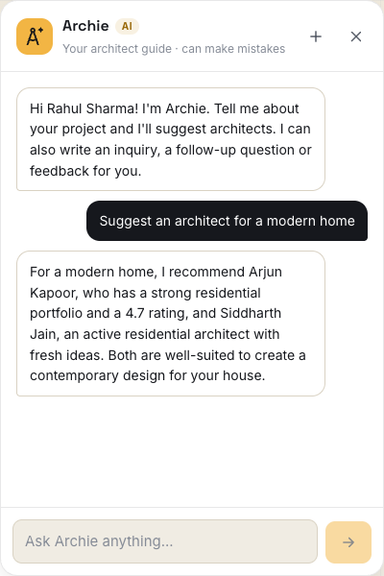
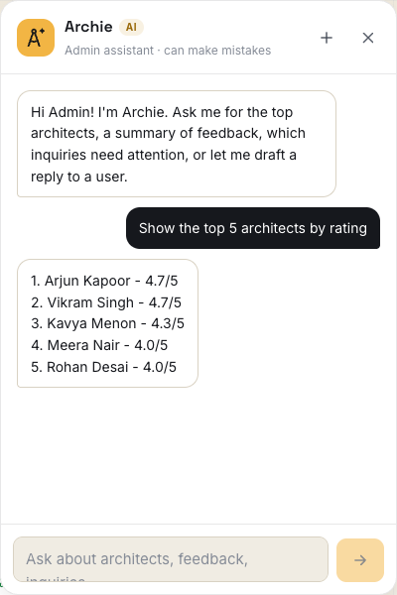

Archie: our AI assistant
A chat window on every page, powered by the Groq API (gpt-oss-120b model)
For users
Suggests architects for a project, with reasons
Answers questions about ratings, status and their own inquiries
Drafts new inquiries, follow-up questions and feedback
For the admin
Lists top architects by rating and checks their work
Summarises feedback and spots repeated complaints
Picks urgent inquiries and drafts replies to users
User asks for an architect
Admin asks for the top 5
Nothing is sent until the user presses Send. "Write with AI" buttons also help on 4 forms.
Notes:
Archie reads our own database (architects, inquiries, feedback) and answers with the Groq AI. Drafts are checked by the backend and only sent when the user presses Send. The API key is kept out of git.

Slide 9
Two roles, one platform
Role-based access is enforced in Angular route guards and in Spring Security
Capability | User | Admin
Sign up with email OTP, log in, change password | ✓ | ✓
Browse, search and filter architects; view portfolios | ✓ | ✓
Ask Archie, the AI assistant | ✓ | ✓
Send inquiries and post follow-up messages | ✓ | –
Give and manage own feedback and ratings | ✓ | –
Add, edit and delete architects | – | ✓
View all inquiries, update status and reply | – | ✓
Review all feedback and dashboard charts | – | ✓
Notes:
Users find and contact architects; admins manage the platform. Both can use Archie, but Archie only shows each role the data it is allowed to see.

Slide 10
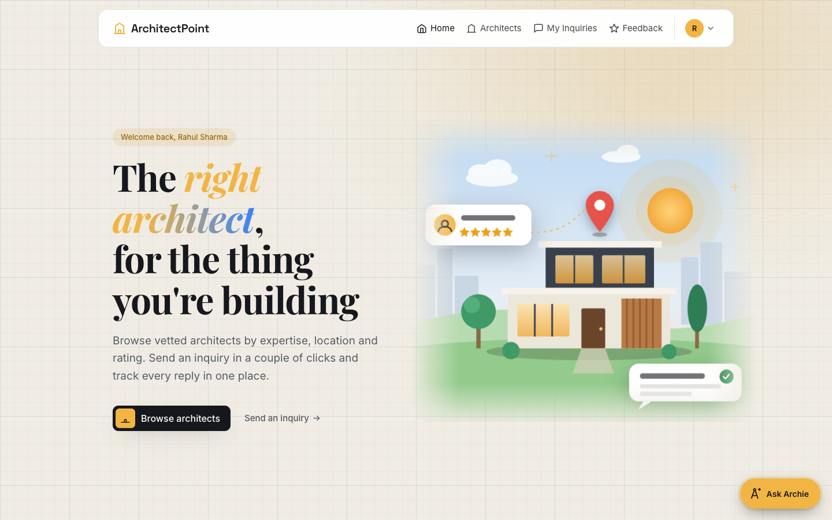
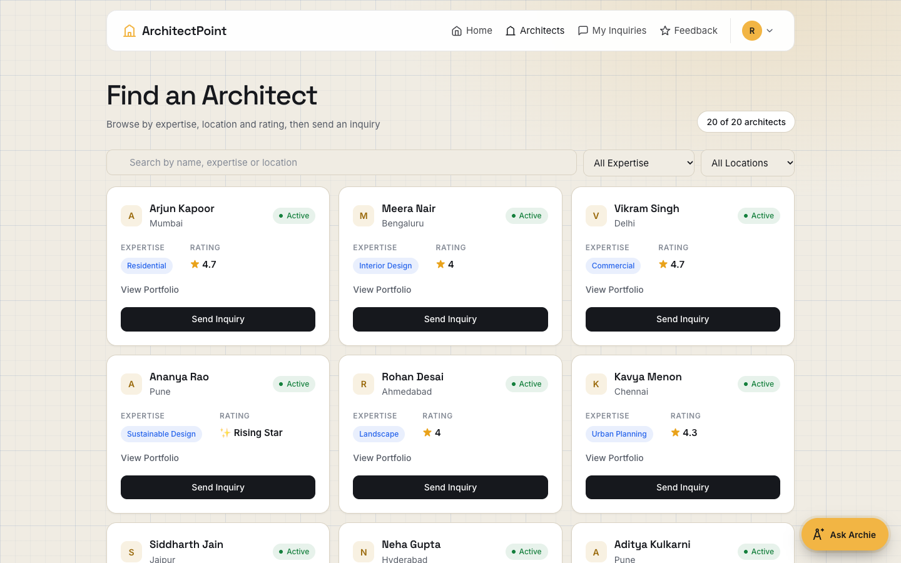
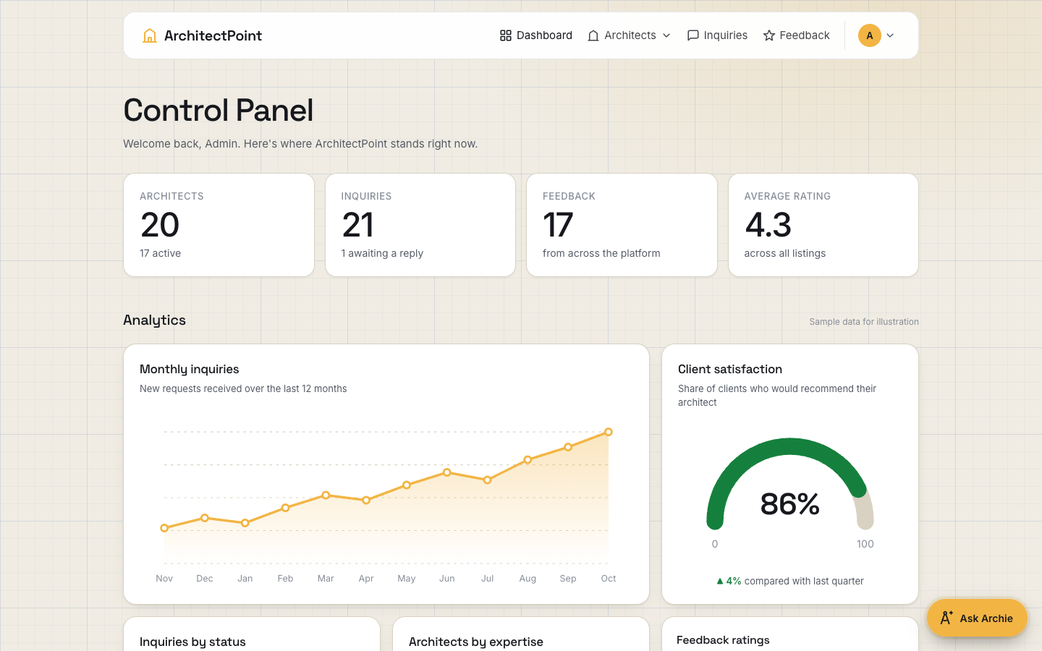
Product screens
Angular single-page app with a responsive layout and light/dark theme
User home page
Find an architect: search and filters
Admin control panel with charts
Notes:
Real screens from the running app: the user home page, the architect directory and the admin dashboard.

Slide 11
Architecture & tech
03
How the pieces fit together
System architecture and tech stack
Data model and project in numbers
Security built into every layer

Slide 12





System architecture
A layered client-server design: an Angular SPA talks to a stateless Spring Boot REST API
Angular 16 SPA
Spring Boot 3 · Java 17
MySQL 8
30 components, 5 services
Auth and role route guards
JWT HTTP interceptor
Archie chat window
JWT security filter + roles
6 REST controllers
Service layer: business rules
Spring Data JPA repositories
6 tables via Hibernate
Soft delete keeps history
Demo data loader
Auto schema update
REST/JSON
+ JWT
JPA /
JDBC
Gmail SMTP
Groq AI API
Sends the 6-digit OTP code for sign-up
Answers Archie’s questions over HTTPS
Notes:
The browser runs the Angular app. Every API call carries a JWT. Spring Boot checks the token and role, runs the business rules and stores data in MySQL. It also calls Gmail for OTP mails and Groq for Archie.

Slide 13




Tech stack
Industry-standard, open-source tools across every layer
Frontend
Backend
Data & auth
AI & tooling
Angular 16
Spring Boot 3.0
MySQL 8
Groq API (gpt-oss-120b)
TypeScript 5.1
Java 17
Hibernate
Maven, Angular CLI
RxJS
Spring Security
JWT (jjwt)
Git and GitHub
HTML5 / CSS3
Spring Data JPA
BCrypt
Postman, Karma
Notes:
All tools are open source or have a free tier. Groq gives fast responses for the AI assistant.

Slide 14
Data model
Six JPA entities; records are soft-deleted so history is never lost
Entity | Key fields | Relationships
User | email (unique), username, mobileNumber, password (BCrypt), userRole | Has many inquiries and feedback
Architect | name, expertise, location, rating, portfolioLink, status | Has many inquiries and feedback
ArchitectInquiry | message, status, priority, contactDetails | Belongs to User and Architect; has SubInquiries
SubInquiry | message, sender, createdAt | Follow-up thread inside an inquiry
Feedback | feedbackText, category, rating, date, inquiryId | Belongs to User and Architect
Otp | email, codeHash, sentAt, expiresAt, attempts, verified | One active code per email
Notes:
Six tables. Deletes are soft (a deleted flag), so reports and history stay correct.

Slide 15
Project in numbers
28 REST endpoints across 6 controllers, all secured with JWT
30
28
Angular components
REST endpoints
6
2
JPA entities
User roles
Notes:
Size of the project at a glance. The architect and inquiry APIs are the biggest; the AI controller adds three endpoints.

Slide 16




Security built in, not bolted on
Five layers protect every account, every request and every secret
Stateless JWT
BCrypt passwords
Signed token issued at login and sent on every call by an Angular interceptor. No server sessions.
Passwords are hashed with BCrypt before storage. Change-password checks the old one first.
Role-based access
Email OTP sign-up
Admin and User rules in Spring Security, mirrored by Angular route guards and role-aware menus.
6-digit code stored as a hash, valid 5 minutes, 60-second resend cooldown, max 5 wrong tries.
Safe AI
Archie only sees data the role may see. AI drafts are re-checked on the server; the API key stays out of git.
Notes:
Security is in every layer: tokens, hashed passwords, role checks on both sides, a safe OTP flow and guard rails for the AI.

Slide 17
Journey & road ahead
04
How people use it, what we learned, where it goes next
User journey from sign-up to feedback
Challenges we solved and what we learned
Future scope

Slide 18
User journey
From sign-up to feedback in seven steps; admins close the loop
1
2
3
4
5
6
7
Sign up
Verify OTP
Log in
Find architect
Send inquiry
Follow up
Give feedback
Archie can help at steps 4 to 7: suggest architects, write the inquiry, the follow-up and the feedback.
Admin side
Manage architects
Handle inquiries
Track quality
Add, edit or remove listings and portfolios
Update status and reply in the thread, with AI drafts
Read feedback, dashboard charts and AI summaries
Notes:
Walk through the seven user steps, then the admin side that closes the loop.

Slide 19
Challenges and learnings
What pushed us, and what we take away
Challenges
Learnings
01
JWT + CORS across two servers
01
Layered Spring architecture
Tokens, roles and CORS between ports 4200 and 8080
Controller, service, repository and global error handling
02
Safe OTP design
02
Angular at scale
Hashed codes, expiry, cooldown and try limits
Guards, interceptors, services and reusable components
03
Reliable AI answers
03
Working with LLM APIs
Keeping Archie to real data and handling API rate limits
Prompts, JSON replies and checking AI output
04
Seven people, one codebase
04
Teamwork in practice
Feature-wise split while keeping APIs and UI consistent
Git, code reviews and testing with Postman and Karma
Notes:
Each challenge taught us something we can reuse on the next project.

Slide 20





Future scope
Where ArchitectPoint goes next
Appointment booking
Real-time chat
Rich portfolios
Book site visits and consultations with calendar slots
WebSocket messaging and in-app notifications
Upload project images and documents to cloud storage
Smarter Archie
Cloud deployment
Mobile app
Match by budget, style and history; voice and multilingual chat
Docker containers on AWS or Azure with CI/CD pipelines
Installable PWA or native app for clients on the go
Notes:
Next steps we would build with more time.

Slide 21
It’s time to
Outcreate
Thank you. Questions?
Team Spring Warriors · ArchitectPoint
Notes:
Thank the audience and invite questions. Offer a live demo of Archie if time allows.

