Slide 1
Amazon Simple Storage Service (S3)
Presented by: Prashant Rathi

Slide 2
Amazon Web Services (AWS)
AWS
Availability Zone A
Availability Zone B
Availability Zone C
AWS Region

Slide 3

Amazon Simple Storage Service (S3)
Agenda:
Main Features Highlights
Basic concepts
Getting started with S3 in AWS console
Versioning
Storage classes
Object Lifecycle Management

Slide 4



(S3) Main Features
Amazon S3 is object storage build to store and retrieve any amount of data from anywhere.
It is designed to deliver 99.999999999% durability of objects over a given year
Durability
AWS
VPC
AWS Region
Backup
Availability Zone A
Backup
Availability Zone B
Backup
Availability Zone C
Availability

Slide 5
(S3) Main Features
It is designed to deliver 99.999999999% durability of objects over a given year
Durability
AWS
VPC
AWS Region
Backup
Availability Zone A
Backup
Availability Zone B
Backup
Availability Zone C
Availability

Slide 6


(S3) Main Features
AWS takes care of scaling S3 depending on the load. You only pay for what you use.
Scalability
Highly secure service with Server side encryption and Client side encryption
Security

Slide 7

(S3) Main Features
S3 provides different storage tiers and different pricing options which can be utilized based on your need
Inexpensive

Slide 8
Amazon Simple Storage Service (S3) Basic concepts (Fundamentals)
Bucket
A container which stores the objects that are uploaded to S3.
There will never be any object without a bucket.
Even though the S3 service console allows you to create folders inside a bucket, there is no “Windows Explorer” like hierarchy. E.g Bucket: rathi-test-bucket, Region: Ohio, Folder Structure: demoLab->aws->presentation->xyz.png
URL: https://s3.us-east-2.amazonaws.com/rathi-test-bucket/demoLab/aws/presentation/xyz.png
https://rathi-test-bucket.s3.us-east-2.amazonaws.com/demoLab/aws/presentation/xyz.png
Every time an object is added to it, S3 generates a unique version ID and assigns it to the object.

Slide 9
Amazon Simple Storage Service (S3) Basic concepts (Fundamentals) Contd.
You can create buckets in any region you want (choose the AWS Region that is geographically close to you or your customers.)

Slide 10
S3 Objects and Metadata
Fundamental entities stored in Amazon S3. E.g Image, Audio, Video, Word/Excel/PowewPoint document etc.
An object consists of object data and metadata (data about the object data)

Slide 11
S3 Endpoints
URL that is the entry point for a web service.
Most Amazon Web Services offer a regional endpoint to make your requests to reduce data latency in your applications.
E.g: If the region is Ohio i.e us-east-2, the endpoint for REST API for S3 service is s3.(dot)us-east-2.amazonaws.com or s3-(or hyphen)us-east-2.amazonaws.com
In the URL,
https://s3.us-east-2.amazonaws.com/rathi-test-bucket/demoLab/aws/presentation/xyz.png

Slide 12
S3 Data Consistency Model
Data consistency model depicts how the results would be after certain operations (such as PUTS, GETS, DELETES) are done on the S3 objects.
Before 1 Dec 2020, S3 was having an Eventually Consistent system for few operations on the object. From 1st Dec. 2020 S3 is updated to support strong read after write consistency
All S3 GET, PUT, DELETE and LIST operations, as well as operations that change object metadata, are now strongly consistent. What you write is what you will read, and the results of a LIST will be an accurate reflection of what’s in the bucket. This applies to all existing and new S3 objects, works in all regions, and is available to you at no extra charge! There’s no impact on performance, you can update an object hundreds of times per second

Slide 13
Gettting started with S3
Getting introduced to S3 via AWS console.
Brief tour of different options and settings offered by S3

Slide 14
S3-Versioning
Versioning allows you to maintain multiple versions of the object in the same bucket.
Use case: Versioning- enabled buckets allows you to recover objects from accidental deletion or overwrite.
Upon deletion, instead of removing object permanently, it just hides the object, does not erase it. You can always restore the previous version.
If you overwrite an object, it results in a new object version in the same bucket.

Slide 15
S3-Versioning Important points
Buckets can be in one of three states
Unversioned (the default)
Versioning-enabled
Versioning-suspended
The versioning state applies to all of the objects in the bucket.
Once versioning is enabled, all subsequent added/modified objects are versioned and given a unique version ID.
Objects that are stored in unversioned bucket have null as the version ID.
You will have to make object of each version public. Even if the previous version was public, the newly added one will not be public.

Slide 16
S3-Storage Classes
S3 provides various storage classes to manage how your data in S3 will be accessed.
Different options offered by S3 to store your data based on frequency of the access, performance, and fault tolerance of your application
Storage classes provides you capability to manage your data througout their life cycle.
Storage class is configured at object level.
Storage class | Purpose
S3 Standard | General purpose storage of frequently accessed data.
S3-Standard Infrequent Access(S3-Standard IA) and S3-OneZone-IA | Long lived, rapidly needed but less frequently accessed data.
S3-Intelligent Tiering | Cost optimization without performance impact and operational overhead.
S3 Glacier and S3 Glacier Deep Archive | Long term storage

Slide 17
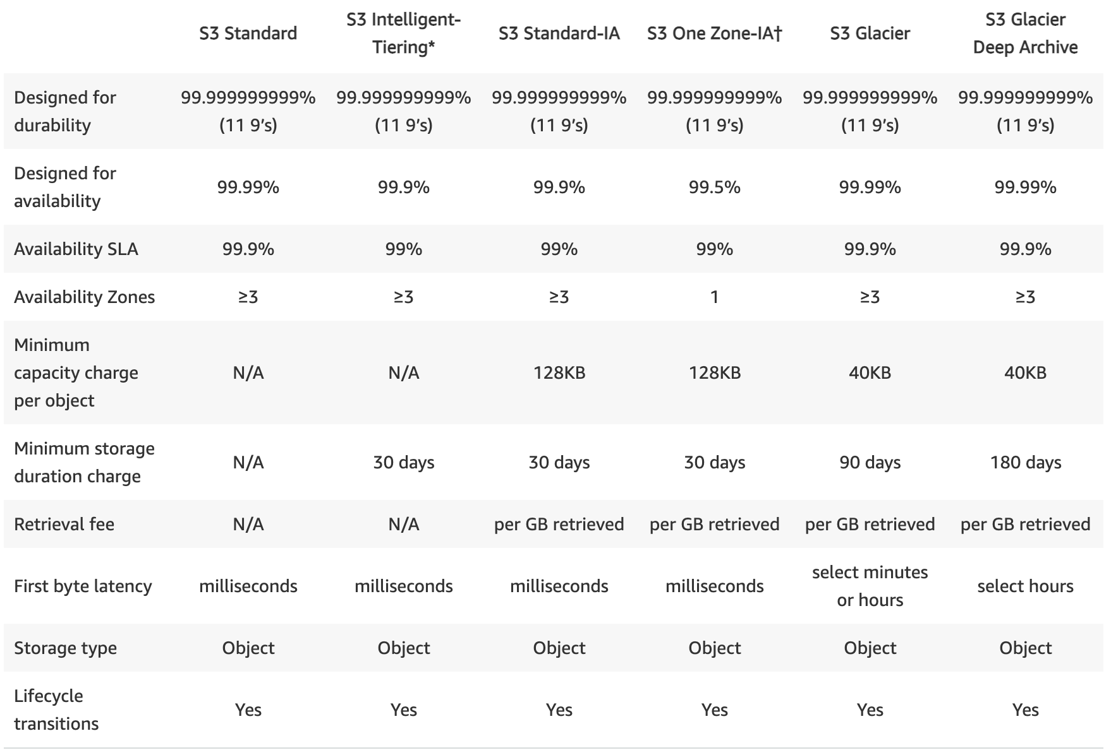
S3 – Storage Classes Comparison

Slide 18
S3– Object Lifecycle Management Introduction
What is Object Lifecycle Management?
Manages the storage of the objects and the cost associated with it throughout the life of the objects.
Why to use it?
To move the objects to different storage classes – depending upon how frequently they are used – to reduce the cost (Transition). For e.g: Patients old reports, Old Employees
Set expiry date on the objects that would no longer be used after certain period, and delete them (Expiration). For e.g Old server logs
This transition and expiration is done via Lifecycle rules.

Slide 19
Thank You

