Slide 1

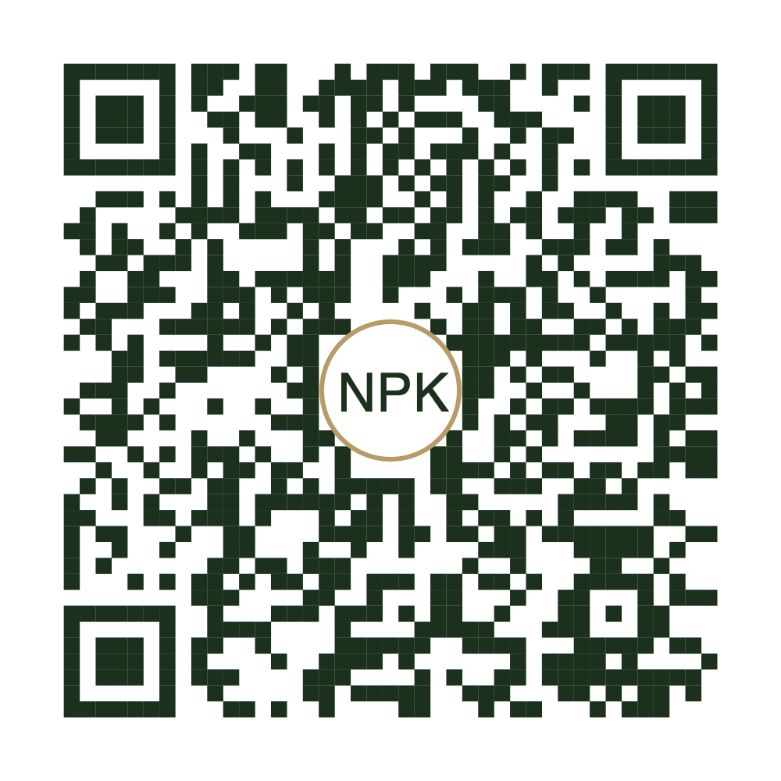
DARWIN • NORTHERN TERRITORY
⚡ GRAB & GO EXPRESS
Morning Breakfast Combo
$14.50
1 GOURMET BITE + 1 REGULAR 8OZ BARISTA COFFEE
Freshly Prepared • Toasted to Perfection • Ready in 5–10 Minutes
Order & pay at the counter — EFTPOS, Card, Apple Pay & Cash!
CHOOSE YOUR COMBO BITE
HOT TOASTIES & ROLLS
ITALIAN BAKERY & COFFEE
• Bacon & Egg Roll (Brioche Milk Bun)
• Cornetto Mandorla (Almond Flakes)
• Ham & Cheese Toastie / Croissant
• Cornetto Cioccolato (Chocolate Crema)
• Chicken & Avocado Toastie
• Artisan Cinnamon Scroll
• Cheese & Tomato Sourdough (VEG)
☕ Paired w/ 8oz: Flat White • Latte • Mocha
• Mushroom, Cheese & Tomato (VEG)
Cappuccino • Long Black • Chai • Hot Choc
(12oz Large / Alt Milk / Extra Shot +$1.00)
SCAN TO VIEW GRAB & GO MENU
Point your phone camera to browse full menu, drinks & upgrades
Simply order at the counter when you’re ready!
NORTHERN PEAKS KITCHEN
Shop 2, 9 Westralia St, Stuart Park, Darwin • Open 6:30 AM – 2:30 PM • 0424 203 924
Fresh, Local, Fast & Made to Order

