Slide 1

Healthcare Analytics for Doctor Visits TIRTC
Prashant Kashyap
STU_ID: STU684d04823822b1749877890

Slide 2

PROBLEM STATEMENT
Healthcare providers need to understand the factors that influence patients' doctor visits. Analyzing healthcare data can help identify patterns related to illness, age, gender, income, health conditions, and healthcare coverage.
Problem Statement:
The objective of this project is to analyze doctor visit data to understand healthcare utilization patterns and explore how patient characteristics and illness levels are associated with the number of doctor visits.
Key Objectives:
Analyze the distribution of doctor visits.
Study doctor visits by gender and age.
Examine the relationship between illness severity and doctor visits.
Explore the role of income, health status, and healthcare coverage.
Generate insights that can support healthcare planning and decision-making.

Slide 3
Project Description
This project uses Python to perform exploratory data analysis on a healthcare dataset containing 5,190 records and 13 columns.
The analysis begins with loading the dataset using Pandas, examining its structure, checking for missing values, and reviewing descriptive statistics.
Data visualization libraries such as Matplotlib and Seaborn are used to explore gender distribution, age distribution, doctor visit frequency, and relationships between doctor visits, gender, and illness levels.
The project aims to identify patterns in healthcare utilization and understand how patient characteristics relate to doctor visits.
Key Analysis Areas:
Dataset inspection and data quality checks
Univariate analysis of gender, age, and visits
Comparison of doctor visits by gender
Analysis of doctor visits across illness levels
Multivariate analysis of age, gender, and doctor visits

Slide 4

WHO ARE THE END USERS?
Healthcare Providers: To understand patient healthcare utilization patterns.
Hospital Administrators: To support healthcare service planning and resource allocation.
Public Health Researchers: To study relationships between illness and healthcare utilization.
Healthcare Policymakers: To gain insights that may inform healthcare planning.
Data Analysts: To practice data exploration, statistical analysis, and visualization using healthcare data.
Expected Benefit: Better understanding of healthcare utilization patterns through data-driven insights.

Slide 5

Technology Used
Programming Language
Python
Libraries
Pandas — data loading, manipulation, and analysis
NumPy — numerical operations
Matplotlib — data visualization
Seaborn — statistical charts and visualizations
Development Environment
Jupyter Notebook
Dataset
Healthcare Analytics for Doctor Visits CSV
5,190 records and 13 columns
Analysis Techniques
Exploratory Data Analysis (EDA)
Descriptive Statistics
Univariate Analysis
Multivariate Analysis
Grouping and Aggregation

Slide 6
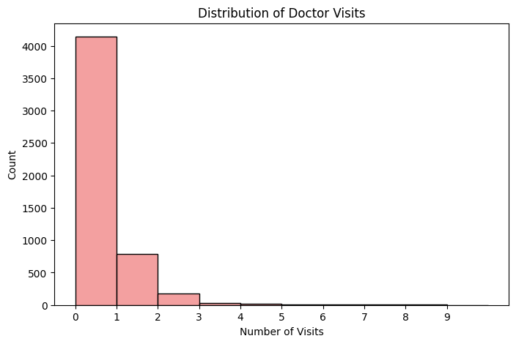
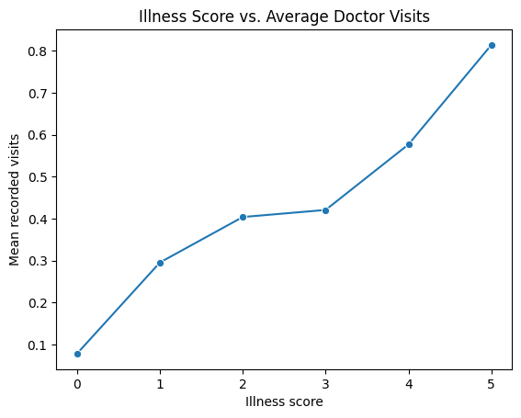
RESULTS
[Add screen shots of your code ]
Demo Link

Slide 7
Thank you
.
.

