Slide 1

CSE 1223: Introduction to Computer Programming in Java Object-oriented Programming Basics

Slide 2
“Object-oriented programming”
You’ve all heard this “buzzword” before
If nowhere else, you heard it the first day of class!
What do we mean by it?
A form of programming based around viewing software as modular objects instead of just as procedural lines of code
Software as “black boxes”

Slide 3
Objects
So what is an “object”?
In the real world, things are objects
Real world objects have state and behavior
State: A configurations of attributes
Behavior: Things that the object can do
Consider a car:
A car’s state is a combination of the car’s attributes (color, make, model, current speed, current direction, current acceleration, etc.)
A car’s behavior are the actions that can be performed to modify its state (accelerate, brake, turn, etc.)

Slide 4
Objects
Software objects are similar to real-world objects
Also have a behavior and a state
Each object has a set of associated data values. The configuration of these values determines its state
Each object also has a set of associated methods. These methods define its behavior
We call this encapsulation
Meaning “putting things into a capsule (container)”
We stuff all of these things (methods & data) into one container – that’s an object

Slide 5
Object Example - Strings
Java Strings are an example of an object
Provide both data and behavior:
String userName = “bob”;
The object is a String with the name “username”
The data is the sequence of characters ‘b’,’o’,’b’
Alternatively, as an array of characters [‘b’,’o’,’b’]
What is the behavior? Methods!
int x = userName.length(); // x=3
char y = userName.charAt(0); // y=‘b’
String z = userName.substring(1,2);
// z = “o”;

Slide 6
Object Example - ArrayLists
Java ArrayLists are another example of an object
ArrayList<Integer> list =
new ArrayList<>();
The object is an ArrayList with the name “list”
The data is the elements in the list
Methods provide “list” behavior
int x = list.size();
list.add(0);
int y = list.get(0);

Slide 7
Object Example - Scanner
Java Scanner is yet another example of an object
Scanner in = new Scanner(System.in);
The object is a Scanner with the name “in”
The data is a bit less obvious in this case, but it is basically the connection between the input (keyboard) and the program
Methods provide I/O behavior
String str = in.nextLine();
int y = in.nextInt();

Slide 8
Classes
So what is a Class?
Again consider real-world objects
There are many kinds of cars in the world
They share the same behavior
They may share some of the same attributes
Two cars with the same make, model and color might only differ in their vehicle ID numbers
They’re all the same “kind of thing”
They belong to the same “class of objects”
Software classes are similar
They define “kinds of objects” with the same behavior and same types of attributes

Slide 9
Classes
classes work as a type of “software blueprint”
Used to create software objects for use in code
Creating an object from a class is called instantiation – (i.e. “creating an instance”)
Each instance is a separate object
String msg1 = “Hello”;
String msg2 = “Goodbye”;
msg1 and msg2 are each String objects
The String class is the blueprint that says how to build (instantiate) these objects

Slide 10
Why use classes?
User-defined types
Allows programmers to extend the language (almost) arbitrarily
Code re-use
Many problems can be described by the same data types – why reinvent the wheel?
Real-world problem solving
Thinking of problems in terms of “objects” can make it easier to model problems in the real world

Slide 11
Public interfaces
Every class has a public interface
This the set of items that are usable by programmers
Classes have private elements too – we’ll talk about those later
Public interfaces from the Java Standard Library are described in the Java documentation
Strings:
http://docs.oracle.com/javase/6/docs/api/java/lang/String.html
ArrayLists:
http://docs.oracle.com/javase/6/docs/api/java/util/ArrayList.html
Scanners:
http://docs.oracle.com/javase/6/docs/api/java/util/Scanner.html
The documentation provides a list of methods offered by the class and a description of what each method does

Slide 12
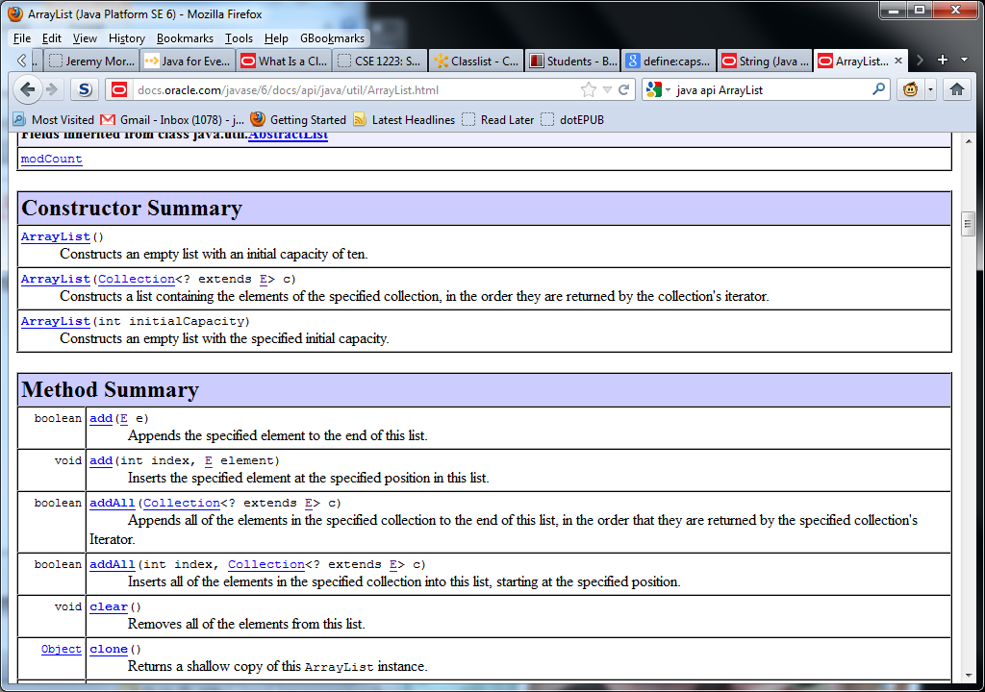
Public interface example - ArrayList
Each class has two types of methods
Constructor methods
Used only to “construct” a new instance of a class
Non-constructor methods (or class methods)
All the other methods used by an object

Slide 13
Constructors
A constructor method is called when the object is instantiated
When we declare a new ArrayList() for example
The constructor is a method and can take parameters
A class can have multiple constructor methods
Each provides different behavior when building a new instance

Slide 14
Constructors you’ve already used
import java.util.ArrayList;
…
public static void main(String [] args) {
ArrayList<String> stringList = new ArrayList<String>();
Scanner keyboard = new Scanner(System.in);
String input = “”;
while (input.equals(“stop”) == false) {
input = keyboard.nextLine();
stringList.add(input);
}
int i = 0;
while (i<stringList.size()) {
System.out.println(stringList.get(i));
i = i + 1;
}
}
Constructor

Slide 15
Constructors you’ve already used
import java.util.ArrayList;
…
public static void main(String [] args) {
ArrayList<String> stringList = new ArrayList<String>();
Scanner keyboard = new Scanner(System.in);
String input = “”;
while (input.equals(“stop”) == false) {
input = keyboard.nextLine();
stringList.add(input);
}
int i = 0;
while (i<stringList.size()) {
System.out.println(stringList.get(i));
i = i + 1;
}
}
Constructor

Slide 16
Constructors you’ve already used
import java.util.ArrayList;
…
public static void main(String [] args) {
ArrayList<String> stringList = new ArrayList<String>();
Scanner keyboard = new Scanner(System.in);
String input = “”;
while (input.equals(“stop”) == false) {
input = keyboard.nextLine();
stringList.add(input);
}
int i = 0;
while (i<stringList.size()) {
System.out.println(stringList.get(i));
i = i + 1;
}
}
Constructor

Slide 17
Constructors you’ve already used
import java.util.ArrayList;
…
public static void main(String [] args) {
ArrayList<String> stringList = new ArrayList<String>();
Scanner keyboard = new Scanner(System.in);
String input = “”;
while (input.equals(“stop”) == false) {
input = keyboard.nextLine();
stringList.add(input);
}
int i = 0;
while (i<stringList.size()) {
System.out.println(stringList.get(i));
i = i + 1;
}
}
Constructor
This last one is a special case – the Java compiler treats this as the same as:
new String(“”);
We call this “syntactic sugar” because it makes programming easier.

Slide 18
Using Constructors
We instantiate objects by calling their constructors:
ArrayList<String> stringList = new ArrayList<String>();
You must use the new keyword to create an instance of an object
Notice the syntax after the new keyword:
Parentheses – because we are calling a constructor method
This method will return a new ArrayList object

Slide 19
Using Constructors
Classes may have more than one constructor method
ArrayList (above) has 3
One with no arguments (the “empty” or “default” constructor)
One that takes a Collection as an argument
One that takes an “initialCapacity” as an argument
How do we know which one to use?
Read the documentation!
See which one fills the requirements that you need for it.

Slide 20
Using Constructors
ArrayList<String> stringList = new ArrayList<String>();
How do we know which constructor will be called?
Look at the arguments (or parameters) to the constructor method
Remember! Constructor is a method!
This one has no arguments, so the “default” constructor will be called
The Java compiler figures out which one you mean based on which arguments you use

Slide 21
Using objects
Once an object has been instantiated we can use it
We use an object by making calls to its public methods
Public methods can do many things, but two categories generally stand out:
Change the data inside an object (mutators or setters)
Access the data inside an object (accessors or getters)

Slide 22
Public methods you’ve already used
import java.util.ArrayList;
…
public static void main(String [] args) {
ArrayList<String> stringList = new ArrayList<String>();
Scanner keyboard = new Scanner(System.in);
String input = “”;
while (input.equals(“stop”) == false) {
input = keyboard.nextLine();
stringList.add(input);
}
int i = 0;
while (i<stringList.size()) {
System.out.println(stringList.get(i));
i = i + 1;
}
}
Accessor

Slide 23
Public methods you’ve already used
import java.util.ArrayList;
…
public static void main(String [] args) {
ArrayList<String> stringList = new ArrayList<String>();
Scanner keyboard = new Scanner(System.in);
String input = “”;
while (input.equals(“stop”) == false) {
input = keyboard.nextLine();
stringList.add(input);
}
int i = 0;
while (i<stringList.size()) {
System.out.println(stringList.get(i));
i = i + 1;
}
}
Accessor?
Mutator?

Slide 24
Public methods you’ve already used
import java.util.ArrayList;
…
public static void main(String [] args) {
ArrayList<String> stringList = new ArrayList<String>();
Scanner keyboard = new Scanner(System.in);
String input = “”;
while (input.equals(“stop”) == false) {
input = keyboard.nextLine();
stringList.add(input);
}
int i = 0;
while (i<stringList.size()) {
System.out.println(stringList.get(i));
i = i + 1;
}
}
Mutator

Slide 25
Public methods you’ve already used
import java.util.ArrayList;
…
public static void main(String [] args) {
ArrayList<String> stringList = new ArrayList<String>();
Scanner keyboard = new Scanner(System.in);
String input = “”;
while (input.equals(“stop”) == false) {
input = keyboard.nextLine();
stringList.add(input);
}
int i = 0;
while (i<stringList.size()) {
System.out.println(stringList.get(i));
i = i + 1;
}
}
Accessor

Slide 26
Public methods you’ve already used
import java.util.ArrayList;
…
public static void main(String [] args) {
ArrayList<String> stringList = new ArrayList<String>();
Scanner keyboard = new Scanner(System.in);
String input = “”;
while (input.equals(“stop”) == false) {
input = keyboard.nextLine();
stringList.add(input);
}
int i = 0;
while (i<stringList.size()) {
System.out.println(stringList.get(i));
i = i + 1;
}
}
Accessor

Slide 27
Using objects
Mutator methods (aka setter methods)
Used to make changes to (or mutate) an object
Also known as “setting values” of an object
Just like a static method, class methods have parameters and a return type
Some ArrayList mutator methods include:
boolean add(E obj)
void add(int index, E obj)
E set(int index, E obj)
Note that we can have two methods with the same name that take different parameters
This is called overloading the method

Slide 28
Using objects
Accessor methods (aka getter methods)
Used to access the data inside of an object
Also known as “getting values” from an object
Some accessor methods include:
ArrayList
E get(int index)
int size()
String
char charAt(int index)
int length()
String substring(int beginindex)
String substring(int beginindex, int endidx)

Slide 29
Your Turn
For the code on the following slide, identify:
Class names
Constructor methods
Public methods
Provide a guess to whether they are accessors or mutators
HINT: Use their names and what they look like they’re doing to figure out what kind of method they are
You’ll be seeing some things you’ve never seen before
Based on what we’ve seen so far you should be able to figure out what’s going on here.

Slide 30
Your Turn
import java.util.*;
import java.io.*;
public class ObjectExample01 {
public static void main(String[] args) {
Map<String,Double> myMap = new TreeMap<String,Double>();
File fileHandle = new File("datafile.txt");
try {
Scanner inFile = new Scanner(fileHandle);
while (inFile.hasNext()) {
String key = inFile.nextLine();
String value = inFile.nextLine();
Double val = new Double(value);
myMap.put(key, val);
}
inFile.close();
}
catch(IOException e) { System.out.println("ERROR: "+e); }
for (String k: myMap.keySet()) {
double val = myMap.get(k);
System.out.println(k+" -> "+val);
}
}
}

Slide 31
Primitive Types
You should note that not every variable in Java is an object
Primitive types are not objects
What are the primitive types?
int
char
boolean
double
There are others (long, float, etc.) but for our purposes this list is what we’ve been working with.

Slide 32
Primitive Types
In Java, primitive types only hold data
They do not have associated methods
How do we deal with shared methods then?
External libraries – we’ve seen some of these in our labs:
Character.isDigit(c)
Math.sqrt(d)
User-defined methods (see your own projects)
These libraries hold methods that are not associated with a particular object
Instead of operating on the data that is held in the object, we pass a parameter to them to operate on
Note that you can pass objects as parameters – not all methods that use objects need to be object-oriented!

Slide 33
Reference types
Variables with a class type hold a reference to the memory location of an object of that type
The value of the variable is just the memory address where the object is stored
With a primitive type, the value of the variable is the actual value
This leads to some non-intuitive behavior for variables with reference types

Slide 34
Reference types vs. Primitive Types
What do you expect this segment of code to do?
int i = 12;
int j = i;
j = j + 1;
System.out.println(i);
System.out.println(j);

Slide 35
Reference types vs. Primitive Types
What do you expect this segment of code to do?
int i = 12;
int j = i;
j = j + 1;
System.out.println(i);
// reports 12
System.out.println(j);
// reports 13

Slide 36
Reference types
Now what do you expect this segment of code to do?
ArrayList<Integer> l1 = new ArrayList<>();
l1.add(3);
ArrayList<Integer> l2 = l1;
l2.add(2);
System.out.println(l1.size());
System.out.println(l2.size());

Slide 37
Reference types
Now what do you expect this segment of code to do?
ArrayList<Integer> l1 = new ArrayList<>();
l1.add(3);
ArrayList<Integer> l2 = l1;
l2.add(0,2);
System.out.println(l1.get(0));
// reports 2
System.out.println(l2.get(0));
// reports 2

Slide 38
Reference types
Why the “strange” behavior on the ArrayList example?
Because ArrayList is a reference type
int j = i;
This line copies the value stored in i into the variable j
ArrayList<Integer> l2 = l1;
This line does NOT make a copy of the object l1 into the object l2
This line instead copies the memory location stored in the variable l1 into the variable l2
Both of these variables now reference (or “point to”) the same memory location
We call this aliasing or making an alias. Both l1 and l2 are now two different names for the same object.
Just like “Superman” and “Clark Kent” are both names for the same person – they’re both aliases to the same object.

Slide 39
Reference Types
ArrayList<Integer> l1 = new ArrayList<>();
[ ]
l1:
Note that this triangle
is what we’ll use to denote a
reference type.
Constructor creates a new, empty
ArrayList object. Assigns the
Reference l1 to refer to it.

Slide 40
Reference Types
ArrayList<Integer> l1 = new ArrayList<>();
l1.add(3);
[ 3 ]
l1:
Add method on l1 puts the value
3 at the end of the list referred to by
l1.

Slide 41
Reference Types
ArrayList<Integer> l1 = new ArrayList<>();
l1.add(3);
ArrayList<Integer> l2 = l1;
[ 3 ]
l1:
l2:
NOTE: The new variable l2 does
NOT contain a copy of l1. Instead
both references now refer to (point
at) the same object.

Slide 42
Reference Types
ArrayList<Integer> l1 = new ArrayList<>();
l1.add(3);
ArrayList<Integer> l2 = l1;
l2.add(0,2);
[ 2, 3 ]
l1:
The value 2 is added to the end
of the object referred to by the
variable l2. Note that this is the
same object that l1 points to, and
so the change will be reflected
through both variables.
l2:

Slide 43
Reference Types
ArrayList<Integer> l1 = new ArrayList<>();
l1.add(3);
ArrayList<Integer> l2 = l1;
l2.add(0,2);
[ 2, 3 ]
l1:
l2:

Slide 44
Reference Types
Upshot: Be careful when dealing with reference types
Variables hold memory locations – programs may not run as intended
Example: equality tests (==)
If l1 and l2 are both of type ArrayList, what is this boolean test really doing?
(l1 == l2)
What if l1 and l2 were of type String?
This is why we can’t use == to test for String equality in our programs! Strings are a reference type.
We need to use .equals() for Strings
We do the same to test equality of other objects (including ArrayLists)

Slide 45
Classes vs. Objects - Summary
A class is a definition of a data type
Similar to a blueprint for a house
An object is the data value instantiated (i.e. created) from a class
Similar to a physical house built from a blueprint
In your code, you can declare multiple objects that use the same class
Think of how you can build multiple houses using the same blueprint
Each object has its own copies of the data values and methods defined by the class

Slide 46
Why Object-Oriented Programming?
Why would we want to use an object-oriented programming framework?
Code re-use
OOP makes it very easy to re-use code from project to project.
With a focus on making everything a class, and breaking models up into data and behavior, code reuse comes naturally
Testing
OOP makes it much easier to test code to make sure that it works properly
Test behaviors of individual objects in isolation, rather than trying to figure out how to test all of the code at once.

Slide 47
Why Object-Oriented Programming?
Maintainability
OOP makes it easy to find and fix errors in code
Error will show up as a problem with the behavior of an object, which narrows down the places to look to find why the object is mibehaving.
Problem Solving
OOP models match up to our models of the world very well
Everyhing is an object
This makes coming up with solutions to problems in code somewhat easier
At least as a starting point.

