Slide 1
Capstone Project Battle of Neighborhoods
Prashant Shingate, ph.d.

Slide 2
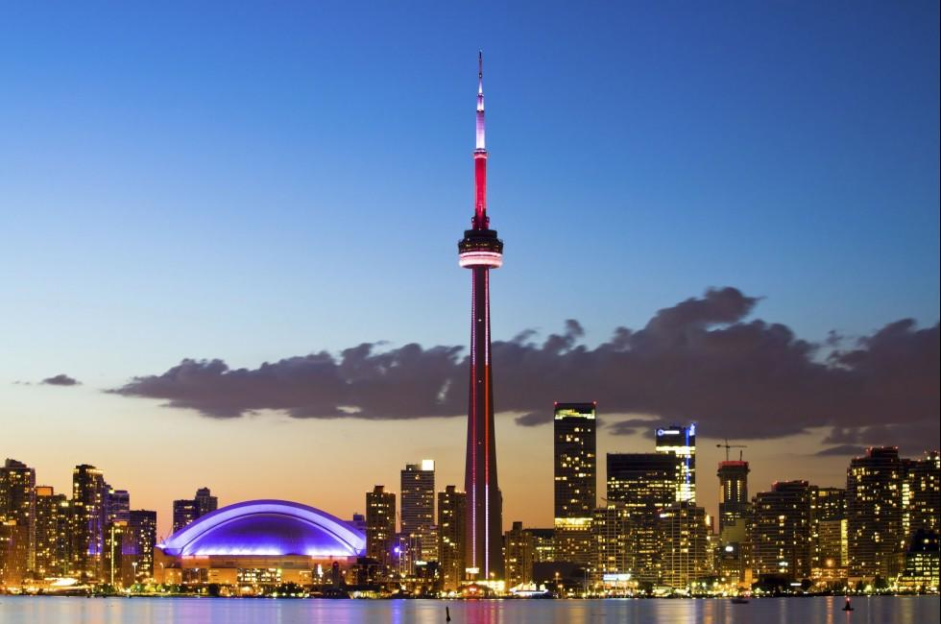
Toronto city
The capital city of the province of Ontario
Dynamic metropolitan city with vast number of diverse groups
One of the most densely populated city in Canada with 5.9 million population
. A premium location for business.

Slide 3
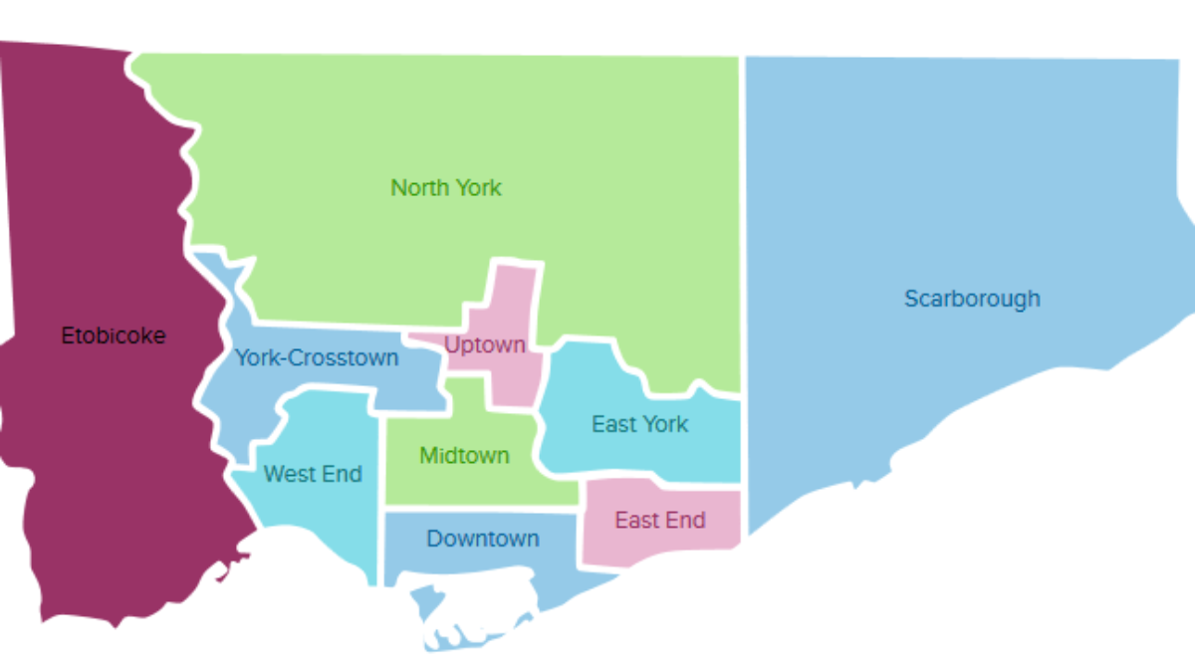
Battle between Toronto neighborhoods

Slide 4
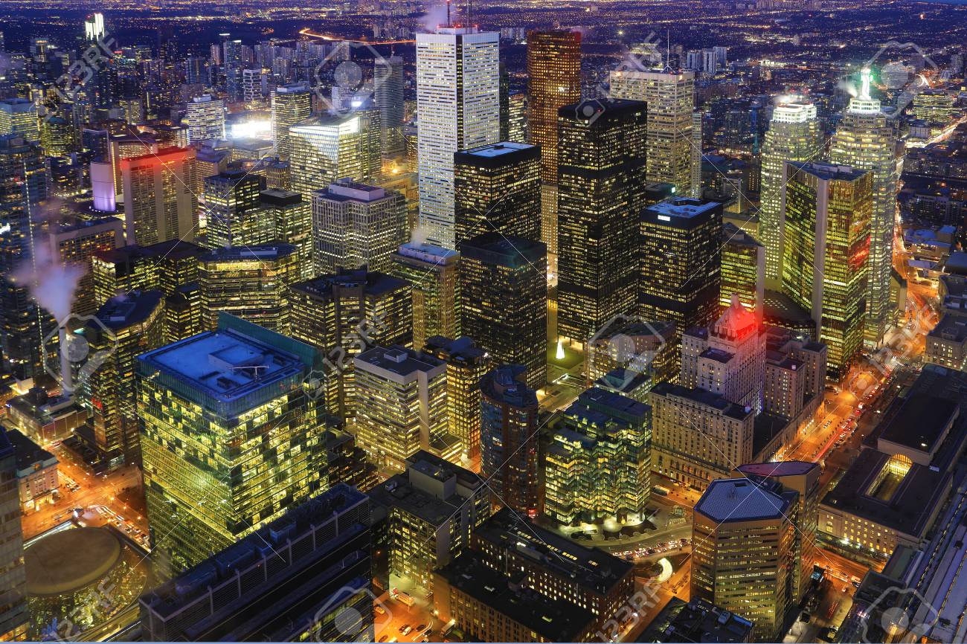
The distance from city center affects the business

Slide 5
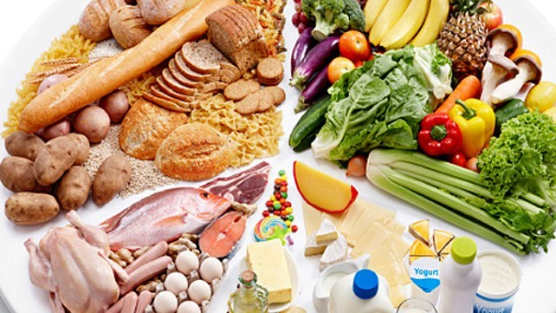
Type of food channel decides fate of the business

Slide 6
Target audience
All entrepreuners willing to enter in a food industry in Toronto area.
Specially different food-chain owners or franchise will be best target audience for this study.

Slide 7
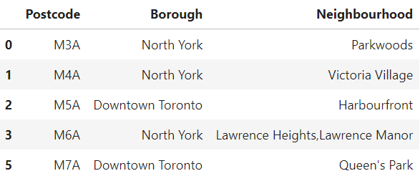
Data Set (1):
Table containing postal code information
This dataset is available at following location:
https://en.wikipedia.org/wiki/List_of_postal_codes_of_Canada:_M

Slide 8
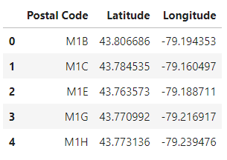
Dataset (II)
Table containing coordinates for postal codes
The coordinates for each postal code using csv file obtained from following URL:
https://cocl.us/Geospatial_data

Slide 9
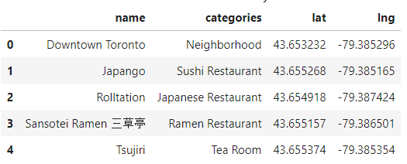
DATaset (III)
Table containing ‘Venue’ information extracted from Foursquare API:
Foursquare API to extract information on Venue location and Venue type within Toronto city.

Slide 10
Methodology
Following steps need to be followed for successful execution of this project:
Download and preprocess data using different libraries like beatifulsoup4, requests, numpy and pandas.
Save data in tabular format as a dataframe. Both the input table looks as follow after processing:
Table containing postal code information:
Table containing coordinates for postal codes:

Slide 11
Methodology contd..
Table containing ‘Venue’ information extracted from Foursquare API:
Then calculate the distance of each venue from Toronto city center (43.6532, -79.3832) using distance function from ‘geopy’ python library to calculate distance of each venue from City center.
Then create a master table by merging all the data-table. The master table will contain several important features.
For Example:
Borough name
Neighborhood name
Neighborhood coordinates
Venue name
Venue Coordinates
Venue Category
Distance from city center, etc.

Slide 12
Methodology contd…
Estimation of Pearson’s correlation coefficient and regression analysis between the distance from city center and number of venues will be calculated using ‘scipy’
Then using k-mean clustering method, cluster all the venues based on their location and check for most common type of food channels for each cluster.
Visualize all these cluster on the map using Foursquare API and folium library
Recommend the stakeholder a location proximal to city center with least number of competition, and warn them about most common type of food channels/competitors in the area.

Slide 13
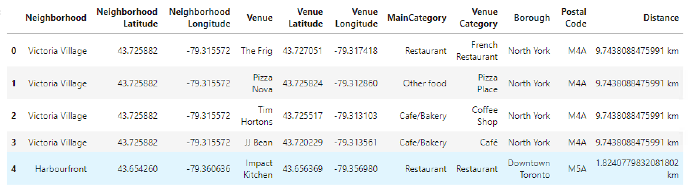
Results
The master table after processing data

Slide 14
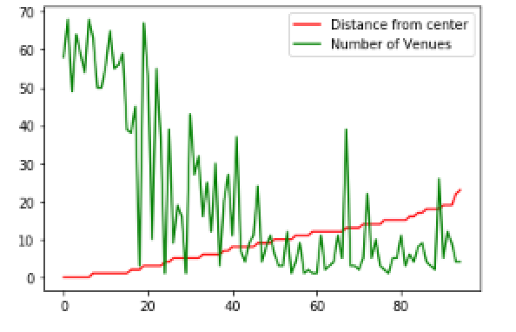
Relationship between distance from city center and number of venues
The Pearson’s correlation coefficient between them is -0.74 with 9 × 10E-18.

Slide 15
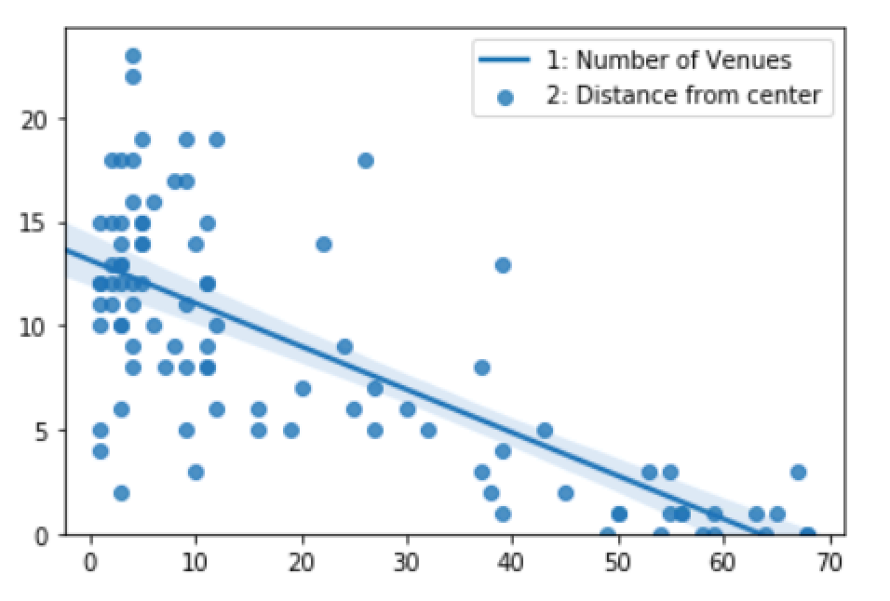
regression plot between number of venues and the distance from city center

Slide 16
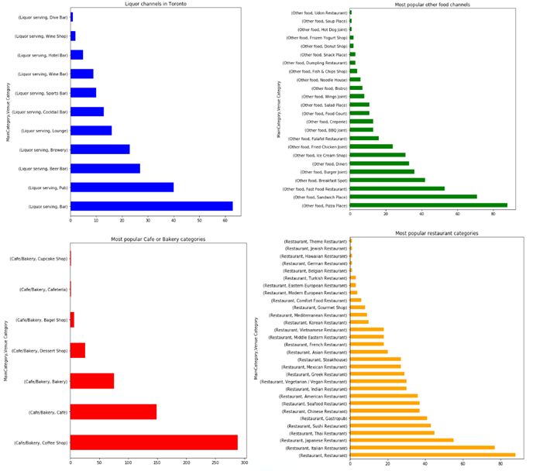
Distribution of venues in Toronto

Slide 17
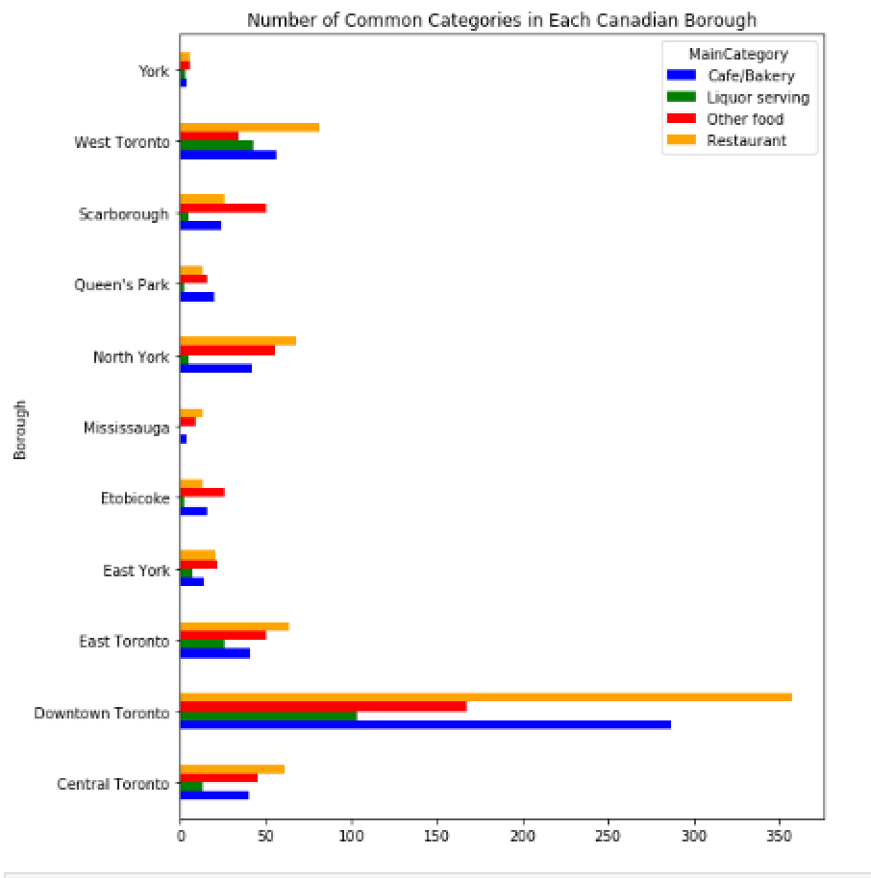
Number of venues in each borough

Slide 18
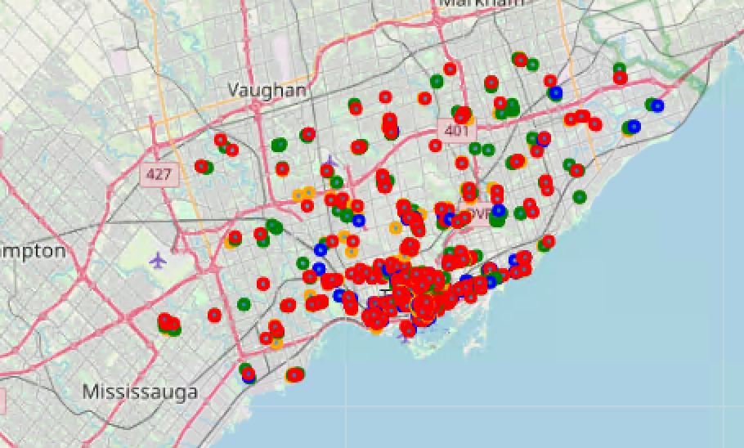
The distribution of different venues on Toronto map

Slide 19
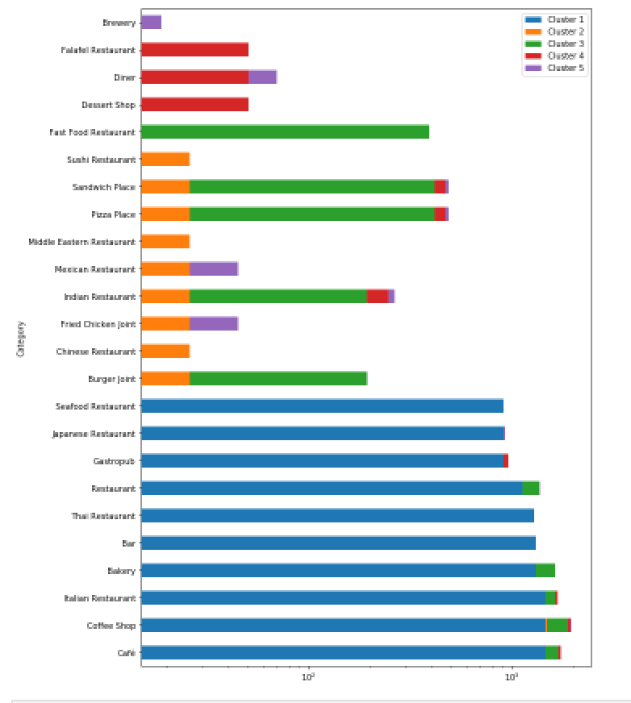
K-mer clustering

Slide 20
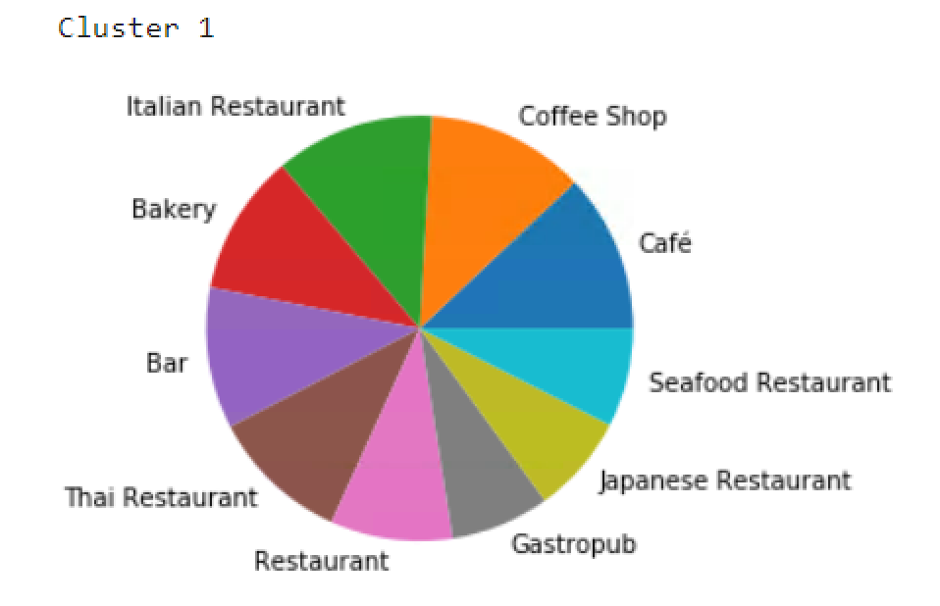
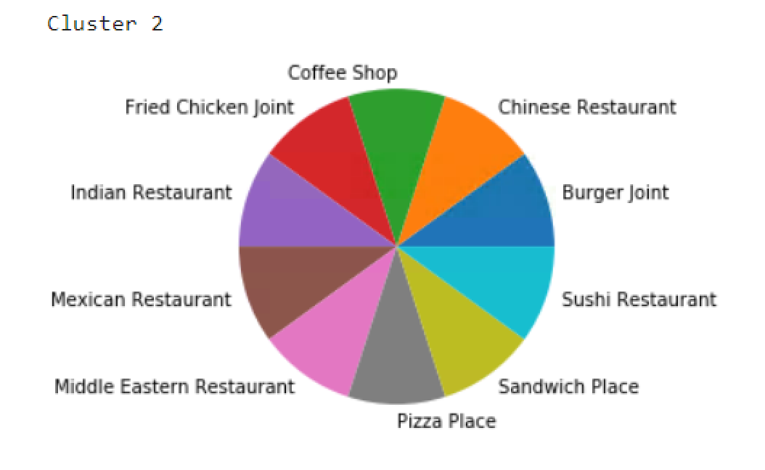
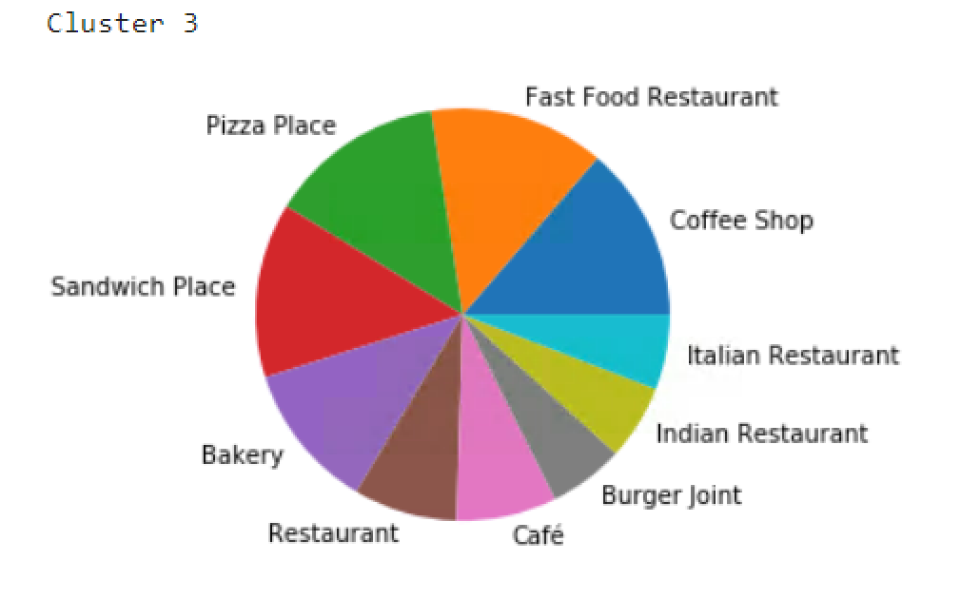
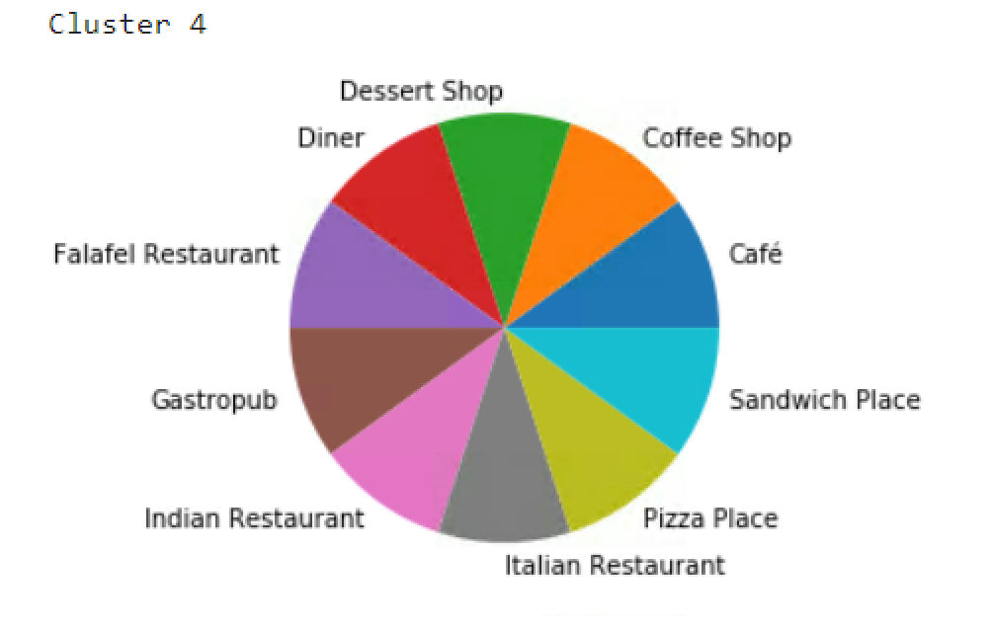
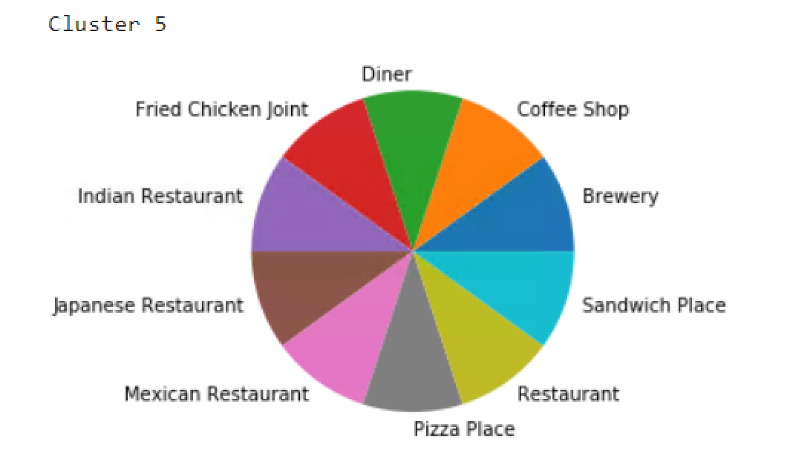
The most popular venues in each clusters are shown in following pie charts

Slide 21
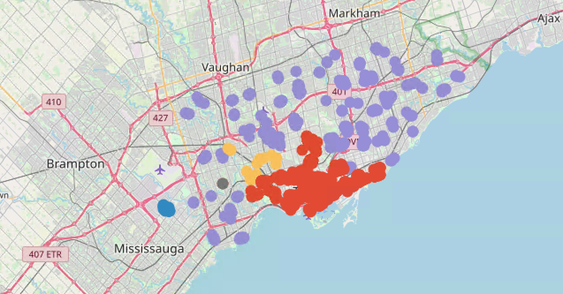
Discussion
Cluster 2
Cluster 2 is very close to city center and still has less number of venues
Few or no café/bakery in cluster 2 hence less competition

Slide 22
Recommendation
Café/Bakery in neighborhoods within cluster 2

Slide 23
Conclusions
The strong and negative correlation between number of venues and distance from city center is confirmed.
It is clear that different venue categories are popular within different neighborhood clusters and it is not a homogenous clusters.
The restaurants are most common type of venues In Toronto.
The bars/pubs in neighborhoods within cluster 2 seems the best choice for the stakeholders.

Slide 24
Thank you!

