Slide 1

READ IT FEEL IT –
“An ocean to ebooks”
RITIK RAVI
IT-3rd Year

Slide 2

CONTENTS-
Introduction
What are E-books?
Advantages
Disadvantages
What is Full Stack Development?
HTML
CSS
Javascript
Snapshots

Slide 3

INTRODUCTION
An ebook is a book in digital format that can be downloaded to a compatible device such as a computer, laptop, smart phone or tablet. eBooks are generally cheaper than paper books and allow you to store hundreds of books on one device at the touch of a button.
Here I’m going to deliever a presentation on a ebooks website.

Slide 4

What are E-books?
An eBook (Electronic Book; eBook; Digital Book) is the digital version of a printed book, or a full length book text that is published or converted to digital format to be viewed on the computer, dedicated ebook readers and mobile phones.
E-books can be created by converting a printer’s source file to formats optimized for easy downloading or on screen reading.

Slide 5
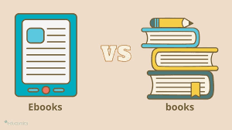
ADVANTAGES
One Device, Many Books
Accessible Everywhere
Easily Updates
Sharable contents
Interactive Elements
Easy on the eyes
Read aloud feature
Affordable in the long run

Slide 6

DISADVANTAGES
Most people enjoy reading books,yet struggle with ebooks.
Health problem as a result of screen overuse.
Power source needed for ebook.
Single book session last long with ebook.
Can’t sell unused books.
Ereader devices needed to read books.

Slide 7
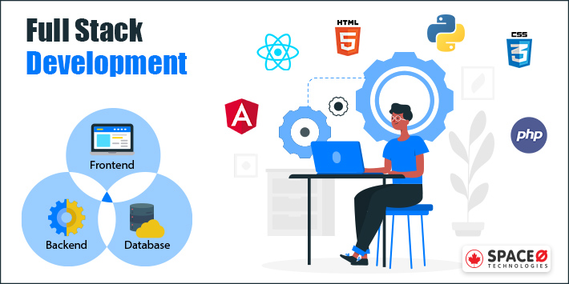
What is Full Stack Development?
Full stack development: It refers to the development of both front end(client side) and back end(server side) portions of web application.
Full stack web Developers: Full stack web developers have the ability to design complete web applications and websites. They work on the frontend, backend, database and debugging of web applications or websites.

Slide 8
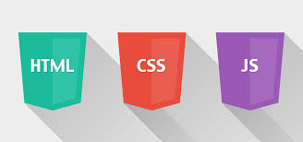
FRONT END
It is the visible part of website or web application which is responsible for user experience. The user directly interacts with the front end portion of the web application or website.
FRONT END LANGUAGES-
HTML
CSS
JAVASCRIPT

Slide 9
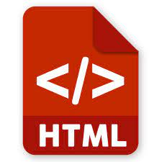
HTML
HTML: HTML stands for Hyper Text Markup Language. It is used to design the front end portion of web pages using markup language. HTML is the combination of Hypertext and Markup language. Hypertext defines the link between the web pages. The markup language is used to define the text documentation within tag which defines the structure of web pages.

Slide 10
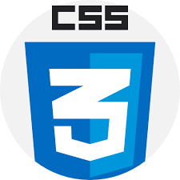
CSS
CSS: Cascading Style Sheets, fondly referred to as CSS, is a simply designed language intended to simplify the process of making web pages presentable. CSS allows you to apply styles to web pages. More importantly, CSS enables you to do this independent of the HTML that makes up each web page.

Slide 11

JAVASCRIPT
JavaScript: JavaScript is a famous scripting language used to create the magic on the sites to make the site interactive for the user. It is used to enhancing the functionality of a website to running cool games and web-based soft

Slide 12
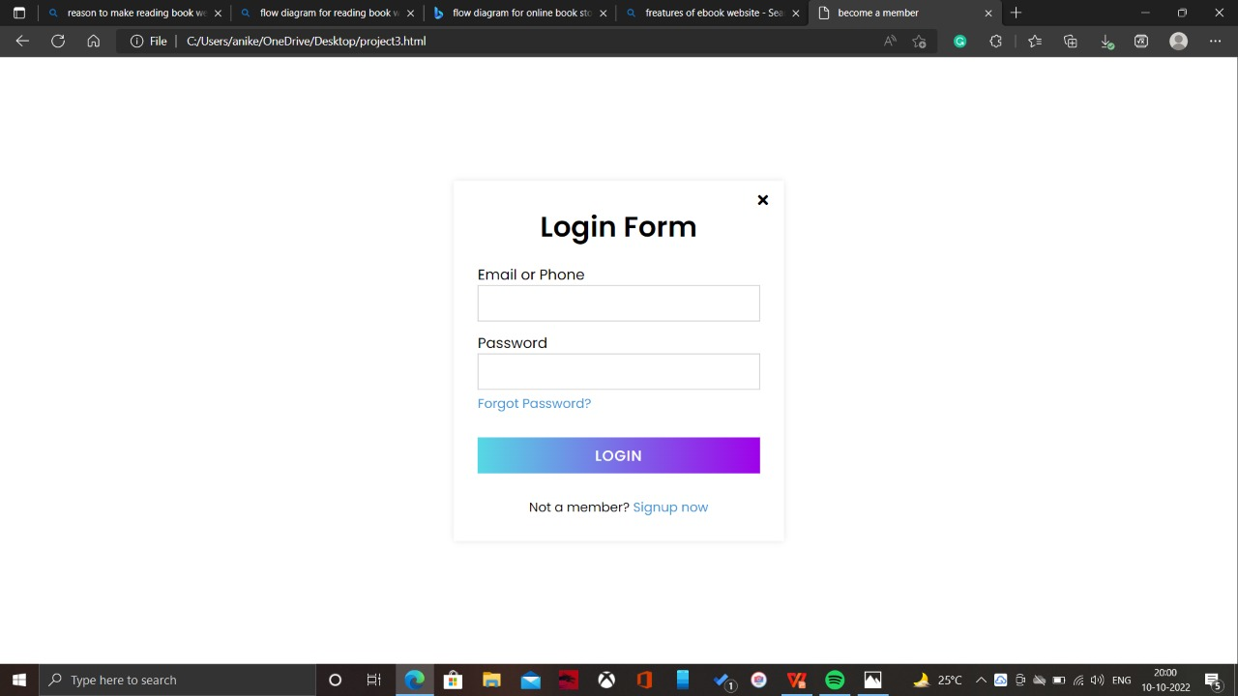
SNAPSHOTS

Slide 13
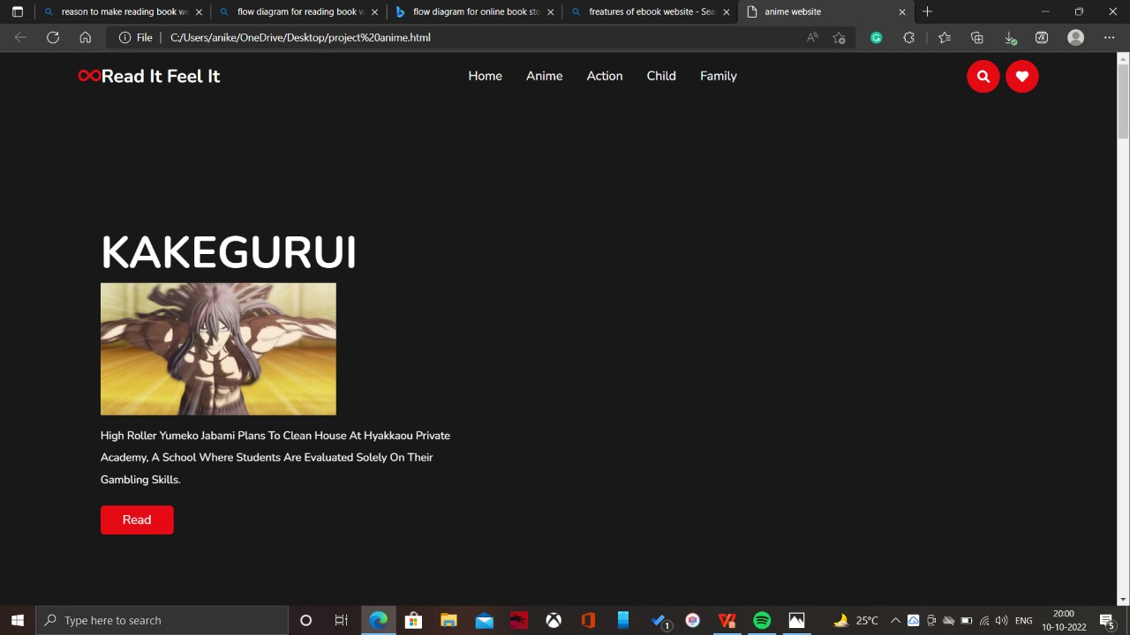
SNAPSHOTS

Slide 14
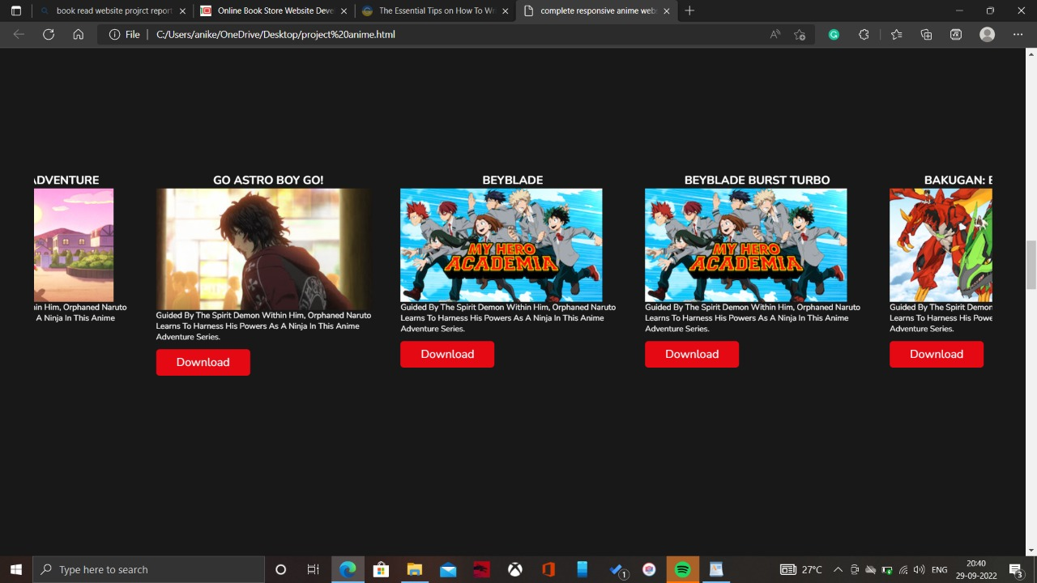
SNAPSHOTS

Slide 15

THANK YOU!

