Slide 1

Prashant Tukaram Bhala
1910800122
4-BIT ARITHMETIC LOGIC UNIT

Slide 2
What is an ALU ?
An arithmetic logic unit is a digital circuit that performs arithmetic, logical and bitwise operations on the operands in the Computer instruction words, i.e, on binary data.
It is the fundamental building block of Computers. It performs Data Processing functions.

Slide 3
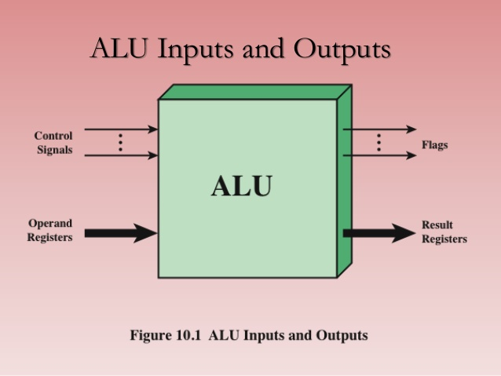
BLOCK DIAGRAM OF ALU:

Slide 4
Operations that ALU performs :
Arithmetic Operations:
ADDITION, SUBTRACTION, INCREMENT, DECREMENT,2’S COMPLEMENT
Bitwise Operations:
AND, OR, NOT, NOR, NAND, EX-OR, EX-NOR, 1’S COMPLEMENT
Shifting Operations:
Logical Left and Right shift, Arithmetic Left and Right shift, Rotate Left and Right
Other Operations:
COMPARISION

Slide 5
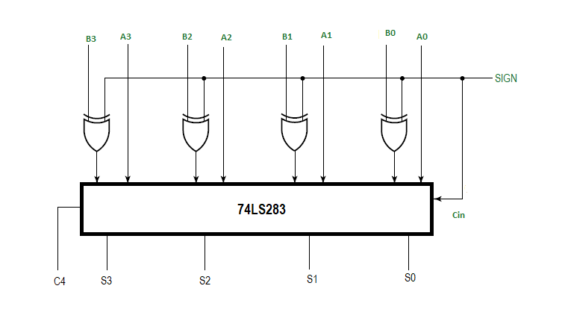
PARTS OF ALU AND THE COMPONENTS USED:
ADDITION / SUBTRACTION UNIT:
IC 74LS283 is a high speed 4-bit binary adder. It comes with look-ahead-carry.
By applying the XOR
Inverter logic it can be made to perform 2’s complement subtraction.
Datasheet

Slide 6
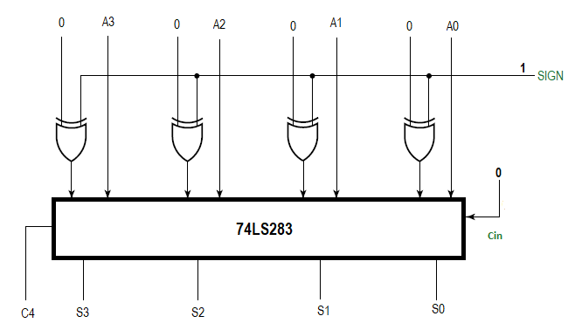
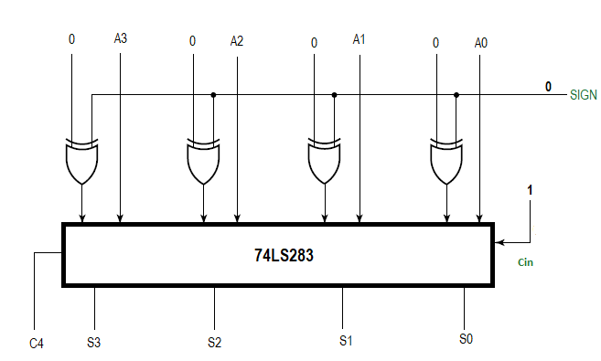
INCREMENT / DECREMENT UNIT:
The same ADD.SUB circuit is used for incrementation and decrementation. The one 4-bit unit will take input from the accumulator and the other 4-bit unit will take 0000 from the register and the carry and sign input will be controlled by the instruction. Both the register and accumulator values will be added or subtracted depending on the instruction.
Decrement
Increment

Slide 7
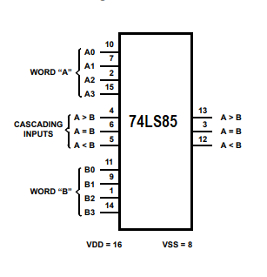
COMPARATOR UNIT:
The ic 74LS85 is used for magnitude comparision of two four bit binary numbers. It gives the output for A>B, A<B and A=B.
It can be extended to compare more than 4 bit binary numbers.
Datasheet Link

Slide 8
BITWISE OPERATIONS UNIT:
The ic 7408 is used for AND operation. It contains four two inputed AND gates.
The ic 7432 is used for OR operation. It contains four two inputed OR gates.
The ic 7404 is used for 1’s complement, that is NOT.
The ic 7486 is used for XOR operation.
The ic 7400 is used for NAND operation.
The ic 7402 is used for NOR operation.

Slide 9
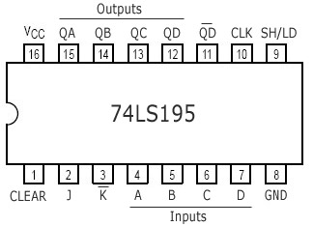
SHIFTING OPERATIONS UNIT:
The ic 74LS195 is used for the shifting bits of a four bit binary number.It is a universal shift register. It performs left shift, right shift and parallel transfer.
Datasheet Link

Slide 10
OTHER COMPONENTS:
To activate or to deactivate the units a 4-bit tri state buffer ic 74HC243 is used. Datasheet
For memory, ic 74LS173 is used as register and accumulator.It is 4 bit d-type flip-flop register.Datasheet
The ic 74HC154 is used as an instructor decoder.It is a 4 line to 16 line decoder.Datasheet
IC 74LS189 is a 16word x 4bit RAM.
IC 7493 is a 4 bit binary counter used as a program counter.

Slide 11
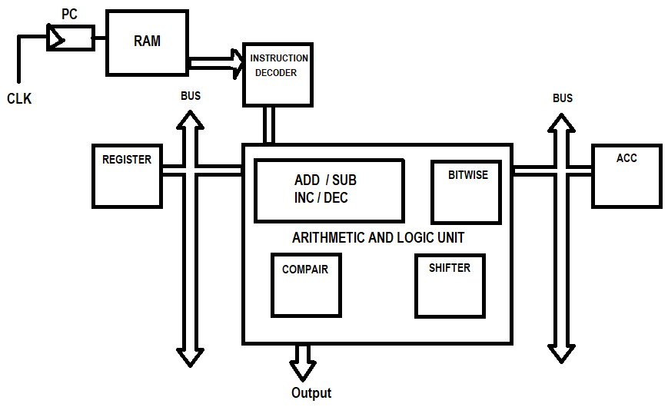
ALU BLOCK DIAGRAM:

Slide 12
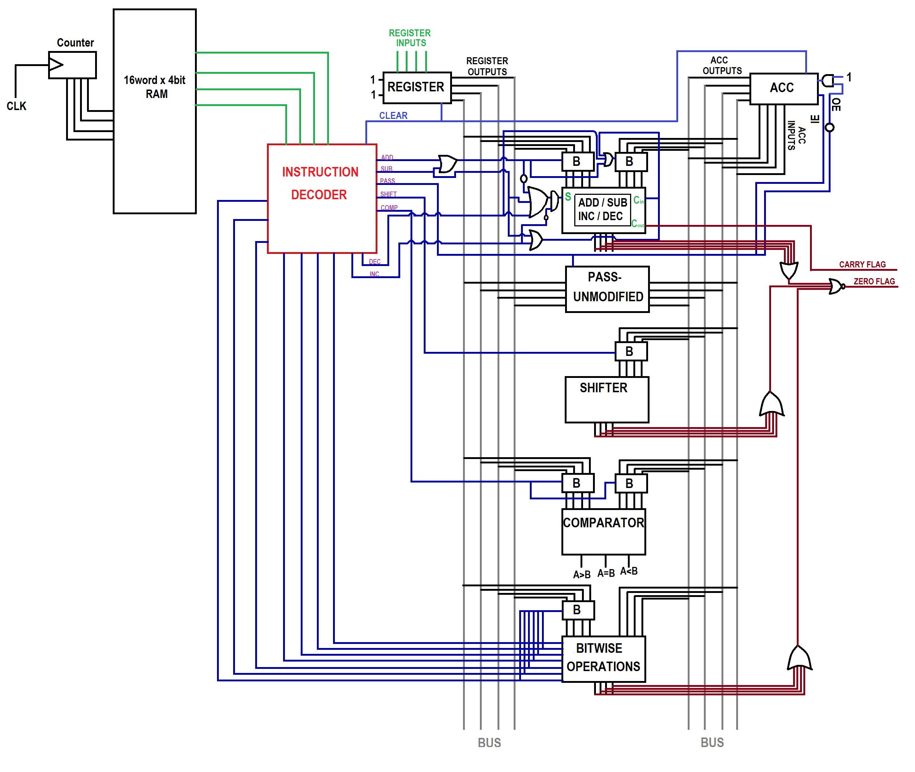
Circuit :

Slide 13
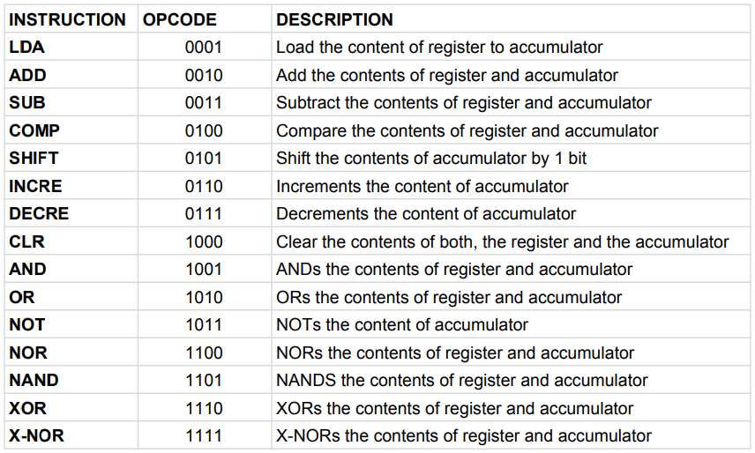
INSTRUCTIONS:

Slide 14
PROGRAM EXAMPLE:
To add two numbers:
LDA 0100
ADD 0011
To Compare two numbers:
LDA 0001
COMP 0100
To increment a number:
LDA 0111
INCRE
To AND two numbers:
LDA 0010
AND 1000

Slide 15
Future Scope:
There are many microcontroller available in the market with lot more functionality.
But we need to study those microcontroller’s syntax and then we can implement some projects.
By designing our own microcontroller we can add the functionality we want.
A recent article is also published that in future AI will be trained on 4 bit computers. Link:https://www.technologyreview.com/2020/12/11/1014102/ai-trains -on-4-bit-computers/ Conclusion: ● In this project we design a 4-bit ALU(4-b

Slide 16
Conclusion:
● In this project we design a 4-bit ALU(4-bit in the sense it can operate on 4 bits).
● List the required components.
● We design instructions.
● Execute programs.

