Slide 1
Comparison between Load Balancing, AutoScaling & Serverless Computing

Slide 2
Load Balancing | AutoScaling | Serverless Computing
Cloud load balancing is the process of distributing workloads across multiple computing resources. | Automatic scaling is a cloud computing feature that allows users to automatically scale cloud services, like virtual machines (VM) and server capacities, up or down, depending on defined situations. | Serverless computing allows you to build and run applications and services without having to manage infrastructure.
Amazon Elastic Load Balancing (ELB) Microsoft Azure's Traffic Manager Google Compute Engine | - Amazon EC2 Auto Scaling Azure Autoscale Google Compute Engine | AWS Lambda Microsoft Azure Functions Google Cloud Functions

Slide 3
Load Balancing | AutoScaling | Serverless Computing
Elastic Load Balancing (ELB) automatically distributes incoming application traffic and scales resources to meet traffic demands Elastic Load Balancing offers three types of load balancers: Application Load Balancer Network Load Balancer Classic Load Balancer | AWS Auto Scaling – monitors your applications automatically adjusts capacity to maintain steady, predictable performance at the lowest possible cost | “Don’t think about the servers” Here the cloud provider dynamically manages the allocation of machine resources.
Load balancing helps enterprises achieve high performance levels for potentially lower costs than traditional on-premises load balancing technology | It allows your applications to gracefully handle increases in traffic and reduces cost when the need for resources is lower | Here, developers can focus on their core product instead of worrying about managing and operating servers or runtimes, either in the cloud or on-premises.

Slide 4
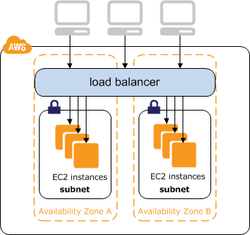
AWS Load Balancing
Benefits
Highly Available Secure Elastic Flexible Robust Monitoring and Auditing Hybrid Load Balancing

Slide 5
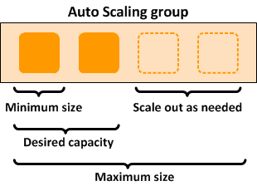
AWS Auto Scaling
Benefits
Setup scaling quickly Make smart scaling decisions Automatically maintain performance Pay only for what you need

Slide 6
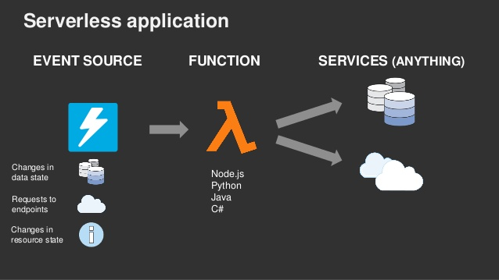
AWS Serverless Computing
Benefits
No server management Flexible scaling Automated high availability

Slide 7
