Slide 1
Classifying Adverse Event Reporting System Data
Prashant Vikram Singh
Priyal Chaudhari
Ranadeep Guha

Slide 2
Introduction
"The FDA Adverse Event Reporting System (FAERS) is a database that contains information on adverse event and medication error reports submitted to FDA."
The FDA produces FDA Adverse Event Reporting System (FAERS) quarterly data.
The FAERS include the following:
Demographic and administrative information and the initial report image ID number (if available);
Drug information from the case reports;
Reaction information from the reports;
Patient outcome information from the reports;
Information on the source of the reports;
A "README" file containing a description of the files.

Slide 3
Part 1: Parse files, Handle Missing Data & EDA
Link to Download data files:
http://www.nber.org/data/fda-adverse-event-reporting-system-faers-data.html
The goal of this exercise is to extract “all” csv files present on the faers website, save them without any manual intervention.
Next step :
Handle missing data
Compute summary metrics
Check for any observable anomalies and outliers
Perform EDA using advanced Python libraries ( Seaborn, Plotly, Matplotlib)

Slide 4
Data Size
Data Size:
Data is since 2004 and is divided in quarterly manner.
Each quarter has 4 source files ( Demo, Drug, Outcome, Reaction)
Each file has an Average size of 60 MB. So, like that there are 16 files for each year till 2018

Slide 5
Features
Features:
Demo: primaryid, caseid, caseversion, i_f_code, event_dt, mfr_dt, init_fda_dt, fda_dt, rept_cod, auth_num, mfr_num, mfr_sndr, lit_ref, age, age_cod, age_grp, sex, e_sub, wt, wt_cod, rept_dt, to_mfr, occp_cod, reporter_country, occr_country
Drug: primaryid, caseid, drug_seq, role_cod, drugname, prod_ai, val_vbm, route, dose_vbm, cum_dose_chr, cum_dose_unit, dechal, rechal, lot_num, exp_dt, nda_num, dose_amt, dose_unit, dose_form, dose_freq
Outcome: primaryid, caseid, outc_cod
Reaction: primaryid, caseid, pt, drug_rec_act

Slide 6
Problem statement
The problem addressed by this project is to classify the outcome of the drug reaction combination supplied to a patient based on the reported event. Since, we have different reported event by various organization we need to check whether the drug and reaction combination falls under following categories:
Death
Life-Threatening
Hospitalization
Initial or Prolonged
Disability
Congenital Anomaly
Required Intervention
Prevent Permanent Impairment/Damage
Other Serious (Important Medical Event)

Slide 7
Part 2: Machine Learning: Multi-class Classification
A Classification script in a Jupiter notebook in Python that builds a classification model for drug information from the case report, reaction information & patient outcome from the reports using downloaded dataset.
Following steps would be covered:
Variable selection
Application of various ML Classification models
Design a pipeline and system to implement this approach and discussion on the system’s capabilities

Slide 8
Part 3: Summarization
Summarize the key insights related to different variables
Present the results using python notebook
Tools:
Python scikit-learn library for applying various classification model
Jupyter Notebook
Data Visualization
Matplotlib library

Slide 9
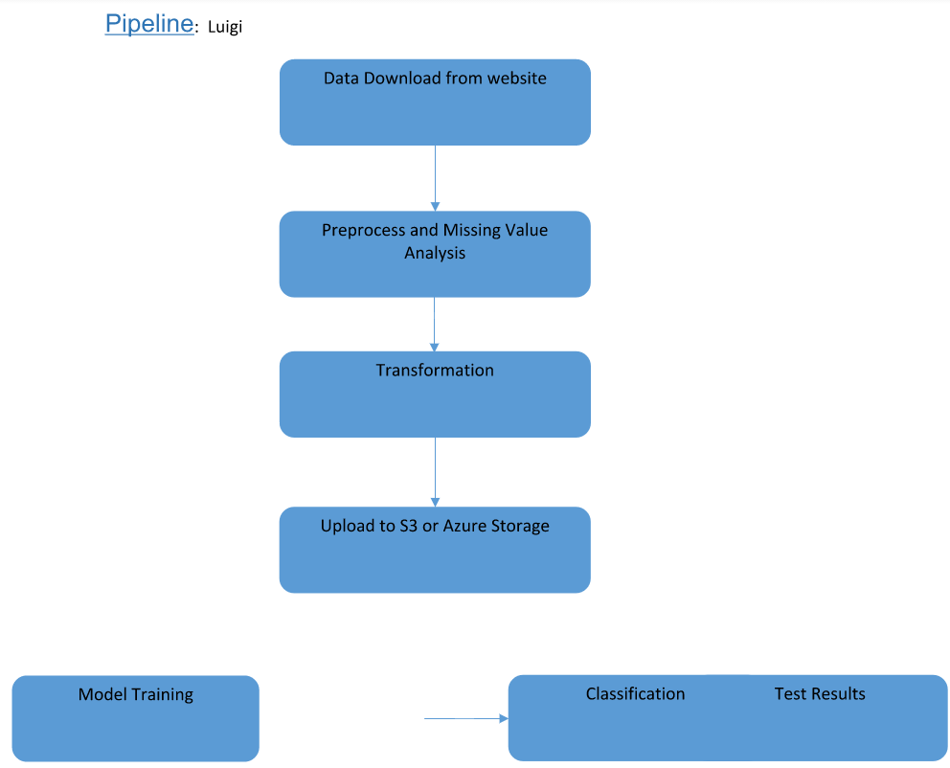

Slide 10
Thank you

