Slide 2
FINAL PROJECT
FDA ADVERSE EVENT REPORTING SYSTEM
(FAERS)
Under Supervision of
Prof. Dino Konstantopoulos
Presented by
Team – 1
Priyal Chaudhari
Ranadeep Guha
Prashant Vikram Singh

Slide 3
PROBLEM STATEMENT
The problem addressed by this project is to classify the outcome of the drug reaction combination supplied to a patient based on the reported event. Since, we have different reported event by various organization we need to check whether the drug and reaction combination falls under following categories:
Death
Life-Threatening
Hospitalization
Initial or Prolonged
Disability
Congenital Anomaly
Required Intervention
Prevent Permanent Impairment/Damage
Other Serious (Important Medical Event)

Slide 4
SUMMARY
Section 1: Data wrangling
Data Download and pre-processing
Exploratory Data analysis in Python
Section 2: Building and Evaluating Multi Class Classification Model
Classification using Multi-Class Logistic Regression, Multi-Class Random Forest, Multi-Class Neural Network

Slide 5
TECHNOLOGY STACK
Python Scikit-learn library for applying Neural Network Classification Model
Azure ML Studio
Amazon ML Web service
Amazon S3

Slide 6
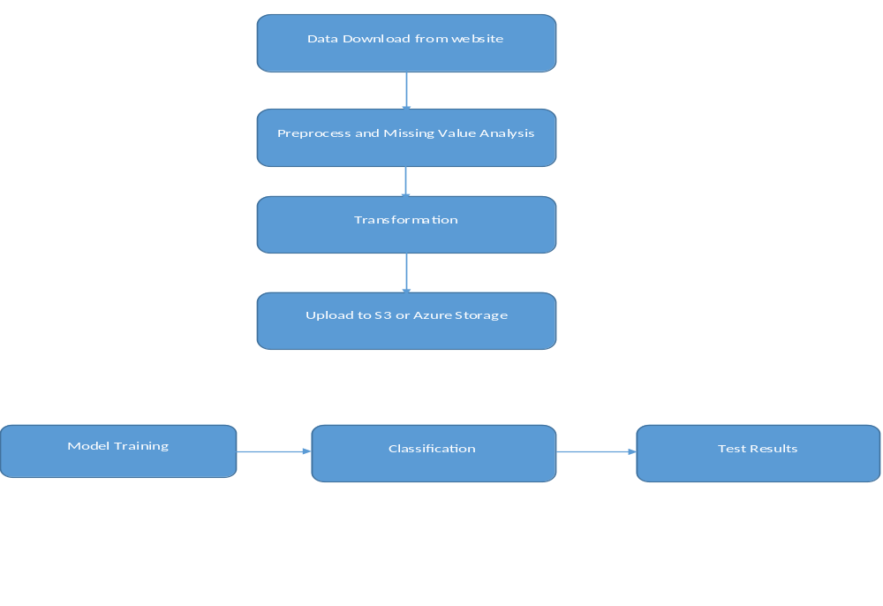
PROCESS FLOW DIAGRAM

Slide 7
FAERS DATASET
The FDA Adverse Event Reporting System (FAERS) is a database that contains information on adverse event and medication error reports submitted to FDA.The FDA produces FDA Adverse Event Reporting System (FAERS) quarterly data. The FAERS include the following:
demographic and administrative information and the initial report image ID number (if available)
drug information from the case reports;
reaction information from the reports;
patient outcome information from the reports
information on the source of the reports
a "README" file containing a description of the files
The FDA provides a lot of additional information about the FAERS. FDA Adverse Event Reporting System (FAERS) began 2012Q4.
Legacy Adverse Event Reporting System (AERS) are available 2014Q1-2018Q2. we have used FAERS variable names in the AERS files in cases where the variables are the same.

Slide 8
Data Download & Pre-Processing:
To download the file programmatically, without any manual intervention we have used the python requests library to navigate to the website and created source directory (FAERSsrc), where all the related files will be downloaded and destination directory where all the files required for our analysis will be saved.
We will be using Beautiful Soup package, a powerful python package for data scrapping from the FDA website and download all the quarterly files for the “FAERS” files for our analysis purpose.

Slide 9
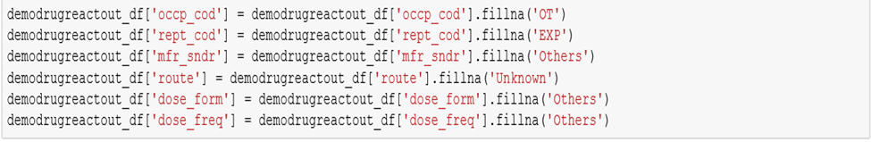
Data Preprocessing & Cleaning
We have used the standard Reaction Name as proposed by MedDRA or Medical Dictionary for Regulatory Activities which is a clinically validated international medical terminology dictionary used by regulatory authorities in the pharmaceutical industry.
For Drug Name standardization, we have used RxNorm provides normalized names for clinical drugs and links its names to many of the drug vocabularies commonly used in pharmacy management
Once, we are done with the cleaning of all the four files, we will create a summarized data set using the python joins file based on primary report id and case id. For this step, we created a function which will join all the four-data frame associated with the final data set.

Slide 10
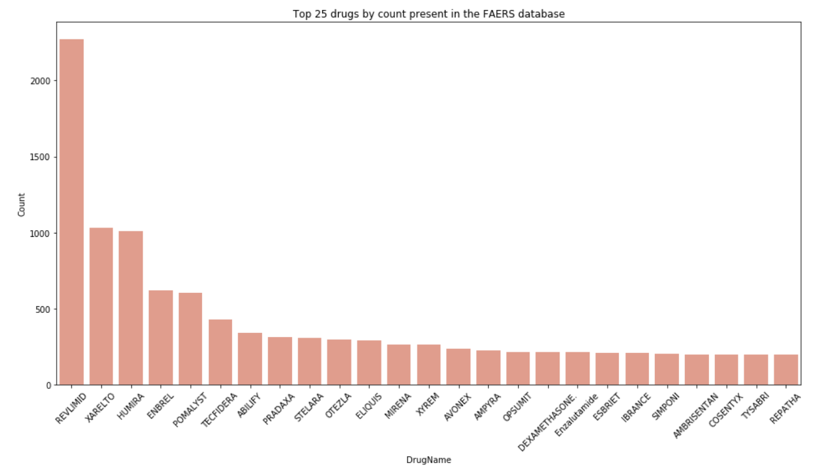
Exploratory Data Analysis
Drug Counts: contains the top 25 drugs by count present in the FAERs database

Slide 11
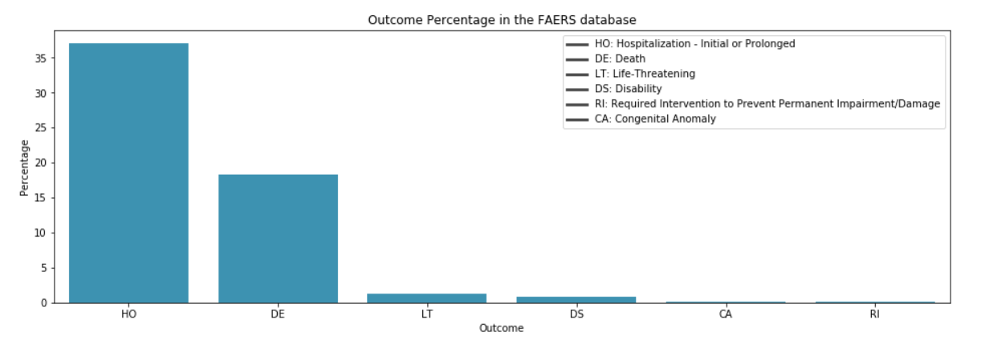
Outcome distribution: provides you the percentage of the outcome distribution based on existing data.

Slide 12
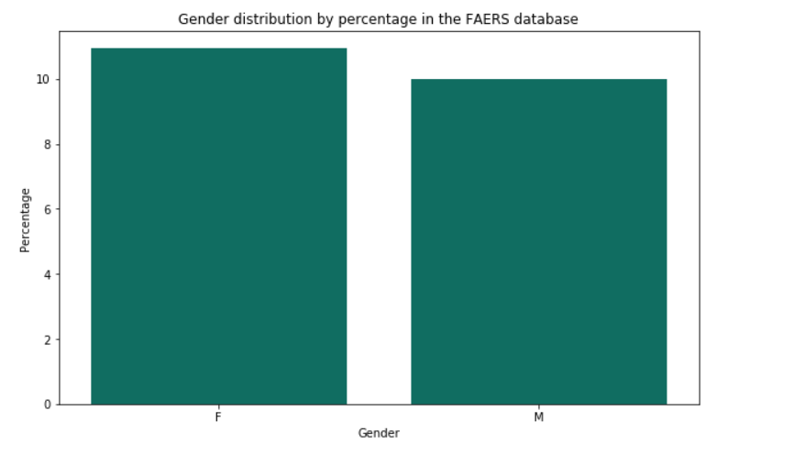
Gender: gives you the % amount about the gender category. Majority of the values in this field were NULL so, we have eliminated those while creating this graph

Slide 13
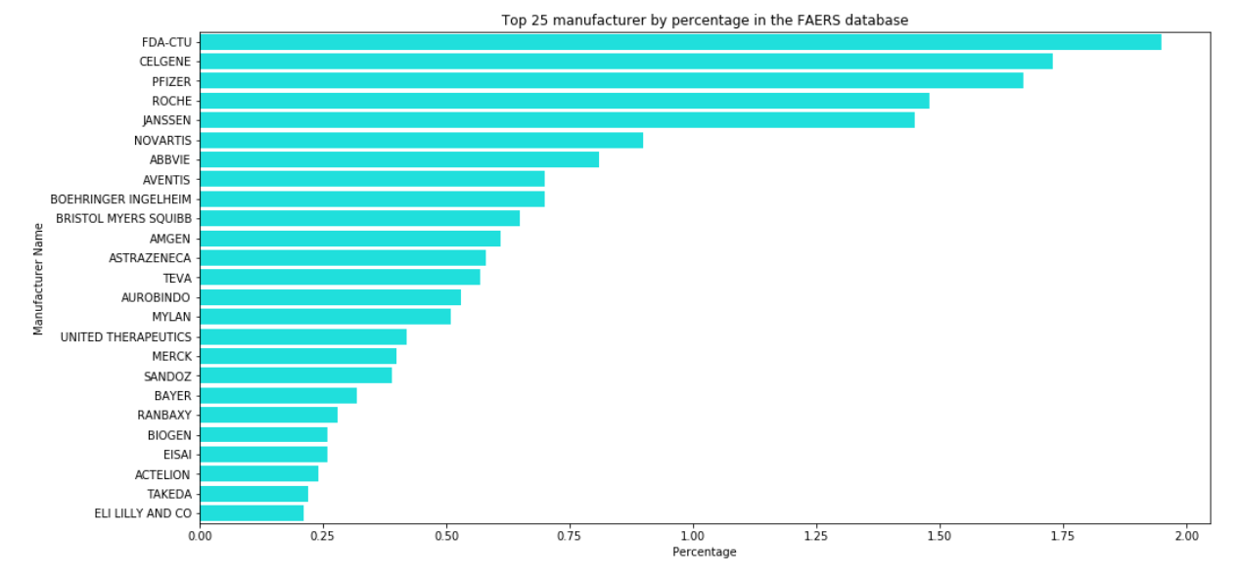
Manufacturer distribution: Top 10 Manufactures which have been reported and % amount by cases received. Majority of the values in this field were NULL so, we have eliminated those while creating this graph.

Slide 14
MULTI - CLASS CLASSIFICATION
In our cleaned FAERS dataset, we have a column named outc_cod, which signifies the primary outcome for e.g. (‘OT’,’DE’) drug intake and reaction occurs. In our project, we are using multi-class classification to predict the probability of the outcome based on features selected from feature engineering.
CODE MEANING_TEXT
---- ------------
DE Death
LT Life-Threatening
HO Hospitalization - Initial or Prolonged
DS Disability
CA Congenital Anomaly
RI Required Intervention to Prevent
Permanent Impairment/Damage
OT Other

Slide 15
APPROACH:CLASSIFCATION
We will use three approaches to find out the outcome of our classification model:
Using Azure ML Studio (For selecting the best model for our problem)
Using Amazon ML web service (uses Stochastic gradient descent)
Python Sklearn Library to test Classification Algorithms

Slide 16
APPROACH:CLASSIFCATION
We have implemented different classification algorithms in Notebook and tested the accuracy to see which algorithm performs better
  Decision tree classifier
  K-Nearest Neighbor classifier
  Gaussian Naive Bayes Classifier
  Logistic Regression classifier
  Neural Network classifier
All the classifiers are implemented in notebook and there respective result matrix has been printed

Slide 17
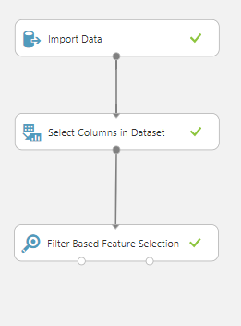
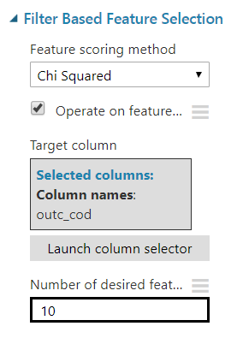
FEATURE SELECTION
Before proceeding with our models, we have done feature selection using Chi Squared method.
The best features that add to the predictive power of the model will be retained and irrelevant features removed from the model.

Slide 18
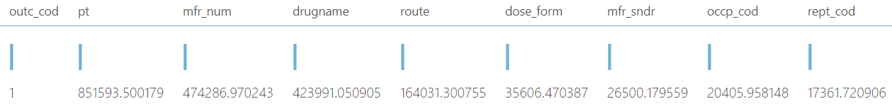
FEATURE SELECTION
We have the selected variables as per the Chi squared Method and used those for further analysis while making sure that all the datasets contain same number of columns. Performing all the feature selection methods we shortlisted below features to best predict our model.

Slide 19
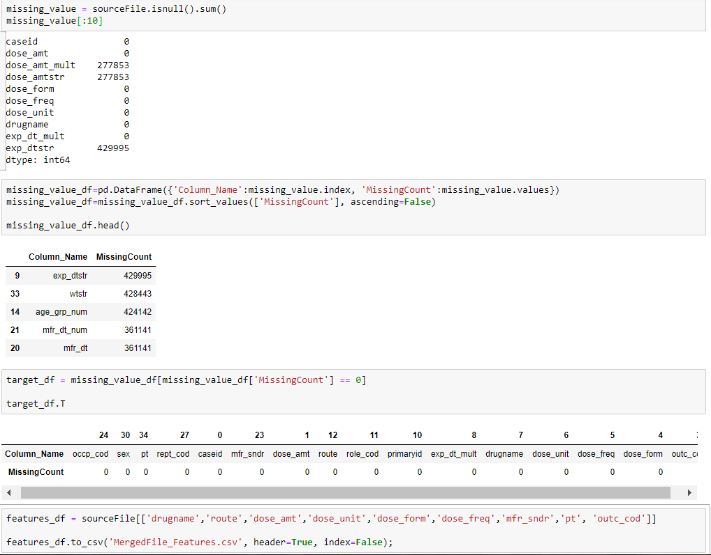
FEATURE SELECTION
Then we computed the count of null values in a column and dropped all those columns where NULL is present even after wrangling and wrote the final output file.

Slide 20
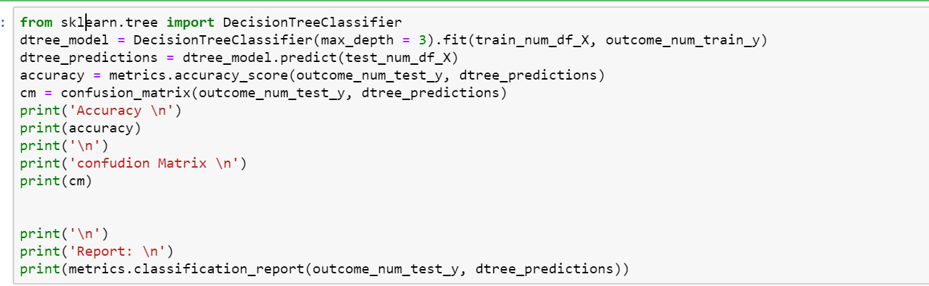
Decision Tree Classifier Using Sklearn
s

Slide 21
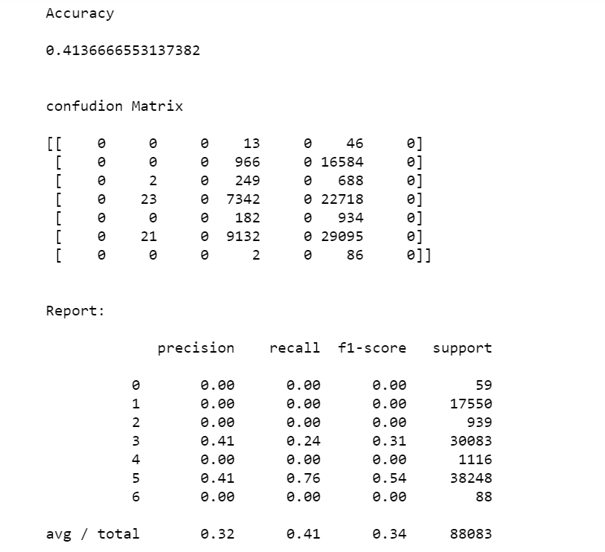
Decision Tree Classifier Using Sklearn

Slide 22
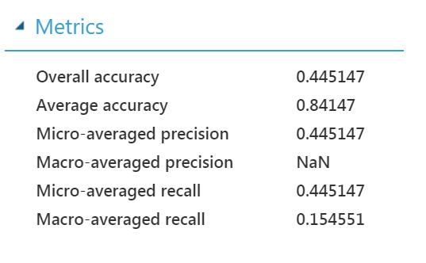
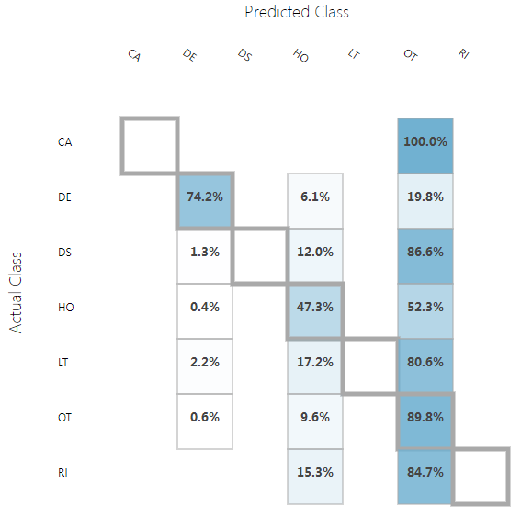
COMPARINING DIFFERENT MODELS
Multi-class Decision Forest

Slide 23
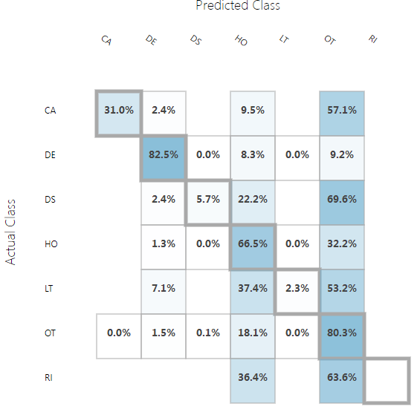
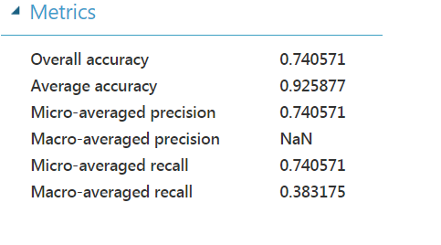
COMPARINING DIFFERENT MODELS
Multiclass Logistic Regression

Slide 24
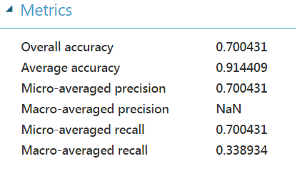
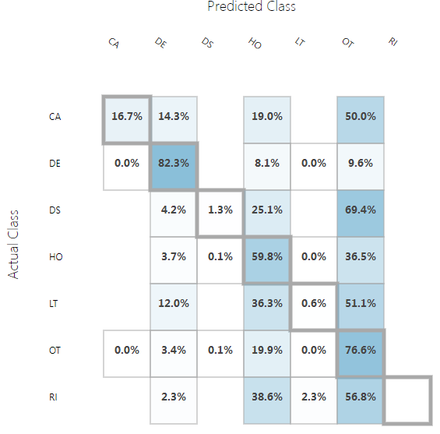
COMPARINING DIFFERENT MODELS
Multiclass Neural Network

Slide 25
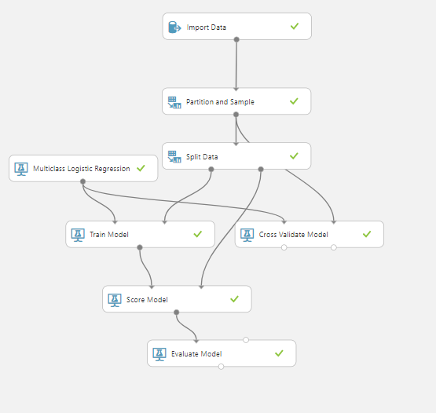
IMPLEMENTING CLASSIFICATION MODEL ON AZURE ML
MULTI_CLASS Logistic Regression CLASSIFICATION

Slide 26
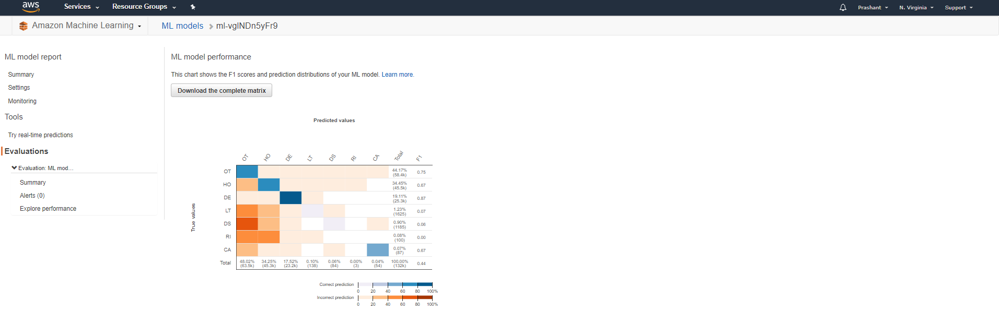
AMAZON MACHINE LEARNING WEBSERVICE

Slide 27
THANK YOU!!!!

