Slide 1


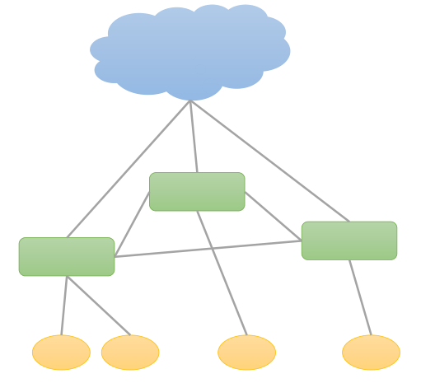
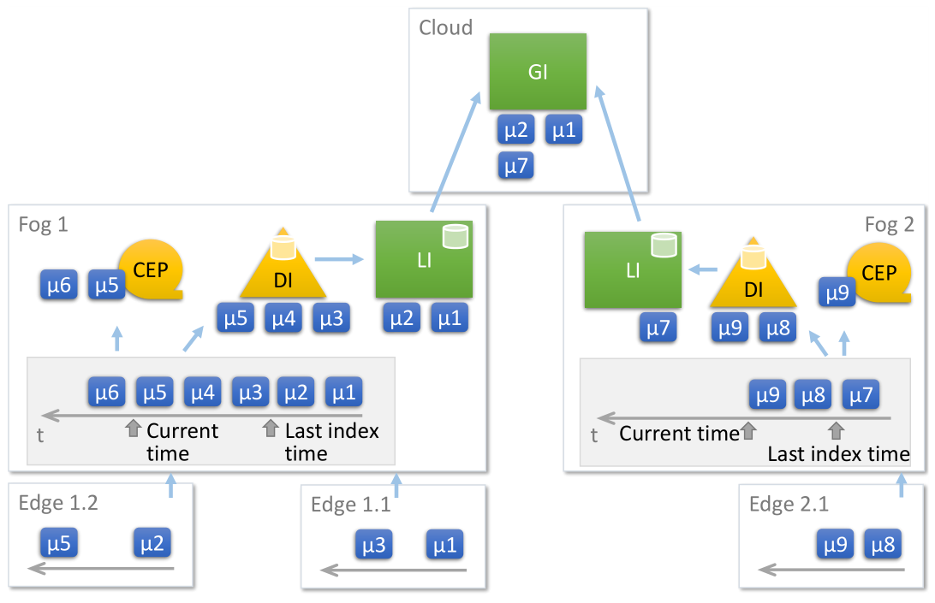
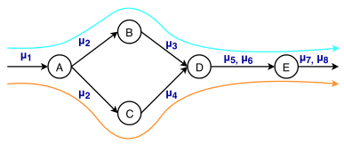
CoFEE: A Scheduler for Cloud Fog and Edge Execution
Introduction
CoFEE Scheduler
Internet of Things (IoT) deployment have millions of sensors at the Edge of the network, through Smart City infrastructure and lifestyle devices.
Cloud computing platforms are often tasked with handling these large volumes and fast streams of data from the Edge
Analytics are performed on these streams of data which are composed into DAG of Tasks
Fog computing is used as a layer to complement Edge and Cloud computing
Schedule a transactional DAG of tasks across edge, fog and cloud, that are triggered based on temporal, spatial, domain features of generated inputs, to execute within a deadline.
ALGORITHM:
Cloud uses a hierarchical index to locate the data based on spatio-temporal features
The DAG is unrolled into tasks that are offered to the Fog for execution
Each fog decides if the input can be run on it’s edge or itself and responds with a bid. The cloud selects the smallest bid for execution.
DAG + Input Query
Cloud
Fog
Edge
Motivation
Use Cases for Smart Cities
Cloud data centers have high round trip latency, limited bandwidth due to which it misses the task deadline set by user
Cloud has higher monetary cost but with reliability and capacity, while Edge is opportunistic and cheap
Fog computing as a concept for low-latency and resource-rich processing between the two.
Due to these factors, there is need for scheduling strategies across Edge-Fog-Cloud that meet these deadlines while minimizing cost.
Visual Sensors in Street lights for Smart traffic systems require detecting vehicle and predicting future paths that it may take so that streetlights could be turned on/off, thus preserving power while fulfilling the functionality
Upon detecting a vehicle, system auto-submits a query to the cloud for predicting path which upon receiving the query uses CoFEE algorithm to schedule the task and actuating the streetlights in the predicted path
Investigators
Prateeksha Varshney, Prasanth Yadla, Shayal Chhabra, Abhilash Sharma, Yogesh Simmhan

