Slide 1
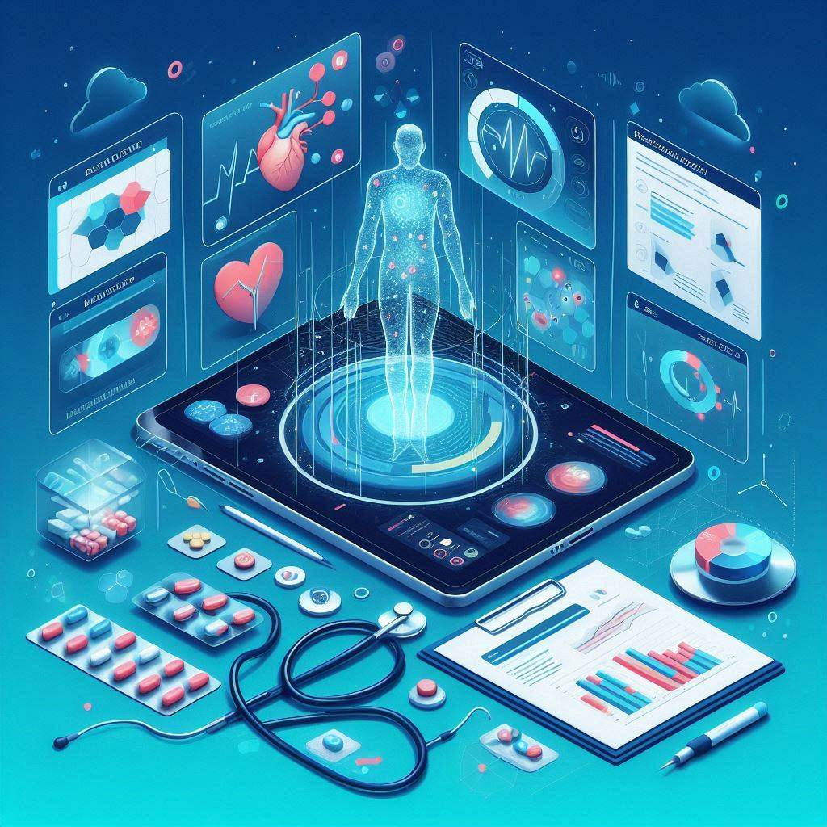

Disease Detection
AND
Medical Guidance
WITH
Image Analysis
By:
Prashant 21BIT0524
Shashank 21BIT0037
Under Guidance of
Sumangali K

Slide 2
Problem Description
Traditional healthcare systems lack comprehensive platforms for disease analysis and holistic AI health management.
Existing solutions do not offer integrated features such as medication information, medicine side-effects, dosage etc.
Users struggle to determine the disease based on the symptoms they are experiencing.
There is a need for an affordable, cross platform, user-friendly, and technologically advanced platform that addresses these needs.

Slide 3
cureAI Features
A single platform where users can get early disease prediction along with it’s treatment, other symptoms & effects, Personalized exercises, Usage guide.
Prescription scanning, shows directions to use them, benefits, side effects etc. directly from the camera/image.
Users can scan any medical tool image to get a step-by-step usage guide on them.
Features:
Symptom based Disease Detection
Medicine analysis through image
Affordable to use
Accessible on all devices
Natural language support
Medical tool usage directions
Prescription analysis through image

Slide 4
Social impact
Improved Access: Provides accessible and integrated healthcare solutions to individuals regardless of geographic location or socioeconomic status.
Early Intervention: Facilitates early disease prediction, leading to timely interventions and improved health outcomes.
Empowerment: Empowers every user to take control of their health through personalized insights, recommendations and access to informative resources.
Affordable Healthcare: Offers affordable healthcare solutions through innovative technology, reducing financial barriers to accessing quality care.
Briefly write something about the hospital. This will give the audience a better understanding about what you are trying to say.
Improved Healthcare Access to all.
Enhanced Patient Convenience.
Reduced Healthcare Costs.
Preventive Healthcare.

Slide 5

Tech Stack
Frontend:
HTML, CSS, Tailwind CSS
Backend:
HuggingFace backend, JS
APIs:
Blip-image-captioning, Generative AI

Slide 6

Business Model | Future Scope
1.
Key Partners & Resources
Healthcare Providers: Partnering for specialized care.
AI Technology Companies: Google’s generative models.
Marketing Agencies: Promotional activities and user acquisition.
2.
Revenue Streams
Subscription Model: Tiered plans for premium features such as AI chats.
Advertisement Revenue: Partnering with healthcare brands.
Premium Content: Local recommended doctors & Medics contact.
3.
Customer Segments
Health-Conscious Individuals: Seeking personalized health solutions.
Healthcare Professionals: Doctors, trainers.

Slide 7
Thank You

