Slide 1


THE OUTLIERS
Mumbai Rent Radar
What should a flat actually cost?
Akshara · Prashasthi · Sudarshan

Slide 2
THE PROBLEM
The same 2BHK, ten different prices
▸ The question: every Mumbai tenant asks what a flat should really cost.
▸ The noise: identical flats are advertised at wildly different rents.
▸ Our job: build a fair-rent model and flag listings that look mispriced.
THE ANSWER, IN ONE LINE
Rent is set by how big a flat is —
far more than where it is.
We predict a fair rent within ~27% for ordinary flats and flag the mispriced ones.
The Outliers · Mumbai Rent Radar
2

Slide 3
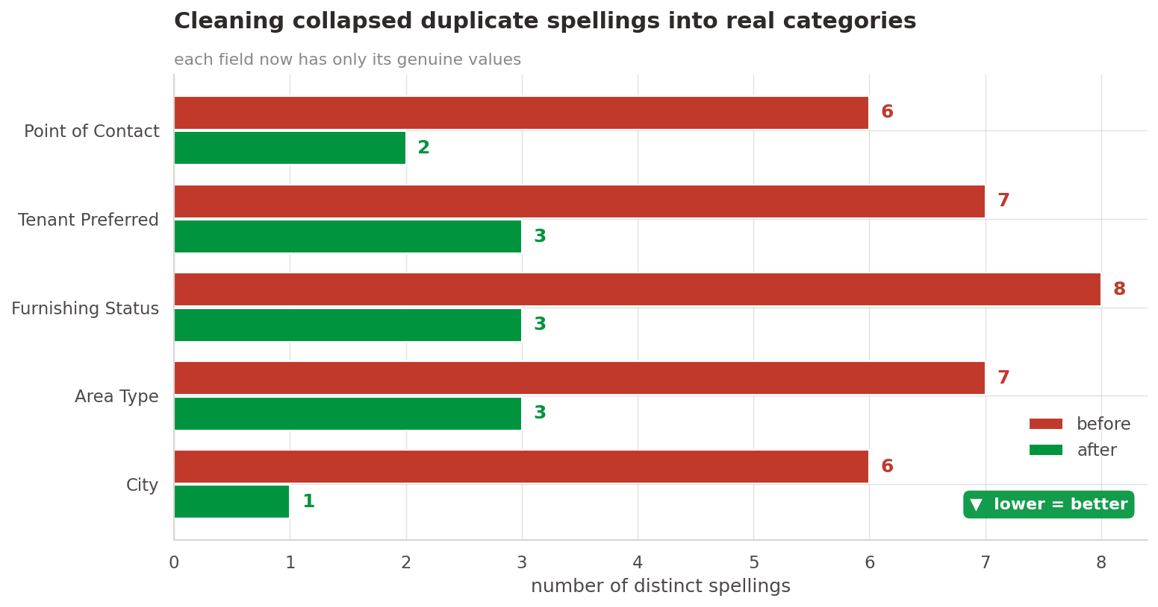
THE DATA
From messy listings to a table we can trust
▸ 5,100 → 5,050 listings after removing duplicates.
▸ 6 fields collapsed from dozens of spellings to real categories.
▸ Prices unlocked from text like ₹1,47,500, 50k and 40,000/-.
▸ 98% join to a locality attributes table.
5,050
98%
10.8%
clean listings
locality match
gaps imputed
The Outliers · Mumbai Rent Radar
3

Slide 4
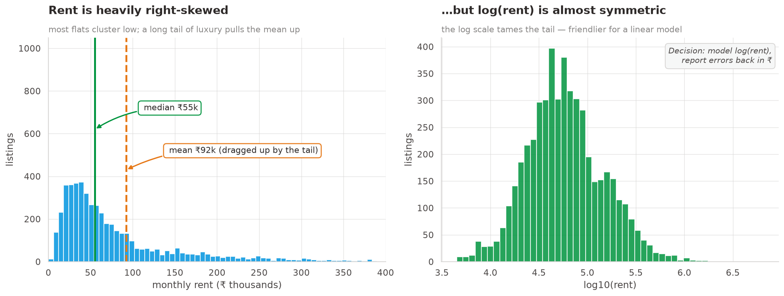
THE SHAPE
Rent is skewed — most flats are affordable
▸ Median ₹55k but the mean is ₹92k — a long luxury tail.
▸ We model log(rent) so a ₹10k miss is judged fairly at every price.
▸ Errors reported back in rupees for the decision owner.
The Outliers · Mumbai Rent Radar
4

Slide 5
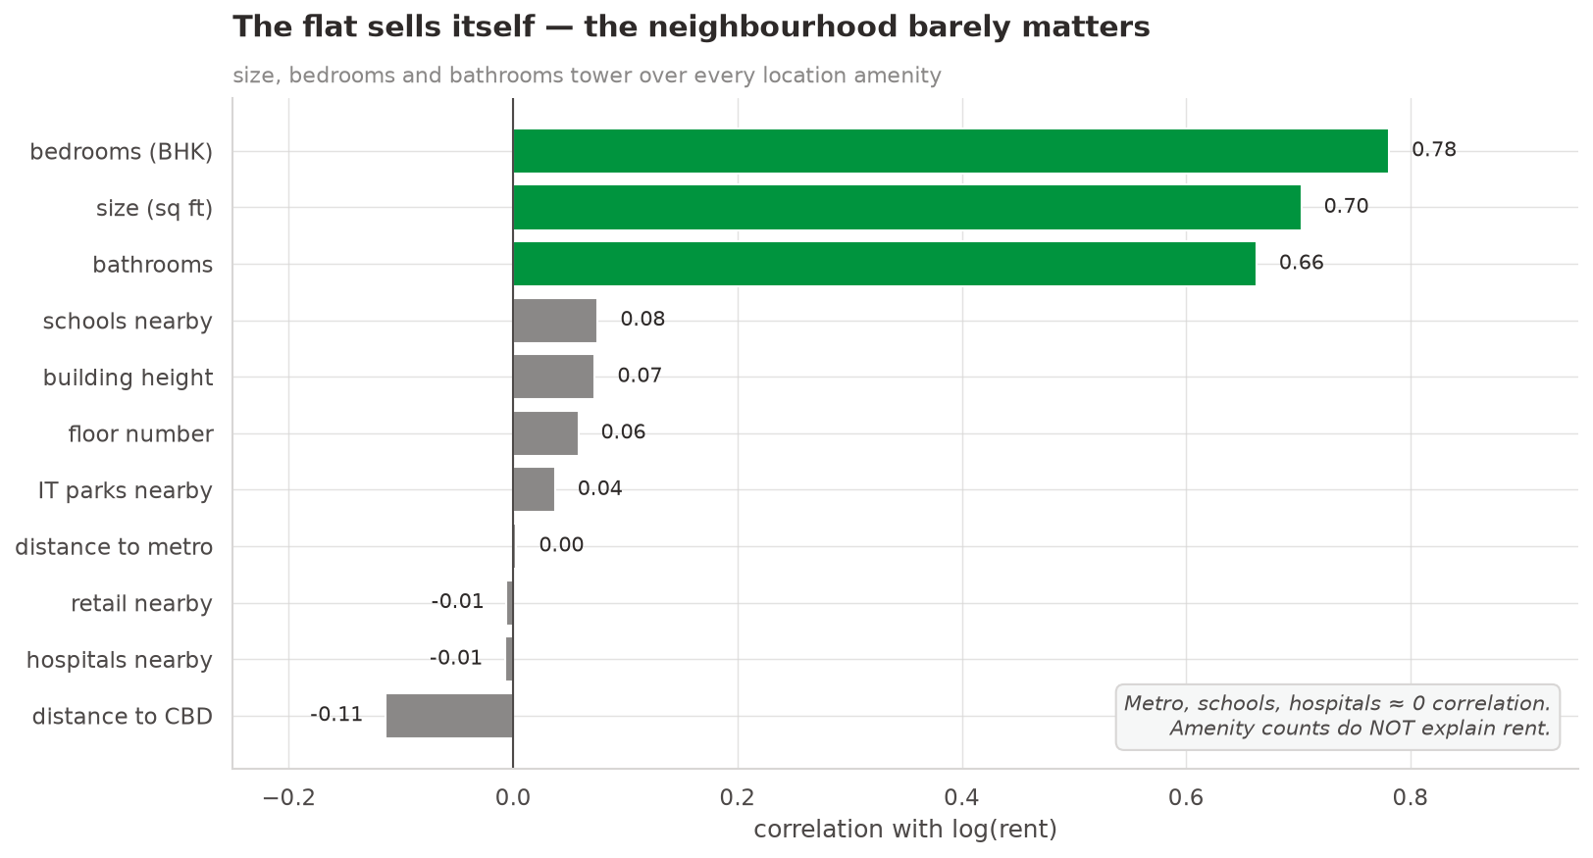
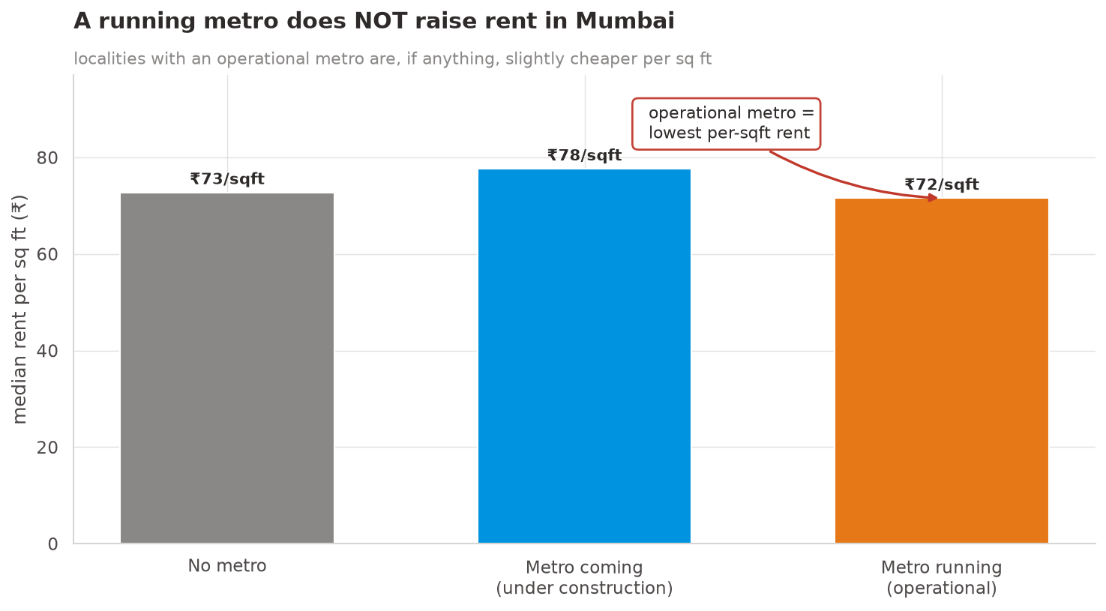
THE SURPRISE
In a location-obsessed city, location barely moves rent
Size, bedrooms & bathrooms carry the price; metro/schools ≈ 0. A running metro is even slightly cheaper — verified, not a bug.
The Outliers · Mumbai Rent Radar
5

Slide 6
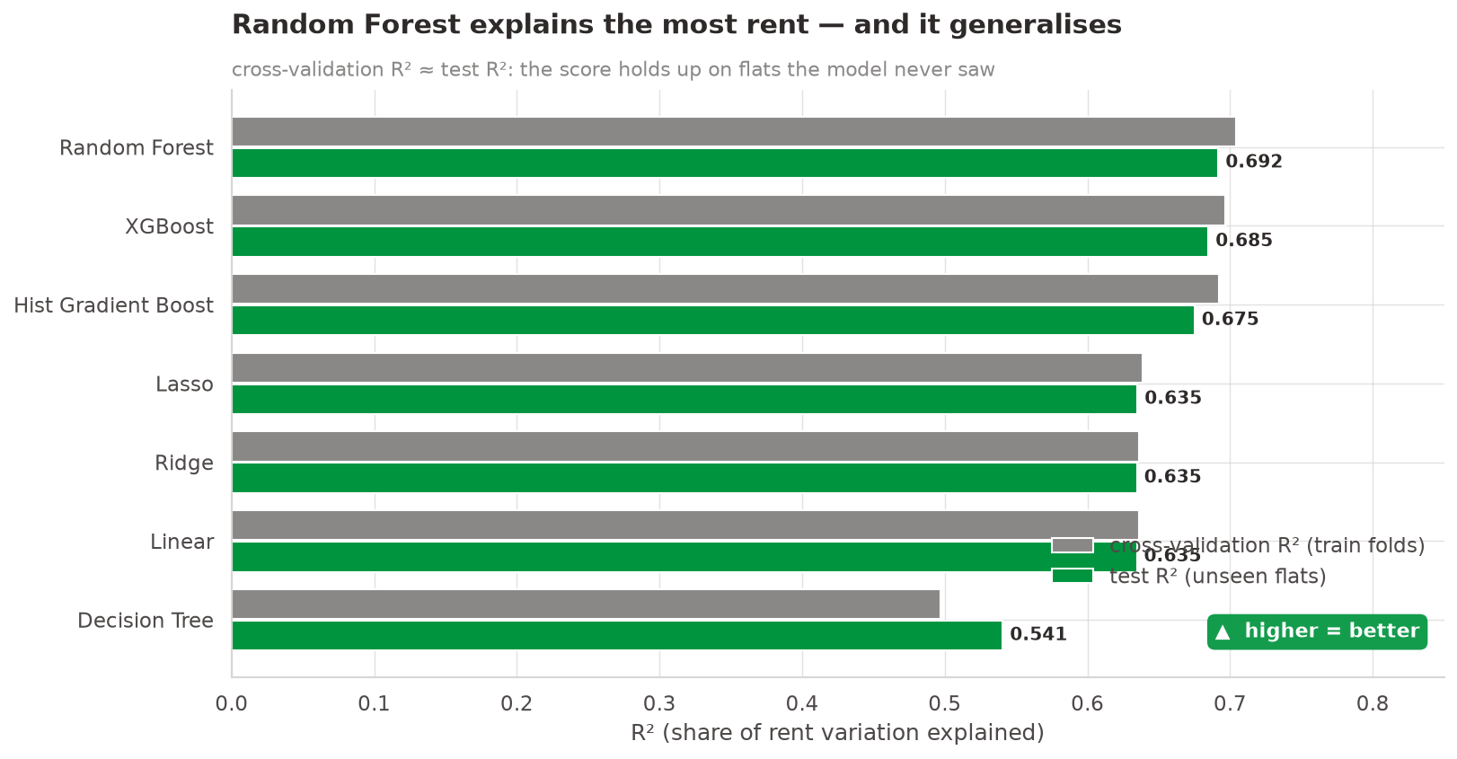
THE MODEL
We benchmarked seven, and let the best one win
▸ Random Forest wins on unseen flats and on rupee error.
▸ It generalises cross-validation R² ≈ test R².
▸ One final model chosen honestly from the field.
0.70
27%
R² (unseen)
typical error
The Outliers · Mumbai Rent Radar
6

Slide 7
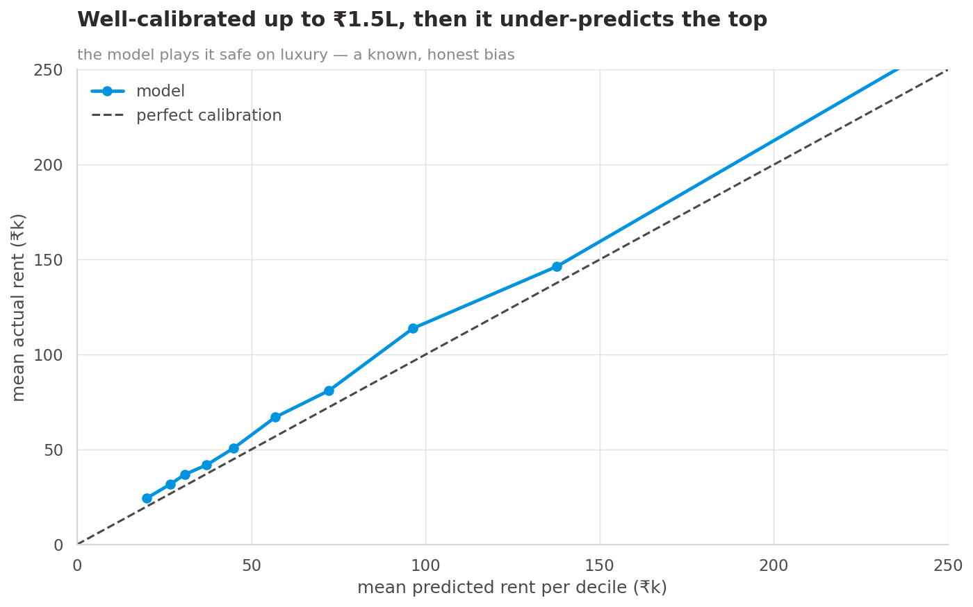
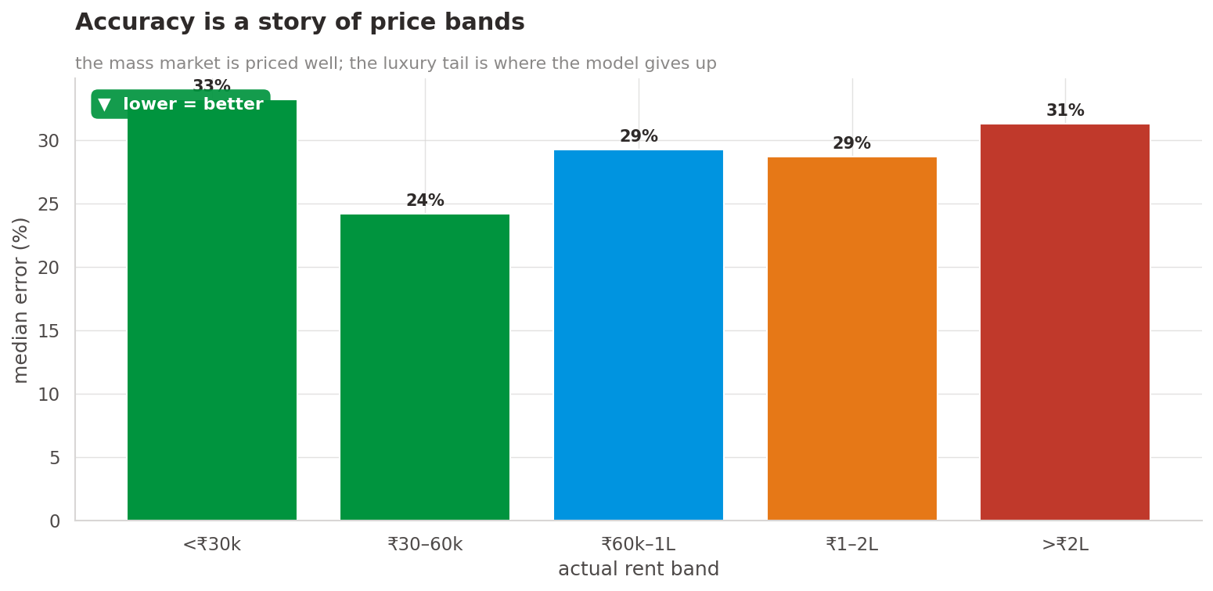
HONESTY
Reliable for the mass market, loose for luxury
Under ₹1L the model is dependable; above ₹2L it under-predicts a thin, unique tail — a known, safe bias.
The Outliers · Mumbai Rent Radar
7

Slide 8
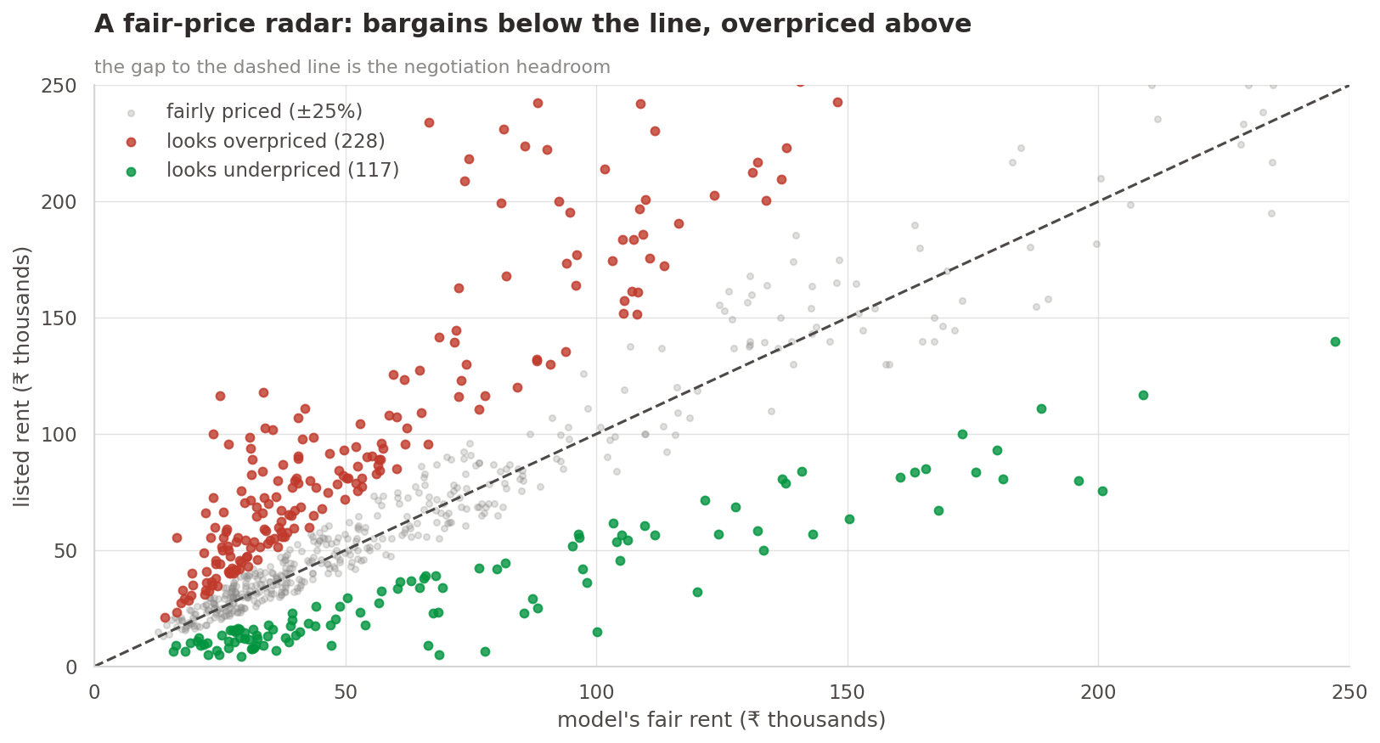
THE PRODUCT
A mispriced-listing radar for renters
▸ The gap is the signal listed rent vs the model's fair rent.
▸ Bargains below the line overpriced above it.
▸ Ready to ship the fastest win for a pricing team.
221
117
flagged overpriced
bargains found
The Outliers · Mumbai Rent Radar
8

Slide 9
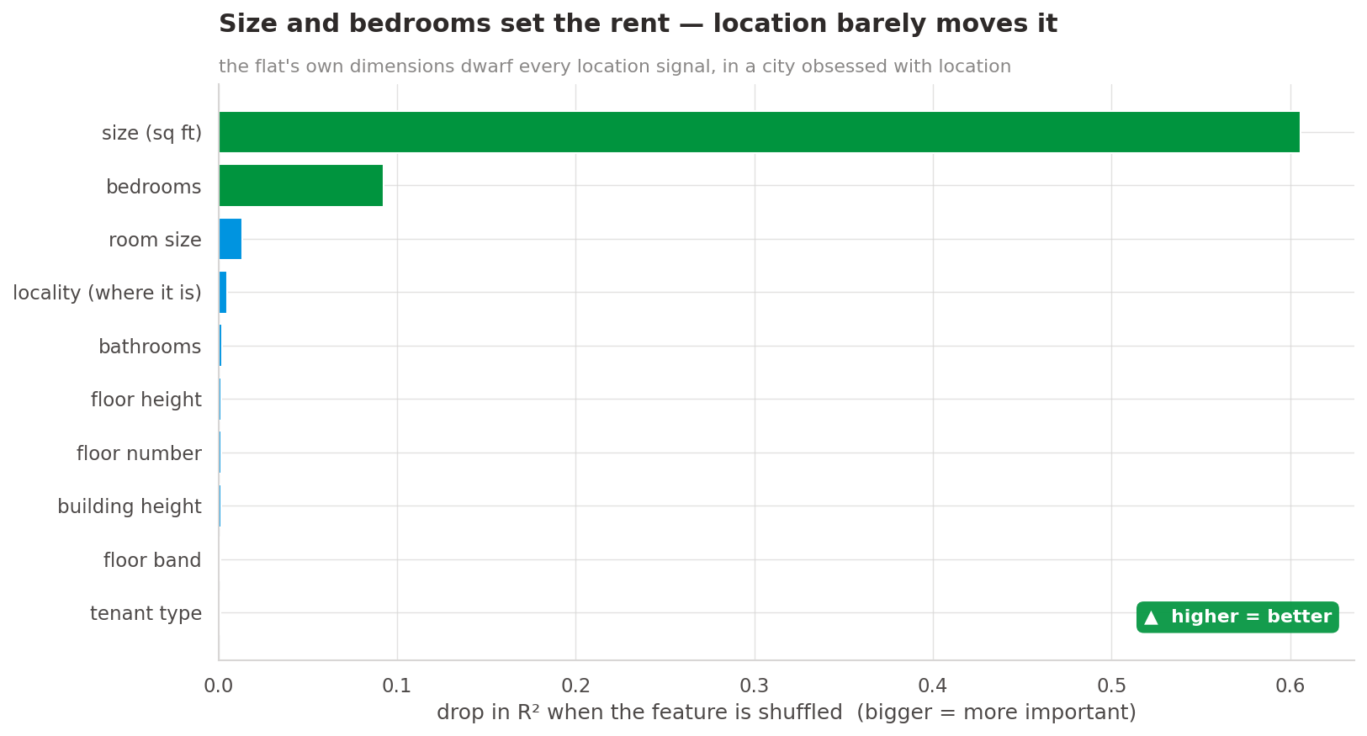
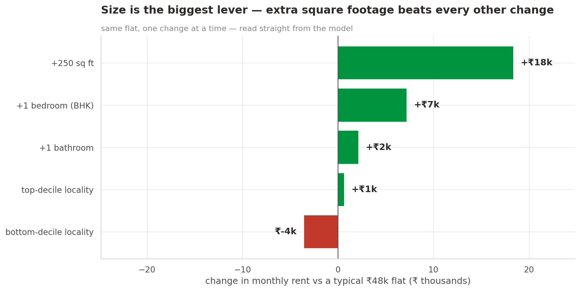
WHAT DRIVES RENT
Size first — and what an upgrade is worth
Adding 250 sq ft beats an extra bedroom, a bathroom, or a jump to a top-tier locality. Location sets the baseline; size sets the price.
The Outliers · Mumbai Rent Radar
9

Slide 10
RECOMMENDATIONS
What NoBroker's pricing team should do
▸ Ship for the mass market (<₹1L) — reliable, and where most renters are.
▸ Launch the mispriced detector — 338 flags on the test set alone.
▸ Price by size first — don't pay up for metro/amenity flags.
▸ Refresh the data — it's one snapshot; watch for drift.
▸ Better features, not more rows — the learning curve is flat.
THE AI MOMENT WE CAUGHT
An early model scored R² > 0.9.
That was the tell — we traced it to a data leak and removed it.
AI drafts fast; we verify before shipping.
Bottom line
Mumbai rent is about how big, not just where. Ship the estimate, flag the mispriced, price by size.
The Outliers · Mumbai Rent Radar
10

