Slide 1


THE OUTLIERS · IIT MANDI
Mumbai Rent Radar
What should a flat actually cost? — the short version
Akshara · Prashasthi · Sudarshan

Slide 2
THE ANSWER
Rent is about how big, not just where
▸ Size & bedrooms drive rent — location barely moves it.
▸ Amenities ≈ 0 — metro, schools, hospitals don't predict rent.
▸ Operational metro isn't a premium — it's slightly cheaper.
▸ Bigger flats cost more per sq ft — luxury clusters in premium pockets.
0.70
~27%
5,050
model R²
typical error
listings
The Outliers · Mumbai Rent Radar
2

Slide 3
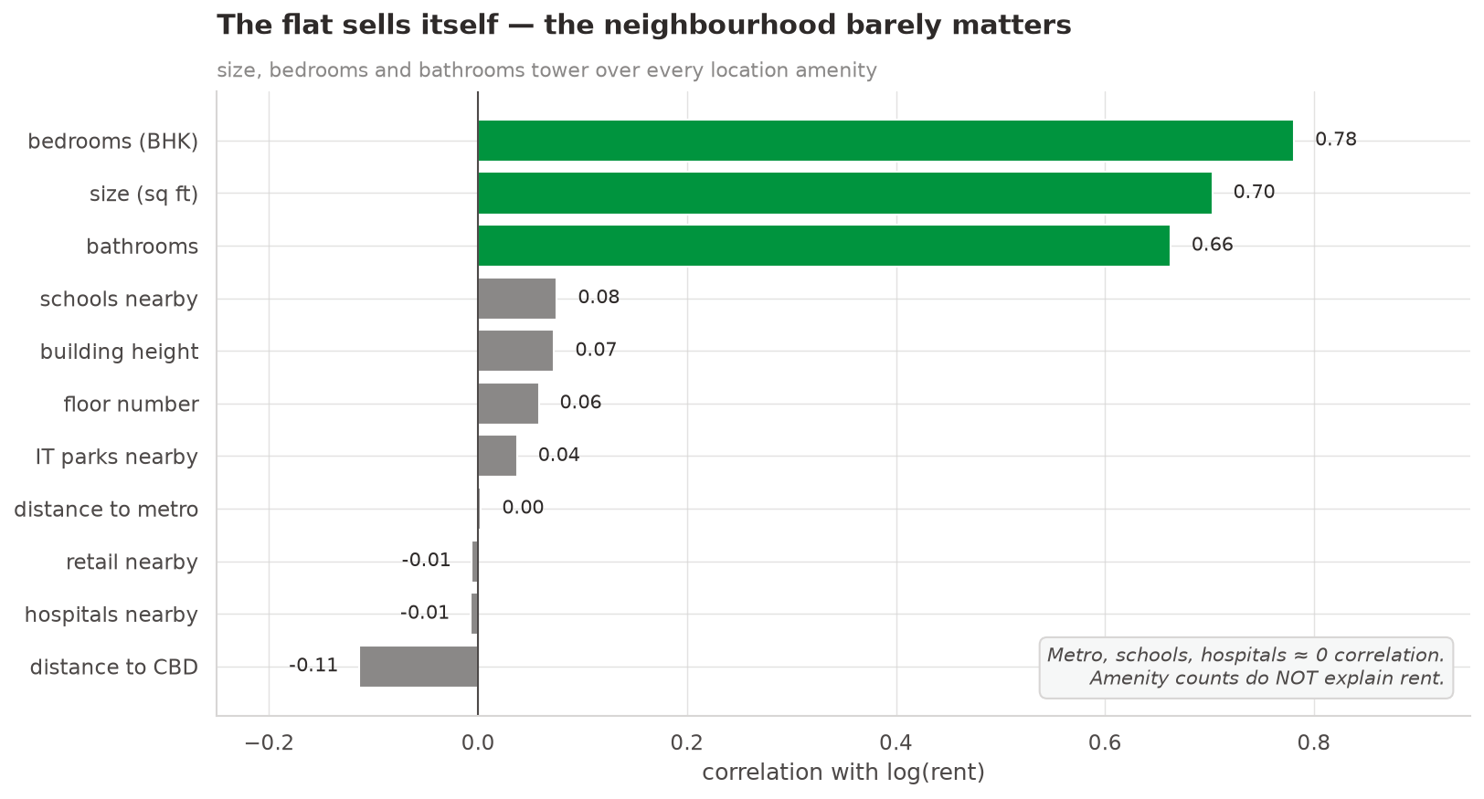
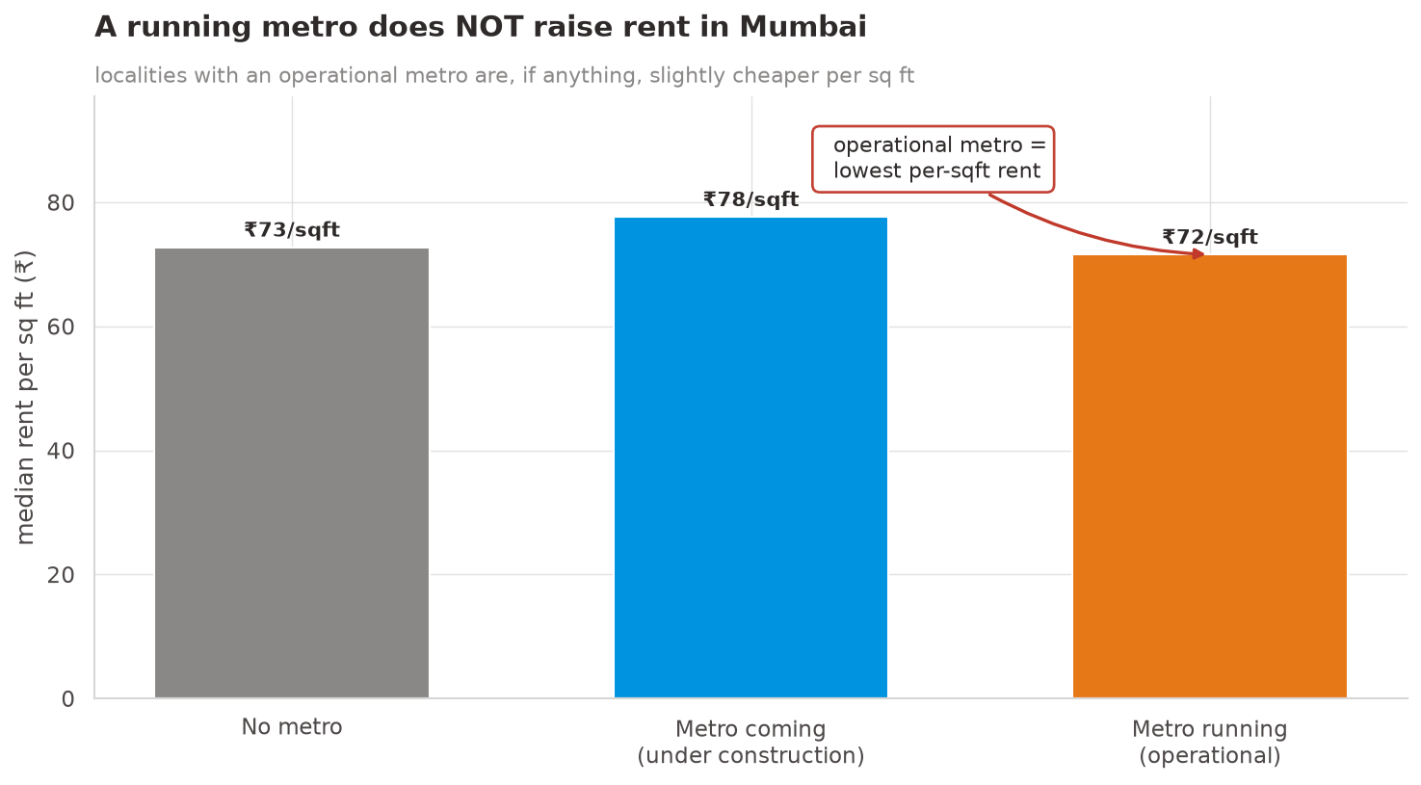
THE SURPRISE
Location barely moves the rent
The Outliers · Mumbai Rent Radar
3

Slide 4
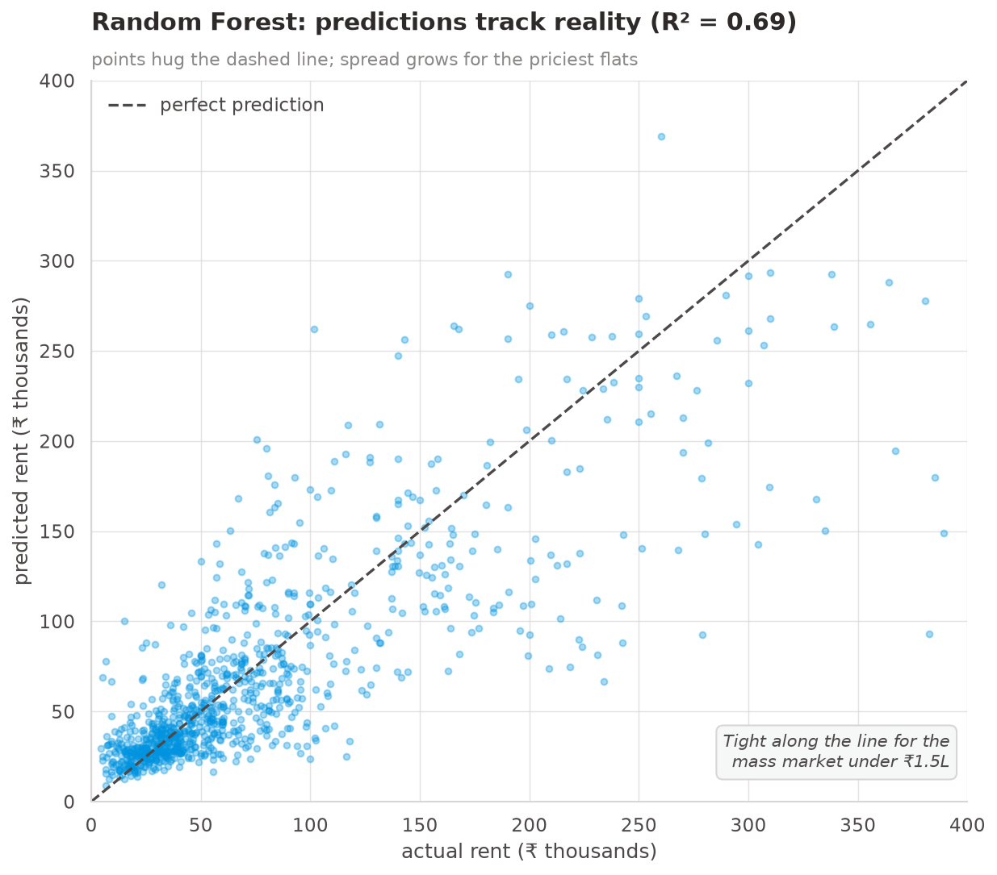
THE MODEL
Benchmarked seven; the best one wins
▸ Tuned Random Forest chosen on unseen-flat accuracy.
▸ R² ≈ 0.70, error ~27% reliable under ₹1L, looser for luxury.
▸ Believable, not perfect we caught a leak that faked R² > 0.9.
The Outliers · Mumbai Rent Radar
4

Slide 5
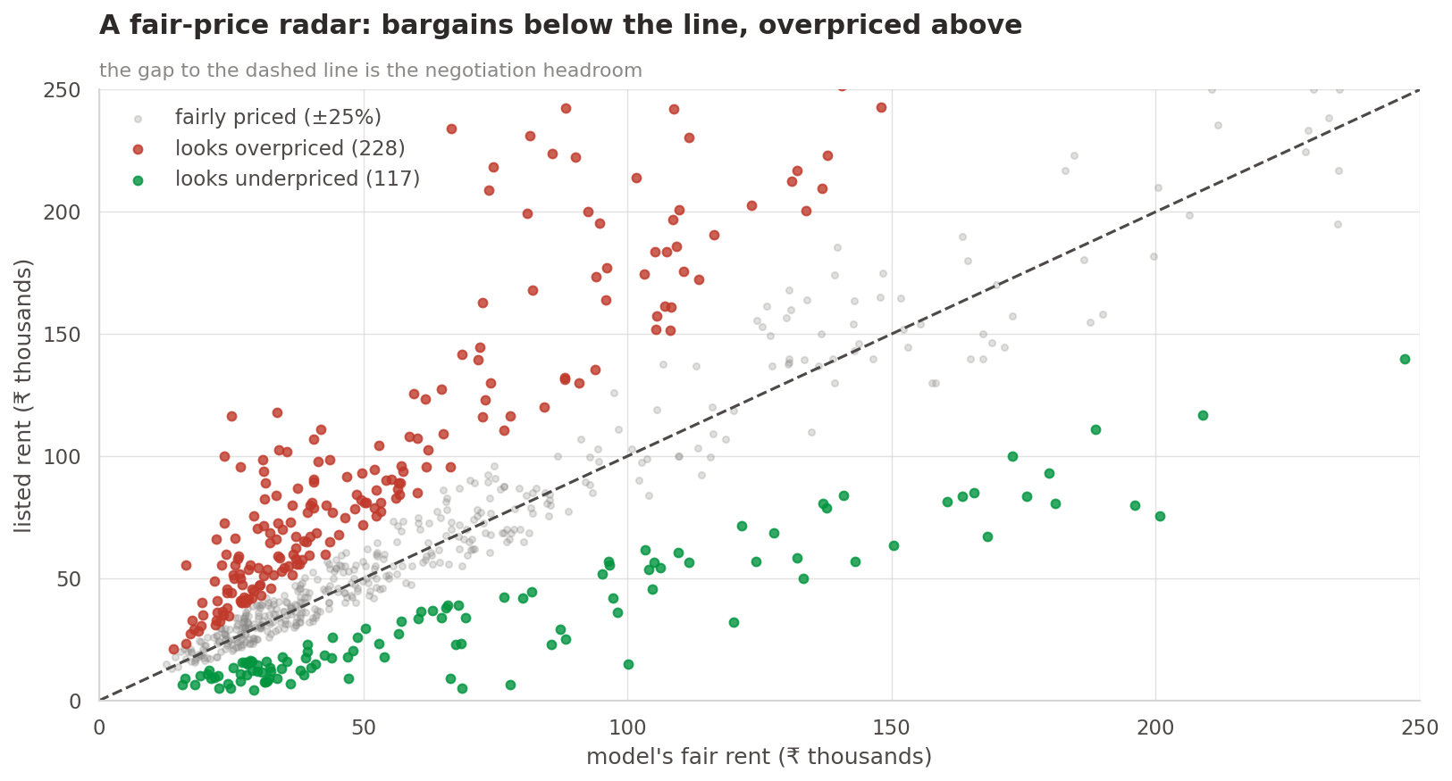
THE PRODUCT
A mispriced-listing radar
▸ Fair rent vs listed rent = the deal signal.
▸ Bargains & overpriced flats flagged automatically.
221
117
overpriced
bargains
The Outliers · Mumbai Rent Radar
5

Slide 6
RECOMMENDATIONS
What to do next
▸ Ship the fair-rent estimate for the mass market (<₹1L) — human-review the luxury tail.
▸ Launch the mispriced-listing detector — the fastest win for renters.
▸ Price by size first, location second — the data is clear.
▸ Refresh the data and invest in better features — not more rows.
The Outliers · Mumbai Rent Radar
6

