Slide 1
SCIENTIFIC CALCULATOR
GUI using SWING in java
Guided By:-
Dr. NARESH NAGWANI Sir
Made By:-
PRASHAST KARMAHE
20115076 (CSE-3rd Sem)

Slide 2
WHAT IS IT ?
It is a simple GUI application.
We can perform basic mathematical operation.
like Addition ,Subtraction ,Multiplication and Division.
It can also compute some scientific operations
such as finding out power of a number ,trigonometric operations
factorials, logarithm etc.

Slide 3
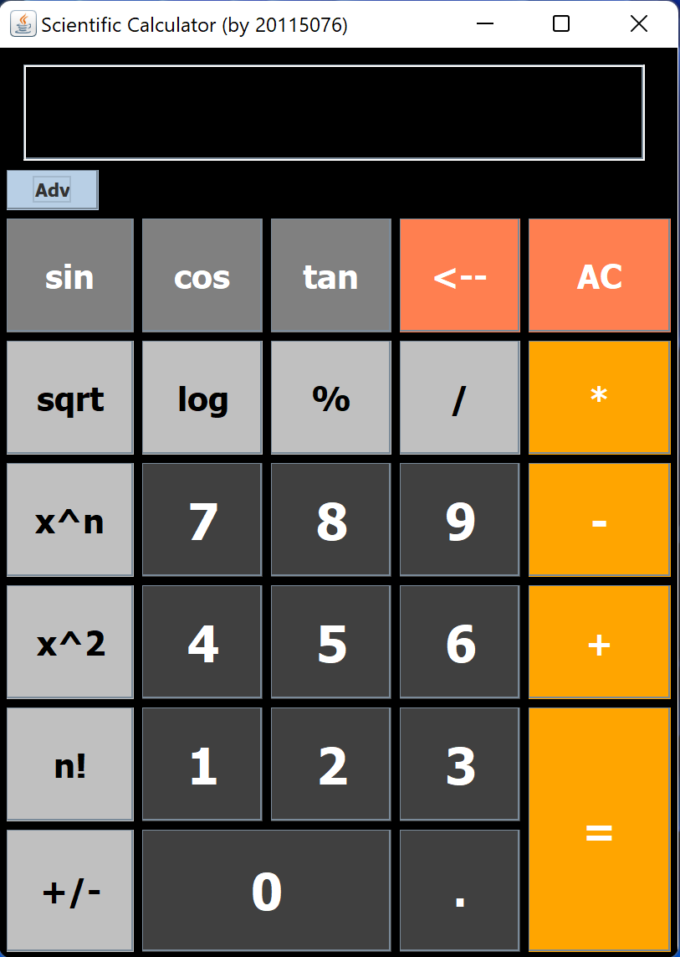
SWING COMPONENTS
JtextField
JToggleButton
JLabel
JButtons

Slide 4
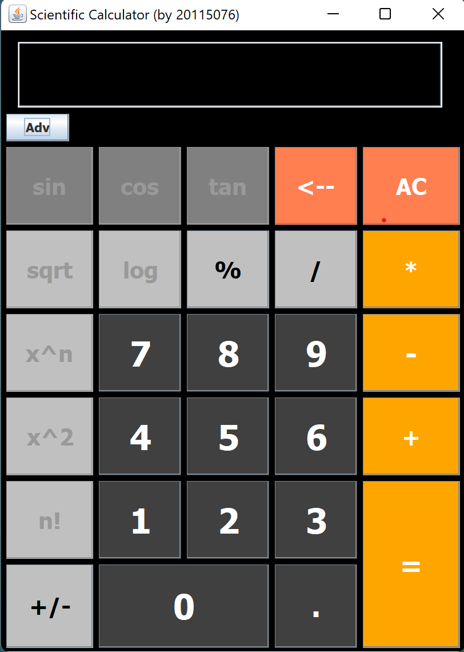
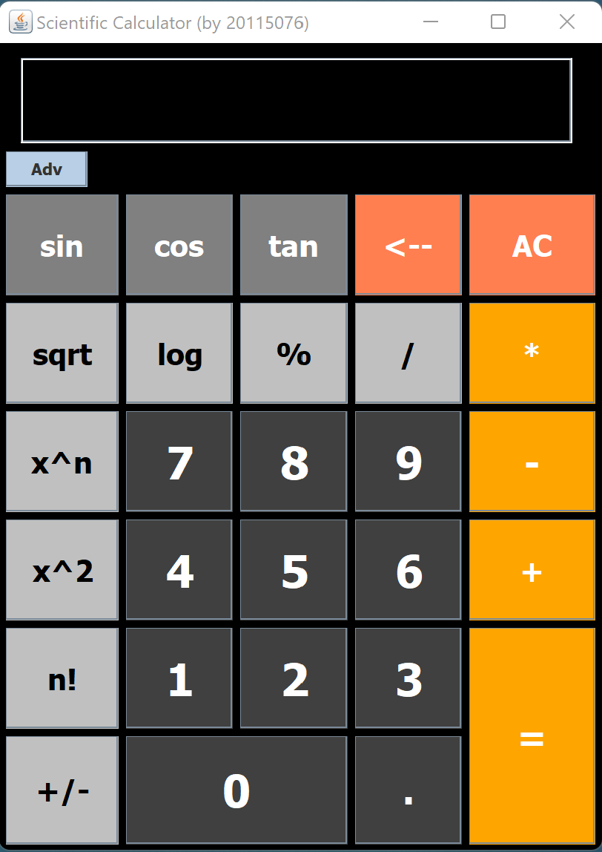
OFF
ON
After pressing toggle
button to on state
Initially Toggle switch is in off
state by default. So scientific
operations are disable by default.
Scientific operation are enabled.

Slide 5
Y \ X
0
1
2
3
4
GRIDBAG LAYOUT
0
gridx=0
gridy=0
Insets(10, 15, 5, 15)
gridwidth = 5
1
Whole JFrame is divided
into grids.
We use GridBagConstraints
(gbc) to specify the position
of any component.
Position on X-axis & Y-axis
is denoted by “gridx” &
”gridy” respectively.
To stretch elements we can use
“grid width” & “gridheight”
in X-axis & Y-axis ,respectively.
Insets are used to give padding.
gridx=0
gridy=1
gridx=1
gridy=1
Insets(0, 0, 5, 15)
2
gridwidth = 4
gridx=0
gridy=2
gridx=1
gridy=2
gridx=2
gridy=2
gridx=3
gridy=2
gridx=4
gridy=2
3
gridx=0
gridy=3
gridx=1
gridy=3
gridx=2
gridy=3
gridx=3
gridy=3
gridx=4
gridy=3
4
gridx=1
gridy=4
gridx=2
gridy=4
gridx=3
gridy=4
gridx=4
gridy=4
gridx=0
gridy=4
5
gridx=0
gridy=5
gridx=1
gridy=5
gridx=2
gridy=5
gridx=3
gridy=5
gridx=4
gridy=5
6
gridx=0
gridy=6
gridx=1
gridy=6
gridx=2
gridy=6
gridx=3
gridy=6
gridx=4
gridy=6
gridheight = 2
7
gridx=0
gridy=7
gridx=1
gridy=7
gridwidth = 2
gridx=3
gridy=7

Slide 6
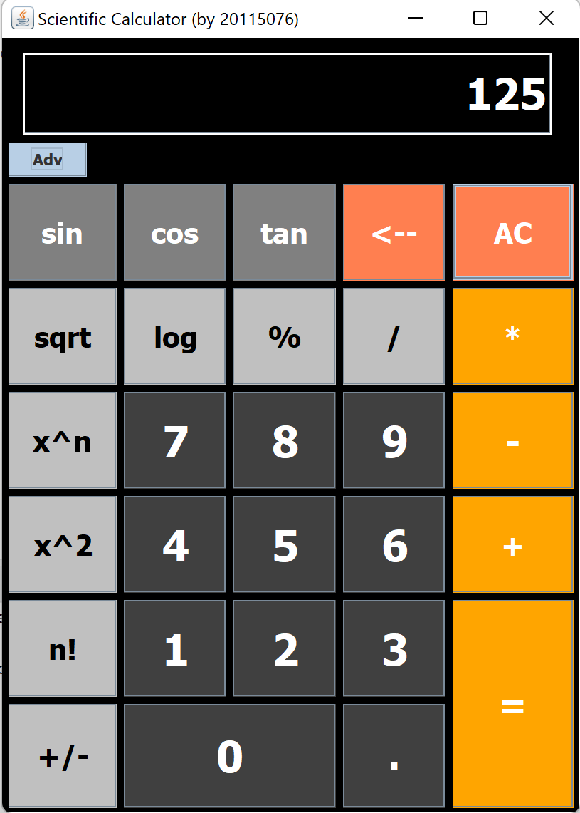
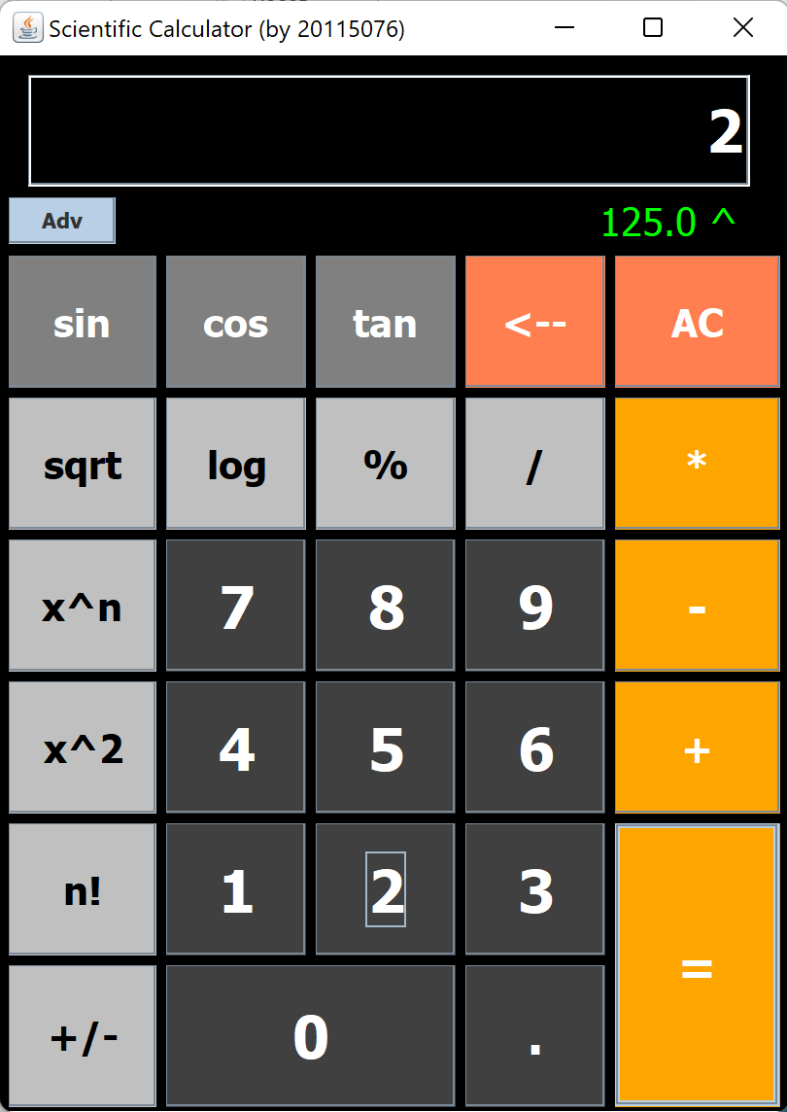
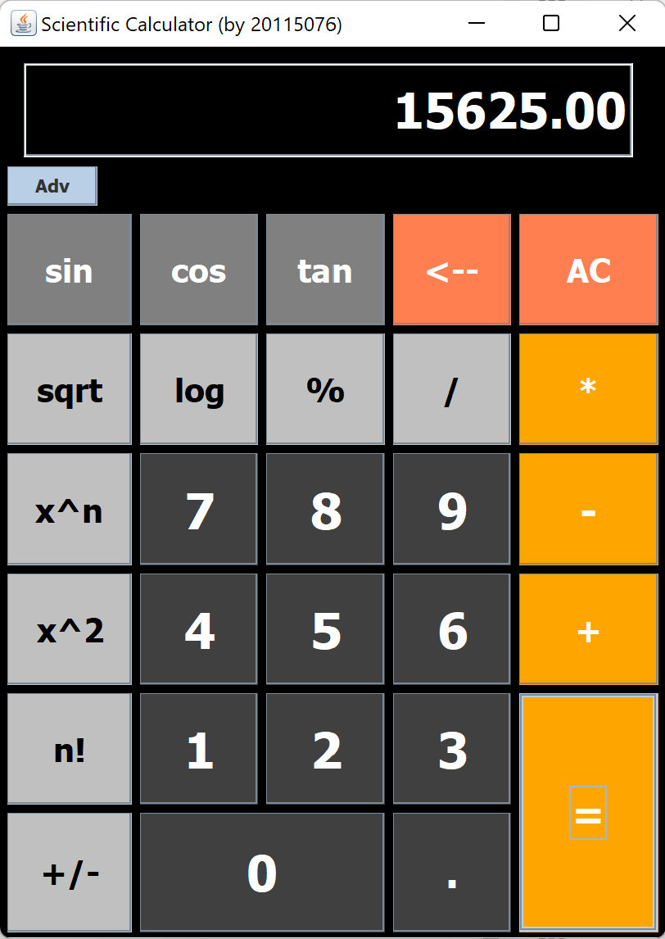
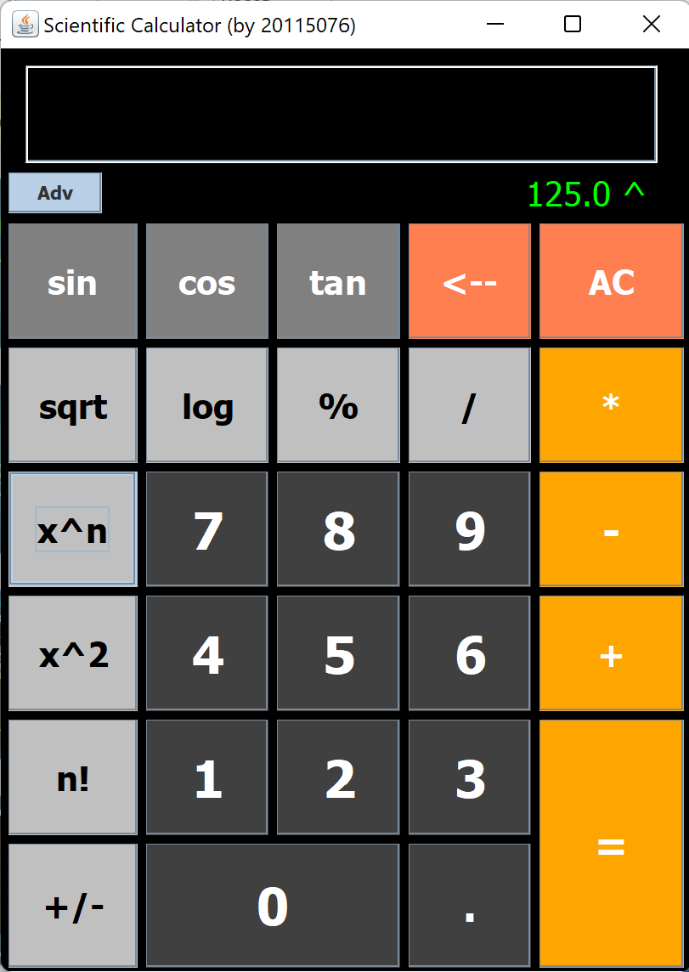
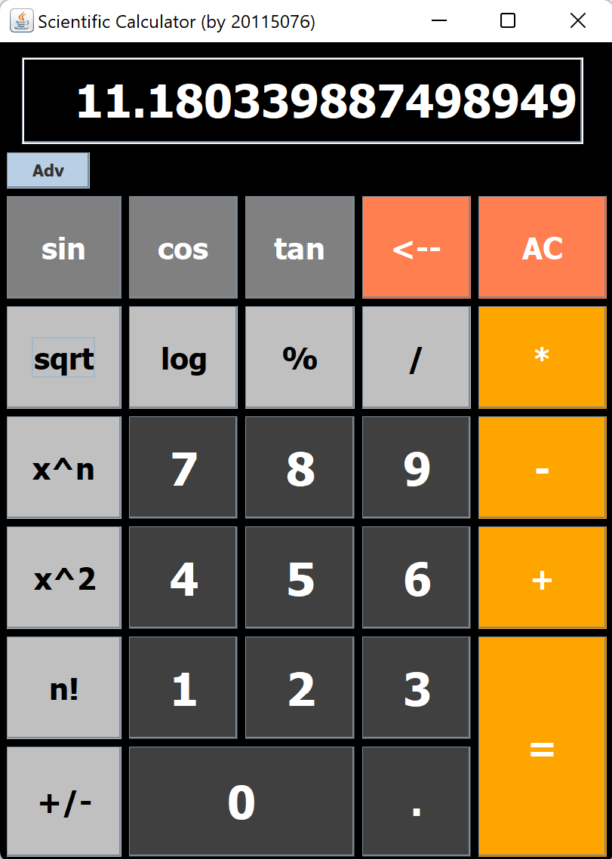

2. If we choose Binary Operators
The first input gets shifted
to label along with operator
3. Enter Second input
And press ‘ = ‘
4.Result is displayed
On Text Field
1. We can enter first input
either by typing in text Field
or by pressing numeric buttons
3.Result is displayed
On Text Field
2. If we select any
Scientific function

