Slide 1
Design Patterns

Slide 2
What is design patterns
“A software design pattern is a general, reusable solution to a commonly occurring problem within a given context in software design. It is not a finished design that can be transformed directly into source or machine code. It is a description or template for how to solve a problem that can be used in many different situations.”

Slide 3
Patterns in real world

Slide 4
Why study design patterns?

Slide 5
CHANGE is constant in software development
Identify the aspects of your
application that vary and separate
them from what stays the same.
Communicate in patterns to convey the design precisely
Powerful vocabulary
Say more with less
Not specific to any language
Used to build higher abstraction in Frameworks

Slide 6
OOP’s Basics
Abstraction
Encapsulation
Polymorphism
Inheritance
IS-A relationship
HAS-A relationship

Slide 7
OO Principles
Encapsulate what varies
Favor Composition over Inheritance
Program to Interface and not concrete Implementations

Slide 8
GoF Design Patterns
Erich Gamma
Richard Helm
Ralph Johnson
John Vlissides
Book name: Design Patterns: Elements of Reusable Object-Oriented Software

Slide 9
UML for expressing design patterns

Slide 10
UML diagram notations
Class
Interface
Use case
Component
Package
Inheritance
Composition
Actor
Initial state
Final state

Slide 11
UML diagrams
Class diagram
Sequence diagram
Deployment diagram
Use case diagram

Slide 12
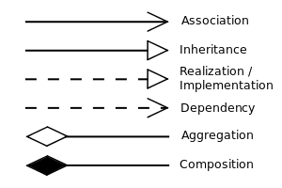
UML Notations

Slide 13
Classification of design patterns
Creational design patterns
Structural design patterns
Behavioral design patterns

Slide 14
Extension of design patterns
JEE design patterns
MVC design pattern
Front Controller design pattern
Business Façade design pattern
DAO design pattern
Interceptor design pattern
Chain of Responsibility

Slide 15
Creational design patterns

Slide 16
Creational design patterns
Singleton
Factory
Abstract Factory
Builder
Object Pool
Prototype

Slide 17
Singleton design pattern

Slide 18
Ensures a class has only one instance, and provides a global point of access to it

Slide 19
Singleton Design pattern
Singleton
- instance:Singleton
Singleton()
+ getInstance() : Singleton

Slide 20
Examples
Connection Factory
Logger
Caching
Data source

Slide 21
Singleton Code Example

Slide 22
Factory design pattern

Slide 23
Factory design pattern
“The Factory Method Pattern defines an interface
for creating an object, but lets subclasses decide which
class to instantiate. Factory Method lets a class defer
instantiation to subclasses”.

Slide 24
Factory pattern in UML
Product
Creator
factoryMethod()
ConcreteProduct
ConcreteCreator
factoryMethod()

Slide 25
Factory design pattern examples
ConnectionFactory
DocumentBuilderFactory
SessionFactory
Calendar
NumberFormat

Slide 26
Factory design pattern Code Example

Slide 27
AbstractFactory design pattern

Slide 28
“ Provides an interface for creating families of related or dependent objects without specifying their concrete classes ”

Slide 29
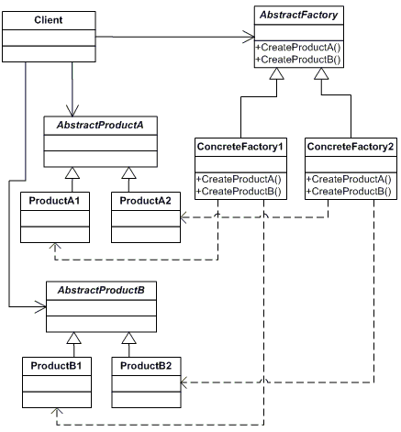

Slide 30
AbstractFactory design pattern code example

Slide 31
AbstractFactory design pattern in Java
TransformerFactory
DocumentBuilderFactory
DriverManager
DataSource

Slide 32
Builder design pattern

Slide 33
“ To encapsulate the construction of a product and allow it to be constructed in steps ”

Slide 34
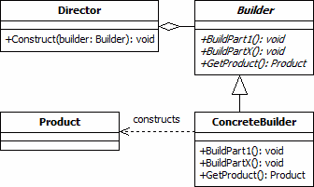

Slide 35
Builder design pattern code example

Slide 36
Builder design pattern examples
DocumentBuilder
StringBuilder
StringBuffer

Slide 37
Observer design pattern – Behavioral design pattern

Slide 38
“ Defines a one-to-many dependency between objects so that when one object changes state, all of its dependents are notified and updated automatically. ”

Slide 39
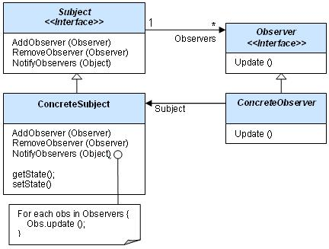

Slide 40
Observer design pattern code example

Slide 41
Observer design pattern examples
EventListner
ServletContextAttributeListener
ServletRequestAttributeListener
HTTPSessionBindingListener

Slide 42
Template design pattern

Slide 43
“ Define the skeleton of an algorithm in an operation, deferring some steps to client subclasses. Template Method lets subclasses redefine certain steps of an algorithm without changing the algorithm's structure ”

Slide 44
Strategy design pattern

Slide 45
Strategy design Pattern
Define the interface of an interchangeable family of algorithms
Bury algorithm implementation details in derived classes
Clients of the algorithm couple themselves strictly to the interface

Slide 46
Strategy design pattern code example

Slide 47
Command design pattern

Slide 48
Command design pattern
Encapsulate a request as an object, thereby letting you parametrize clients with different requests, queue or log requests, and support undoable operations.

Slide 49
Iterator design pattern

Slide 50
Adapter design pattern

Slide 51
Iterator design pattern
Provide a way to access the elements of an aggregate object sequentially without exposing its underlying representation providing "full object status" the traversal of a collection

Slide 52
Iterator design pattern code example

Slide 53
Adapter design pattern
The adapter pattern converts the interface of a class into another interface the clients expects. This pattern mainly adapts one object to another one. Adapter lets classes work together that couldn’t otherwise because of incompatible interfaces

Slide 54
Adapter design pattern code example

Slide 55
Decorator design pattern

Slide 56
“ You want to add behavior or state to individual objects at run-time. Inheritance is not feasible because it is static and applies to an entire class”

Slide 57
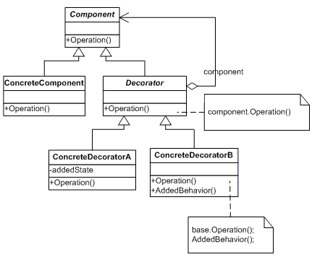
Decorator design pattern

