Slide 1
What Should Science Ask Next?
question choice is under-formalized
Prashant Garg
Imperial College London
the literature is large and fragmented
github.com/prashgarg/frontiergraph
Economics seminar version
some progress adds mechanisms, some states direct links
the graph helps rank what may be worth reading first
Full seminar draft

Slide 2
Motivation
Appendix
Question choice is a science-wide bottleneck
Choosing what to work on is one of the least formalized decisions in science.
Three anchor ideas
why this is not just an economics problem
The burden of existing knowledge keeps rising as the stock of work grows.
knowledge burden rises
Conservative search dominates even when riskier exploration matters disproportionately.
ideas get harder to find
If AI lowers downstream costs, the scarce input shifts upstream toward question choice.
scientists still search conservatively
Jones (2009); Bloom et al. (2020); Foster, Rzhetsky, and Evans (2015)
Motivation connects science-wide concerns to an economics-facing empirical testbed.

Slide 3
Setting
Appendix
Why this setting?
The paper uses a published economics-facing corpus because it gives dated, realized research structure.
Why published papers?
what this setting buys
dated structure
That makes missing-question backtesting possible without mixing in draft noise.
observed realizations
The object is economics-facing, but the broader question is science-wide.
clean prospective evaluation
Narrow enough to interpret, broad enough to matter.
The empirical testbed is narrow enough to be interpretable and broad enough to matter.

Slide 4
Overview
Appendix
This paper
We build
We test
We learn
data object
historical screen
substantive implication
a dated graph from published economics-facing papers
rank still-open next questions using only the literature observed at date t-1
the graph helps in two distinct historical families
paper-local extraction, then cross-paper matching
evaluate them prospectively against later publication
the historical result reveals which kind of scientific movement is more common
The seminar centers the substantive interpretation, not only the benchmark.
The seminar centers the substantive interpretation, not only the benchmark.

Slide 5
Data and object
Appendix
Overall pipeline
papers
paper-local graphs
shared graph
dated candidates
future realization
Extraction builds one local graph per paper.
Matching creates a shared concept space across papers.
Candidate generation freezes the graph at t-1 and ranks still-open directed questions.
This is the full-paper object in one slide, before we split into the two historical families.

Slide 6
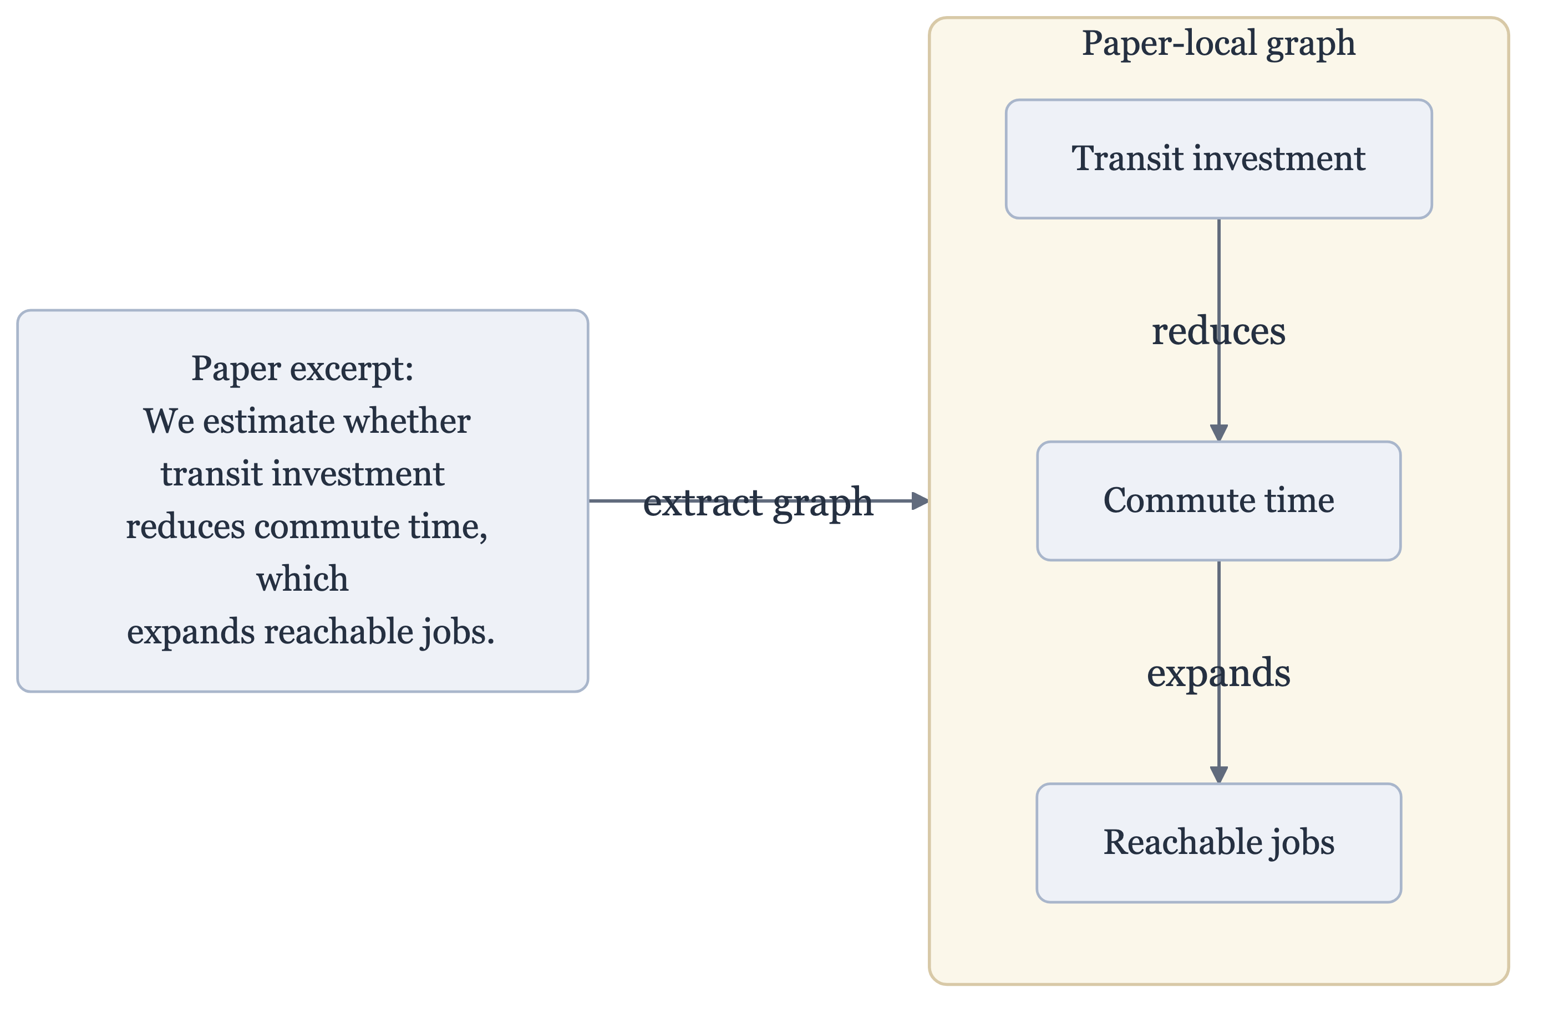
Method
Appendix
Each paper becomes a local graph
Paper-local extraction gives the first reusable object.

Slide 7
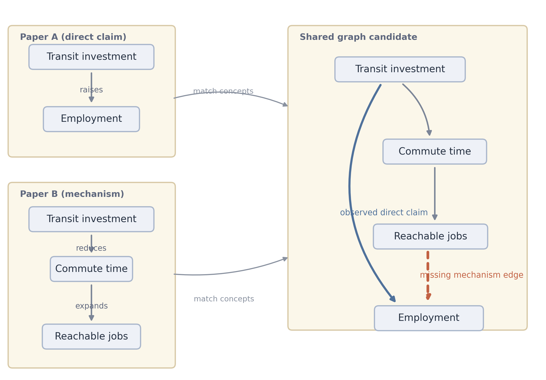
Method
Appendix
Candidate questions appear only after cross-paper matching
Cross-paper matching is what turns paper-local fragments into shared candidate structure.

Slide 8
Method
Appendix
Why node normalization matters
Normalization is central because candidate generation, paths, and missingness all depend on concept identity.

Slide 9
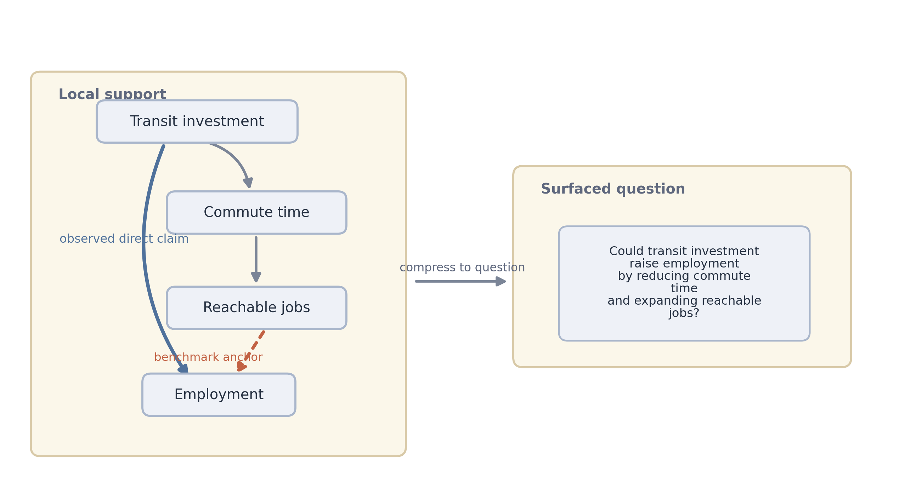
Empirical object
Appendix
Two graph-grounded next-question objects
The benchmark event is narrower than the surfaced question.

Slide 10
Evaluation
Appendix
Historical evaluation design
Freeze the graph at t-1.
Rank still-open directed candidates.
Ask which questions later appear during [t, t+h].
Keep the benchmark event separate from the richer reader-facing surfaced question.
This is what makes the exercise prospective rather than narrative.

Slide 11
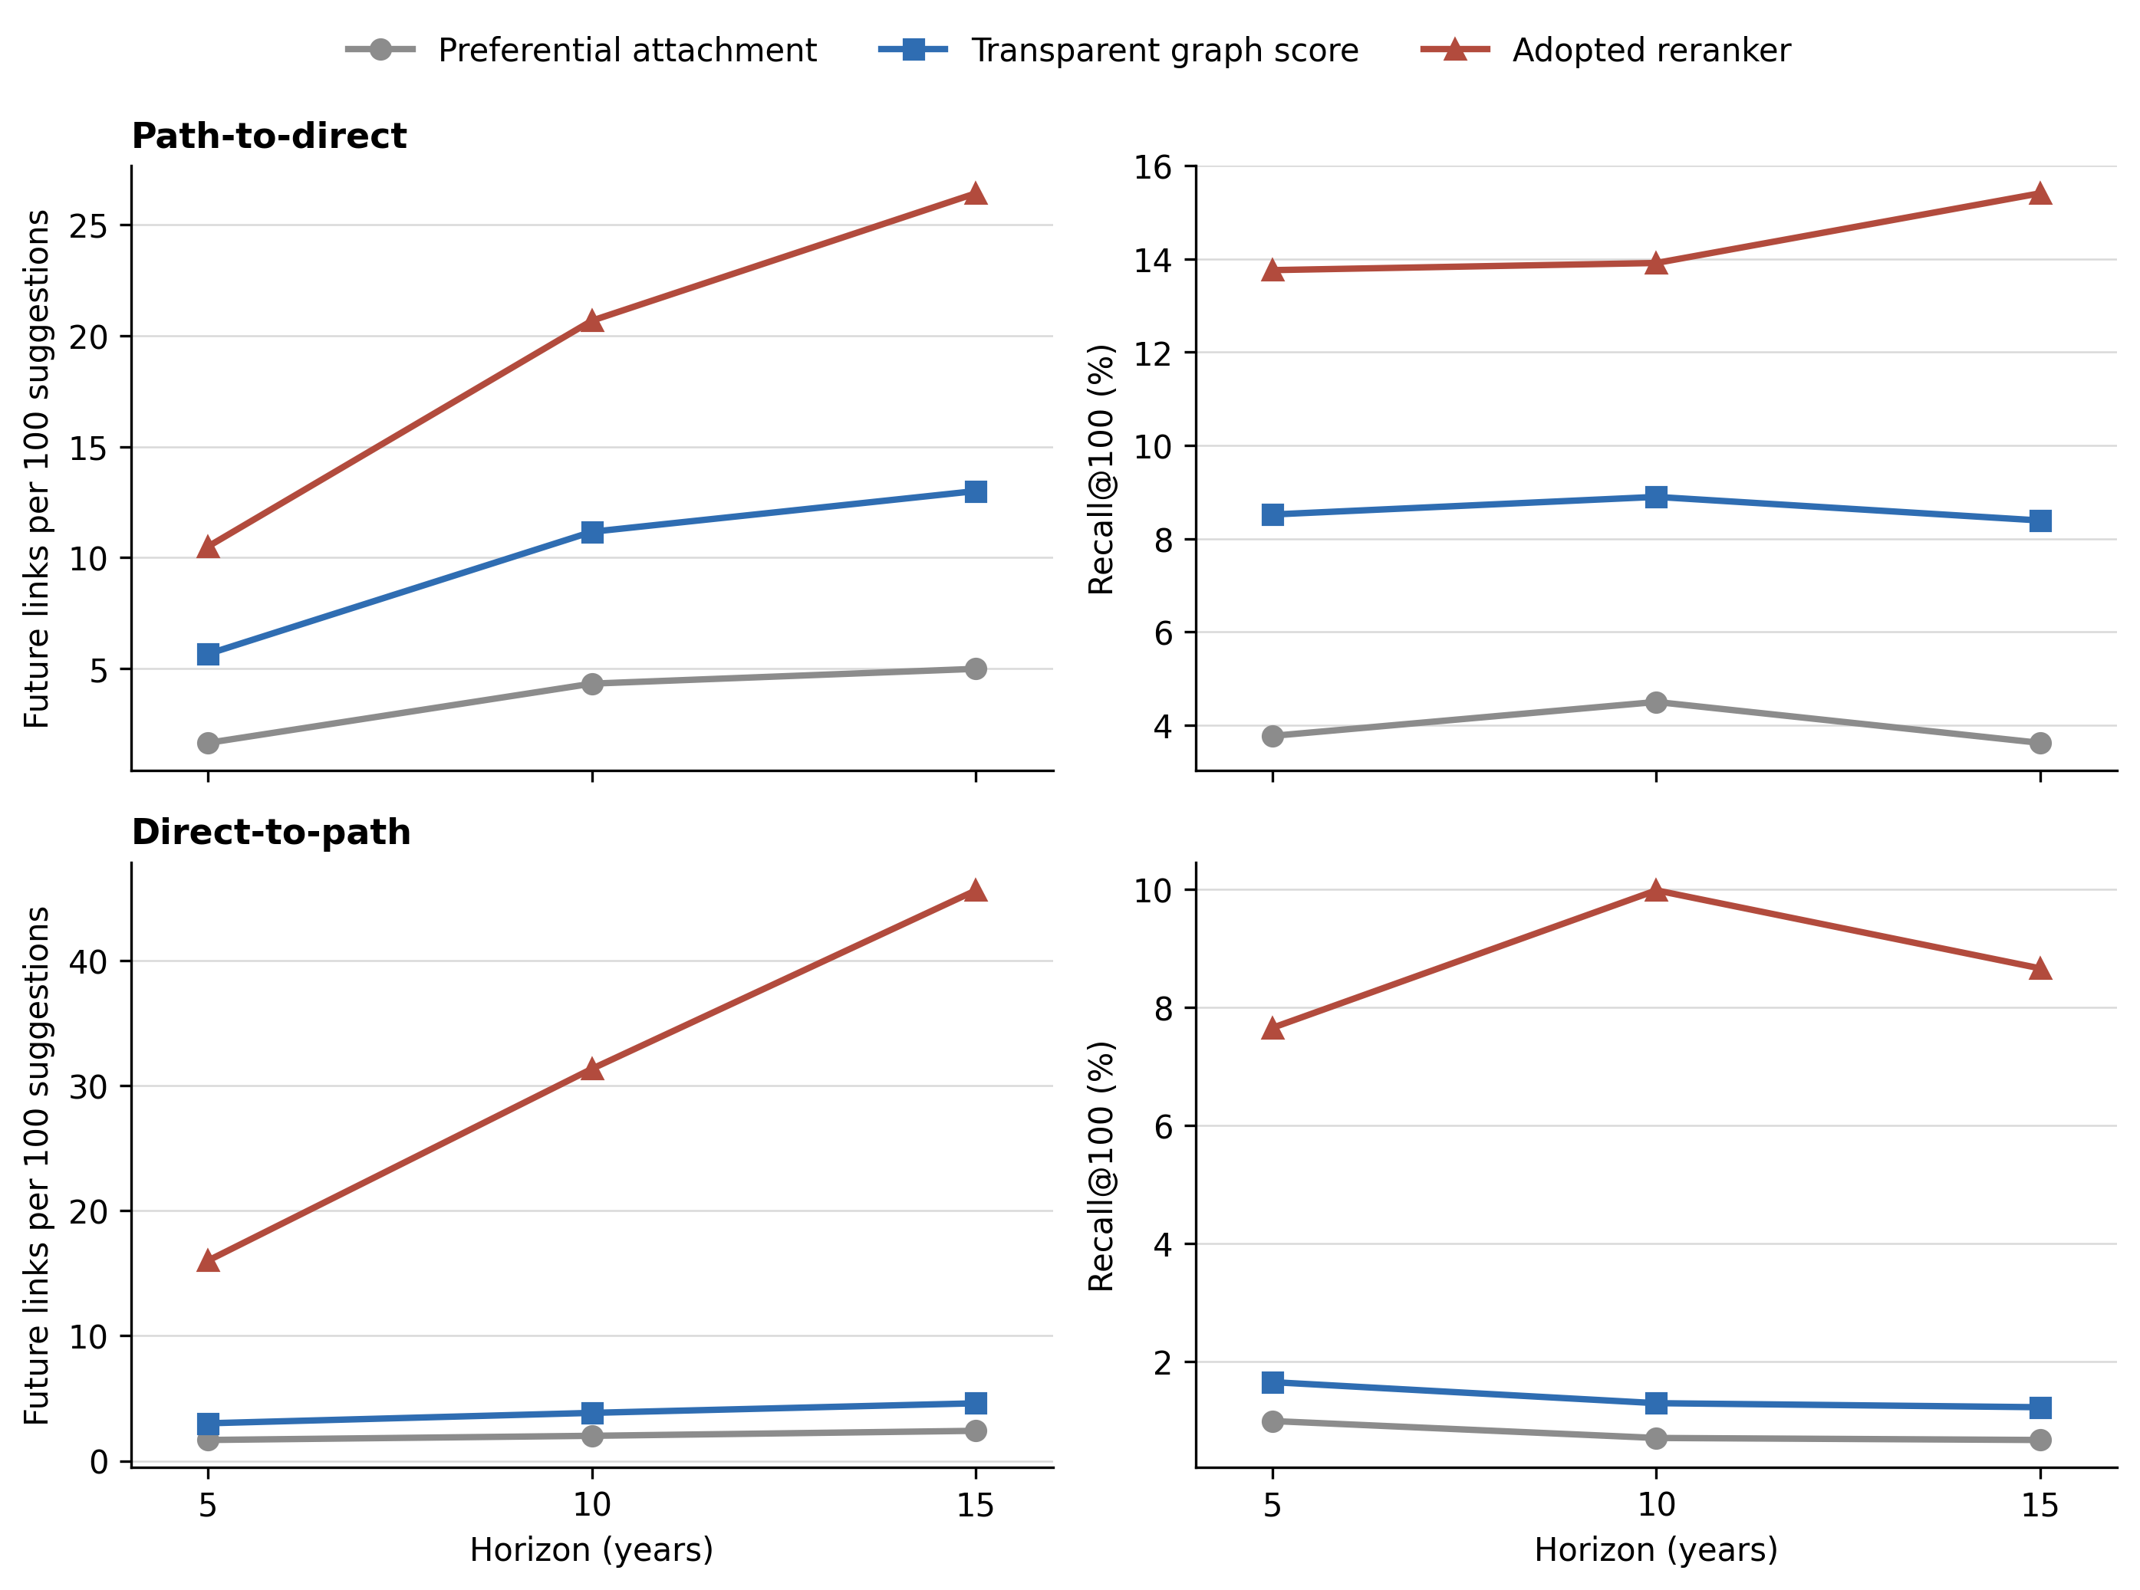
Historical result
Appendix
Paired historical benchmark
Graph-based screening improves on popularity in both families.

Slide 12
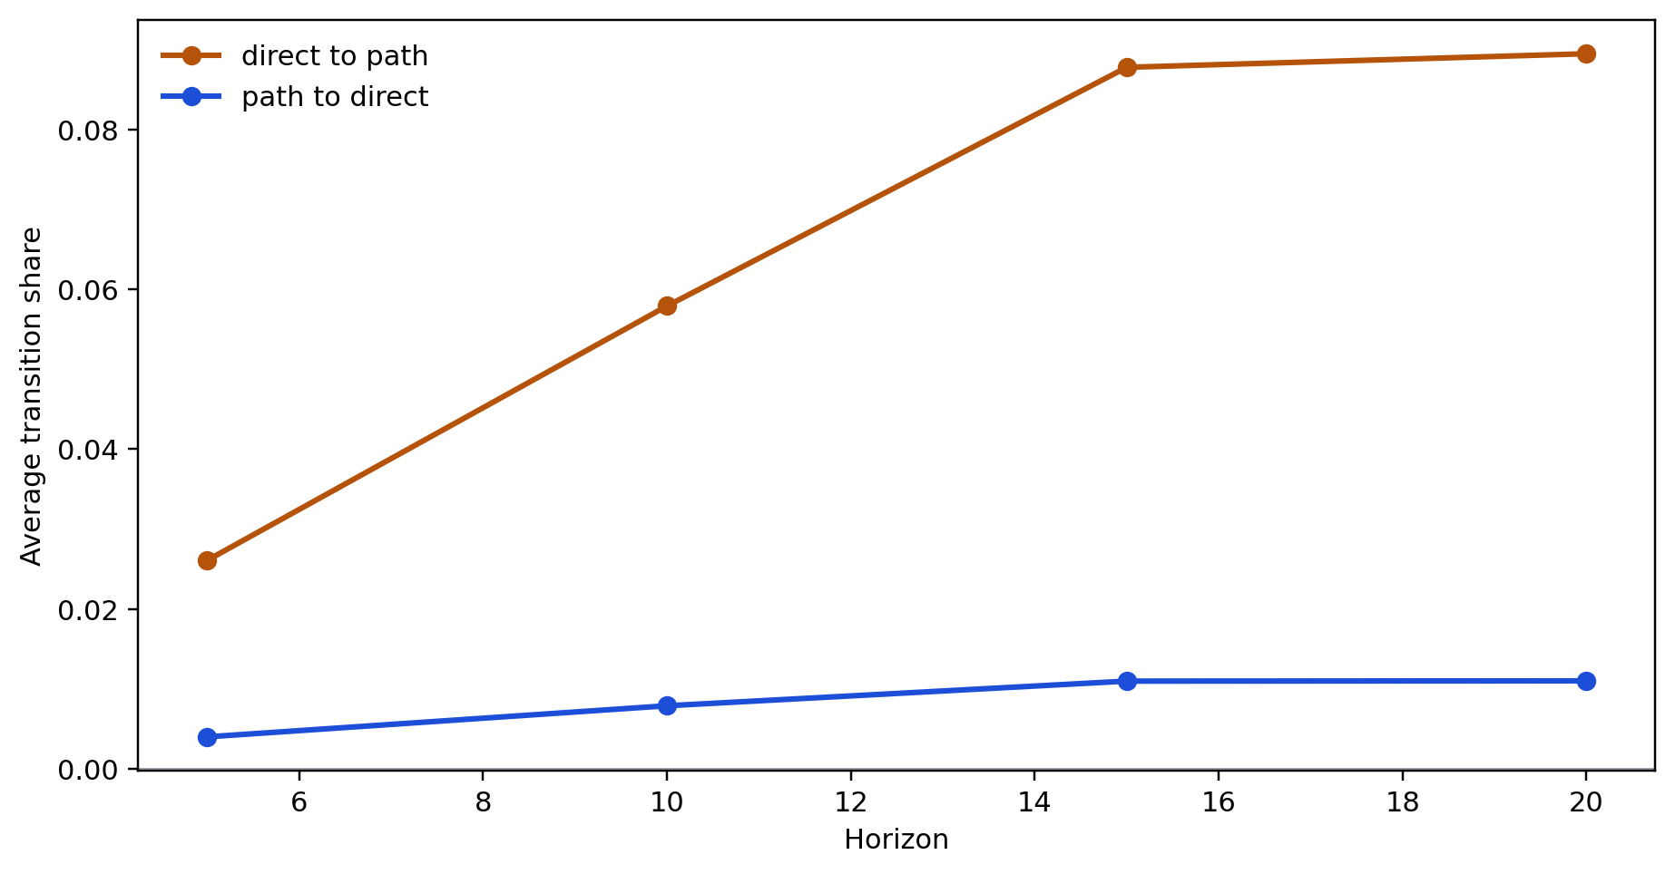
Substantive result
Appendix
How the literature moves
The literature more often thickens mechanisms than it later states locally implied direct links.

Slide 13
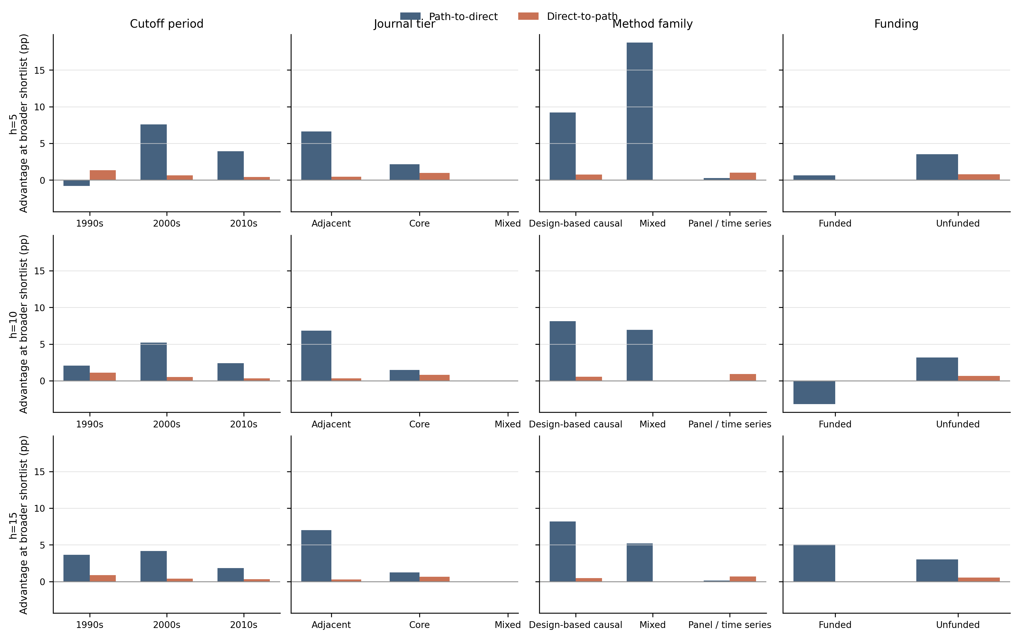
Extra empirical view
Appendix
Where the graph helps
This stays secondary to the main historical and substantive comparison.

Slide 14
Interpretation
Appendix
Why the families differ
Direct-to-path
Path-to-direct
smaller candidate universe
larger candidate universe
higher later realizations per shortlist
higher recall of all later-realized links
benchmark event: a mechanism appears around an already known relation
benchmark event: a locally supported direct relation later becomes explicit
These are different denominators, not inconsistent results. One family is better for finding high-hit mechanism thickening; the other is better for recovering a broader set of later explicit links.
Direct-to-path and path-to-direct are not mirror images; they reward different kinds of success.

Slide 15
Current frontier
Appendix
What the graph surfaces now
Illustrative cleaned renderings of current frontier items
Direct-to-path
Path-to-direct
known relation, missing mechanism
nearby support, missing direct relation
Could digital financial inclusion support employment through labour matching or market access?
Could trade liberalization raise R&D?
Could tax refunds lift productivity through liquidity and investment?
Could the digital economy strengthen environmental regulation?
Could nutrition information shift willingness to pay through health-salience channels?
Could renewable energy reshape urbanization?
The path-to-direct side is already cleaner publicly. The direct-to-path side is promising but still needs more manual relabeling.

Slide 16
Interpretation
Appendix
What this changes
Question choice can be partly disciplined rather than treated as pure intuition.
Practical reading rule
how I would actually use this
use the graph to choose what to inspect first
The graph is most useful for directing scarce reading time, not replacing judgment.
compare the two families rather than forcing one object
Mechanism thickening appears to be a central mode of scientific progress.
treat ranked questions as a disciplined shortlist, not an oracle
This is the slide to linger on in discussion.

Slide 17
Limits
Appendix
What this does not do
Not all imagination
Imperfect identity
It does not rank all scientific imagination.
It does not solve concept identity perfectly.
Judgment still matters
Cleanly dateable only
It does not remove the need for field knowledge or judgment.
It benchmarks only objects that can be dated cleanly in the observed literature.
The limits are part of the design, not afterthoughts.

Slide 18
Next steps
Appendix
Where this can go next
Longer path support
Context extension
ask whether slightly more distant support improves novelty without losing too much coherence
take known relations and ask where they remain under-tested across settings
LLM workflow layers
Node activation
use screening models as a practical refinement layer on top of graph-ranked shortlists
treat the appearance of entirely new concepts as a separate frontier object
These are research directions, not slide filler.

Slide 19
Conclusion
Appendix
Conclusion
Build
Test
Learn
Build a dated graph from published research.
Use it to rank still-open next questions prospectively.
Learn not only whether the graph works, but what kind of scientific movement is more common.
The benchmark is the credibility layer. The contribution is the claim about how science moves and how researchers can choose what to inspect next.
Full seminar version.

Slide 20
Appendix
Back to main
Extra benchmark detail
Appendix: extra benchmark detail.

Slide 21
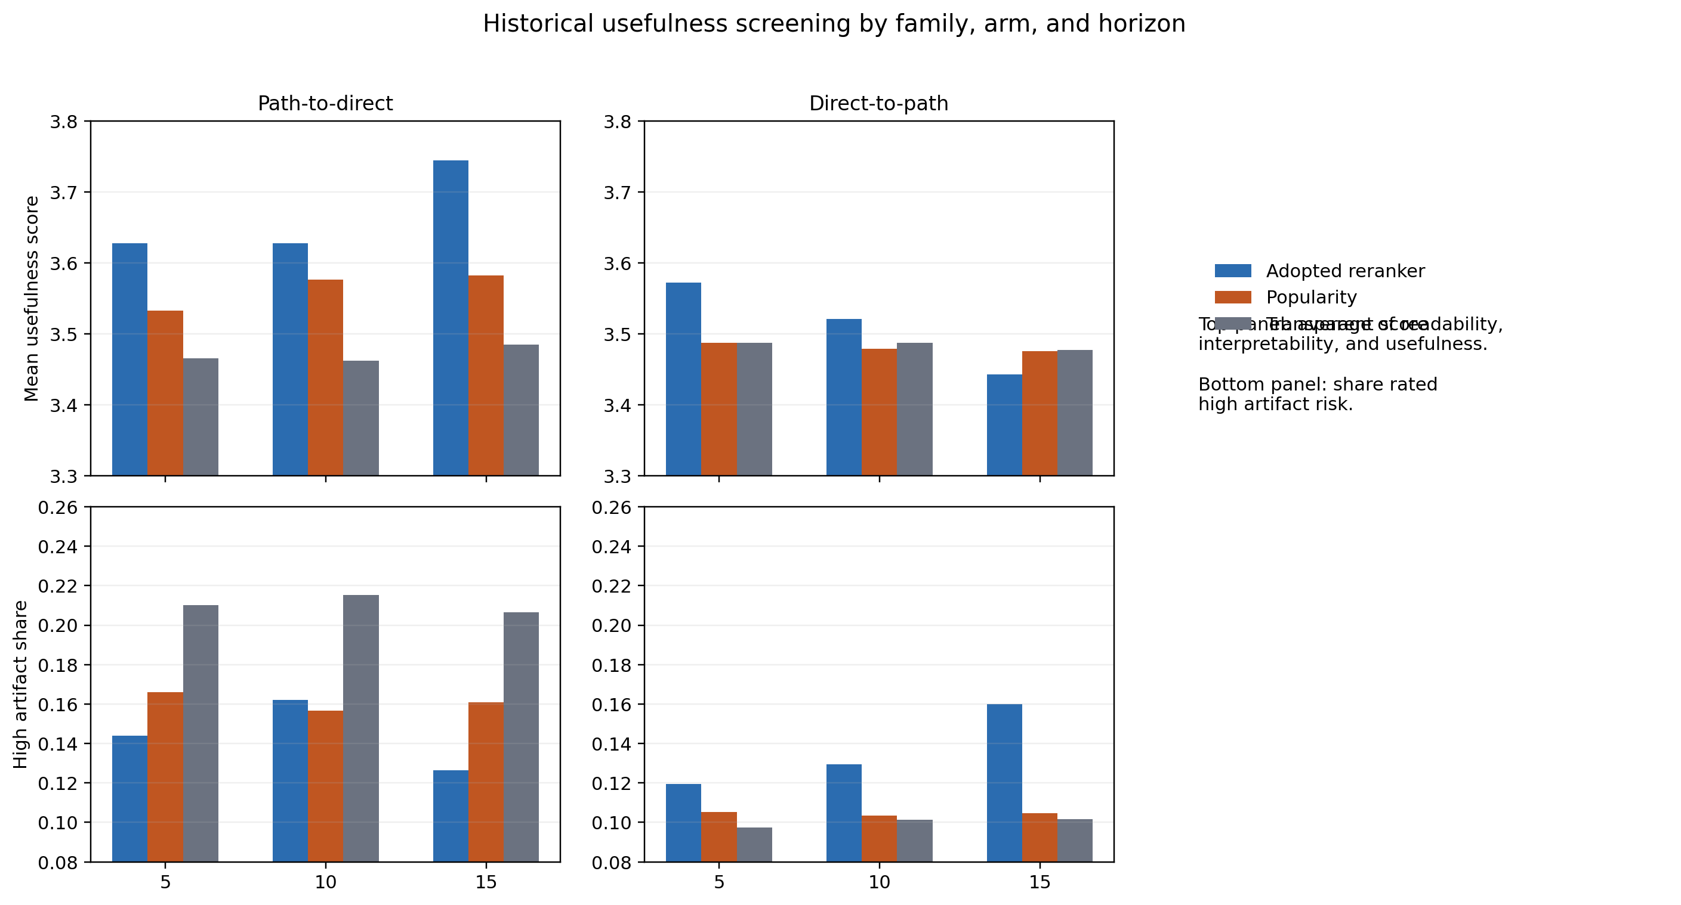
Appendix
Back to main
Current frontier and usefulness
Appendix: current frontier and usefulness.

Slide 22
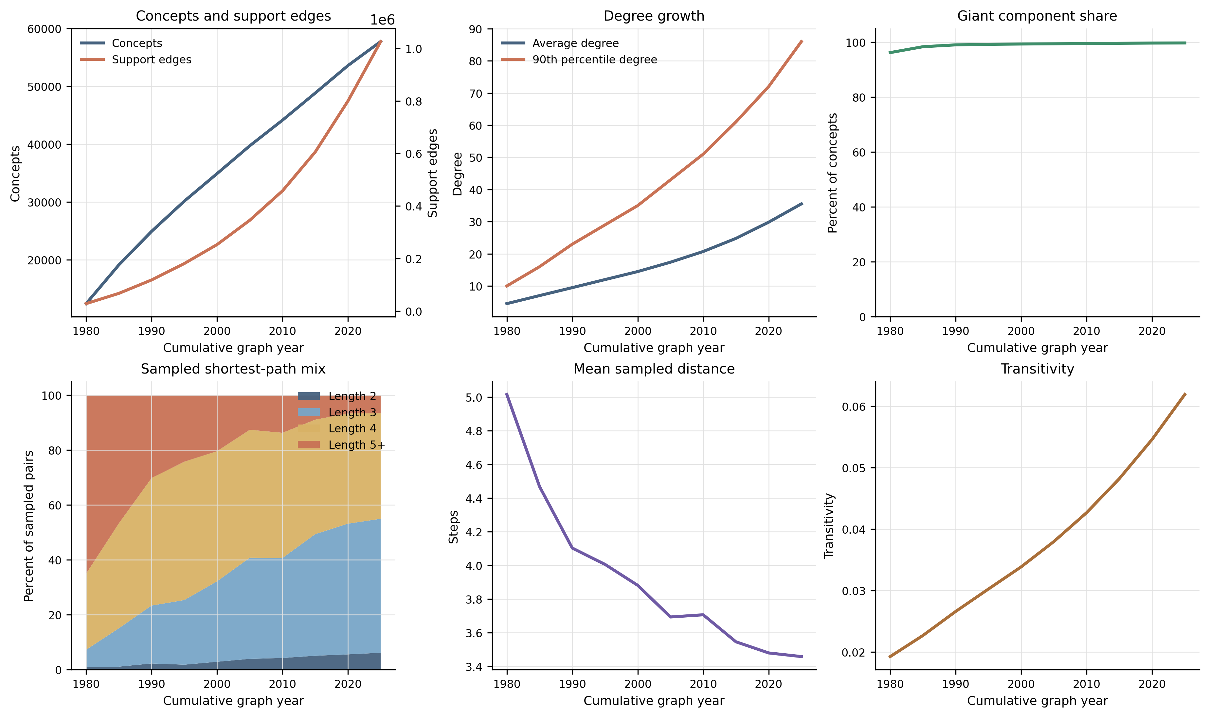
Appendix
Back to main
Graph evolution
Appendix: graph evolution.

