Slide 1
What Should Economics Ask Next?
Question choice is the scarce input.
Prashant Garg
Published work leaves structured gaps.
Imperial College London
github.com/prashgarg/frontiergraph
Some later papers add mechanisms.
Economics, machine learning, and metascience
Others make direct links explicit.
The graph helps decide what to inspect first.

Slide 2
Motivation
Appendix
Question choice remains weakly formalized
Choosing what to work on is one of the least formalized decisions in science.
The stock of published work is large, fragmented, and hard to navigate.
Researchers still face a conservative-search bias even when riskier moves matter.
If AI lowers downstream costs, the bottleneck shifts further upstream toward question choice.
Jones (2009); Bloom et al. (2020); Foster, Rzhetsky, and Evans (2015)

Slide 3
Overview
Appendix
This paper
We build and test
We learn
dated graph + walk-forward evaluation
substantive result
a dated graph from published economics-facing papers
the graph helps in two distinct historical families
paper-local extraction, then cross-paper matching
economics more often thickens mechanisms than later states locally implied direct links
still-open questions are ranked at t and checked against later publication

Slide 4
Empirical object
Appendix
Two dated question objects
Direct-to-path
Path-to-direct
the literature already contains a direct relation
the literature already contains nearby support
later work adds a clearer mediating path around it
the direct relation itself is still missing
this is the mechanism-thickening object
later work states that direct link explicitly

Slide 5
Method bridge
Appendix
From published papers to dated candidate questions
papers
paper-local graphs
shared graph
dated candidates
future realization
Freeze the literature at t-1, rank still-open directed questions, then check which later appear during [t, t+h].

Slide 6
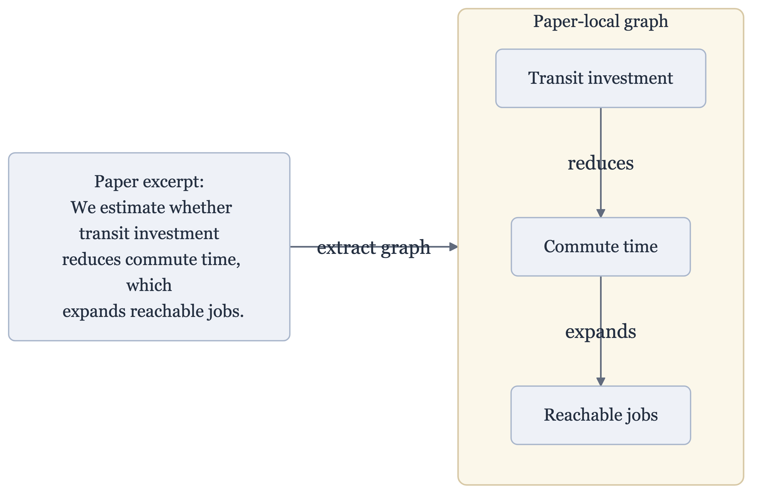
Pipeline
Appendix
Each paper becomes a local graph
One excerpt -> one paper-local graph

Slide 7
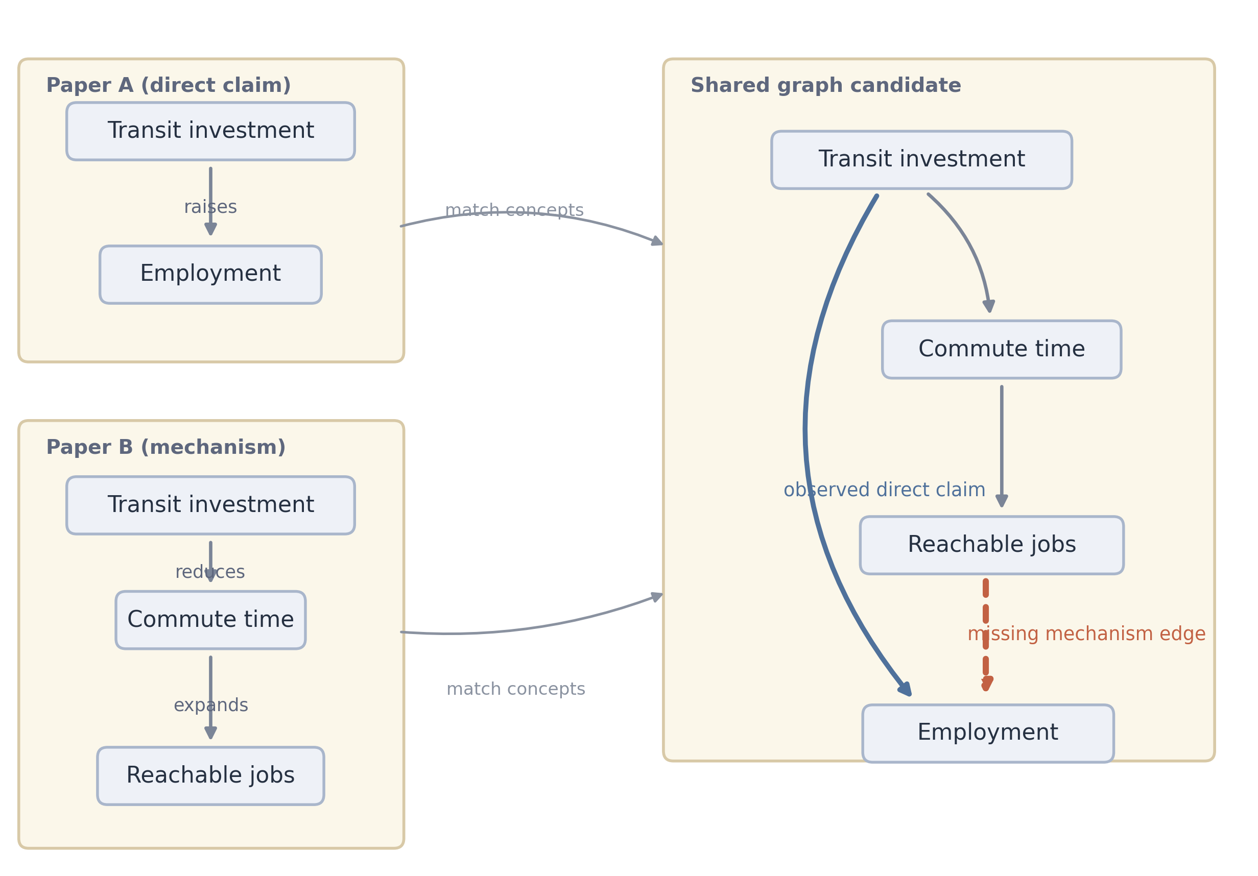
Pipeline
Appendix
Candidate questions only exist after cross-paper matching
Two paper-local graphs -> one shared candidate neighborhood

Slide 8
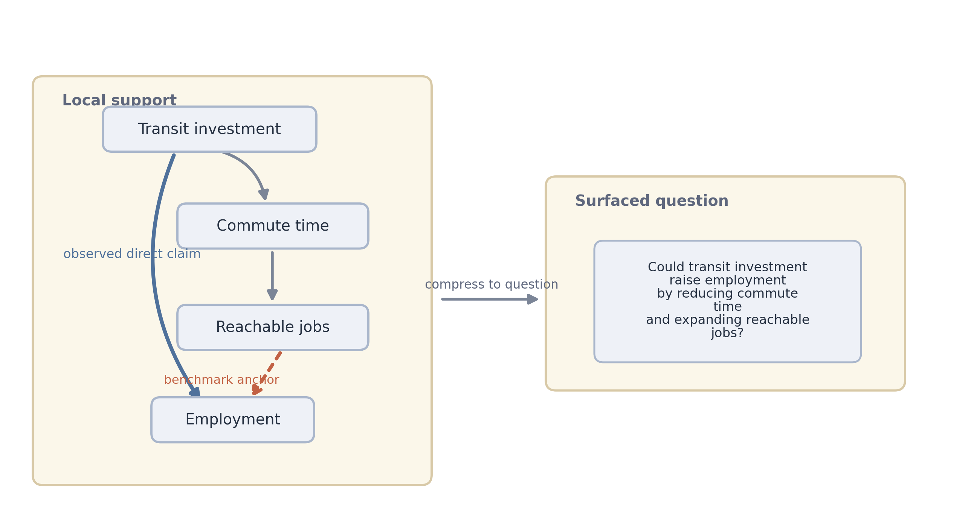
Benchmark logic
Appendix
The benchmark event is narrower than the surfaced question
What gets backtested versus what a reader would inspect

Slide 9
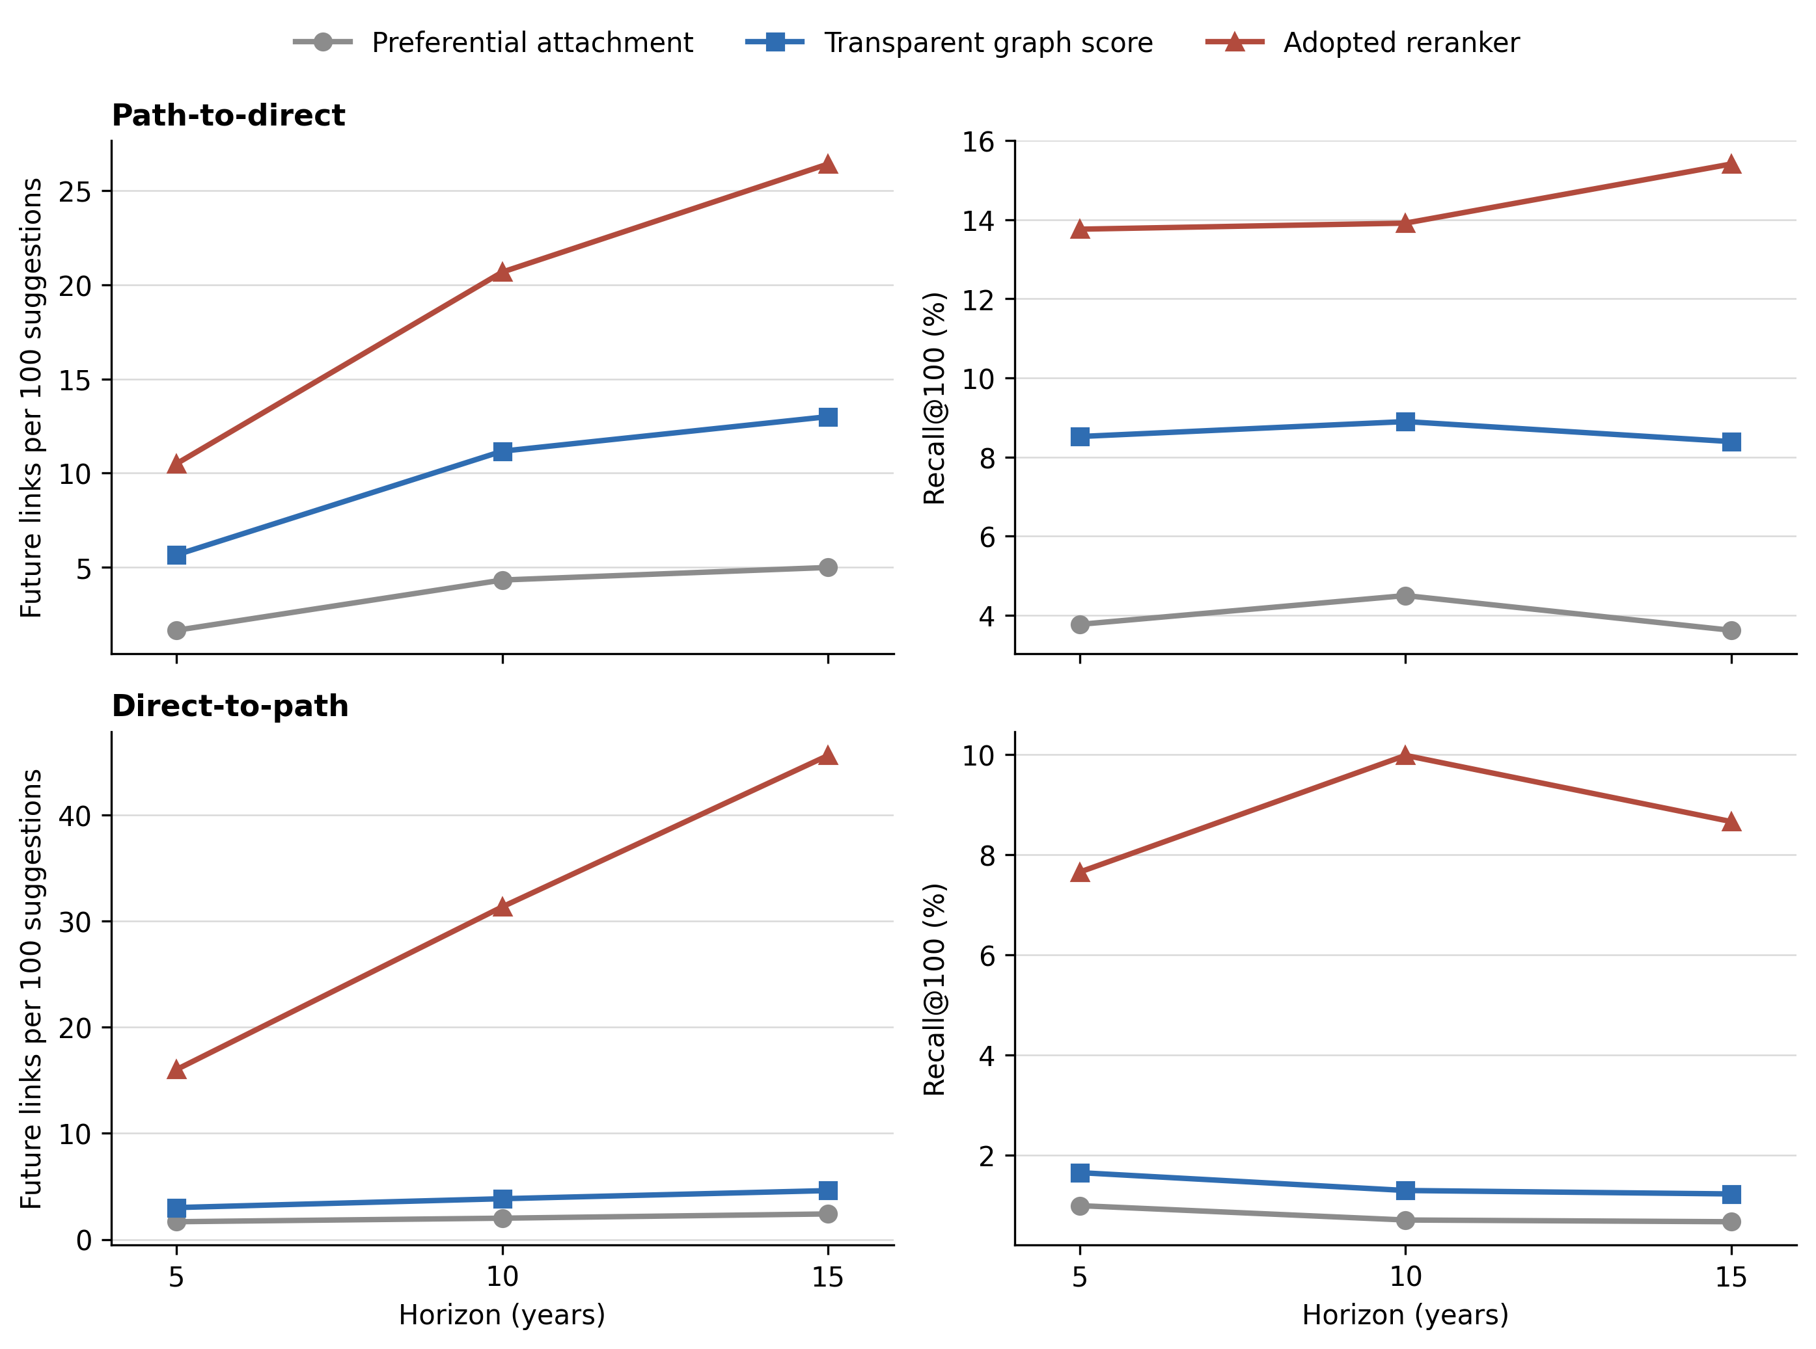
Historical result
Appendix
The graph improves on popularity in both families
Paired short-list benchmark
Direct-to-path yields denser shortlists: more later realizations per 100 suggestions.
Path-to-direct captures a larger share of all later-realized links; reranking improves both.

Slide 10
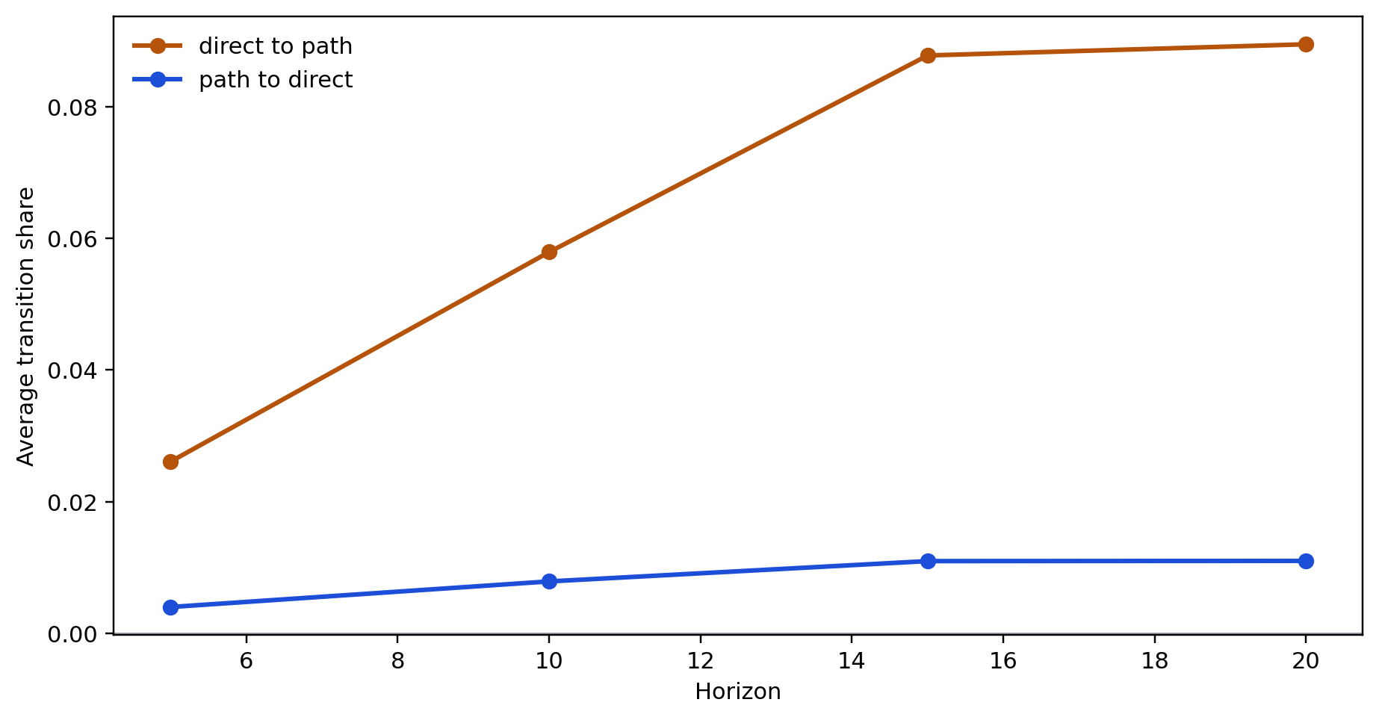
Substantive result
Appendix
Mechanism thickening is more common than direct closure
How the two forms of progress compare
The literature more often deepens mechanisms around existing claims than later closes locally implied direct links.

Slide 11
Current frontier
Appendix
What the graph surfaces now
Direct-to-path
Path-to-direct
known relation, missing mechanism
nearby support, missing direct relation
Could digital financial inclusion support employment through labour matching or market access?
Could trade liberalization raise R&D?
Could tax refunds lift productivity through liquidity and investment?
Could the digital economy strengthen environmental regulation?
Could nutrition information shift willingness to pay through health-salience channels?
Could renewable energy reshape urbanization?

Slide 12
Conclusion
Appendix
What we built and learned
built a dated graph from published economics-facing papers
tested two benchmarkable forms of still-open next questions
showed that graph structure helps when reading time is scarce
found that the literature more often thickens mechanisms than it later states locally implied direct links
Thank you

Slide 13
Appendix
Back to main
Benchmark detail
Paired benchmark result
Appendix detail: paired main benchmark.

Slide 14
Appendix
Back to main
Method detail
Extraction and matching
Benchmark anchor versus surfaced question
Appendix detail: methodology figures.

Slide 15
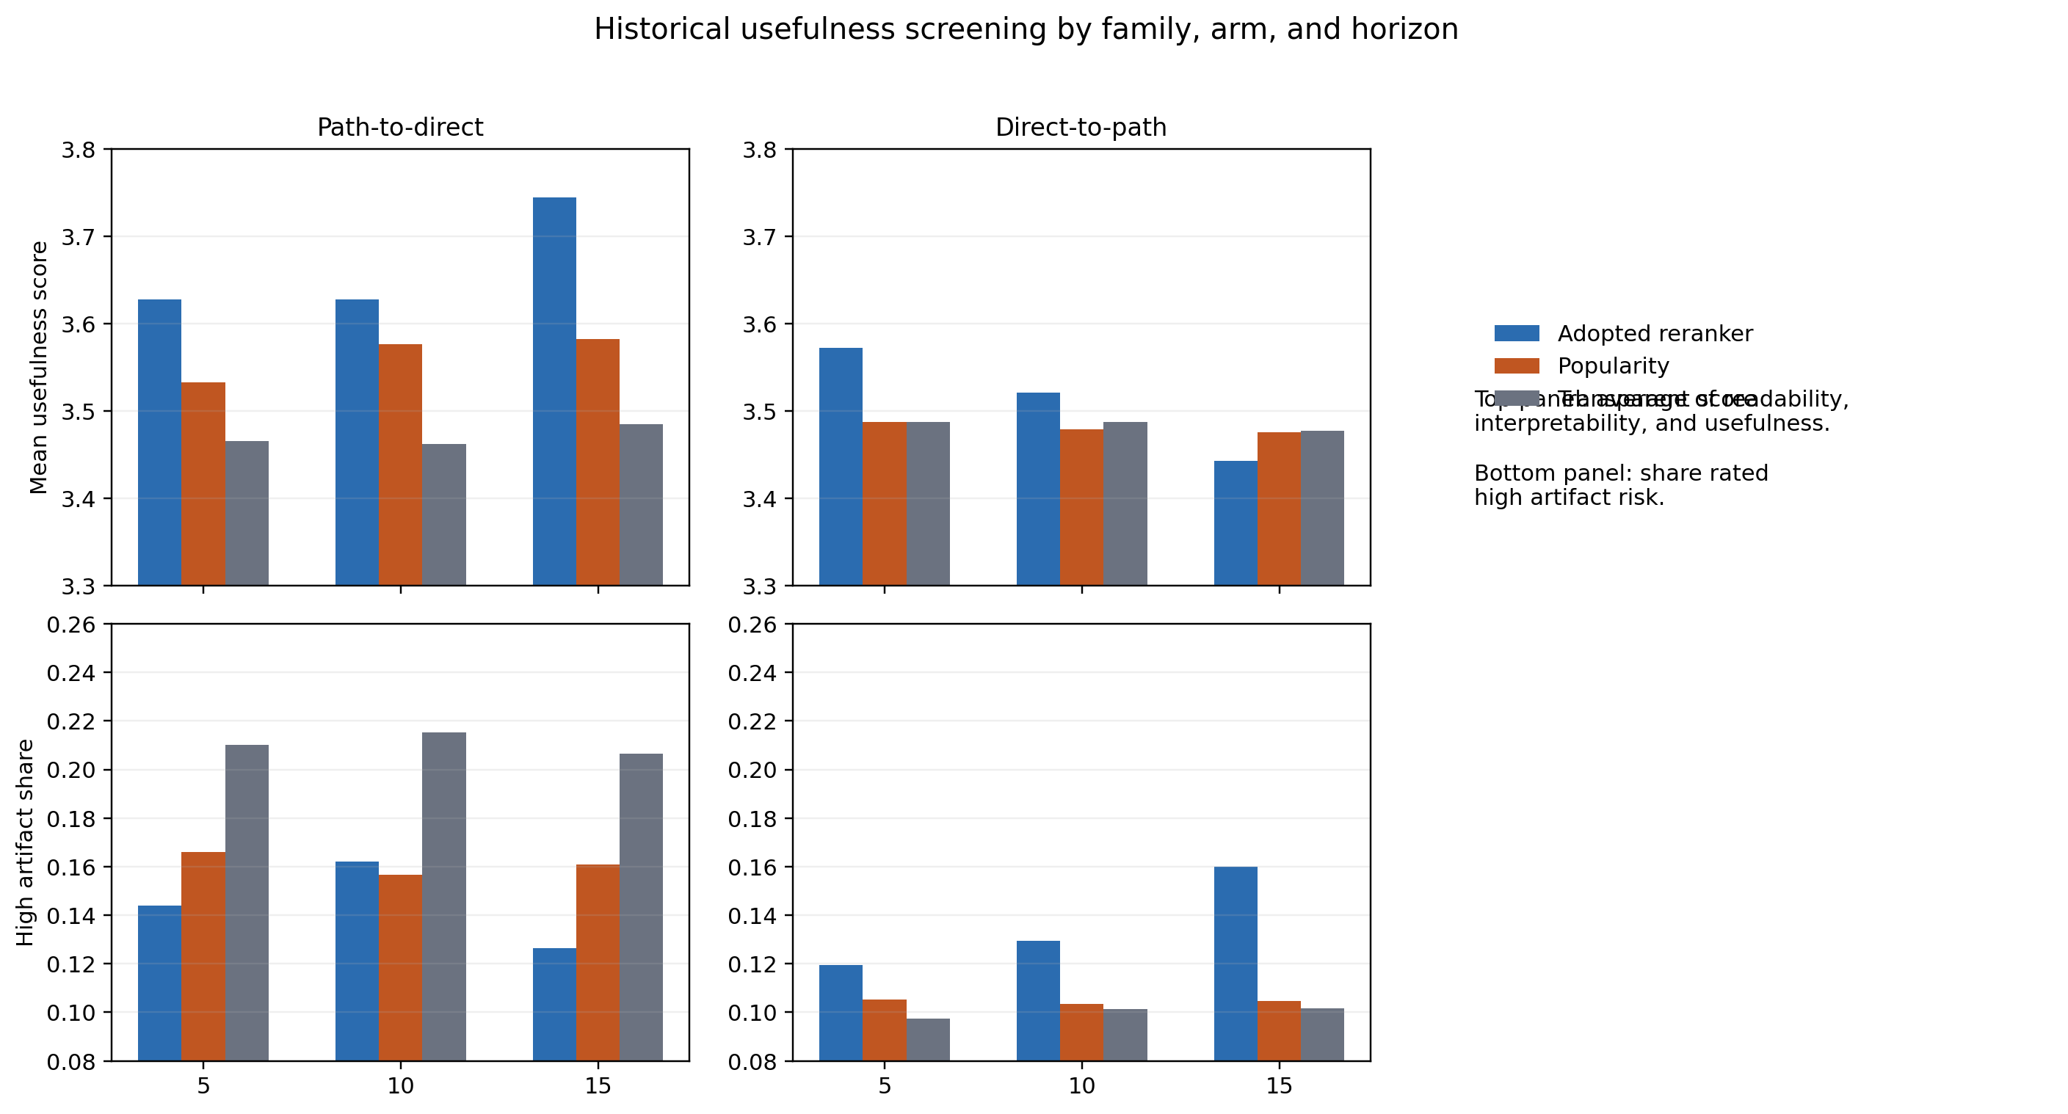
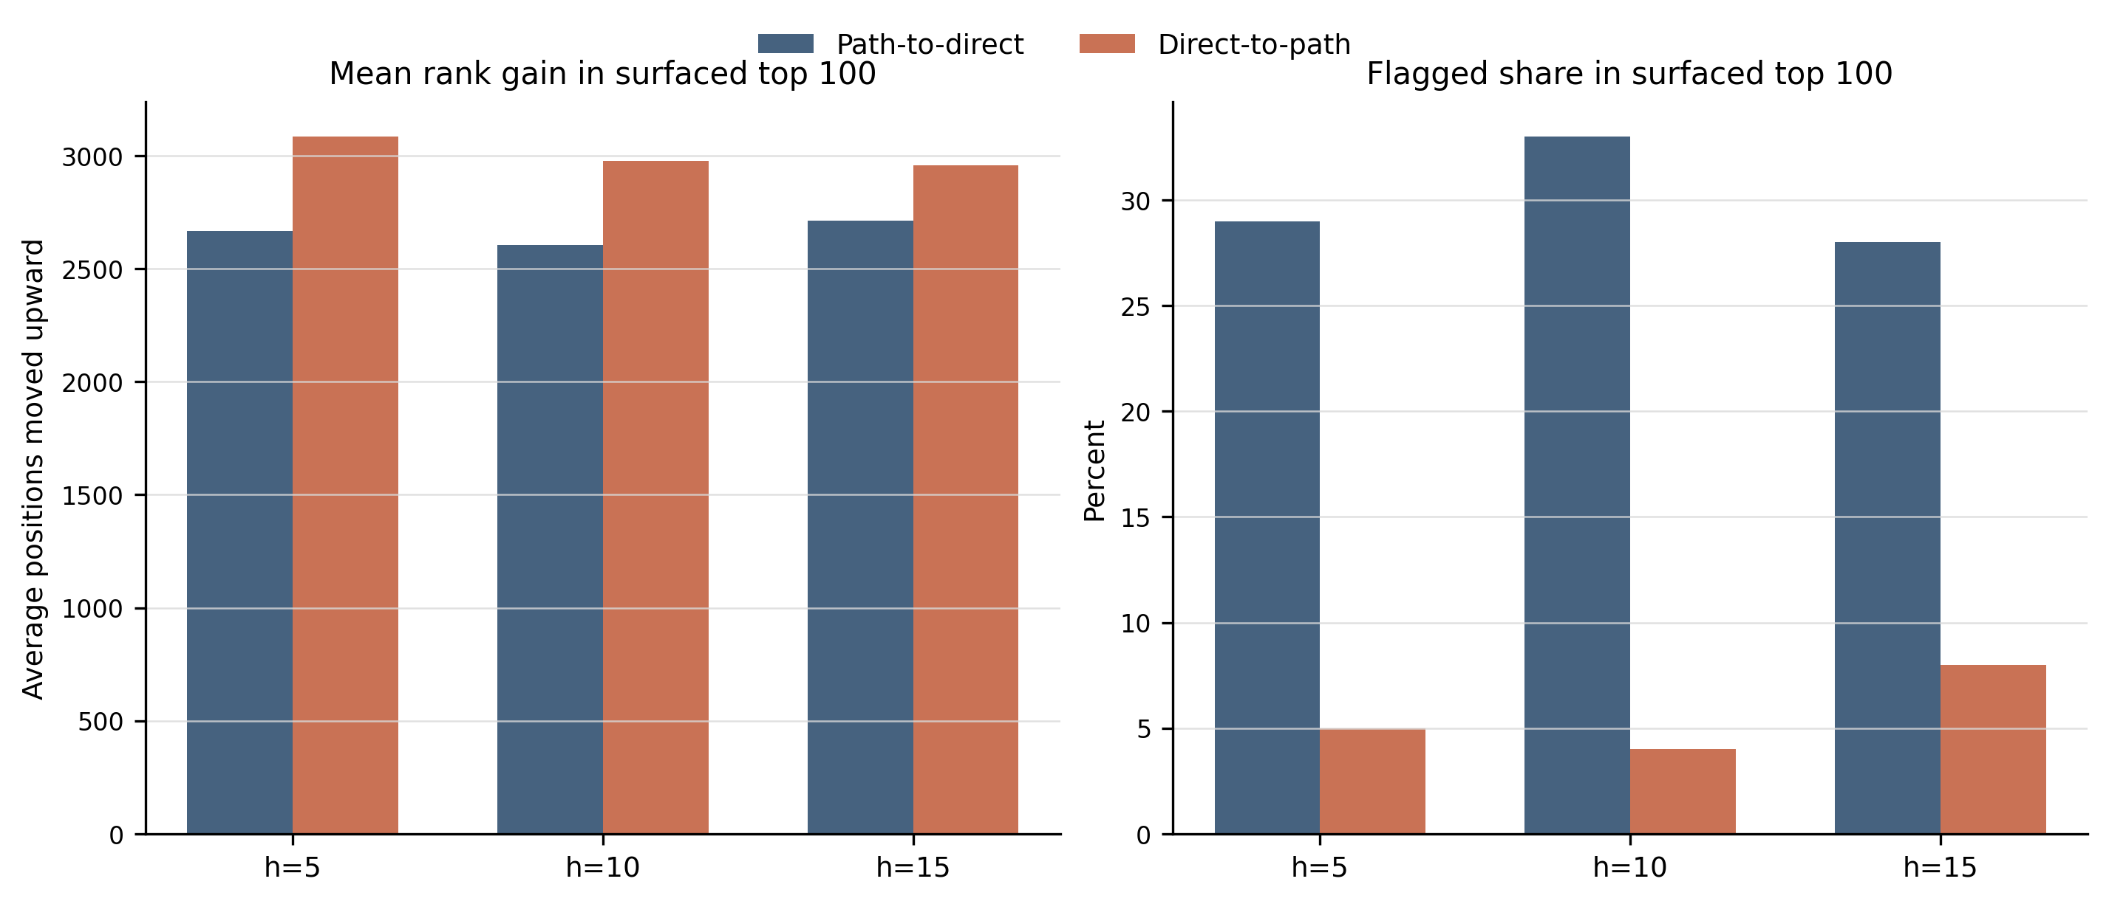
Appendix
Back to main
Extra empirical views
Current frontier summary
Paired usefulness screen
Appendix detail: surfaced examples and workflow screen.

