Slide 1
#40 : SpotTheDoc
Anupama Anupama
Harshini Priya MuthuKrisna
Prashil Bhimani

Slide 2
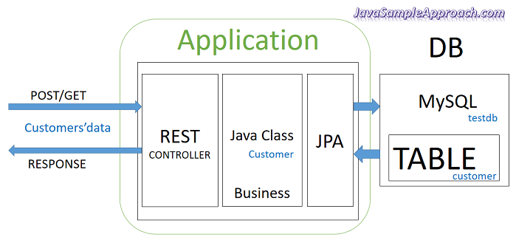
Source : http://javasampleapproach.com/spring-framework/spring-mvc/angular-4-spring-jpa-mysql-example-angular-4-http-client-spring-boot-restapi-server

Slide 3
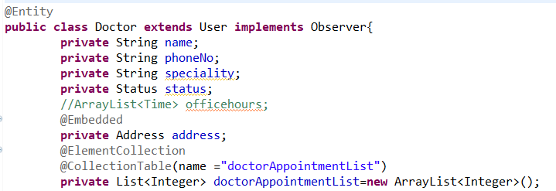
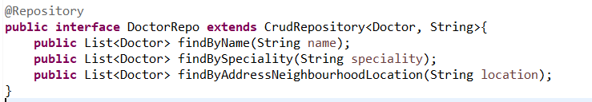
Sample Model implementation

Slide 4
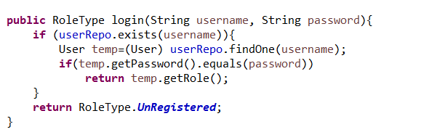
Login Usecase

Slide 5
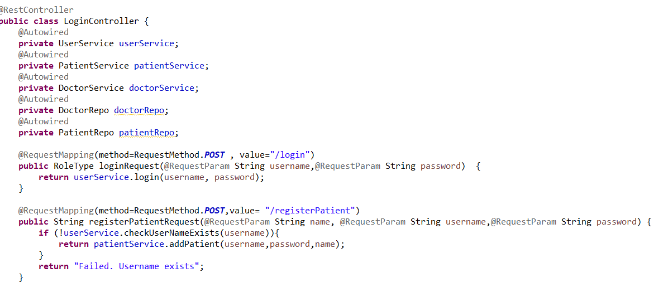
Sample Controller class

Slide 6
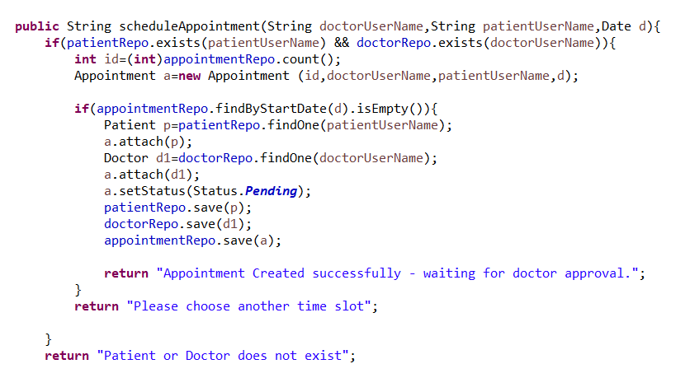
Schedule appointment Use case

Slide 7
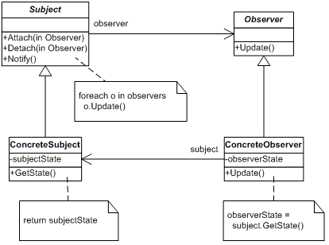
Observer Design Pattern

Slide 8
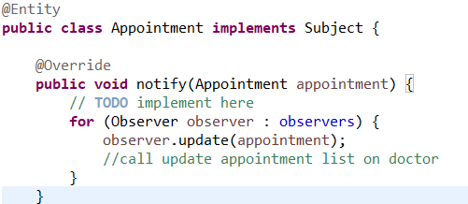
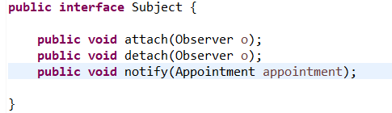
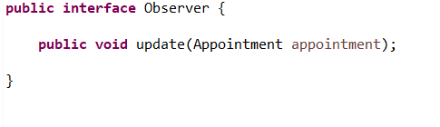
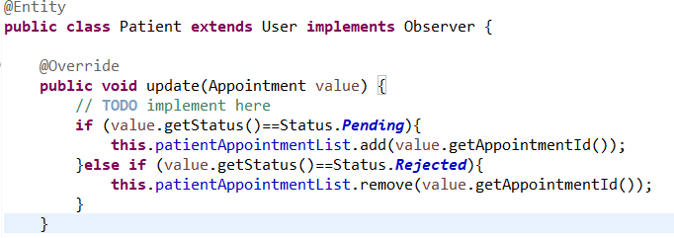
SpotTheDoc Observer Design Pattern

Slide 9
Thank You
Video Demo Link : https://github.com/prashilbhimani/SpotTheDoc/blob/master/40_SpotTheDoc_Video_compressed.mp4
Final Report : https://github.com/prashilbhimani/SpotTheDoc/blob/master/40_SpotTheDoc_part6.pdf

